Slide 1
Hibernate
Sven haala
E-portfolio software engineering

Slide 2
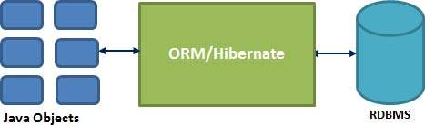
What is Hibernate
ORM-Framework for Java
Open source persistent framework
Since 2001
Supports most RDBMS

Slide 3
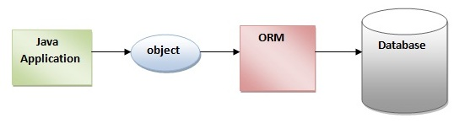
What is ORM
Object-Relational Mapping
Java Objects and there attributes and methods can be converted into a relational DBMS and the other way round

Slide 4
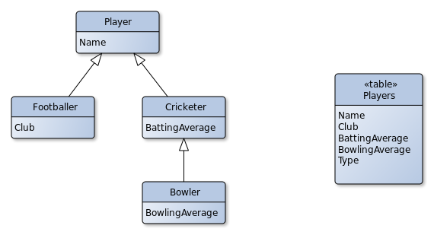
ORM types
Single Table
Type defines the particular class

Slide 5
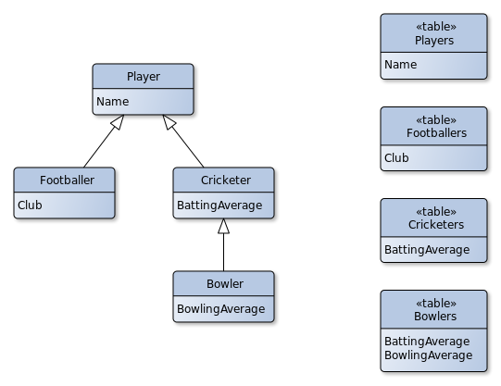
ORM types
Joined Table
A table for each class and subclass

Slide 6
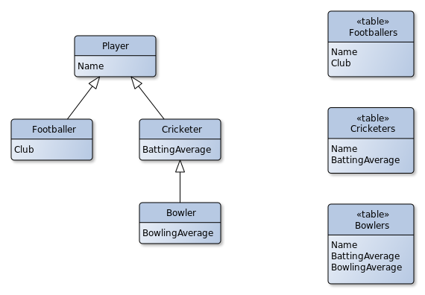
ORM types
Table per Class
Attribute of the main class are
in the subclass tables

Slide 7
Advantages of Hibernate
takes care of mapping Java Objects to database tables
simple API for storing and retrieving objects
Changes can be easy applied
Support a variety of DBMS:
MySQL
Oracle
PostgreSQL
DB2

