Slide 1
Servlets ?
Servlet Technology is used to create web applications.
Servlet technology uses Java language to create web applications.
Servlet technology is Secured, Scalable and Robust.
Servlet is an API that provides many interfaces and classes including documentations.
Servlet is a web component that is deployed on the server to create dynamic web page.
Before Servlet, CGI scripting language was used as a server-side programming language. But there were many disadvantages.
So, Sun Microsystems developed Servlet.

Slide 2
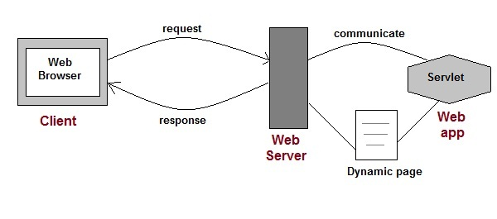
Web Applications?
Web applications are helper applications that resides at web server and build dynamic web pages.
A web application is composed of web components like Servlet, JSP, PHP, HTML etc..
The web components typically execute in Web Server and respond to HTTP request.

Slide 3
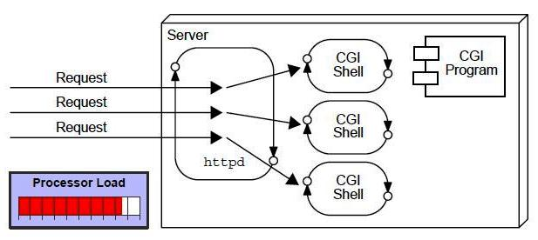
CGI
(Common Gateway Interface)
Before Servlet, CGI scripting language was used as a server-side programming language. But there were many disadvantages.
Drawbacks of CGI programs
High response time because CGI programs execute in their own OS shell.
If number of clients increases, it takes more time for sending response.
For each request, it starts a process and Web server is limited to start processes.
CGI is not scalable.
CGI programs are not always secure.
It is Platform dependent.

Slide 4
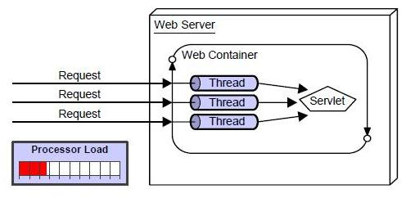
Servlet Technology
Servlet Technology is used to create web applications.
Servlet technology is Secured, Scalable and Robust.
There were many disadvantages. So, Sun Microsystems developed Servlet.
Advantages of Servlet over CGI.
The web container creates threads for handling the multiple requests to the servlet.
Threads have a lot of benefits over the processes such as they share a common memory area, light weight, cost of communication between the threads are low.

Slide 5
Benefits of Servlets
Less response time: because each request runs in a separate thread.
Better performance: because it creates a thread for each request not process.
Portability: because it uses java language.
Robust: Servlets are managed by JVM so no need to worry about memory leak, garbage collection etc.
Secure: because it uses java language.

Slide 6
Servlet API
You need to use Servlet API to create servlets.
It contains set of classes and interfaces needed to build servlets.
These classes and interfaces are available in two packages.
javax.servlet (9 classes + 13 interfaces)
javax.servlet.http (6 classes + 7 interfaces)
javax.servlet package that contains the classes to support generic servlet (protocol-independent servlet)
javax.servlet.http package that contains classes to support http servlet.

Slide 7
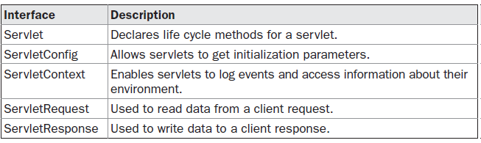
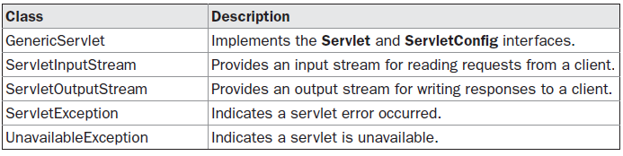
1) javax.servlet Package
It contains a number of interfaces and classes that establish the framework in which servlets operate.

Slide 8
Various Methods in
javax.servlet Interfaces
Servlet: init(), service(), destroy(), …
servletConfig: getServletContext( ), getServletName( ), …….
servletContent: getAttribute(String attr), getServerInfo( ), log(),...
ServletRequest: getAttribute(String attr), getContentType(), getParameter(String pname), getParameterNames()...
ServletResponse: getOutputStream(), getWriter( ), setContentLength(), setContentType(), …..

Slide 9
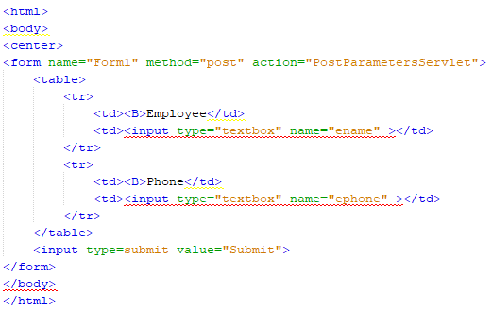
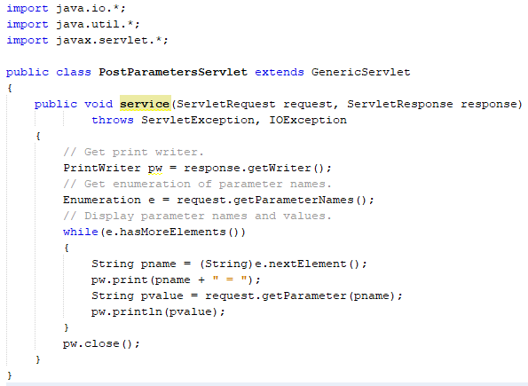
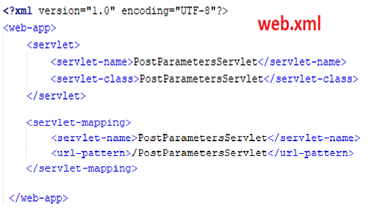
Example: - Generic Servlet
Index.html
PostParameterServlet.java

Slide 10
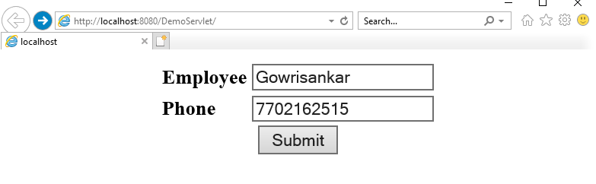
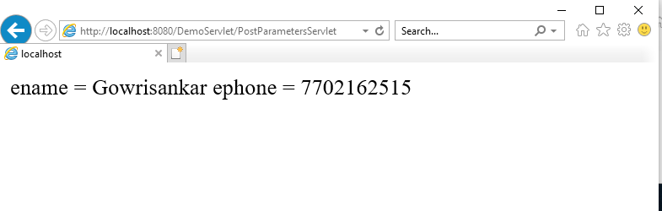
Output

Slide 11
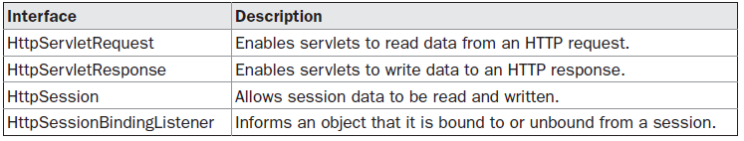
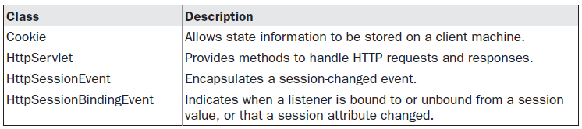
2) javax.servlet.http Package
It contains a number of interfaces and classes that are commonly used by servlet developers.

Slide 12
Various Methods in
javax.servlet.http Interfaces
HttpServletRequest: getCookies(), getDateHeader(), getRequestURL(), getSession( ), getPathInfo(), getMethod(), ……
HttpServletResponse: addCookie(), sendError( ), sendRedirect(), setHeader(), setStatus(), …….
HttpSession: getAttribute(String attr), getAttributeNames( ), getId(), invalidate(), isNew(), removeAttribute(), setAttribute(), ...
HttpSessionBindingListener:
void valueBound(HttpSessionBindingEvent e)
void valueUnbound(HttpSessionBindingEvent e)

Slide 13
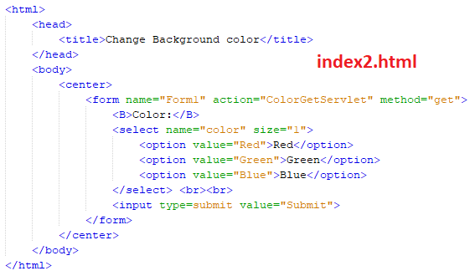
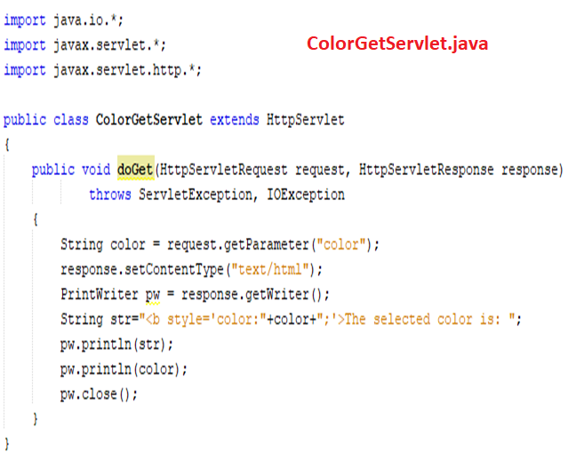
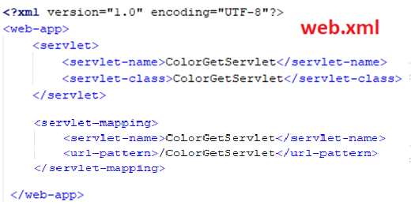
Example: - HttpServlet

Slide 14
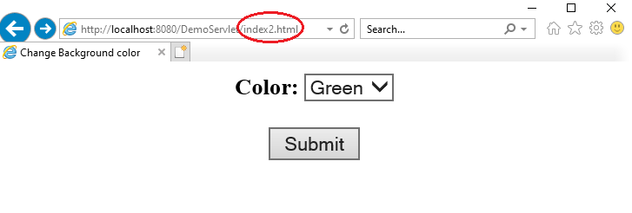
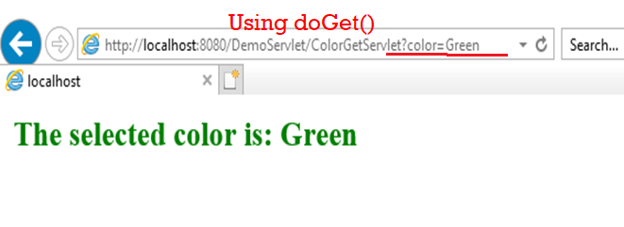
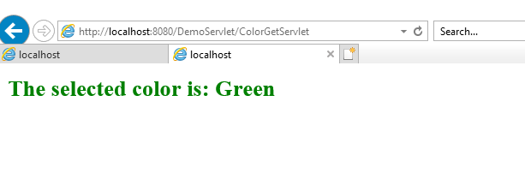
Output
Using doPost()

Slide 15
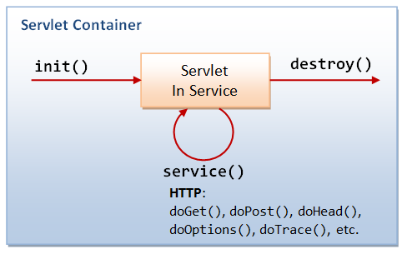
Servlet Life cycle
A servlet life cycle can be defined as the entire process from its creation till the destruction.
The servlet is initialized by calling the init() method.
The servlet calls service() method to process a client's request.
The servlet is terminated by calling the destroy() method.
Finally, servlet is garbage collected by the garbage collector of the JVM.

Slide 16
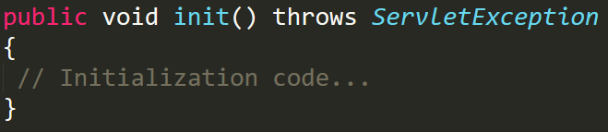
The init() method
The init() method is designed to be called only once.
It is called when the servlet is first created, and not called again for each user request.
So, it is used for one-time initializations, just as with the init() method of applets.
The servlet is normally created when a user first invokes a URL corresponding to the servlet.

Slide 17
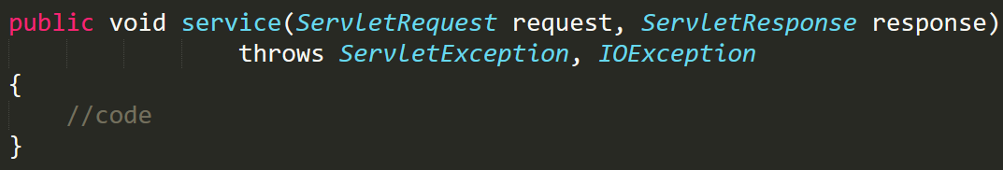
The service() method
The service() method is the main method to perform the actual task.
The servlet container (i.e. web server) calls the service() method to handle requests coming from the client(browsers) and to write the formatted response back to the client.
Each time if the server receives a request for a servlet, the server issues a new thread and calls service.
The service() method checks the HTTP request type (GET, POST, PUT, DELETE, etc.) and calls doGet, doPost, doPut, doDelete, etc. methods as appropriate.

Slide 18
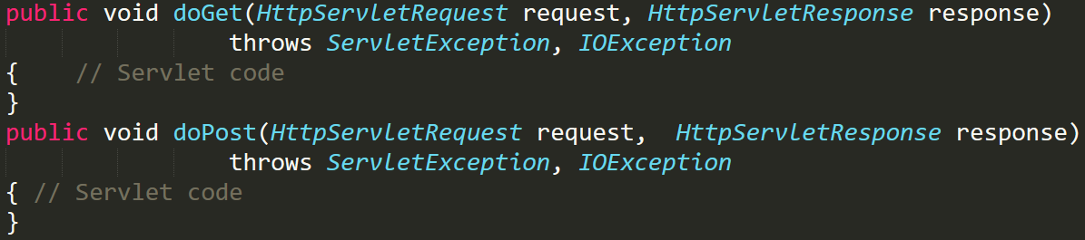
doGet() and doPost() methods
The service() method is called by the container and service method invokes doGet, doPost, doPut, doDelete, etc.
So you have nothing to do with service() method but you override either doGet() or doPost() depending on what type of request you receive from the client.
The doGet() and doPost() are most frequently used methods.

Slide 19
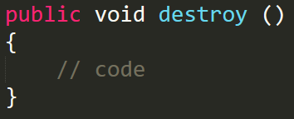
The destroy() method :
The destroy() method is called only once at the end of the life cycle of a servlet.
This method gives your servlet a chance to close database connections, halt background threads, write cookie lists or hit counts to disk, and perform other such cleanup activities.

Slide 20
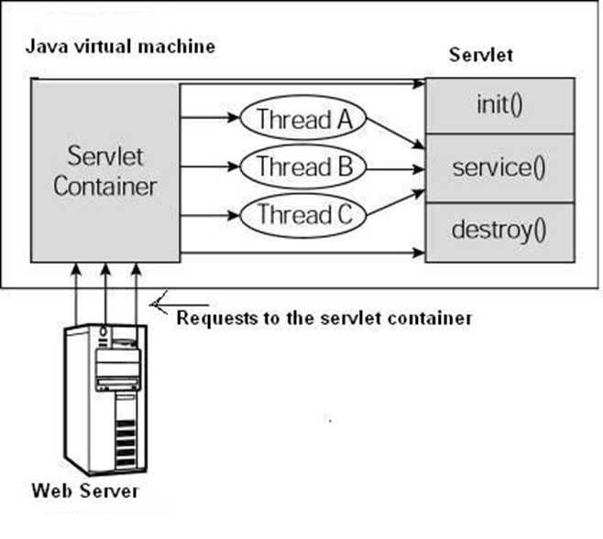
Architecture : a typical servlet life-cycle scenario
First the HTTP requests coming to the server are delegated to the servlet container.
The servlet container loads the servlet before invoking the service() method.
Then the servlet container handles multiple requests by producing multiple threads, each thread executing the service() method of a single instance of the servlet.

Slide 21
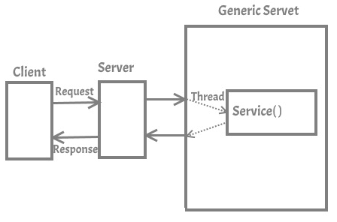
Generic Servlet
if you are creating a Generic Servlet then you must extend javax.servlet.GenericServlet class. GenericServlet class has an abstract service() method. Which means the subclass of GenericServlet should always override the service() method.

Slide 22
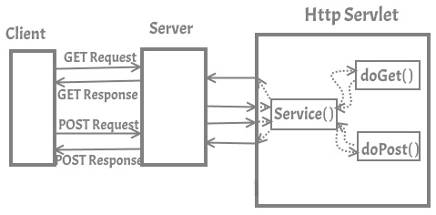
HTTP Servlet
If you creating Http Servlet you must extend javax.servlet.http.HttpServlet class, which is an abstract class. Unlike Generic Servlet, the HTTP Servlet doesn’t override the service() method. Instead it overrides one or more of the following methods.
doGet() – This method is called by servlet service method to handle the HTTP GET request from client. The Get method is used for getting information from the server
doPost() – Used for posting information to the Server
doPut() – This method is similar to doPost method but unlike doPost method where we send information to the server, this method sends file to the server, this is similar to the FTP operation from client to server
doDelete() – allows a client to delete a document, webpage or information from the server
init() and destroy() – Used for managing resources that are held for the life of the servlet
getServletInfo() – Returns information about the servlet, such as author, version, and copyright.

Slide 23
Generic Servlet
Web Server: It is also known as HTTP Server, it can handle HTTP Requests send by client and responds the request with an HTTP Response.
Web Container: Also known as Servlet Container and Servlet Engine. It is a part of Web Server that interacts with Servlets. This is the main component of Web Server that manages the life cycle of Servlets.

Slide 24
Cookies

Slide 25
Cookies
A cookie is a small piece of information that is persisted between the multiple client requests.
A cookie has a name, a single value, and optional attributes such as a comment, path and domain qualifiers, a maximum age and a version number.
How Cookie works ?
By default, each request is considered as a new request.
In cookies technique, the server adds a cookie with response from the servlet.
So cookie is stored in the cache of the browser.
After that if request is sent by the client, cookie is added with request by default. Thus, the server recognizes the user as the old user.

Slide 26
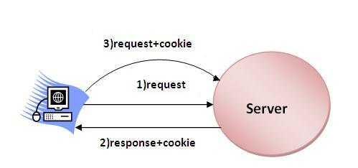
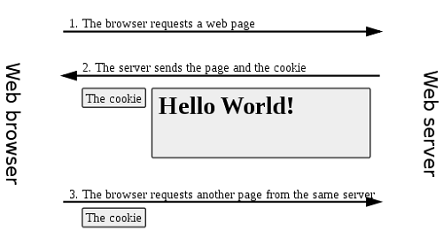

Slide 27
Types of Cookies
There are 2 types of cookies in servlets.
1) Non-persistent cookie
2) Persistent cookie
Non-persistent cookie
It is valid for single session only. It is removed each time when user closes the browser.
Persistent cookie
It is valid for multiple session .
It is not removed each time when user closes the browser. It is removed only if user logout or signout.

Slide 28
Cookies Advantages and Disadvantages
Advantage of cookie
Simplest technique of maintaining the state.
Cookies are maintained at client side.
Disdvantage of cookie
It will not work if cookie is disabled from the browser.
Only textual information can be set in Cookie object.
Note: Gmail uses cookie technique for login. If you disable the cookie, gmail won't work.

Slide 29
Cookies Classes
javax.servlet.http.Cookie class provides the functionality of using cookies.
It provides a lot of useful methods for cookies.
Constructor of Cookie class
Constructor | Description
Cookie() | constructs a cookie.
Cookie(String name, String value) | constructs a cookie with a specified name and value.

Slide 30
Methods of Cookies Classes
Method | Description
public void setMaxAge(int expiry) | Sets the maximum age of the cookie in seconds.
public String getName() | Returns the name of the cookie. The name cannot be changed after creation.
public String getValue() | Returns the value of the cookie.
public void setName(String name) | changes the name of the cookie.
public void setValue(String value) | changes the value of the cookie.

Slide 31
Other Methods required for using Cookies
For adding cookie or getting the value from the cookie, we need some methods provided by other interfaces. They are:
public void addCookie(Cookie ck):method of HttpServletResponse interface is used to add cookie in response object.
public Cookie[] getCookies(): method of HttpServletRequest interface is used to return all the cookies from the browser.

Slide 32
How to create Cookie?
Let's see the simple code to create cookie:
1) Cookie ck=new Cookie("user",“RVRJCCE");
//creating cookie object
2) response.addCookie(ck);
//adding cookie in the response

Slide 33
How to delete Cookie?
Let's see the simple code to delete cookie. It is mainly used to logout or signout the user:
1)Cookie ck=new Cookie("user","");
//deleting value of cookie
2) ck.setMaxAge(0);
//changing the maximum age to 0 seconds
3) response.addCookie(ck);
//adding cookie in the response

Slide 34
How to get Cookie?
Let's see the simple code to get all cookies:
1) Cookie ck[]=request.getCookies();
for(int i=0; i<ck.length; i++)
{
out.print("<br>"+ck[i].getName()+" "+ck[i].getValue());
//printing name and value of cookie
}

Slide 35
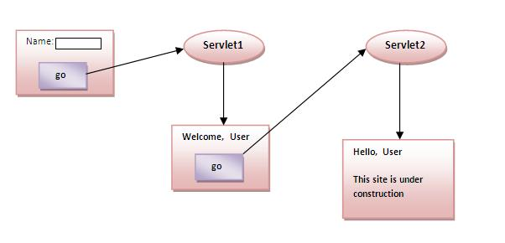
Example of Servlet Cookies
In this example, we are storing the name of the user in the cookie object and accessing it in another servlet. As we know well that session corresponds to the particular user. So if you access it from too many browsers with different values, you will get the different value.

Slide 36
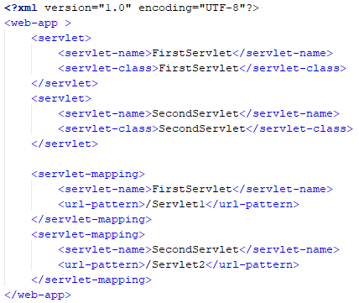
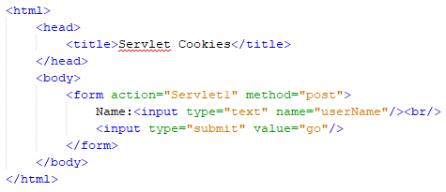
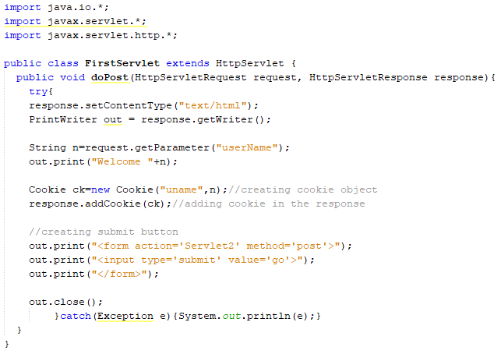
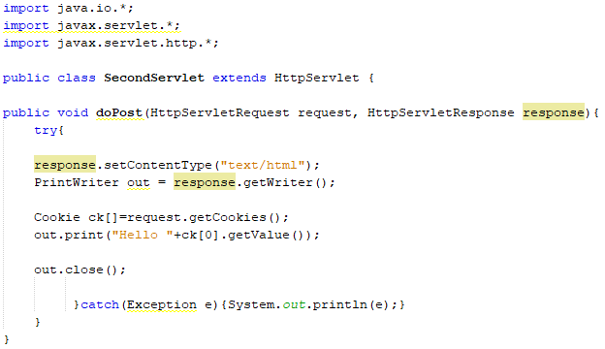
Example: - Cookies
Web.xml
Index.html
FirsstServlet.java
SecondServlet.java

Slide 37
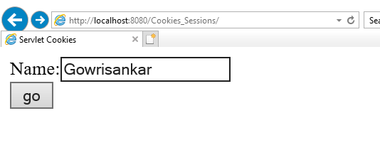
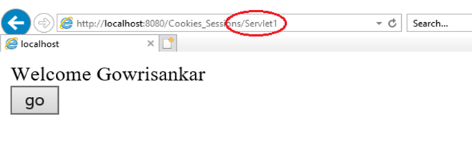
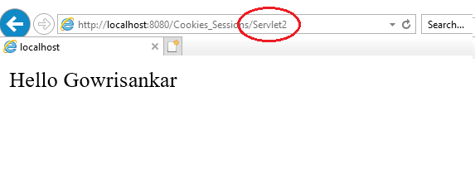
Output

Slide 38
Hidden Form Field
In case of Hidden Form Field a hidden (invisible) textfield is used for maintaining the state of an user.
In such case, we store the information in the hidden field and get it from another servlet. This approach is better if we have to submit form in all the pages and we don't want to depend on the browser.
Let's see the code to store value in hidden field.
<input type="hidden" name="uname" value=“Gowrisankar">
Here, uname is the hidden field name and Gowrisankar is the hidden field value.

Slide 39
Hidden Form Field
Real application of hidden form field:
It is widely used in comment form of a website.
In such case, we store page id or page name in the hidden field so that each page can be uniquely identified.
Advantage of Hidden Form Field:
It will always work whether cookie is disabled or not.
Disadvantage of Hidden Form Field:
It is maintained at server side.
Extra form submission is required on each pages.
Only textual information can be used.

Slide 40
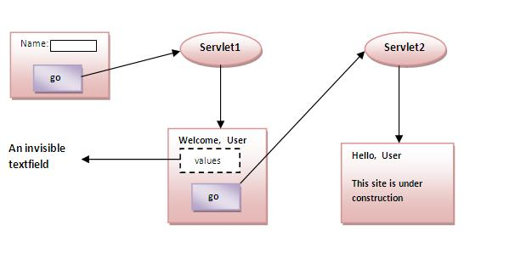
Example of using Hidden Form Field
In this example, we are storing the name of the user in a hidden textfield and getting that value from another servlet.

Slide 41
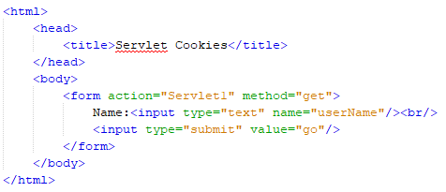
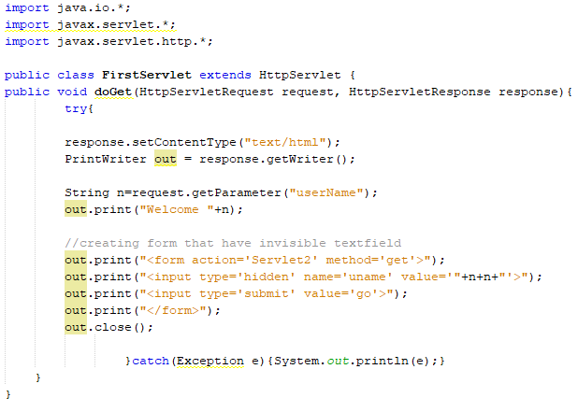
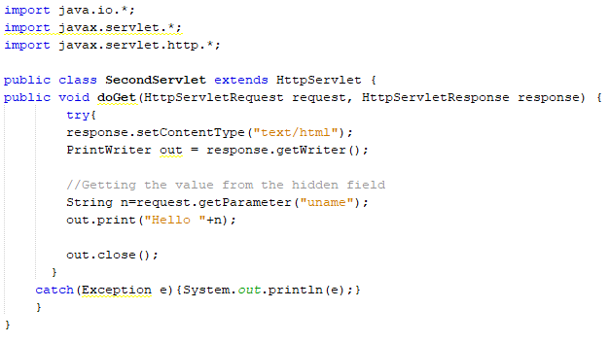
Example: - Hidden Form Field
Web.xml
Index.html
FirstServlet.java
SecondServlet.java

Slide 42
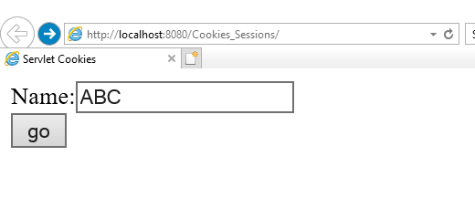
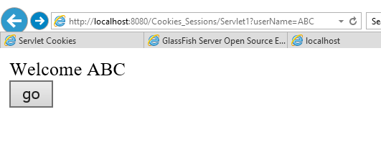
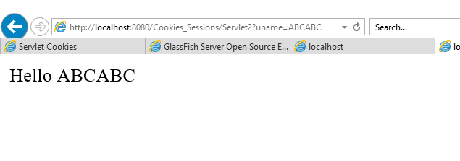
Output

Slide 43
URL Rewriting
In URL rewriting, we append a token or identifier to the URL of the next Servlet or the next resource. We can send parameter name/value pairs using the following format:
url?name1=value1&name2=value2&??
A name and a value is separated using an equal = sign, a parameter name/value pair is separated from another parameter using the ampersand(&). When the user clicks the hyperlink, the parameter name/value pairs will be passed to the server. From a Servlet, we can use getParameter() method to obtain a parameter value.

Slide 44
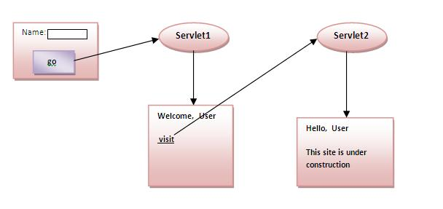
Example of using URL Rewriting

Slide 45
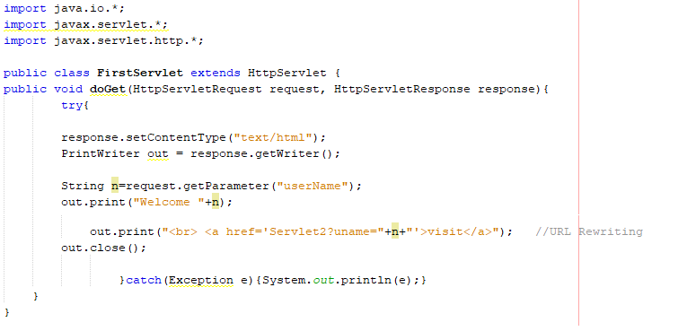
Example: - URL Rewriting
Web.xml
Index.html
FirstServlet.java
SecondServlet.java

Slide 46
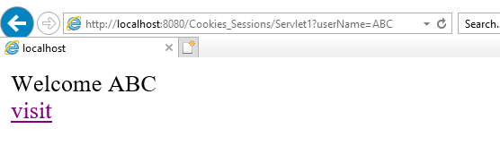
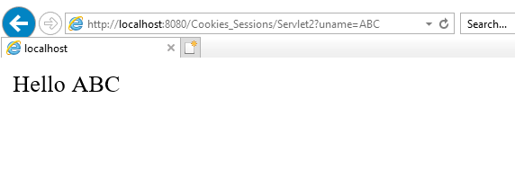
Output

Slide 47
Session Tracking
Session simply means a particular interval of time.
Session Tracking is a way to maintain state (data) of an user. It is also known as session management in servlet.
Http protocol is a stateless so we need to maintain state using session tracking techniques.
Each time user requests to the server, server treats the request as the new request.
So we need to maintain the state of an user to recognize to particular user.
HTTP is stateless that means each request is considered as the new request. It is shown in the figure given below

Slide 48
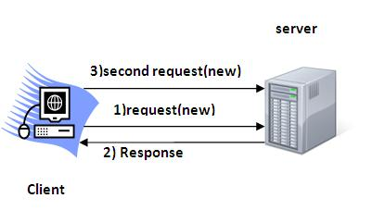
Session Tracking

Slide 49
Http Session
In this case, container creates a session id for each user.
The container uses this id to identify the particular user.
An object of HttpSession can be used to perform two tasks:
bind objects
view and manipulate information about a session, such as the session identifier, creation time, and last accessed time.

Slide 50
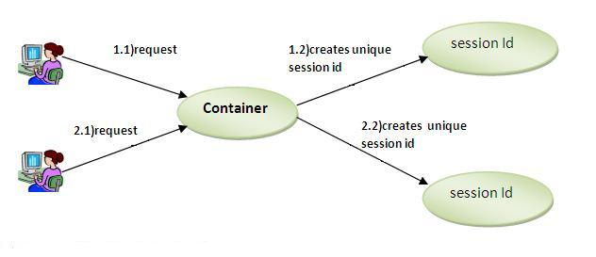
Session Tracking

Slide 51
HttpSession object
The HttpServletRequest interface provides two methods to get the object of HttpSession:
public HttpSession getSession(): Returns the current session associated with this request, or if the request does not have a session, creates one.
public HttpSession getSession(boolean create): Returns the current HttpSession associated with this request or, if there is no current session and create is true, returns a new session.

Slide 52
Commonly used methods of HttpSession interface
public String getId(): Returns a string containing the unique identifier value.
public long getCreationTime(): Returns the time when this session was created, measured in milliseconds since midnight January 1, 1970 GMT.
public long getLastAccessedTime(): Returns the last time the client sent a request associated with this session, as the number of milliseconds since midnight January 1, 1970 GMT.
public void invalidate(): Invalidates this session then unbinds any objects bound to it.

Slide 53
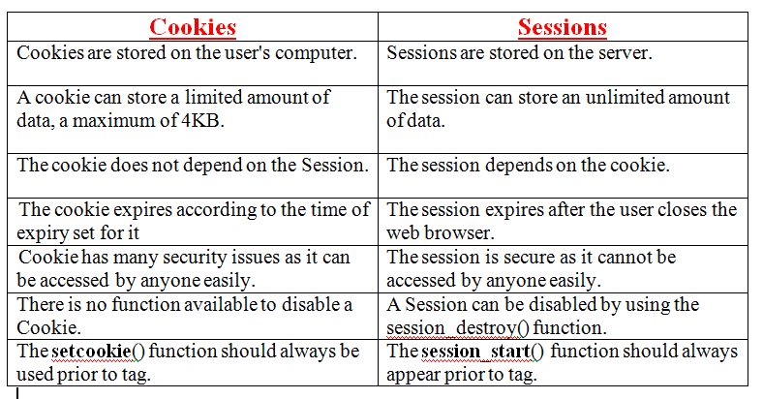
Example Program: - Session Tracking
Ex: - we are setting the attribute in the session scope in one servlet and getting that value from the session scope in another servlet. To set the attribute in the session scope, we have used the setAttribute() method of HttpSession interface and to get the attribute, we have used the getAttribute method.

Slide 54




Example: - Session Tracking
Session2.java
Index.html
Session1.java
Web.xml

Slide 55



Output

Slide 57
Basic Terminology Used in Servlet
HTTP
HTTP Request Types
Difference between Get and Post method
Container
Server and Difference between web server and application server
Content Type
Introduction of XML
Deployment

Slide 58
HTTP (Hyper Text Transfer Protocol)
Http is the protocol that allows web servers and browsers to exchange data over the web.
It is a request response protocol.
Http uses reliable TCP connections by default on TCP port 80.
It is stateless means each request is considered as the new request. In other words, server doesn't recognize the user by default.

Slide 59
HTTP
(Hyper Text Transfer Protocol)
HTTP is a stateless protocol and it defines how Clients and Servers communicate.
HTTP transaction Stages:
Connection (client establishes the connection with the web server)
Request (client sends a request message to the web server)
Response (Web server sends a response to the client)
Close (Connection is closed by the web server)

Slide 60

HTTP

Slide 61
Http Request Methods
Every request has a header that tells the status of the client.
There are many request methods. Get and Post requests are mostly used.
The http request methods are:
GET
POST
HEAD
PUT
DELETE
OPTIONS
TRACE

Slide 62
HTTP Request | Description
GET | Asks to get the resource at the requested URL.
POST | Asks the server to accept the body info attached. It is like GET request with extra info sent with the request.
HEAD | Asks for only the header part of whatever a GET would return. Just like GET but with no body.
TRACE | Asks for the loopback of the request message, for testing or troubleshooting.
PUT | Says to put the enclosed info (the body) at the requested URL.
DELETE | Says to delete the resource at the requested URL.
OPTIONS | Asks for a list of the HTTP methods to which the thing at the request URL can respond

Slide 63
What is the difference between Get and Post?
GET | POST
1) In case of Get request, only limited amount of data can be sent because data is sent in header. | In case of post request, large amount of data can be sent because data is sent in body.
2) Get request is not secured because data is exposed in URL bar. | Post request is secured because data is not exposed in URL bar.
3) Get request can be bookmarked | Post request cannot be bookmarked
4) Get request is idempotent. It means second request will be ignored until response of first request is delivered. | Post request is non-idempotent
5) Get request is more efficient and used more than Post | Post request is less efficient and used less than get.

Slide 64
Container
It provides runtime environment for Java Web or JavaEE (J2EE) applications.
It performs many operations that are given below:
Life Cycle Management
Multithreaded support
Object Pooling
Security etc.

Slide 65
Server
It is a running program or software that provides services.
There are two types of servers:
Web Server
Application Server

Slide 66
Web Server
Web server contains only web or servlet container. It can be used for servlet, jsp, struts, jsf etc. It can't be used for EJB.
Example of Web Servers are: Apache Tomcat and Resin.
Web Container
Also known as Servlet Container and Servlet Engine.
It is a part of Web Server that interacts with Servlets. This is the main component of Web Server that manages the life cycle of Servlets.
Application Server
Application server contains Web and EJB containers. It can be used for servlet, jsp, struts, jsf, ejb etc.
Example of Application Servers are:
JBoss Open-source server from JBoss community.
Glassfish provided by Sun Microsystem. Now acquired by Oracle.
Weblogic provided by Oracle. It more secured.
Websphere provided by IBM.

Slide 67
Content Type
Content Type is also known as MIME (Multipurpose internet Mail Extension) Type. It is a HTTP header that provides the description about what are you sending to the browser.
There are many content types:
text/html
text/plain
application/msword
application/vnd.ms-excel
application/jar
application/pdf
application/octet-stream
application/x-zip
images/jpeg
video/quicktime etc.

Slide 68
Servlets
https://www.javatpoint.com/servlet-tutorial
https://www.tutorialspoint.com/servlets/index.htm
https://www.studytonight.com/servlet/introduction-to-servlet.php
https://www.splessons.com/lesson/servlet-tutorials/

