Slide 1
Personal Presentation
Intelligent Industrialization
Yiqun Song
2025/10/24

Slide 2

Self Introduction
Project Experience
Personal Motivation
Future Plan
CONTENTS

Slide 3
Self Introduction
Education
Zhejiang University, Computer Science and Technology. 2018–2022
Employment
Tech Leader in Chohotech Co., Ltd. 2022–2025
Internship
Server Development Engineer Intern in ByteDance Ltd. 2021
Honors
Bronze prices in National Olympiad in Informatics(NOI). 2017

Slide 4

Entrepreneurship in Chohotech
Chohotech is a startup company dedicated to the intelligent orthodontic solutions. I joined Chohotech as a founding member in 2021.
Nowadays, the company has over 70 members and its annual revenue reaches tens of millions.
I design and implement the automatic orthodontics algorithms as project leader. During this process, I lead the engineering, algorithm and medical teams to iterate the product.

Slide 5
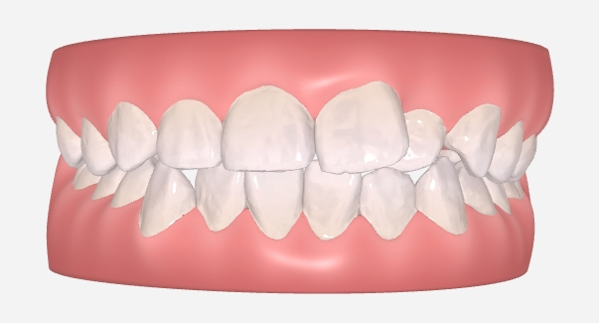
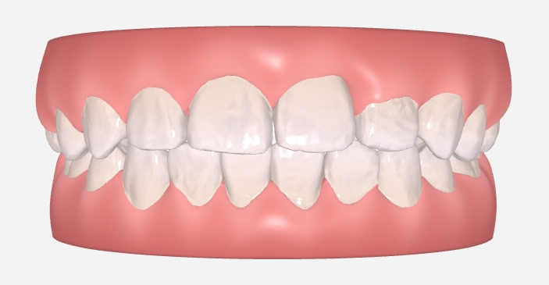
Project: Automatic Orthodontics Design
Initial dentition
Target dentition
We build a system that automatically designs the target dentition from the patient's initial dentition.
The system also generates the whole treatment plan.

Slide 6
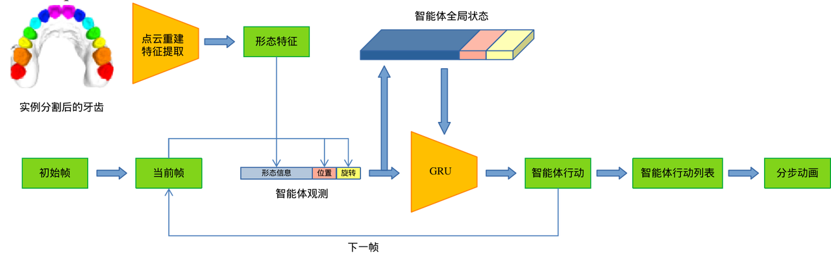
Project: Automatic Orthodontics Design
The system is based on variational auto-encoder and multi-agent reinforcement learning.
Our method achieved a clinical availability rate of 68% while traditional methods is less than 30% in the medical test. And Our method is more efficient.

Slide 7
Project: Automatic Orthodontics Design
The algorithm has been accessed by several orthodontic manufacturers and deployed on our webapp for customers to use: https://lyoral-container.alpha.chohotech.com/
The project has applied for multiple technical patents.

Slide 8
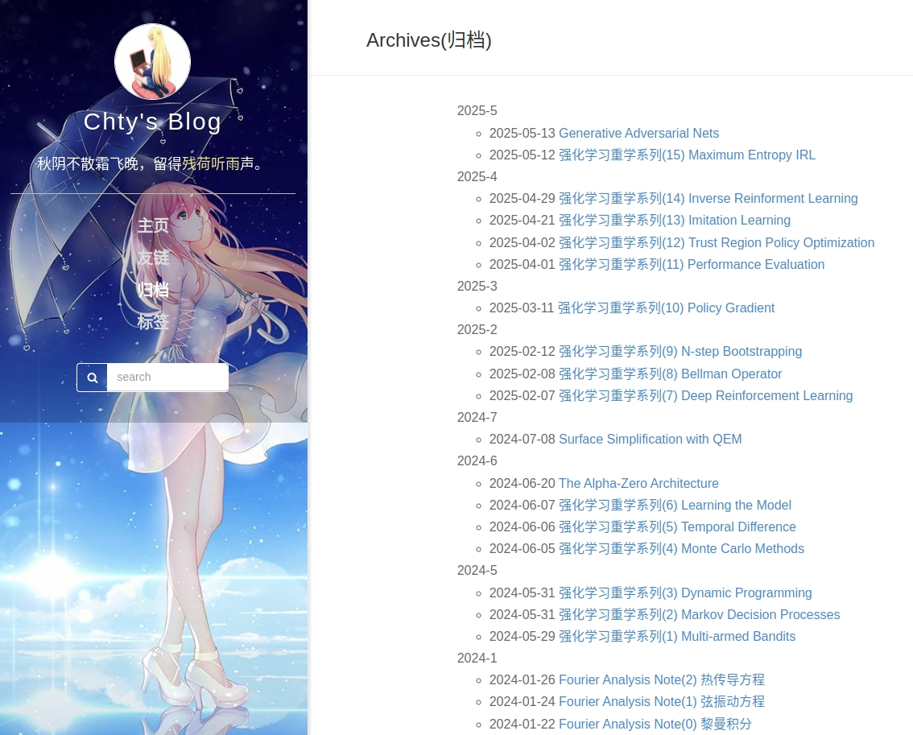
Welcome to My Blog
I keep sharing my experience on blog during
studies, which made me understanding the
principles more clear.
I love to question to the end. I often encounter
details that are not explained in the textbook,
such as the proofs of certain lemmas. I always
explore them and record the process on my blog.
http://blog.leanote.com/chty_syq

Slide 9
Personal Motivation
Current situation
Academic in HKUST(GZ)
No academic freedom in company. Endless customer needs take up most of my time.
No sense of accomplishment in what I am doing.
Little guidance, no academic exchange.
Free and interdisciplinary academic atmosphere.
Strong faculty, like-minded researchers and excellent collaborators.
A wealth of academic resources that support me with cool projects.
Passionate about
academics

Slide 10
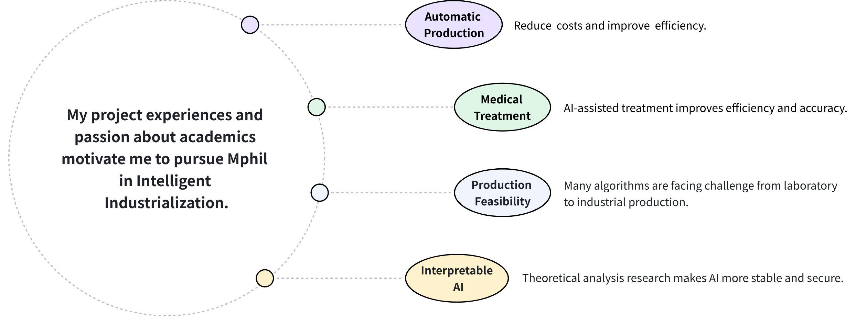
Intelligent Industrial Vision

Slide 11
Future Plan
1
Research for reinforcement learning in various scenarios, such as robotics design, autonomous driving and large language model.
2
Study the algorithm principles in depth. Not just superficial works.
3
Pursue a PHD degree, and a postdoctoral position or a faculty role in the future.

Slide 12
Thanks

