Slide 1
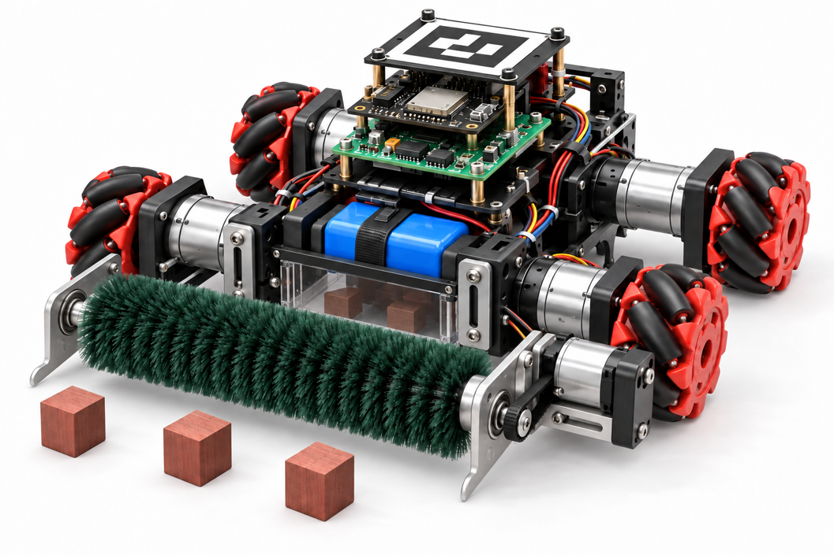
Autonomous
Block-Clearing Robot
System Progress & Pushing Strategy
Robot concept
Team members: 秦琪翔，楚健如，胡锦诚
20 October 2026
Notes:
Suggested timing: 10 seconds.
Good morning. This update covers our hardware progress, the new debugging workbench, and our pushing strategy, followed by a simulation demonstration.
Sources (not spoken):
Group01-1.pptx (template)
Previous ten-slide deck (cover and team)
User-supplied robot concept image, preserved from the prior revision

Slide 2
Robot System Architecture
Overall robot design with PC planning and ESP32 motion control
Stage | Responsibility
PC perception | Camera input, block detection and robot localization
PC strategy | Pushing route and body velocity targets (vx, vy, wz)
ESP32 control | Mecanum wheel mapping and wheel speed control
Drive and feedback | D24A motor outputs and encoder feedback to ESP32
Control loop: PC planning with encoder feedback
Competition link: wireless communication (planned)
01
Notes:
This slide presents the overall robot system design. The PC receives camera images, detects blocks and estimates robot position. The strategy layer selects a pushing route and produces body velocity targets: forward velocity vx, lateral velocity vy and yaw rate wz. The ESP32 converts these targets into Mecanum wheel commands and uses encoder feedback for wheel speed control. The D24A drives the motors and routes encoder feedback to the ESP32. Wireless communication is planned for the competition.
Sources (not spoken): robot_ppt.md; 开发连接调试方案.md; motor-bringup/FOUR-MOTOR-WIRING.md; source presentation.
Architecture scope: This is the intended complete robot architecture, not a claim that every subsystem has completed physical integration. Four-wheel feedback control and wireless communication remain integration targets. Detailed current test evidence appears on the dedicated motor testing slide.

Slide 3
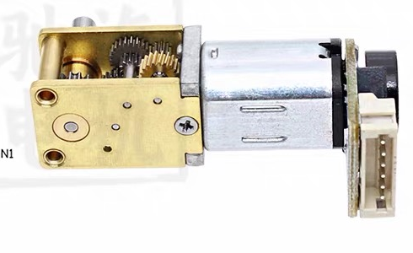
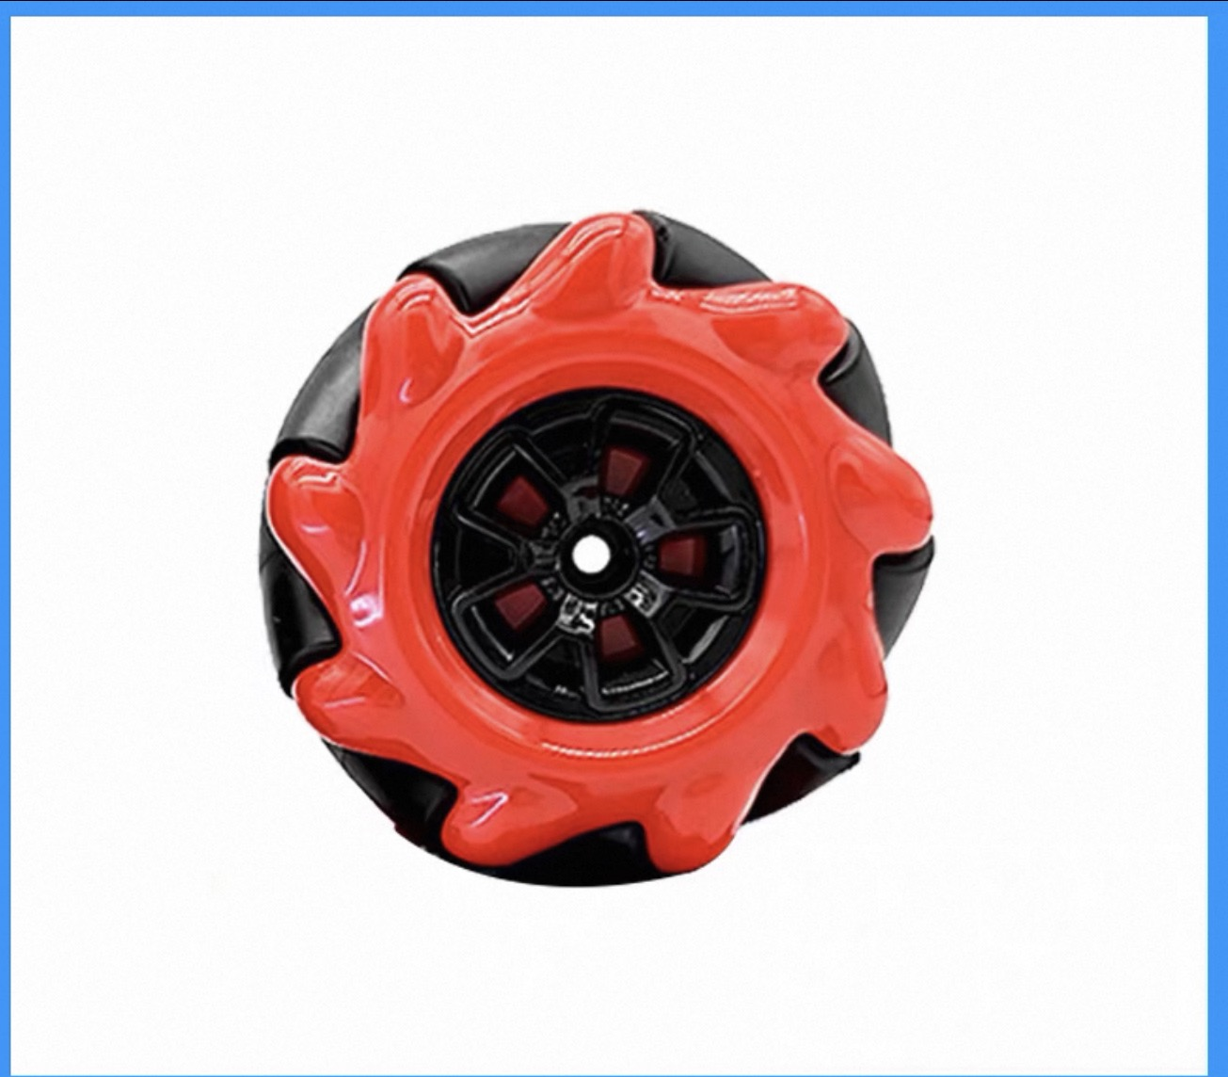
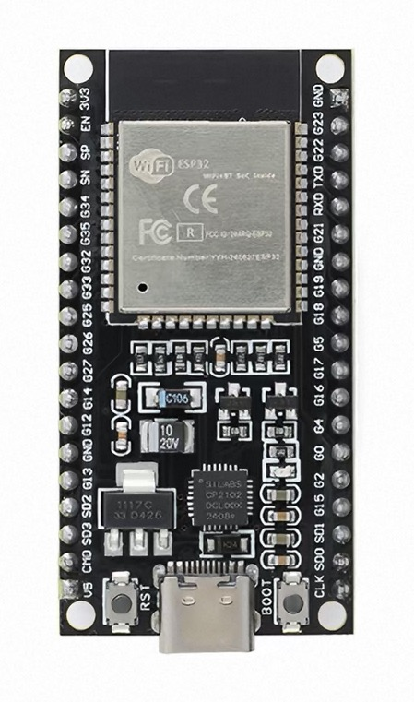
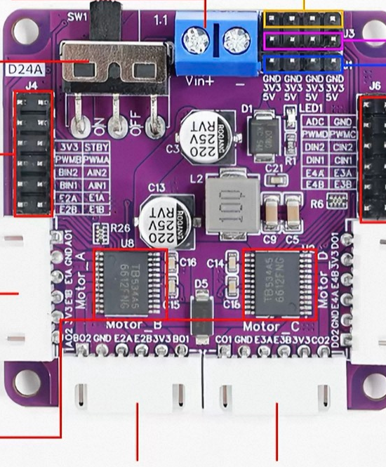
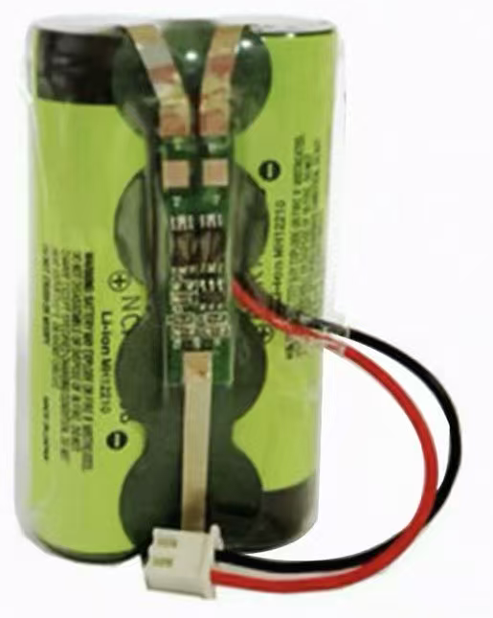
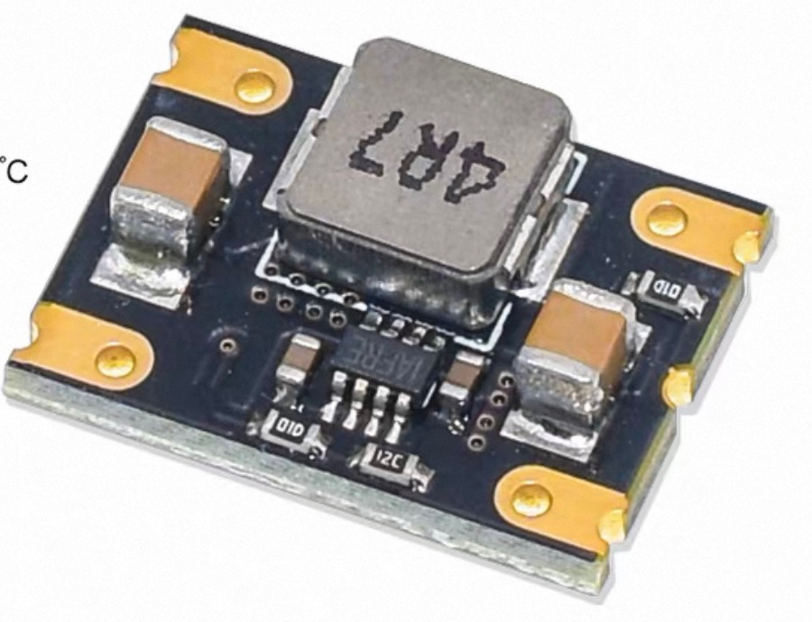
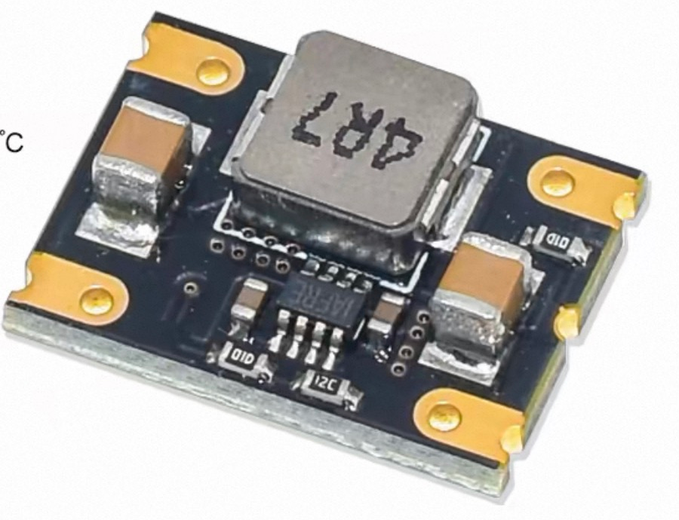
Part I: Hardware Configuration
Selected drive, control and power components
DC Geared Motors
Mecanum Wheels
ESP32 Controller
D24A Motor Driver
6 V, 1:118, encoders
48 mm, four wheels
WROOM-32, 38 pins
TB6612, four channels
Battery Pack
6 V Buck Converter
5 V Buck Converter
2S lithium-ion, 7.4 V nominal
Motor supply branch
Controller supply branch
02
Notes:
The hardware includes four six-volt geared motors with encoders, four forty-eight-millimeter Mecanum wheels, an ESP32-WROOM-32 controller and a four-channel D24A driver. A two-cell battery feeds separate six-volt motor and five-volt controller branches for vehicle operation. The current bench setup powers the ESP32 by USB.
Sources (not spoken): 使用物料图片/esp32.jpg; original hardware component images in Group01-2-latest.pptx; 开发连接调试方案.md; motor-bringup/README.md; motor-bringup/FOUR-MOTOR-WIRING.md. Full-load power and four-wheel operation remain pending.

Slide 4
Part I: Hardware Connections
Control signals, encoder feedback and separate power branches
Signal path (USB now, Wi-Fi planned)
USB
frames
USB
serial
PWM
+ STBY
Motor
outputs
Camera
（Phone）
PC
ESP32
D24A
4 × Motors
Overhead view
Vision + strategy
WROOM-32
4-ch TB6612
Mecanum wheels
Encoder A/B feedback via D24A
Vehicle power
6 V Buck
D24A VIN
2S Battery
Motor rail
6 V motor supply
7.4 V nominal
5 V Buck
ESP32 5 V Input
Controller rail
Vehicle operation
03
Notes:
The overhead camera sends images to the PC. The PC runs perception and strategy and communicates with the ESP32 through USB serial during bench testing. Wireless communication is planned for the competition. The ESP32 sends PWM and standby control to the D24A. The driver supplies the motors, and encoder A/B signals return through the D24A headers to ESP32 inputs. For vehicle operation, the two-cell battery splits into a six-volt branch for D24A VIN and a five-volt branch for the ESP32 board input. All modules share ground. During USB bench testing, the ESP32 takes power from USB and the external five-volt branch stays disconnected.
Sources (not spoken): motor-bringup/README.md; motor-bringup/FOUR-MOTOR-WIRING.md (2026-10-20); 开发连接调试方案.md (vehicle power plan); debug-workbench/README.md.
Scope: This is a functional hardware connection diagram, not a physical connector pinout. A-channel bench operation is demonstrated; four-channel operation, wireless control and vehicle power under full load are pending. The PWM label denotes modulation on IN1/IN2 in the current two-input control scheme. PWMA/B/C/D are fixed high from D24A itself. Encoder signals use 3.3 V and must not feed 5 V into ESP32 inputs. The current direct 3.3 V control experiment has not established TB6612 input specification compliance at 5 V logic supply. No unverified interface is added to the overhead camera beyond the project USB frame source.

Slide 5
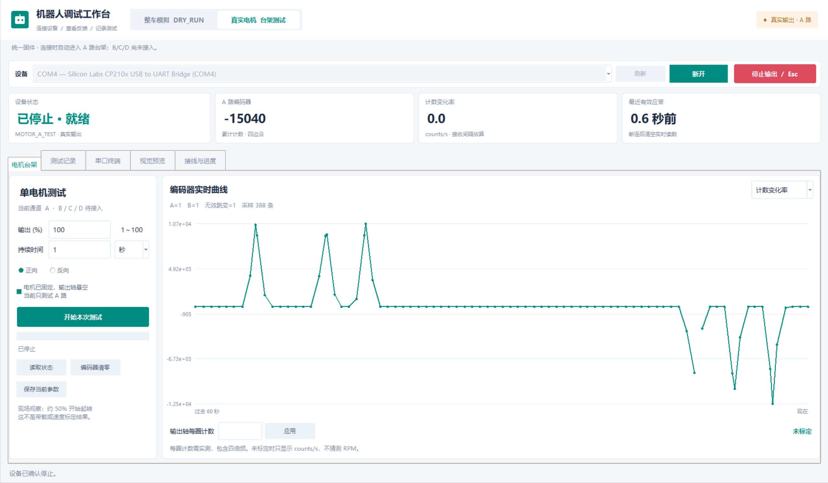
Part I: Single-Motor Bench Test
A-channel bench operation with live encoder feedback
Motor Operation
Rotation starts at about
50% output in the initial
bench observation.
Encoder Feedback
Signed counts and
count-rate traces
appear in the workbench.
Calibration Pending
Counts/rev and loaded
performance need testing.
B/C/D and PID pending.
04
Notes:
Suggested timing: 37 seconds.
We have progressed beyond stationary firmware queries. In the initial bench setup, the motor starts rotating at about fifty-percent output. The supplied screenshot shows signed encoder counts and positive and negative count-rate traces. This is preliminary A-channel evidence. Counts per revolution are still uncalibrated, so we report counts per second rather than RPM. The other motor channels and PID control remain unfinished.
Sources (not spoken):
motor-bringup/TEST-REPORT.md (user observation near 50% output)
D:/Users/WeChat Files/xwechat_files/wxid_5wjijhrfo2b912_5b5d/temp/RWTemp/2026-10/9e20f478899dc29eb19741386f9343c8/a43ed221138a8032abc177308ef81618.png
Evidence boundary: motor rotation near 50% is a user bench observation. The screenshot shows encoder readings and count-rate traces. It does not establish a repeatable starting threshold, counts/rev, RPM, loaded performance or PID tuning. The unified-firmware verification script checked connections and mode isolation without sending a real JOG.

Slide 6
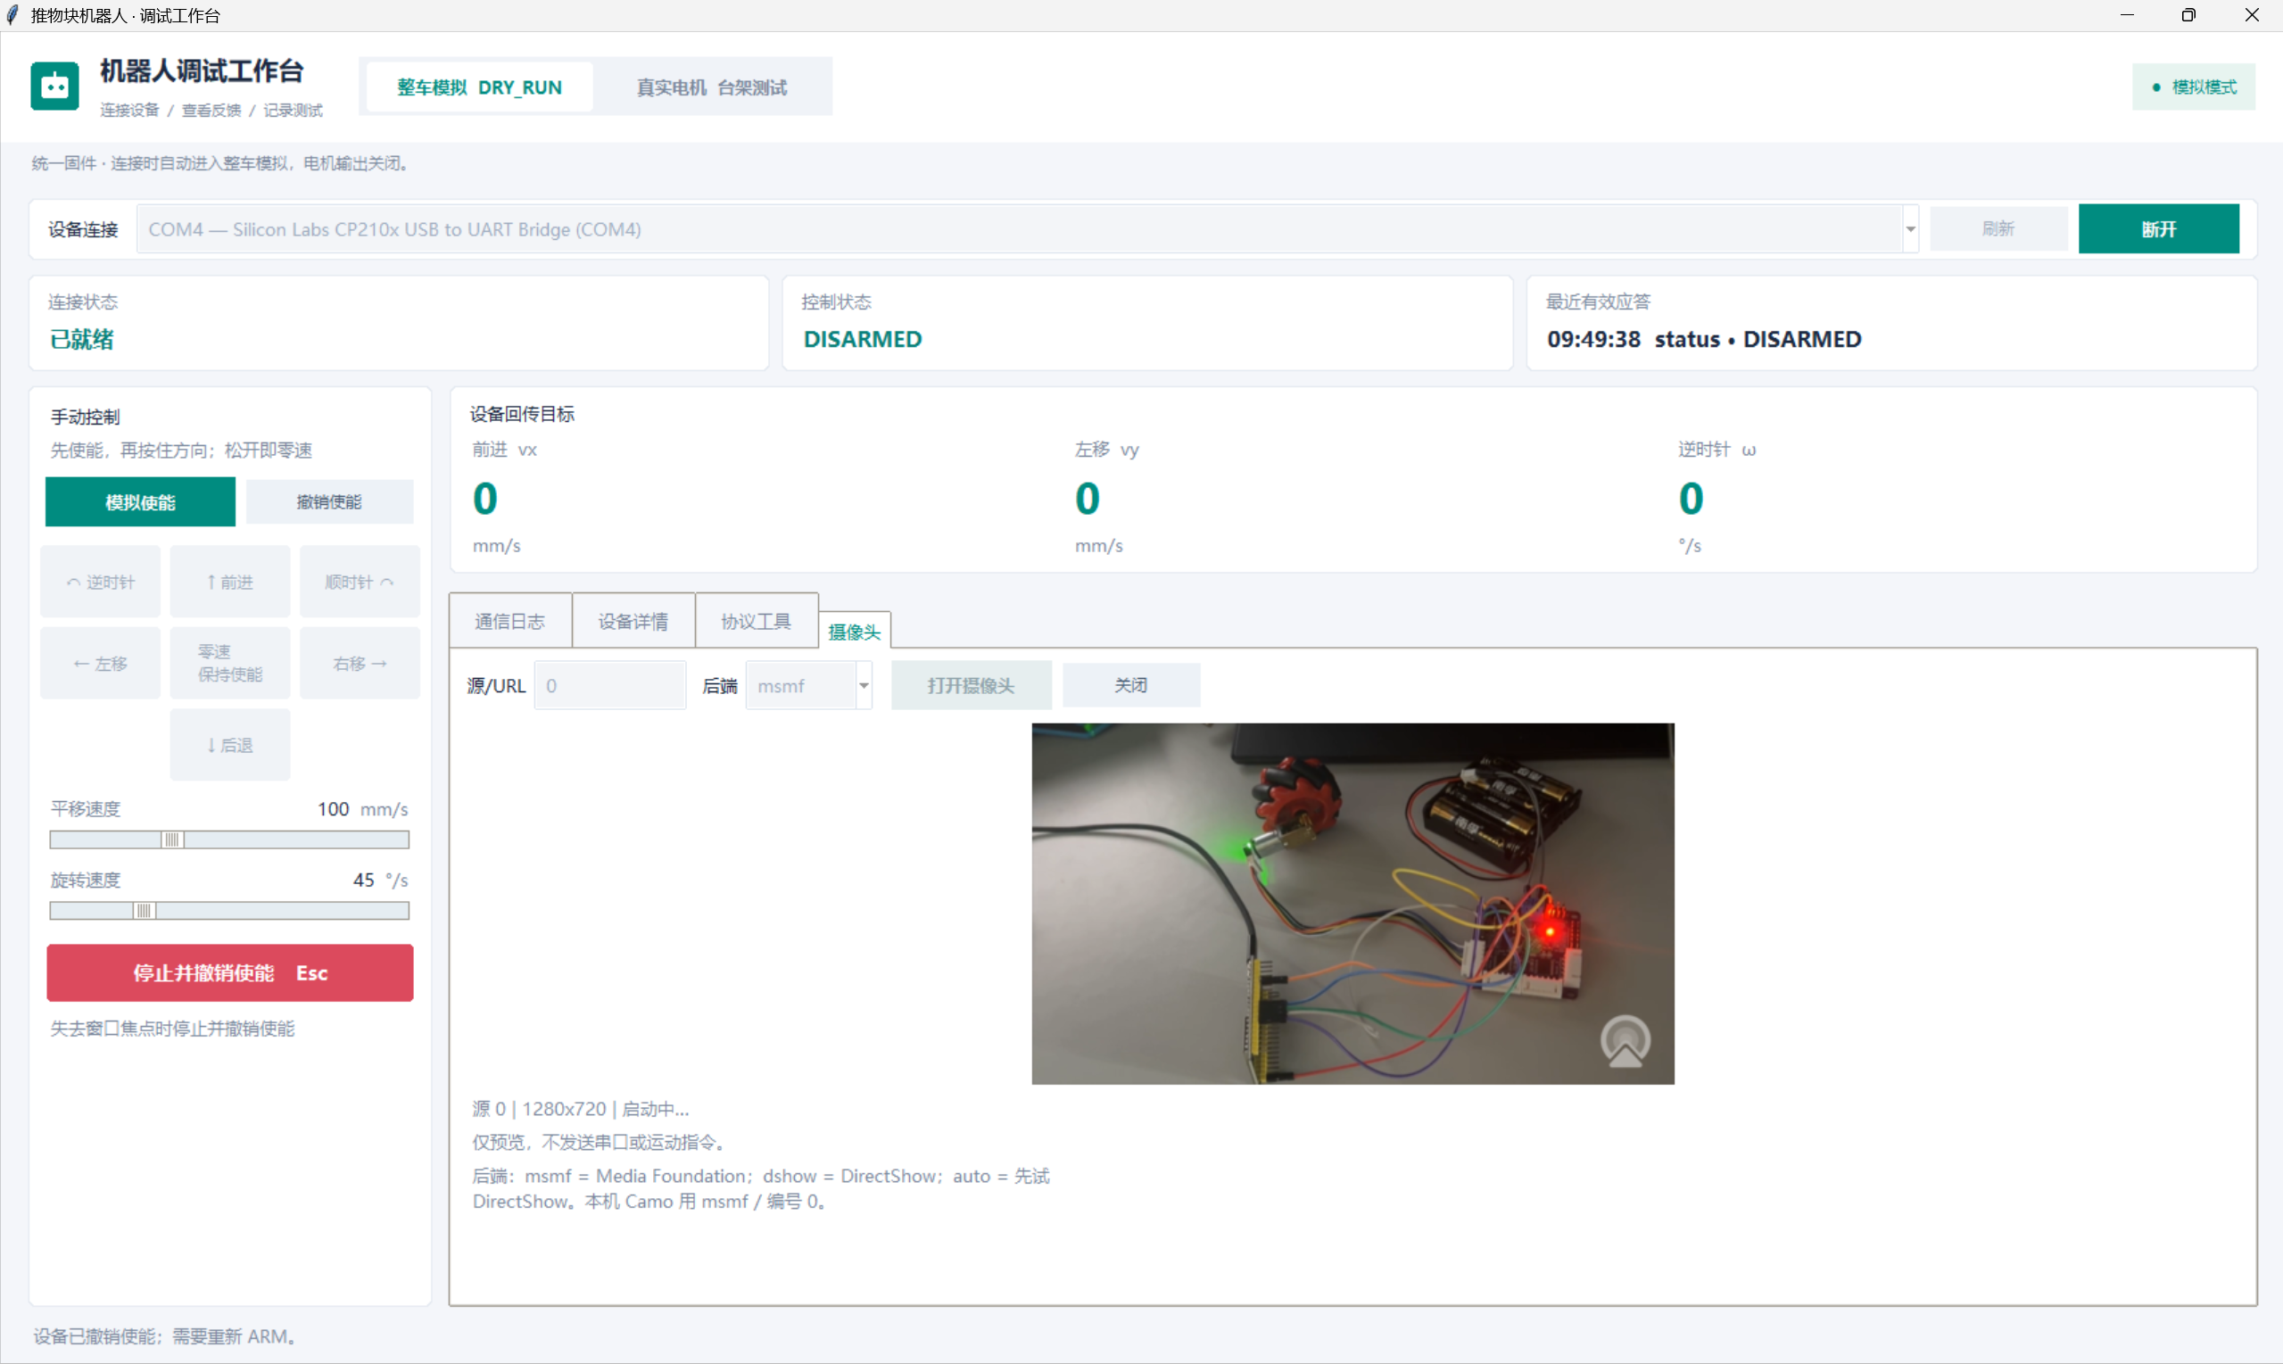
Part II: Unified Debugging Workbench
Motor testing, live feedback and camera preview in one window
Two Operating Modes
DRY_RUN: command tests
Bench: A-channel output
Plots and Records
Encoder plots and logs
Test records and CSV export
Camera Preview
1280 × 720 live input
Grid overlay and frame saving
05
Notes:
Suggested timing: 50 seconds.
Our unified workbench supports dry-run commands and real A-channel bench testing with one firmware. It provides encoder plots, serial logs, and test-record export. Connection and mode switching have passed device tests. This same window also displays live camera input at seven-twenty-p resolution, with a reference grid and frame saving. Preview works independently of motor commands. Field and block detection already work in simulation, while physical calibration and visual control still require integration.
Sources (not spoken):
debug-workbench/README.md
debug-workbench/TEST-REPORT.md
debug-workbench/unified-verification.txt
robot_ppt.md
D:/Users/WeChat Files/xwechat_files/wxid_5wjijhrfo2b912_5b5d/temp/RWTemp/2026-10/9e20f478899dc29eb19741386f9343c8/90554a5cf70eb2456bec5b2f8217dae3.png
D:/Users/WeChat Files/xwechat_files/wxid_5wjijhrfo2b912_5b5d/temp/RWTemp/2026-10/9e20f478899dc29eb19741386f9343c8/d9ce23927e76730b9fd25a523604aa4e.png
Validation detail (not spoken): latest project report records 57 Python offline tests and 126 protocol assertions, plus GPIO simulation and device/client switching checks. These are existing recorded results, not new tests run during PPT editing. Chinese UI labels remain authentic to the supplied screenshot.
The separate live bench screenshot reports approximately 30 FPS at 1280x720. This is a displayed snapshot, not a long-duration frame-rate benchmark. Preview does not issue motor commands. Perception is validated in simulation; physical vision control is pending. Camera content is intentionally combined with the workbench page.

Slide 7
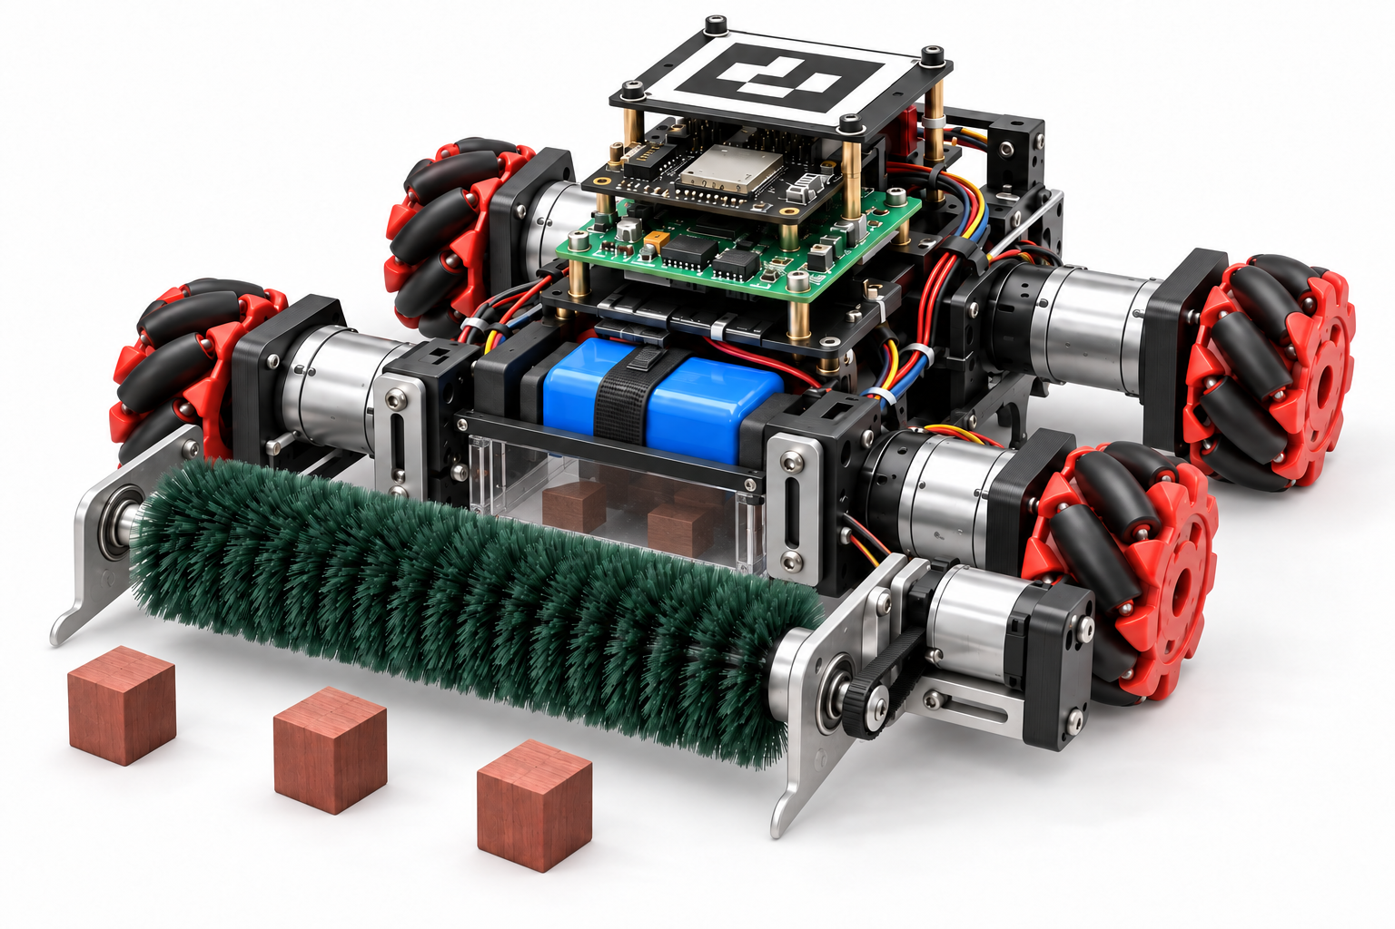
Part III: Block-Handling Mechanism
Conceptual mechanism for front contact and wall-side collection
Front Roller Brush
A 14 cm brush reaches blocks
before the side wheels.
Side Guide Plates
Guide wall-side blocks
toward the roller brush.
Open-Bottom Chamber
Blocks stay on the floor.
The rear panel carries them forward.
Contact rule: pushing uses the front. Side and rear contact limit motion.
06
Notes:
Suggested timing: 22 seconds.
Our proposed mechanism uses a front roller brush and side guide plates to direct blocks inward. The central chamber has an open bottom, so blocks remain on the floor. The controller limits side and rear contact during pushing.
Sources (not spoken):
robot_ppt.md
Group01-1.pptx (concept render)

Slide 8
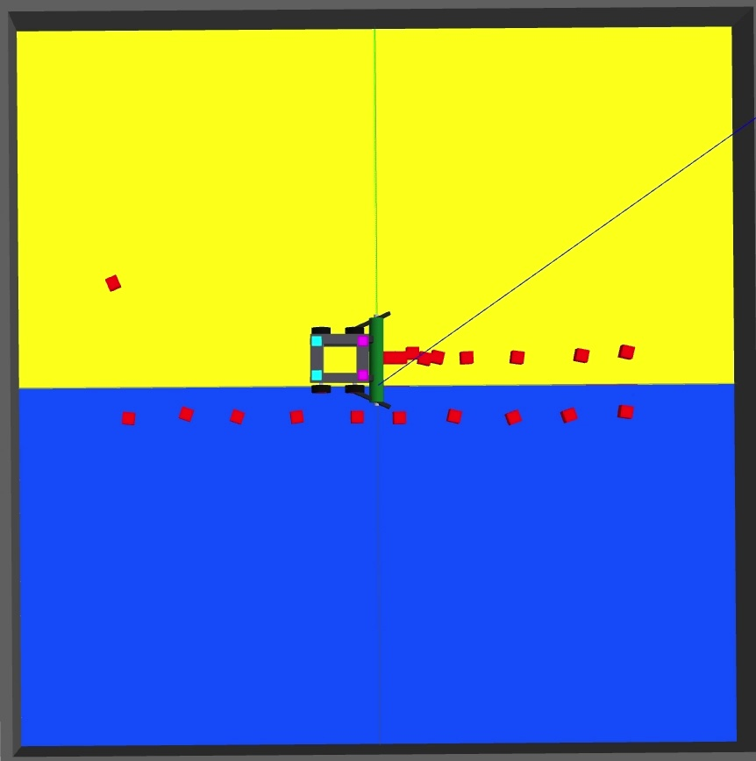
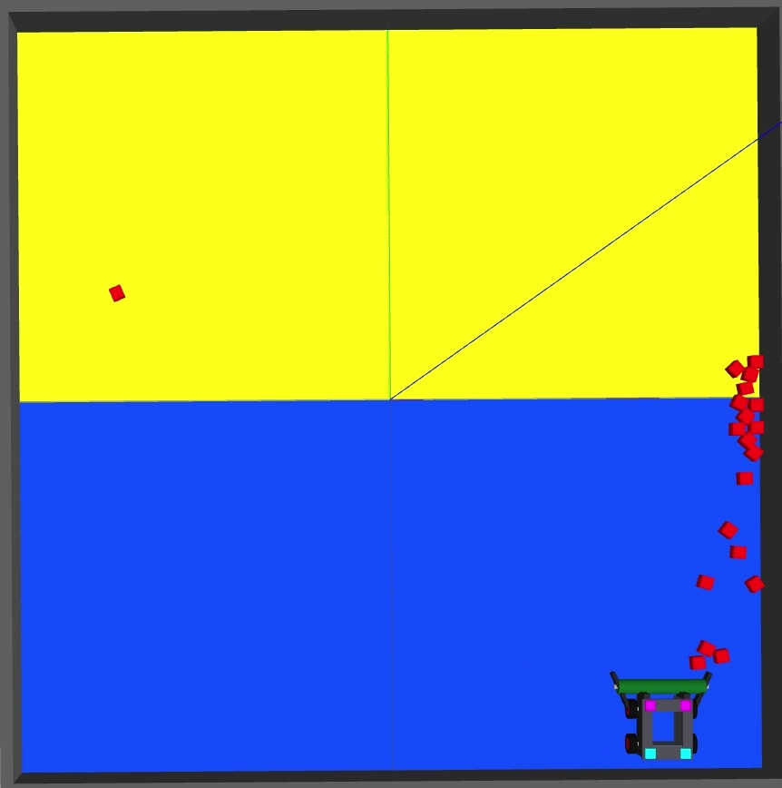
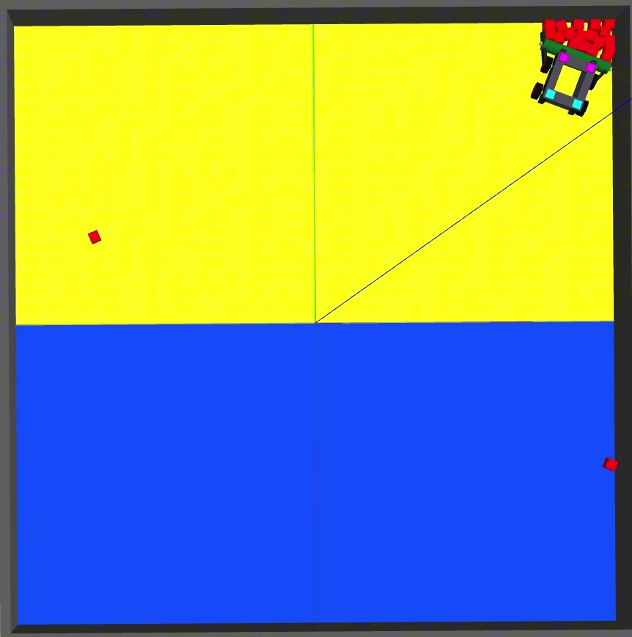
Part III: Block-Pushing Strategy
Front roller brush and guide plates concentrate blocks for pushing
1. Sweep Both Rows East
2. Reposition in the South
3. Push North and Revisit
Opponent row first, then ours.
Gather blocks at the east wall.
Face north and enter the lane
beside the east wall.
Cross the center line.
Revisit the easternmost column.
07
Notes:
Suggested timing: 37 seconds.
The strategy follows three stages. First, the robot sweeps the opponent's row and then our row toward the east wall. Second, it moves to the southern end, faces north, and enters the east-wall lane. Third, it pushes the accumulated blocks across the center line. If blocks remain in our half, it revisits the easternmost remaining column. It aligns its heading before pushing and adjusts the lane using visual feedback.
Sources (not spoken):
robot_ppt.md
推物块仿真.mp4

Slide 9
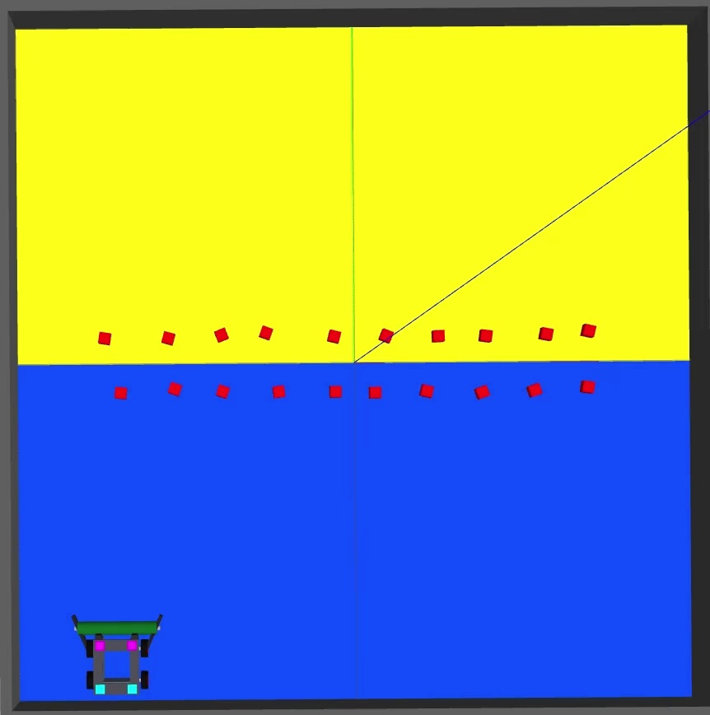
Part III: Simulation Results
Two recorded autonomous runs without manual intervention
Detected Remaining Blocks: 0
Run | Time to Zero* | Stop Time
1 | ~53 s | ~58 s
2 | ~43 s | ~48 s
Vision estimate in our half.
Touching blocks near walls may merge.
Planar motion simulation.
Physical drivetrain validation remains.
08
Notes:
Suggested timing: 47 seconds including the 28.5-second video.
This video demonstrates the staged strategy. In two recorded runs, the detected count in our half reached zero at about fifty-three and forty-three seconds. These vision estimates and simulation results still need physical validation.
Sources (not spoken):
robot_ppt.md
推物块仿真.mp4 (embedded original)
Click the embedded video in Slide Show. Playback duration and simulation elapsed time differ.

Slide 10
Part IV: Next Steps
Mechanical CAD, assembly, calibration and field testing
01
Complete Mechanical CAD
Finalize the chassis, brush mounts and component placement.
02
Assembly and Bring-Up
Assemble the robot, connect all motor channels and verify power.
03
Encoder and Wheel Calibration
Measure counts/rev and tune four-wheel speed control.
04
Vision Integration and Trials
Calibrate field vision, add wireless control and run pushing trials.
09
Notes:
Suggested timing: 32 seconds.
Next, we will complete the mechanical CAD model, including the chassis and brush mounts. We will then assemble the robot, connect all motor channels, and verify power delivery. After assembly, we will calibrate the encoders and tune wheel-speed control. Finally, we will integrate field vision and wireless commands and run physical pushing trials. Thank you.
Sources (not spoken):
debug-workbench/README.md
debug-workbench/TEST-REPORT.md
motor-bringup/TEST-REPORT.md
robot_ppt.md
The user explicitly requested completing the mechanical model followed by robot assembly and bring-up as the first next steps.

