Slide 1

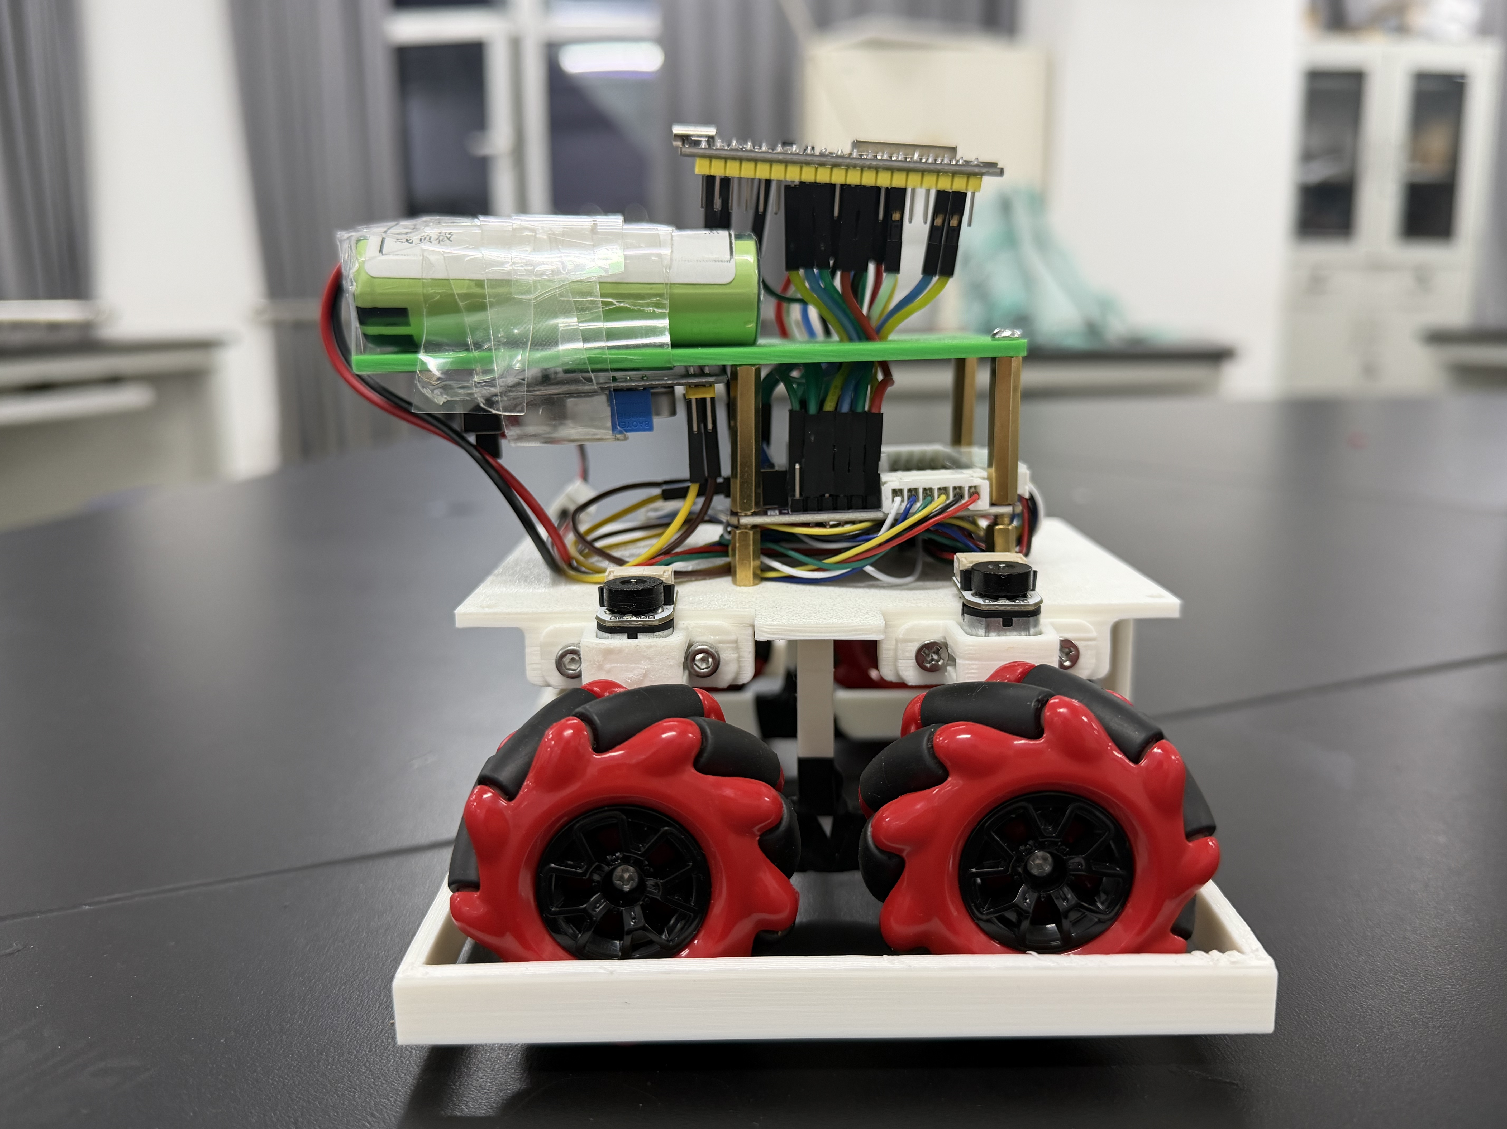
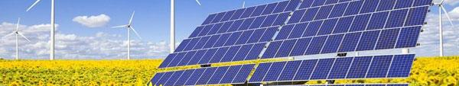
GROUP 01
Autonomous
Block-Clearing Robot
秦琪翔 胡锦诚 楚健如
3 November 2026

Slide 2

00 Overview
01 Chassis
02 Perception
03 Navigation
04 Strategy recap
05 Summary

Slide 3
00 Review — Progress Since Last Review
Area | Previous review | This review
Chassis | Motor bench and encoder feedback | Real motion recorded; PI firmware added
Perception | Vision architecture and color detection | ArUco pose; tag-assisted 2 cm block filtering
Navigation | Simulated pushing route | Pose-driven timed jogs and stop logic

Slide 4
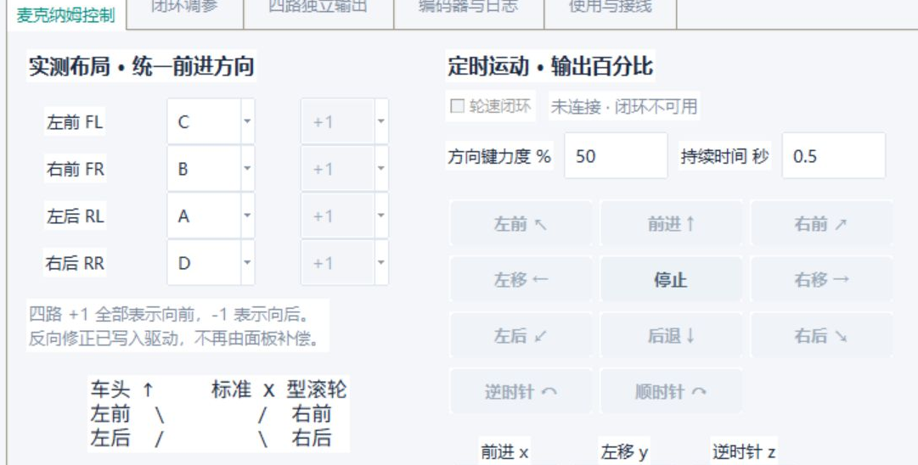

01 Chassis — Motion Workbench and PI Firmware
Added in the firmware
Encoder counts estimate speed
Feedforward sets base PWM
P corrects the current error
I corrects persistent error
$$u = u_{ff} + K_{P}e + K_{I}\int_{0}^{t}{e(τ) dτ}$$
Next on this car
Calibrate wheels; record
speed targets, feedback, PWM.
e: normalized wheel-speed error.
Motion controls shown disconnected; PI calibration pending.

Slide 5
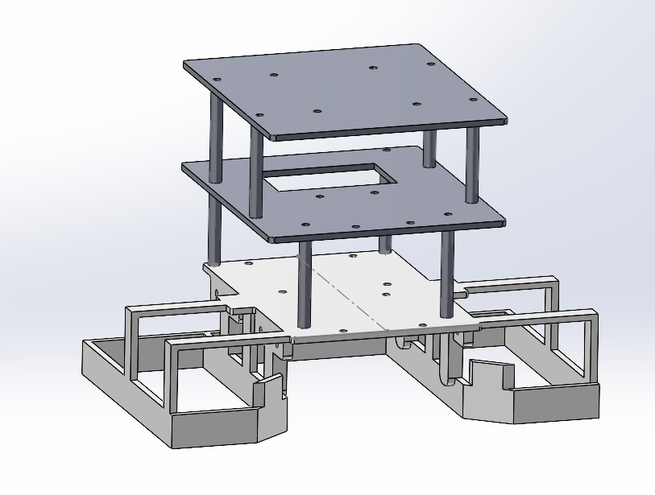
01 Chassis — Initial Frame Concept
Initial CAD design
Upper layer
Top platform for the tag
Middle layer
Battery and ESP32 placement
Lower layer
Motor and driver placement
Wheel guards
Impact protection; keep blocks
from jamming the wheels

Slide 6
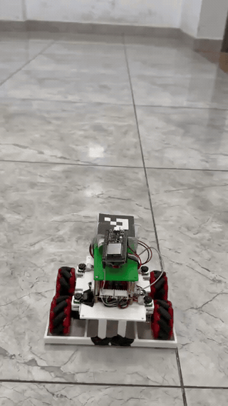
01 Chassis — Motion and Residual Drift
Observed on the current robot
Forward and reverse movement recorded;
overall travel is comparatively stable.
Remaining mechanical issue
Uneven wheel loading in the current structure;
residual drift is still visible.
Next repeatable check
Redistribute the load; repeat equal-distance runs.
Record lateral offset and heading change.
2× speed, 6.7 s loop

Slide 7
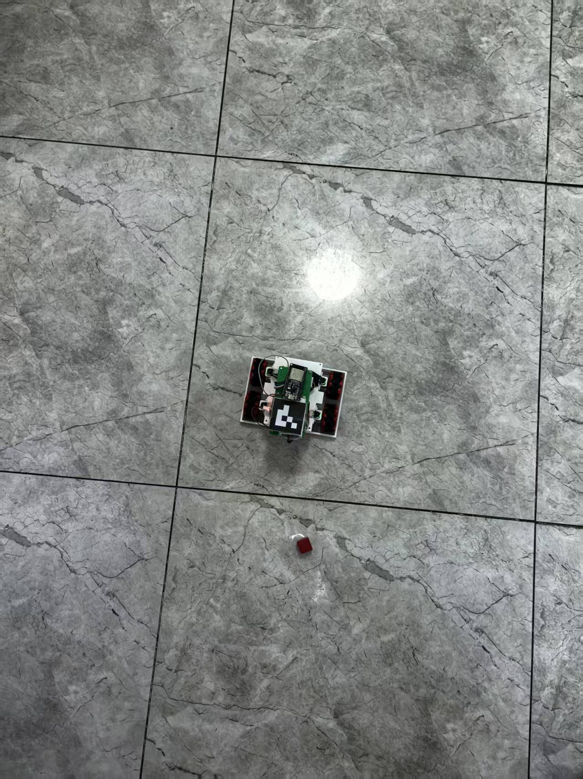
02 Perception — Tag Pose and Field Mapping
ArUco tag choice
DICT_4X4_50; ID 0; 50 mm side.
Black-white code limits color conflicts.
Pose output
Four corners give center and heading.
Known tag size supplies a local scale.
Field coordinates
Fix the overhead camera and mark four
field corners for perspective mapping.

Slide 8
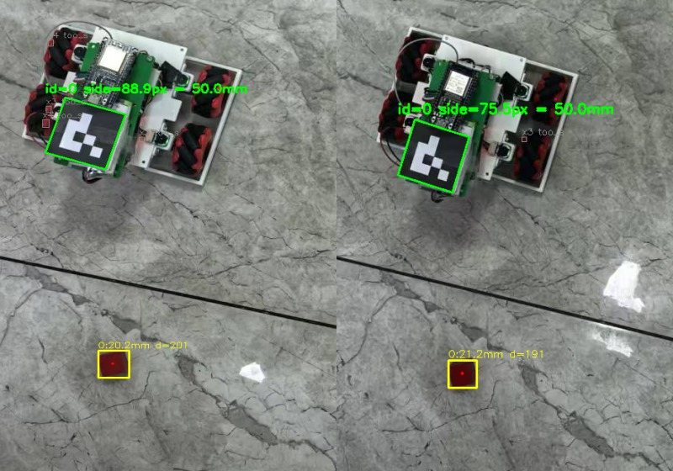

02 Perception — Detecting 2 cm Blocks
1 Select red pixels
HSV red mask with S/V checks.
Optional low-light red pass.
2 Reject color fragments
Screen aspect ratio, rectangularity
and solidity of each contour.
3 Apply a physical-size filter
$$s ≈ \frac{50}{l_{tag,px}} mm/px$$
$$l_{block} ≈ \sqrt{A_{px}} s$$

Slide 9


03 Navigation — Pose-to-Motion Control
1 Compute target error
3 Execute and observe again
Input: current pose and target pose.
Align
$$Δx = x_{tar} − x, Δy = y_{tar} − y$$
Correct heading before translation.
2 Convert to the robot frame
Pulse
Bounded percentage and duration.
$$e_{f} = cos θ Δx + sin θ Δy$$
$$e_{l} = −sin θ Δx + cos θ Δy$$
Stop
Read a fresh pose before the next jog.
Forward and leftward errors drive translation.
Heading error drives the turn command.

Slide 10
03 Navigation — Command Timing and Stops
Condition | Current software response
No pose / pose age > 0.35 s | Request STOP; wait for valid vision
Match time reaches 90 s | Stop before another planning step
Action active / cooldown not over | Hold the next timed movement command
STOP request | Give stopping priority in the link
PC navigation
Timed jogs; about 1.05 s cooldown between actions.
MCU PI
10 ms PI implementation; on-car calibration pending.

Slide 11
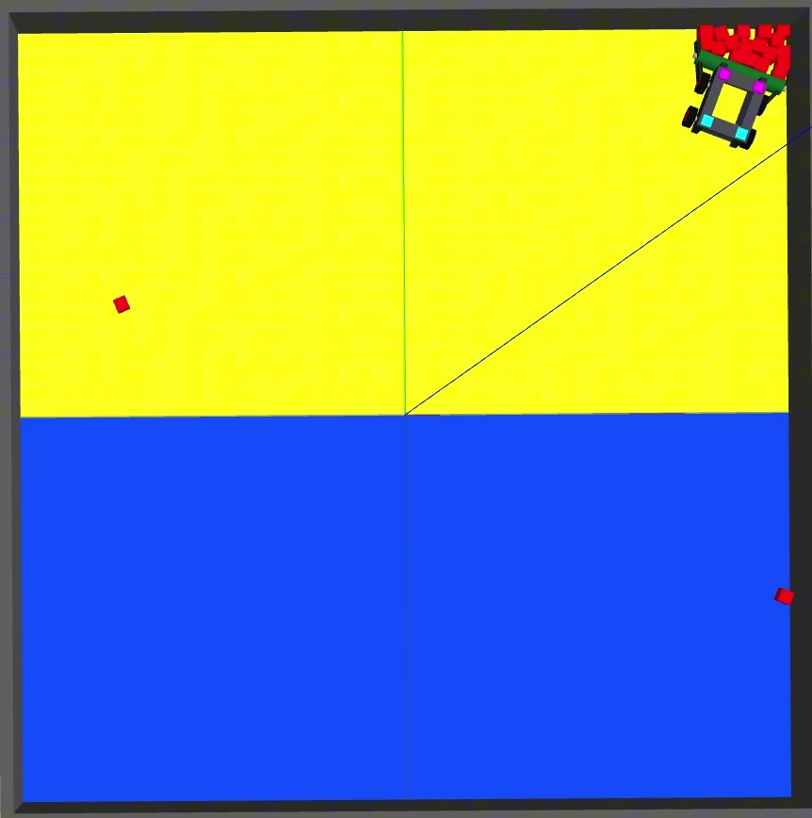
04 Strategy — Brief Recap
Existing plan
Regular rows: push east, then north along the wall.
Dispersed or blocked rows: switch to local cleanup.
Constraints retained
Select own blocks using nearby blue/yellow floor.
Push with the front; check clearance before turning.
Work for this stage
Feed measured poses into the existing policy.
Use measured car dimensions for clearance.

Slide 12
05 Summary — Next Physical Test
Next gate: push one block across the midline
Save synchronized pose, command and stop records for the complete attempt.
Workstream | Present evidence | Next measurable check
Chassis | Video; PI not calibrated | Load balance, wheel calibration and target-versus-speed logs
Perception | Tag + block photo checks | Fixed-camera field calibration and continuous detection checks
Navigation | Offline jog / stop logic | One-block push with pose, command and stop records

Slide 13
Thank you
Group 01
秦琪翔 胡锦诚 楚健如

