Slide 1
Content：
the model and the method
compare two different degeneration model(linear vs exponential)
conclusion and discussion

Slide 2
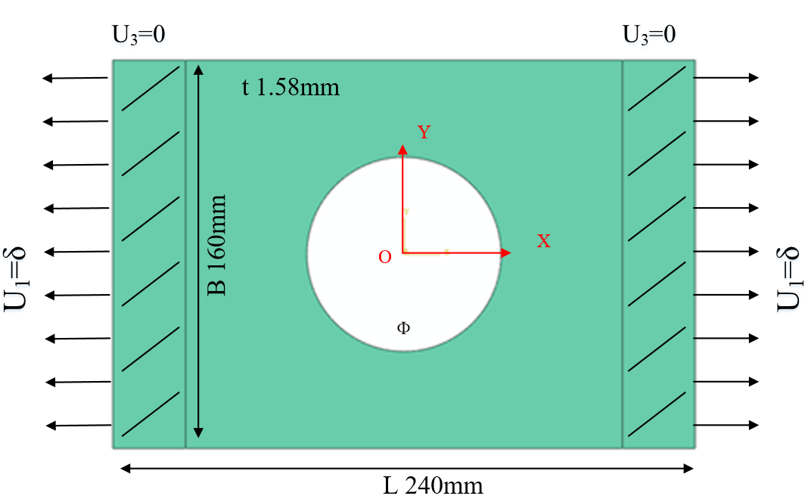
Simulation Model
FEM：Abaqus
Model: 3D Shell(SC8R)
Strength criterion：Hashin
Ф: 60mm, 80mm, 100mm
Layups: [0˚]₁₀, [0˚/90˚]₅, [±45˚]₅
Table 1 Material properties of a single lamina
ρ（kg/m³） | E₁(GPa) | E₂(GPa) | G₁₂(GPa) | υ₁₂
1520.7 | 127.70 | 9.67 | 6.50 | 0.30
Table 2 Strength parameters of a single lamina
Strength | X_{t} | X_{c} | Y_{t} | Y_{c} | S₁₂
(MPa) | 1518 | 764.3 | 36.0 | 160.3 | 60

Slide 3
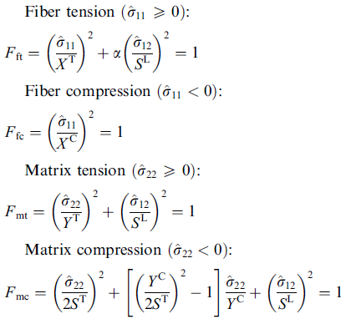
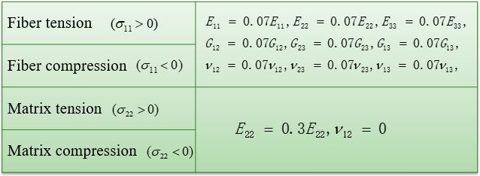
Simulation Model
Ply-discount model
Hashin criterion
Ply-discount model:
Wang Danyong, Wen Weidong, Cui Haitao. Three-Dimensional progressive damage analysis of composite laminates containing a hole subjected to tensile loading. Chinese Journal of Theoretical and Applied Mechanics, 2005, 37(6):788-795.

Slide 4
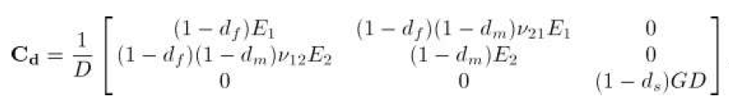
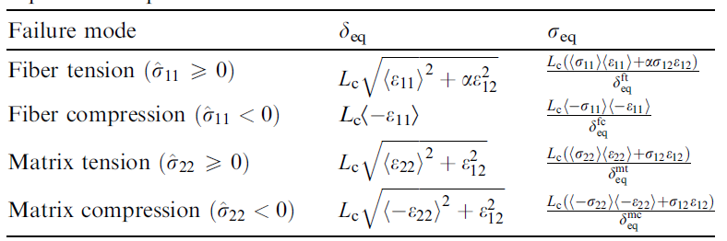
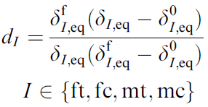


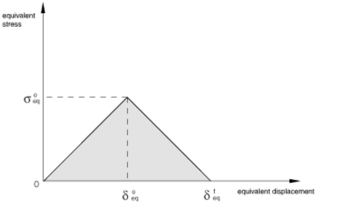
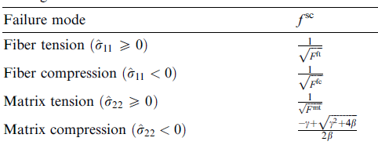
Simulation Model
Continuum Damage Model I（Linear degenaration law)
）
Damage variable:
Lapczyk I, Hurtado J A. Progressive damage modeling in fiber-reinforced materials[J]. Composites Part A Applied Science & Manufacturing, 2007, 38(11):2333-2341.

Slide 5
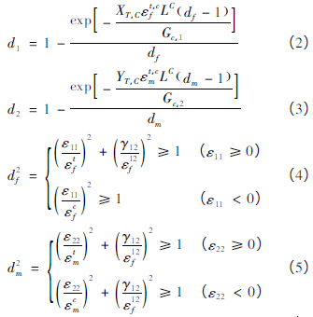


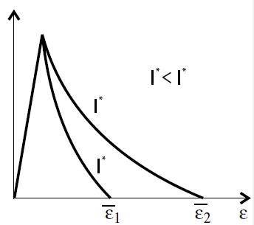
Simulation Model
Continuum Damage Model II（Exponential degenaration law)
Damage variable:
Damage and Failure Study of Composite Laminates with
Reinforced Cutout Based on CDM
Wang Wenzhi，Wan Xiaopeng，Yao Liaojun

Slide 6

UMAT subroutine：
after each increment
UMAT subroutine
calculate strain and undamaged stiffness matrix
calculate damage variable d and
calculate stress
damaged
calculate damaged stiffness matrix
checkout failure ( Hashin
criterion)
undamaged
calculate stress and Jacobian matrix; update damage variable d
quit UMAT,back to main program

Slide 7
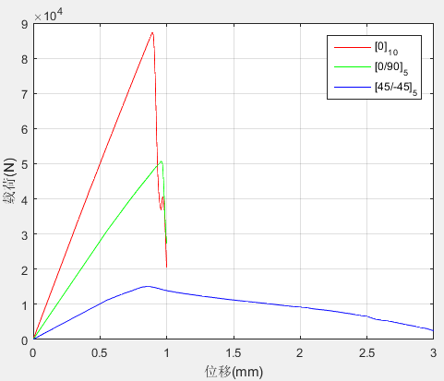
Results and Comparing
The ultimate strength:
Ultimate load （kN） Layer | Exp. | Linear degenaration
 |  | Simulation | Error
[0]₁₀ | 69.73 | 86.98 | 24.73%
[0/90]₅ | 47.20 | 45.37 | 3.88%
[±45]₅ | 23.79 | 14.31 | 39.85%
Exponential degenaration
Simulation | Error
87.32 | 25.23%
50.67 | 7.35%
15.04 | 36.78%
Linear degenaration
Exponential degenaration
Experiment

Slide 8
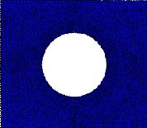
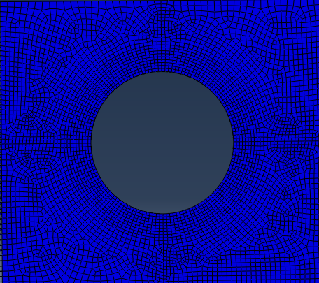
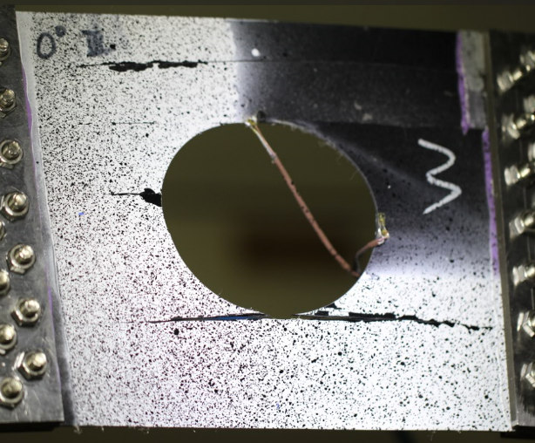
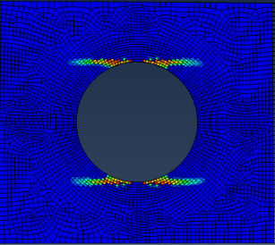
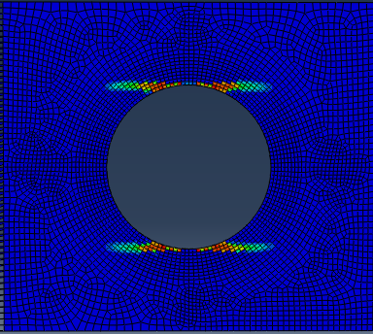
Results and Comparing
[0]₁₀
Fiber failure
Fiber failure
Matrix failure
Matrix failure
Linear degenaration
Exponential degenaration

Slide 9
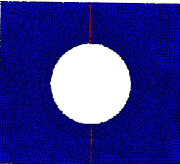

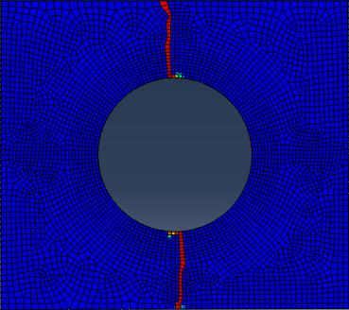
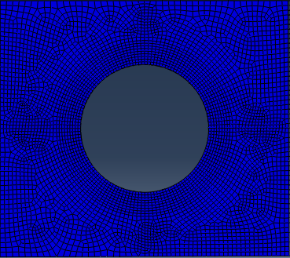
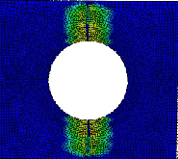
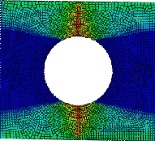
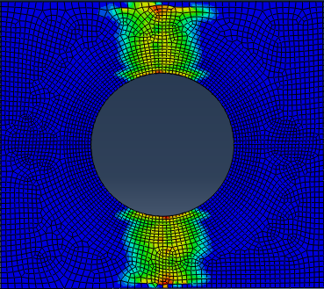
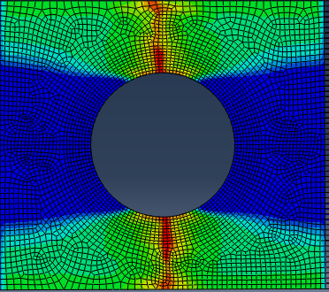


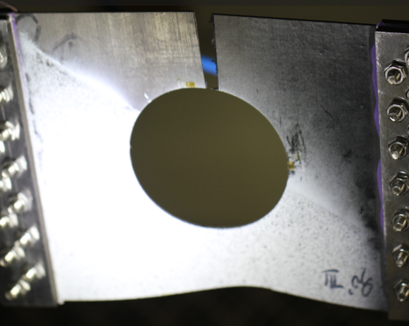
Results and Comparing
[0/90]₅
Fiber failure
Matrix failure
$0^{°}$ layer
${90}^{°}$ layer
Linear degenaration
Exponential degenaration
Notes:
This is the failure behavior of the 0/90 layup laminates. The fiber failure is shown in the animation above. The matrix failure is shown in the animation below,The left one is 0 layer,the right one is 90 layer. In the 0 layer,we can see that the fiber failure extends along the 90 direction,and the matrix failure also extends on the either sides of the fiber failure.In the 90 layer,there is only matrix failure without any fiber failure.

Slide 10
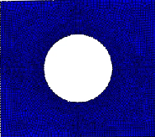
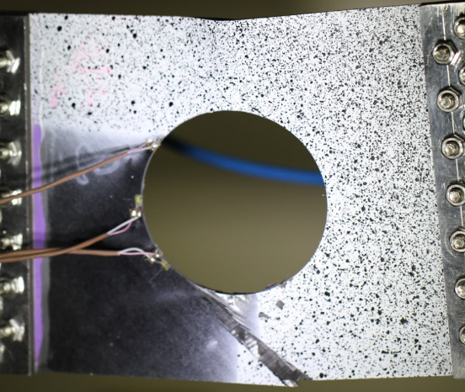
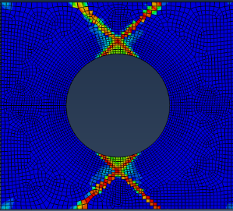
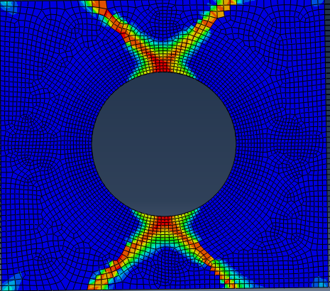
Results and Comparing
[±45]₅
Fiber failure
Fiber failure
Matrix failure
Matrix failure
Linear degenaration
Exponential degenaration
Notes:
This is the failure behavior of the 45 layup laminates.The matrix failure extends along the 45 direction.The simulation agree with the experimental results.

Slide 11
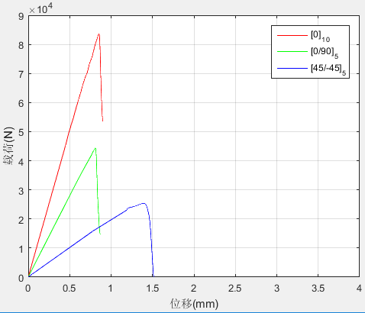
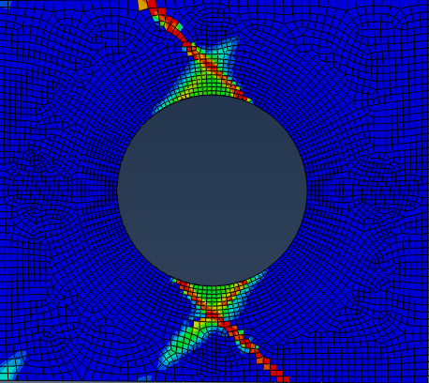
Results and Comparing
Influence of the shear strength S₁₂ ：
S₁₂ = 65
S₁₂ = 95
Experiment

Slide 12
Conclusions
The continuum damage models using the exponential degenaration law and the linear degenaration law almost have same preformance for predicting the failure behavior and the ultimate strength of composite laminates with big cutouts;
The simulation using the exponential degenaration law has an affect on the displacement-force curve in the [±45]₅ layup laminates but still did not agree well with the expriment.
next step:
1. cohesive element
2. shear nonlinearity

