Slide 1
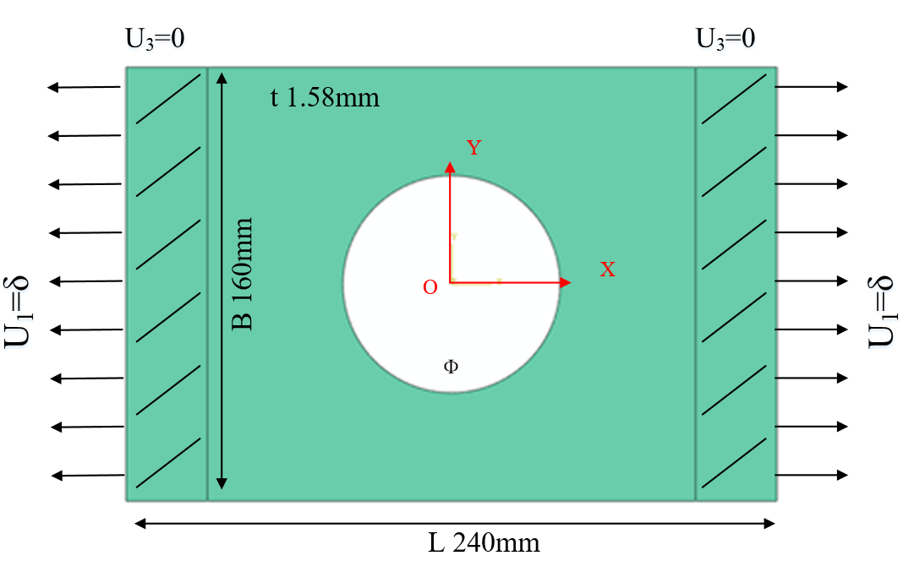
Simulation Model
FEM：Abaqus
Model: 3D Shell(SC8R)
Strength criterion：Hashin
Ф: 60mm, 80mm, 100mm
Layups: [0˚]₁₀, [0˚/90˚]₅, [±45˚]₅
Table 1 Material properties of a single lamina
ρ（kg/m³） | E₁(GPa) | E₂(GPa) | G₁₂(GPa) | υ₁₂
1520.7 | 127.70 | 9.67 | 6.50 | 0.30
Table 2 Strength parameters of a single lamina
Strength | X_{t} | X_{c} | Y_{t} | Y_{c} | S₁₂
(MPa) | 1518 | 764.3 | 36.0 | 160.3 | 60

Slide 2
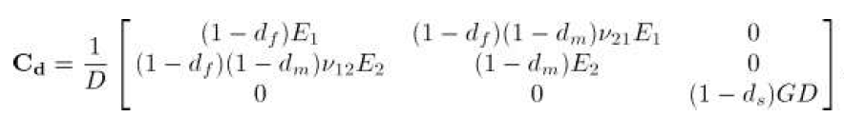
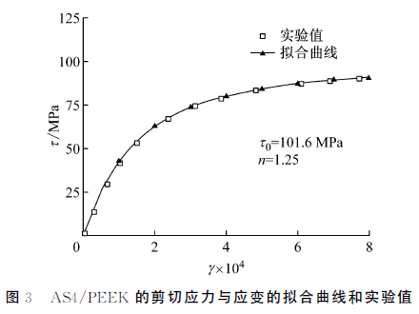
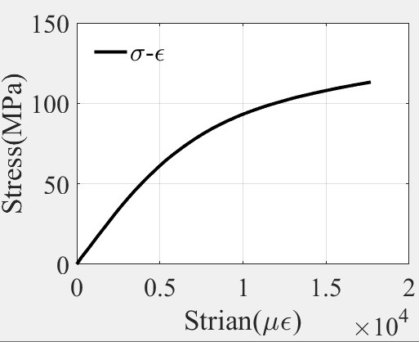


Shear Nonlinearity：
shear nonlinearity constitutive relations for the laminates were defined with the Ramberg-Osgood equation:
刘魏光, 余音, 汪海. 考虑剪切非线性的复合材料渐进损伤模型[J]. 上海交通大学学报, 2016, 50(2):194-199.

Slide 3
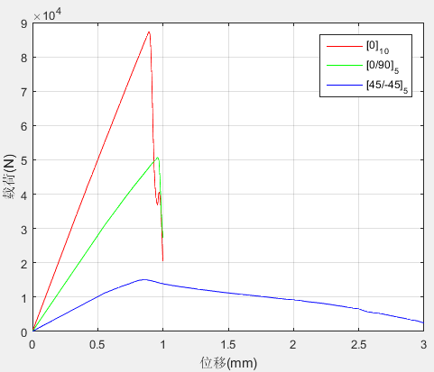
Former Results：
The ultimate strength:
Ultimate load （kN） Layer | Exp. | Linear degenaration
 |  | Simulation | Error
[0]₁₀ | 69.73 | 86.98 | 24.73%
[0/90]₅ | 47.20 | 45.37 | 3.88%
[±45]₅ | 23.79 | 14.31 | 39.85%
Exponential degenaration
Simulation | Error
87.32 | 25.23%
50.67 | 7.35%
15.04 | 36.78%
Linear degenaration
Exponential degenaration
Experiment

Slide 4
UMAT subroutine：
after each increment
UMAT subroutine
calculate strain and undamaged stiffness matrix
calculate damage variable d and
calculate stress
damaged
calculate damaged stiffness matrix
checkout failure ( Hashin
criterion)
undamaged
calculate stress and Jacobian matrix; update damage variable d
quit UMAT,back to main program

Slide 5
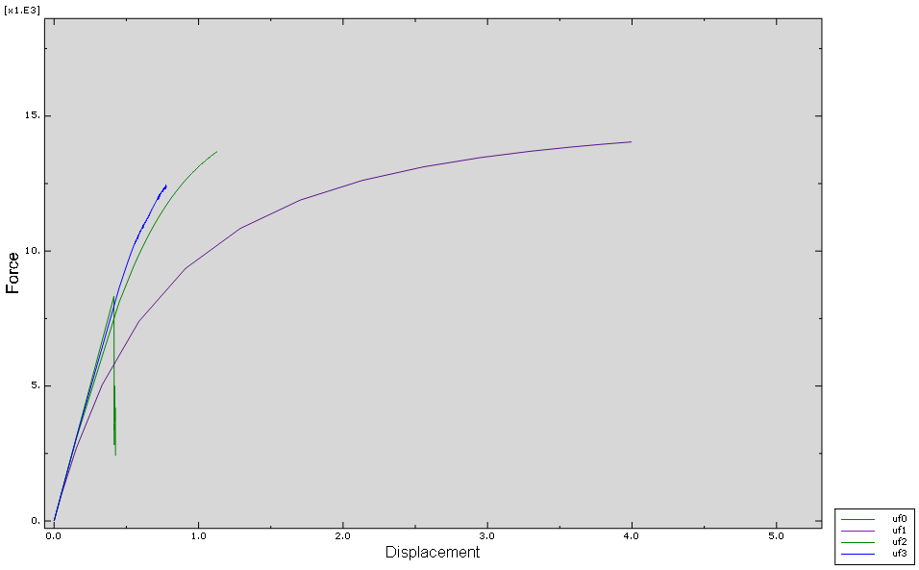
Results and Comparing
linear
Exponential degenaration
Displacement-Force curve of the [45/-45] ₅ with different shape parameters.
Experiment

Slide 6
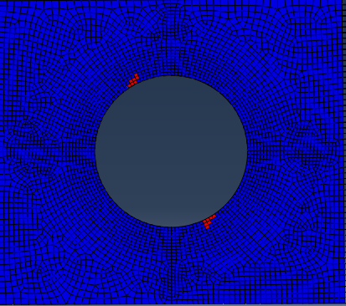
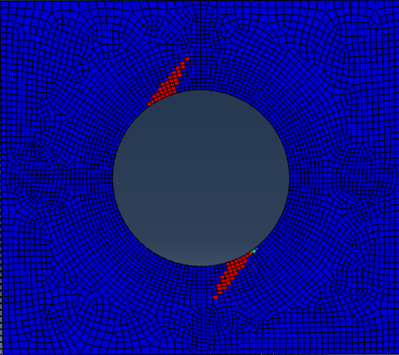
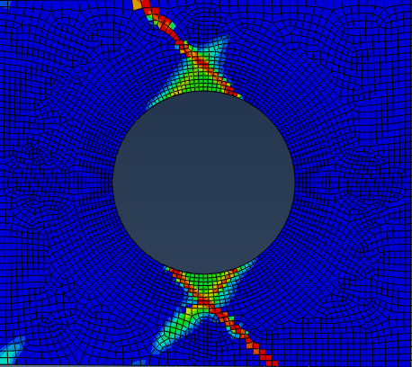
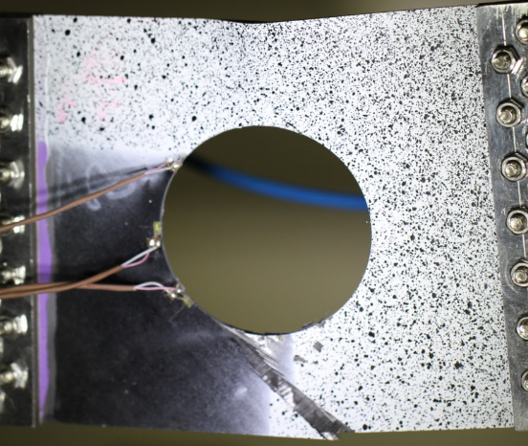
Results and Comparing
shear nonlinearity:
n = 2 n = 3
The position of the initial failure is the same and argrees well with the experiment.
experiment

Slide 7
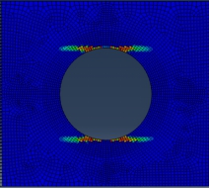
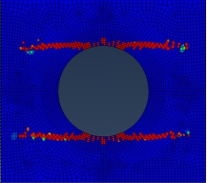
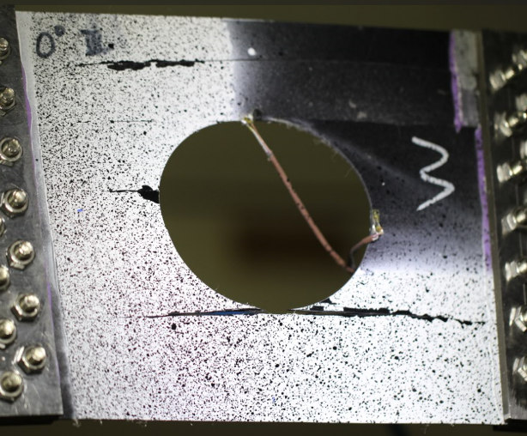


Improvement
Failure mode with different Fracture energe ：
Gm = 5 Gm = 0.5
Refer to other papers:
Laminate damage model for composite structures
A continuum damage model for composite laminates: Part II – Computational implementation and validation

