Slide 1
Progressive damage analysis of Composite laminates with big cutouts
Chu PengCheng
2018.01.10

Slide 2
Numerical Model
Hashin Criteria & Continumm Damage Model(CDM)
Degeneration Model(linear vs exponential)
Shear Nonlinearity
就地强度准测？？
Abaqus Simulation
Modeling Technique
UMAT subroutine
characteristic length
coefficient of viscosity
implicit dynamic
Results & Conclusions

Slide 3
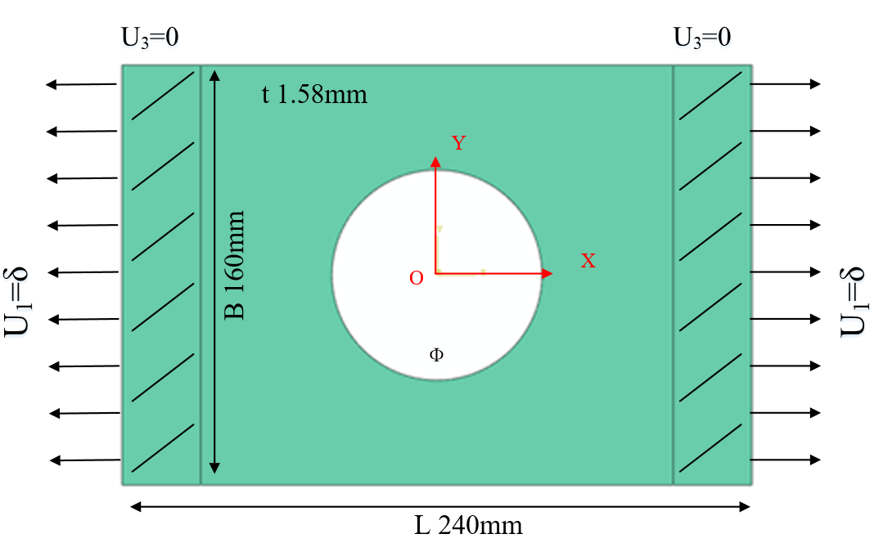
Problem：
FEM：Abaqus
Model: 3D Shell(SC8R)
Strength criterion：Hashin
Ф: 60mm, 80mm, 100mm
Layups: [0˚]₁₀, [0˚/90˚]₅, [±45˚]₅
Table 1 Material properties of a single lamina
ρ（kg/m³） | E₁(GPa) | E₂(GPa) | G₁₂(GPa) | υ₁₂
1520.7 | 127.70 | 9.67 | 6.50 | 0.30
Table 2 Strength parameters of a single lamina
Strength | X_{t} | X_{c} | Y_{t} | Y_{c} | S₁₂
(MPa) | 1518 | 764.3 | 36.0 | 160.3 | 60

Slide 4
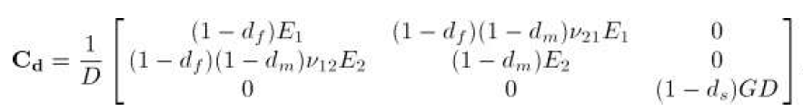

Numerical Model
Hashin criteria & Continuum Damage Model
Constitutive damage model:
To establish a constitutive law, it is possible to define a scalar function corresponding to the complementary free energy density in the material.The proposed definition for the ply complementary free energy density is:
The damage variables as a measure of the effective surface density of the microdefects.
The strain tensor is equal to the derivative of the complementary free energy density with respect to the stress tensor:
The lamina compliance tensor:
Inverse matrix is the stiffness tensor:
P. Maimí, P.P. Camanho, J.A. Mayugo, et al. A continuum damage model for composite laminates: Part I – Constitutive model[J]. Mechanics of Materials, 2007, 39:897–908.

Slide 5
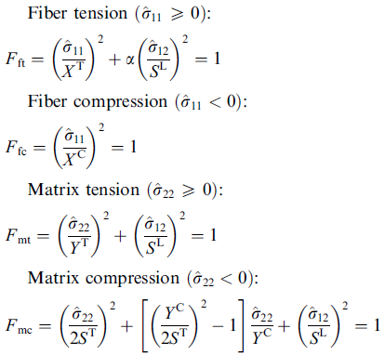
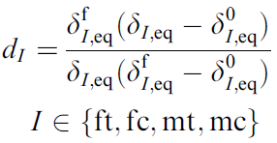


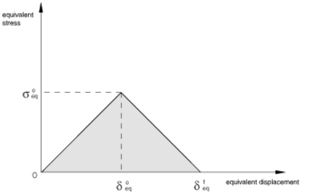
Numerical Model
Hashin criteria & Continuum Damage Model
Hashin criterion
The Continuum Damage Model:
Damage variable:
Lapczyk I, Hurtado J A. Progressive damage modeling in fiber-reinforced materials[J]. Composites Part A Applied Science & Manufacturing, 2007, 38(11):2333-2341.

Slide 6
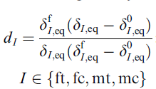


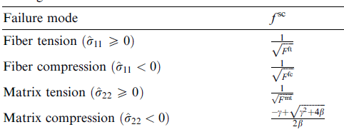
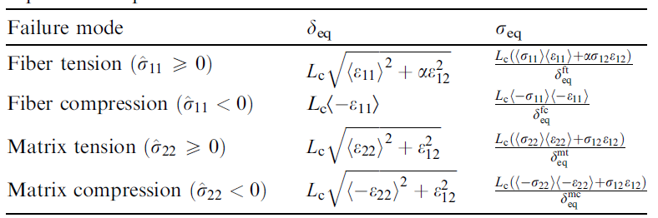
Numerical Model
Hashin criteria & Continuum Damage Model
Damage variables calculation：
damage variables:
Jaccobian matirx:

Slide 7
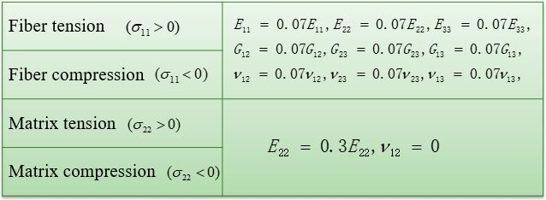
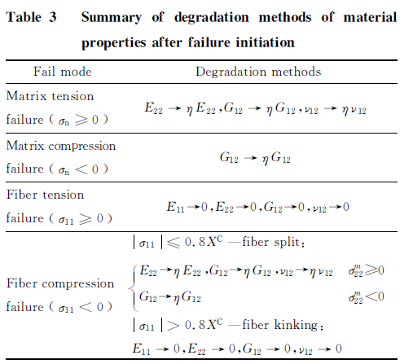
Numerical Model
Hashin criteria & Continuum Damage Model
Stiffness reduction model:
Ply-discount VS CDM model ：
折减法 | CDM法
通过乘以折减系数使刚度矩阵退化，是一种半经验法的探索模型 | 基于不可逆过程的热力学，将势能定义为损伤变量的函数，损伤变量定义了应力应变的关系，同时取决于能量耗散值
折减系数的不确定 | 所有使用参数均可测量得到
不能模拟层合板的准脆性失效 | 可以模拟材料的弹脆性行为（无显著的塑形变形）
Wang Danyong, Wen Weidong, Cui Haitao. Three-Dimensional progressive damage analysis of composite laminates containing a hole subjected to tensile loading. Chinese Journal of Theoretical and Applied Mechanics, 2005, 37(6):788-795.
Li B,Li Y Z,Yang F.Theoretical methodology for laminated composite strength including in-situ effect[J]. Acta Aeronautica et Astronautica Sinica, 2014, 35(11): 3025-3036

Slide 8


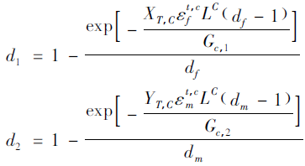
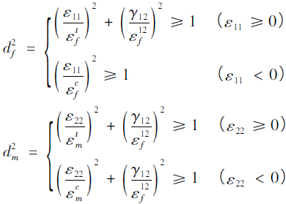
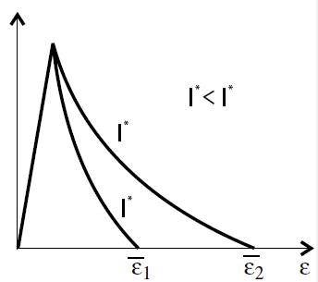
Numerical Model
Degeneration Model(linear vs exponential)
Linear degenaration:
Exponential degenaration:
Damage variable:
Damage variable:
Maimí P, Camanho P P, Mayugo J A, et al. A continuum damage model for composite laminates: Part II – Computational implementation and validation[J]. Mechanics of Materials, 2007, 39(10):909–919.
Lapczyk I, Hurtado J A. Progressive damage modeling in fiber-reinforced materials[J]. Composites Part A Applied Science & Manufacturing, 2007, 38(11):2333-2341.
Damage and Failure Study of Composite Laminates with
Reinforced Cutout Based on CDM
Wang Wenzhi，Wan Xiaopeng，Yao Liaojun

Slide 9
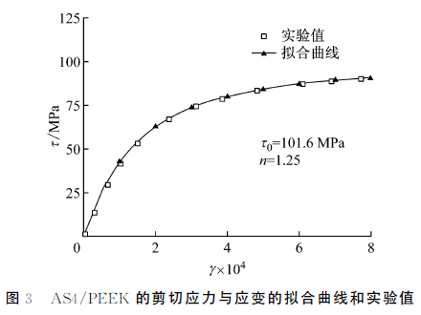
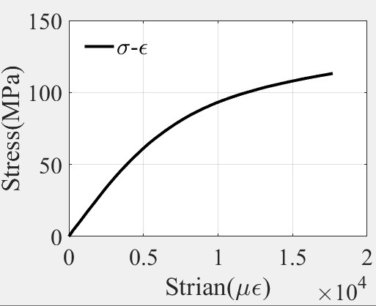


Numerical Model
Shear Nonlinearity
shear nonlinearity constitutive relations for the laminates were defined with the Ramberg-Osgood equation:
刘魏光, 余音, 汪海. 考虑剪切非线性的复合材料渐进损伤模型[J]. 上海交通大学学报, 2016, 50(2):194-199.

Slide 10
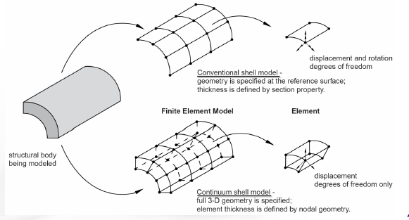
Abaqus Simulation
—Modeling Technique
Element choise:
conventional shell (where only the shell reference surface is discretized只有壳参考面被离散)
continuum shell (where a 3D volume is discretized but the kinematic behavior of the element is based on shell theory网格离散的是三维图形，但单元的动力学行为是基于壳理论计算的)(SC6R and SC8R)
solid element(C3D8R)
Continuum shell elements allow for:
• 同样适用于厚壳及薄壳
• 线性和非线性力学行为 (大变形及弹塑性材料的力学响应).
• 厚度渐变(单元为三维几何图形)
• 比常规壳更加精确的接触模型(考虑单元两边的接触及厚度变化)
• 堆叠。(在对复合材料层合板厚度方向上的模拟能得到更加精确的结果)

Slide 11
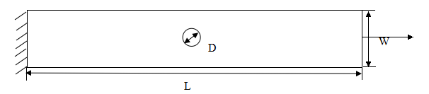
Abaqus Simulation
—Modeling Technique
Modeling method：
在厚度方向上建立一层单元vs建立与层合板相同层数的单元
solid element （C3D8R）vs continuum shell element（SC8R）
不同建模方式的对比：meshpart vs composite layup
左图为 铺层的层合板尺寸图，长度L为203mm，宽度W为25.4mm，孔的直径D为6.35mm，单层层合板的厚度h为0.13mm。
 | 单元划分方法 | ply1初始失效位移（mm） | ply2初始失效位移（mm） | ply11初始失效位移（mm） | ply12初始失效位移（mm） | 拉伸极限载荷（N）
solid element (C3D8R) | 1层单元 | 0.75 | 0.57 | 0.75 | 0.57 | 29456.2
 | 24层单元 | 0.75 | 0.57 | 0.75 | 0.57 | 29516.4
 | meshpart | 0.74 | 0.5 | 0.68 | 0.5 | 26229.9
continum shell (SC8R) | 1层单元 | 0.75 | 0.57 | 0.75 | 0.57 | 30501.7
 | 24层单元 | 0.75 | 0.57 | 0.75 | 0.57 | 30140.8
 | meshpart | 0.74 | 0.56 | 0.68 | 0.5 | 26964.5
Test ultimate loading：
28394.6N
Considering the efficiency and accuracy, we use SC8R and composite layup to build the model in Abaqus,and mesh one element in the thickness direction.

Slide 12
Abaqus Simulation
—UMAT subroutine
after each increment
UMAT Overview：
1 can be used to define the mechanical constitutive behavior of a material;
2 will be called at all material calculation points of elements for which the material definition includes a user-defined material behavior;
3 must update the stresses and solution-dependent state variables to their values at the end of the increment for which it is called;
4 Jocobian Matrix of the material must be supplied by users：
UMAT Flowchart
calculate strain and undamaged stiffness matrix
calculate damage variable d and
calculate stress
damaged
calculate damaged stiffness matrix C_{d}
checkout failure ( Hashin
criterion)
undamaged
calculate stress and Jacobian matrix ;update damage variable d
quit UMAT,back to main program

Slide 13
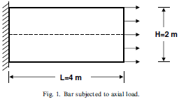

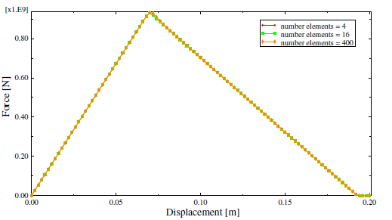
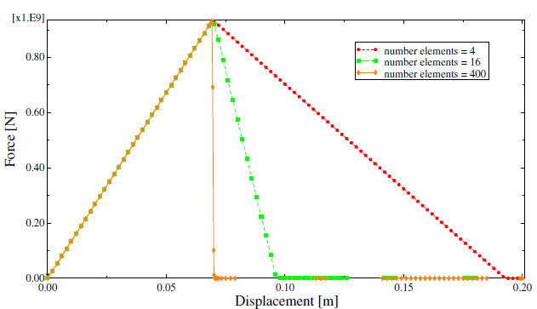
Abaqus Simulation
—characteristic length
Mesh Dependency：
When the material exhibits strain-softening behavior, leading to strain localization, this formulation results in a strong mesh dependency of the finite element results in that the energy dissipated decreases upon mesh refinement.The energy dissipated is proportional to the volume of the failed element.
To correct this behavior we use the crack band model,In this model the strength limit is not kept constant but is adjusted in such a way that the fracture energy is preserved
Different methods have been suggested for computing the characteristic length.In the current model, we assume that the characteristic length at a material point is equal to the square root of the area associated with it.
Lapczyk I, Hurtado J A. Progressive damage modeling in fiber-reinforced materials[J]. Composites Part A Applied Science & Manufacturing, 2007, 38(11):2333-2341.
Notes:
为了说明这个问题，我们考虑一个施加了单向拉伸的棒，此棒由线弹性材料组成，直到应力达到峰值，并且在此后的构型中线性软化。更进一步，我们假设在垂直于轴线方向有一条很窄的材料带，这个地方的强度比材料其他地方要稍低一些。从有限元的力-位移响应解显示出有很强的网格依赖性。清晰的显示出随着单元尺寸的减小，断裂所做的外部功不断减少。应变局部化被限制与一个单元厚度的一层上。能量耗散和失效单元的体积成正比，而不是断裂表面的面积，随着网格划分的细密，能量耗散趋于0.
为了纠正这个行为，我们使用裂纹带模型，在这个模型中，断裂被做成一个平行的密集分布的微裂纹带（一个弄脏的裂纹带）在这个模型中，强度极限应变ef并不是固定的而是按照公式来调整，使得总的断裂能保持不变bao。(公式略)
Lc为单元的特征长度，Gc是断裂能，这是一个材料性能，必须要被确定，Lc可以有不同的方法来计算

Slide 14




Abaqus Simulation
—coefficient of viscosity
To improve convergence, a technique based on viscous regularization (a generalization of the DuvautLions
regularization) of the damage variables is implemented in the user subroutine. In this technique we do not use the damage variables calculated from the aforementioned damage evolution equations directly; instead, the damage variables are “regularized” via the following equations:
the above equations are discretized in follows:
From the above expressions it can be seen that:
Therefore, the Jacobian matrix can be further formulated as follows:
Care must be exercised to choose an appropriate value for since a large value of viscosity might cause a noticeable delay in the degradation of the stiffness.
Abaqus Example Problem Manual:Failure of blunt notched fiber metal laminates

Slide 15
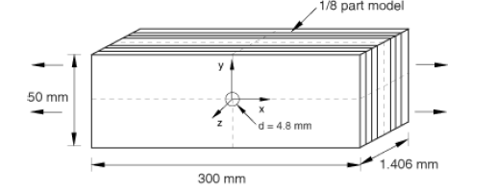
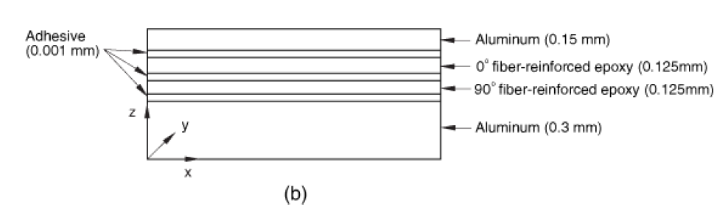
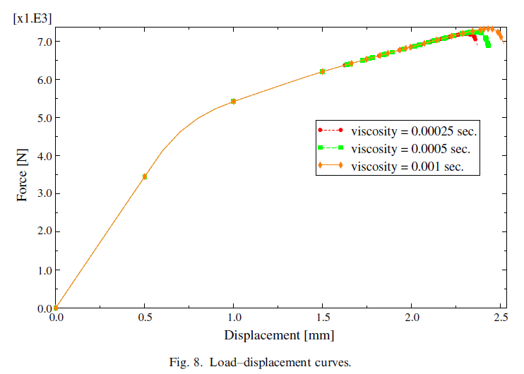
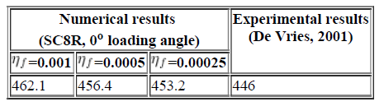
Abaqus Simulation
—coefficient of viscosity
Numerical example
Net blunt notch strength (MPa) for different values of the viscosity parameter in fiber direction(using built-in
fiber reinforced material damage model, viscosity in the matrix direction =0.005).
Lapczyk I, Hurtado J A. Progressive damage modeling in fiber-reinforced materials[J]. Composites Part A Applied Science & Manufacturing, 2007, 38(11):2333-2341.

Slide 16
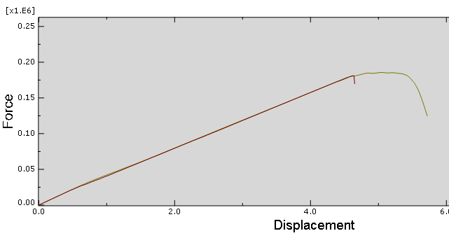
Abaqus Simulation—implicit dynamic
The use of an implicit dynamic finite element model enables the prediction of the load drop that occurs when the specimens fail catastrophically.
Prediction of size effects in notched laminates using continuum damage mechanics，P.P. Camanho a,*, P. Maimı´ b, C.G. Da´vila ,Composites Science and Technology 67 (2007) 2715–2727
此处分析步的time period设为60，时间长度越大，越接近脆性。
将密度设为小值，保持不受惯性力的影响
implicit dynamic analysis VS static analysis

Slide 17
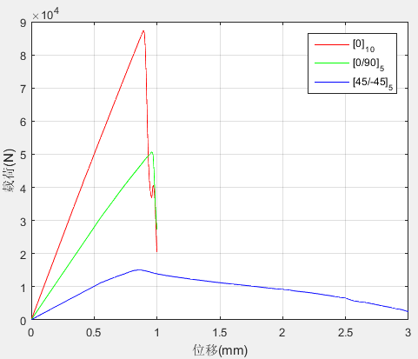
Results：
The ultimate strength:
Ultimate load （kN） Layer | Exp. | Linear degenaration
 |  | Simulation | Error
[0]₁₀ | 69.73 | 86.98 | 24.73%
[0/90]₅ | 47.20 | 45.37 | 3.88%
[±45]₅ | 23.79 | 14.31 | 39.85%
Exponential degenaration
Simulation | Error
87.32 | 25.23%
50.67 | 7.35%
15.04 | 36.78%
Linear degenaration
Exponential degenaration
Experiment

Slide 18
Shear Nonlinearity：
shear nonlinearity constitutive relations for the laminates were defined with the Ramberg-Osgood equation:
刘魏光, 余音, 汪海. 考虑剪切非线性的复合材料渐进损伤模型[J]. 上海交通大学学报, 2016, 50(2):194-199.

Slide 19
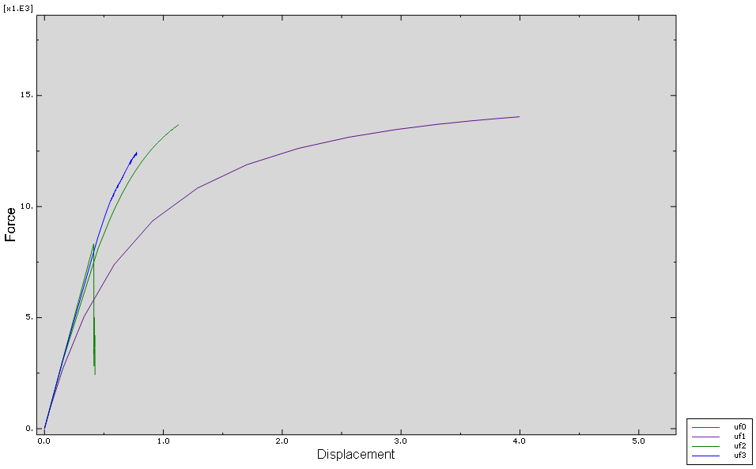
Results and Comparing
linear
Exponential degenaration
Displacement-Force curve of the [45/-45] ₅ with different shape parameters.
Experiment

Slide 20
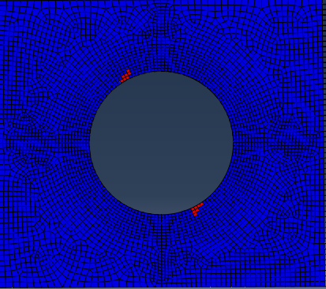
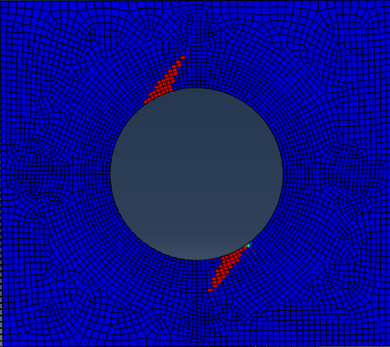
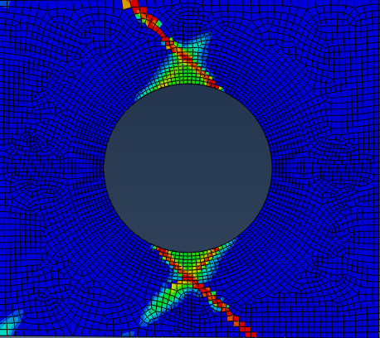
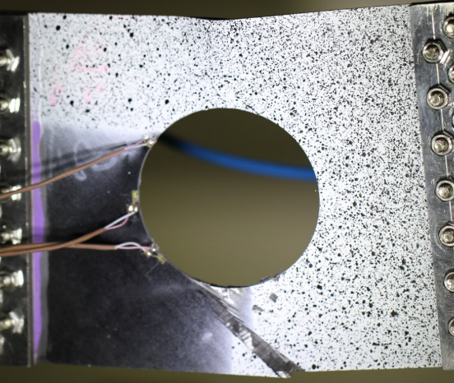
Results and Comparing
shear nonlinearity:
n = 2 n = 3
The position of the initial failure is the same and argrees well with the experiment.
experiment

Slide 21
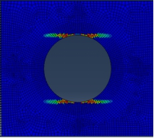
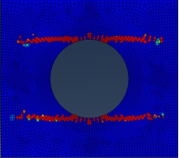
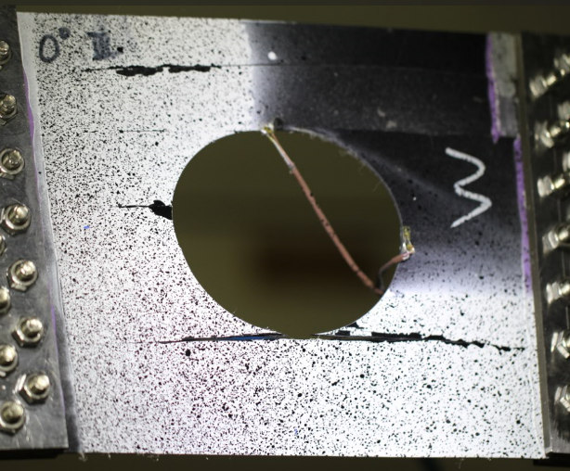


Improvement
Failure mode with different Fracture energe ：
Gm = 5 Gm = 0.5
Refer to other papers:
Laminate damage model for composite structures
A continuum damage model for composite laminates: Part II – Computational implementation and validation

Slide 22
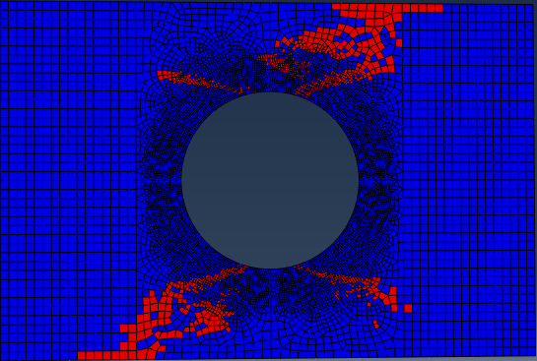
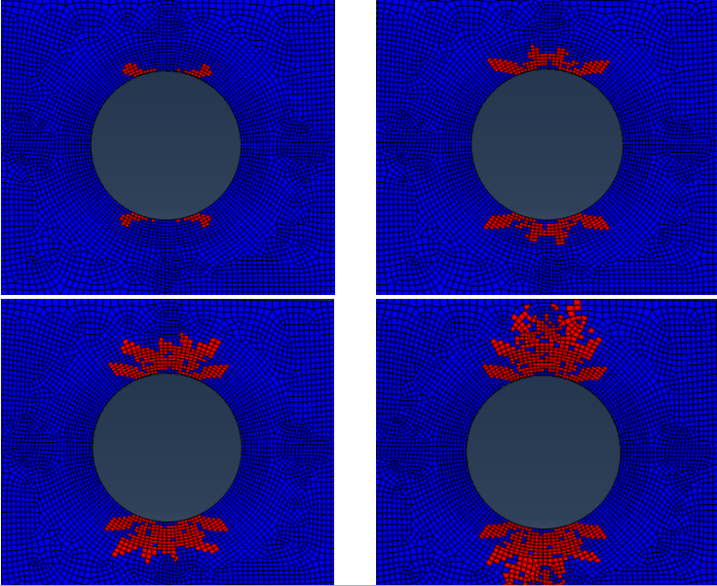
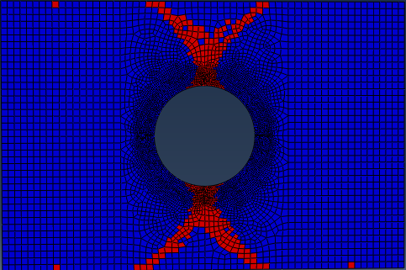
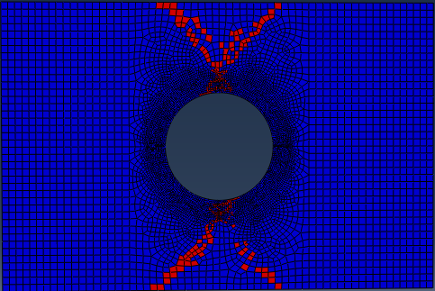
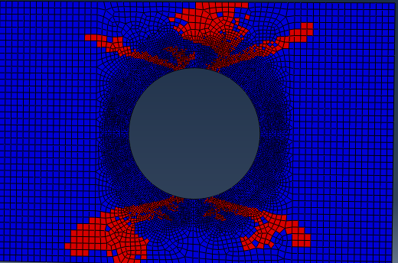
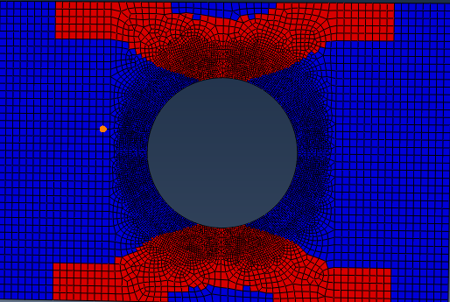
Compare with Ply-Discount method：
Comparing of Ultimate loads Layer | Size of cutout (Ф)
 | 60mm |  |  | 80mm |  |  | 100mm
 | Simul. | Exp. | Relative error | Simul. | Exp. | Relative error | Simul. | Exp. | Relative error
[0]₁₀ | 97.69 | 78.23 | -19.9% | 76.11 | 69.73 | -8.4% | 52.82 | 35.00 | -34%
[0/90]₅ | 56.91 | 59.32 | 4.0% | 45.89 | 47.20 | 2.8% | 32.99 | 37.54 | 12.1%
[±45]₅ | 22.46 | 28.72 | 21.8% | 17.89 | 23.79 | 24.8% | 13.42 | 17.60 | 23.8%
图3.4 [0]10铺层Ф80mm开口层合板纤维失效模式
图3.6 [±45]5铺层Ф60mm开口层合板失效模式
Simulation
Experiment
图3.5 [0/90]5铺层Ф80mm开口层合板失效模式

Slide 23
Future work：
cohesive element
Cohesive behavior is useful in modeling adhesives, bonded interfaces, and gaskets.(粘合剂、连接面、垫片)
• Models separation between two initially bonded surfaces
• Progressive failure of adhesives
• Delamination in composites
Cohesive elements in Abaqus primarily address two classes of problems:
• Adhesive joints
Adhesive layer with finite thickness
Typically the bulk material properties are known
• Delamination
Adhesive layer of “zero” thickness
Typically the bulk material properties are not known

