Slide 1
Progressive damage analysis of Composite laminates with big cutouts
Chu PengCheng
2018.01.10

Slide 2
Overview：
Numerical Model
Hashin Criteria & Continumm Damage Model(CDM)
Ply-discount Method VS CDM
Degeneration Model(linear vs exponential)
Shear Nonlinearity
in-situ strength effect
Abaqus Simulation
Modeling Technique
UMAT subroutine
characteristic length
coefficient of viscosity
implicit dynamic

Slide 3
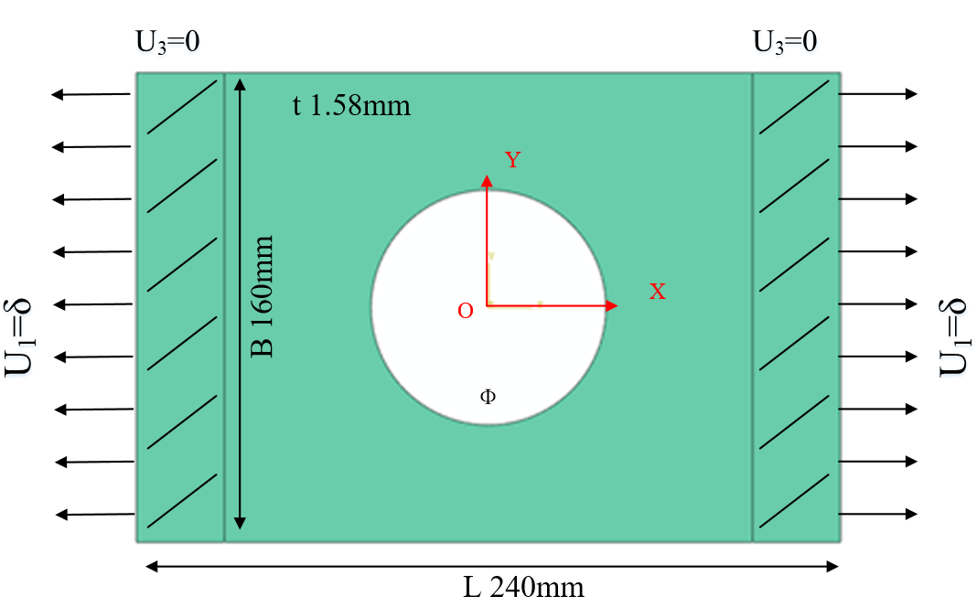
Problem：
FEM：Abaqus
Model: 3D Shell(SC8R)
Strength criterion：Hashin
Ф: 60mm, 80mm, 100mm
Layups: [0˚]₁₀, [0˚/90˚]₅, [±45˚]₅
Table 1 Material properties of a single lamina
ρ（kg/m³） | E₁(GPa) | E₂(GPa) | G₁₂(GPa) | υ₁₂
1520.7 | 127.70 | 9.67 | 6.50 | 0.30
Table 2 Strength parameters of a single lamina
Strength | X_{t} | X_{c} | Y_{t} | Y_{c} | S₁₂
(MPa) | 1518 | 764.3 | 36.0 | 160.3 | 60

Slide 4
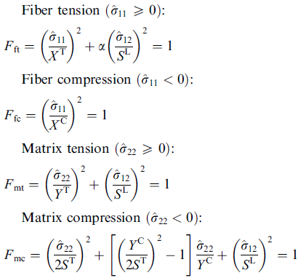
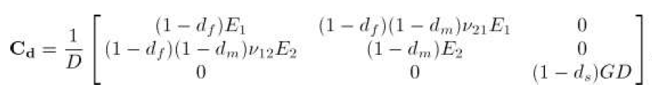
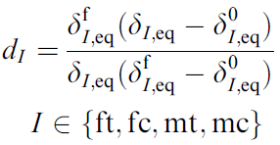


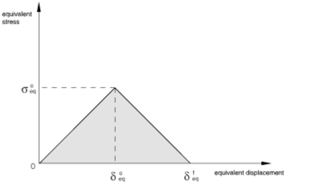
Numerical Model
Hashin criteria & Continuum Damage Model
Hashin criterion
The Continuum Damage Model:
Damage constitutive matrix:
Damage variable:
Lapczyk I, Hurtado J A. Progressive damage modeling in fiber-reinforced materials[J]. Composites Part A Applied Science & Manufacturing, 2007, 38(11):2333-2341.

Slide 5


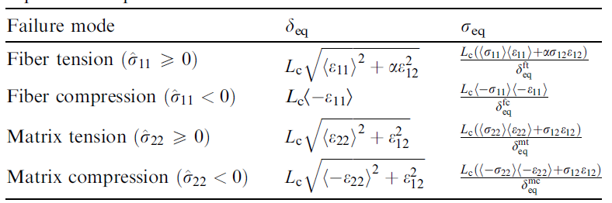
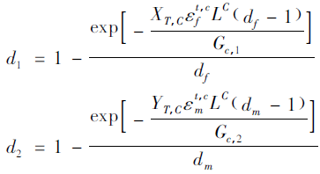
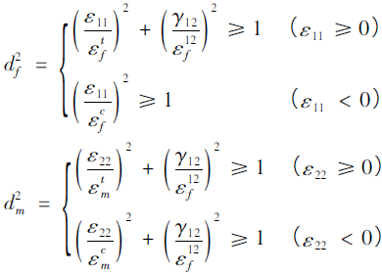
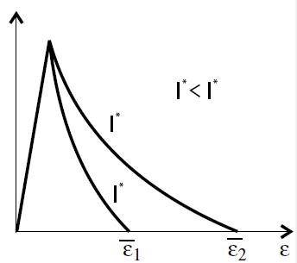
Numerical Model
Degeneration Model(linear vs exponential)
Linear degenaration:
Exponential degenaration:
Damage variable:
Damage variable:
Maimí P, Camanho P P, Mayugo J A, et al. A continuum damage model for composite laminates: Part II – Computational implementation and validation[J]. Mechanics of Materials, 2007, 39(10):909–919.
Lapczyk I, Hurtado J A. Progressive damage modeling in fiber-reinforced materials[J]. Composites Part A Applied Science & Manufacturing, 2007, 38(11):2333-2341.
Damage and Failure Study of Composite Laminates with
Reinforced Cutout Based on CDM
Wang Wenzhi，Wan Xiaopeng，Yao Liaojun

Slide 6
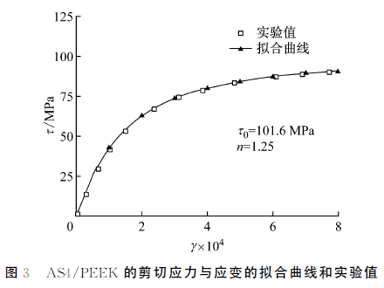
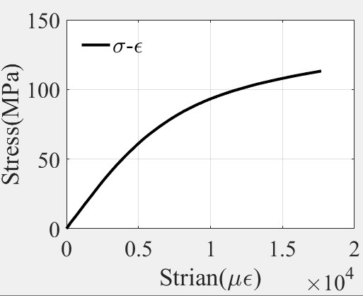


Numerical Model
——Shear Nonlinearity
shear nonlinearity constitutive relations for the laminates were defined with the Ramberg-Osgood equation:
刘魏光, 余音, 汪海. 考虑剪切非线性的复合材料渐进损伤模型[J]. 上海交通大学学报, 2016, 50(2):194-199.

Slide 7
Numerical Model
——in-situ effect
在传统强度理论研究中，通常将单向板试验获得的拉伸、压缩和剪切强度值作为材料的固有属性并用于建立强度准则，进而预测多向层合板的强度。然而通过一系列试验研究发现，对于铺层方向和厚度都相同的子层，它在多向层合板内和在单向板内时表现出的基体强度（包括横向拉伸和剪切强度）不同，在层合板内表现的强度明显高于在单向板内，许多文献将层合板的这种现象称为就地效应（in-situ effect）。
李彪，李亚智，杨帆．考虑复合材料层合板就地效应的强度理论[J]．航空学报，2014，35(11)：3025-3036
By examining the results presented previously,5±7 we take the in-situ tensile transverse and shear strengths to be 1.5 times those measured from unidirectional laminates for all the laminates discussed.
Sun C T, Tao J. Prediction of failure envelopes and stress/strain behaviour of composite laminates 1[J]. Composites Science & Technology, 1998, 58(7):1125-1136.
为单层板的固有横向拉伸强度与固有面内剪切强度， 为单层板在层合板中相应的就低强度，ABCD为材料相关的常数，N为层合板中同一方向并相邻的单层板的层数。 是本单层的纤维铺设角度与其相邻的两个单层板纤维铺设角度之差。
Wang J, Karihaloo B L. Optimum In Situ Strength Design of Composite Laminates. Part I: In Situ Strength Parameters[J]. Journal of Composite Materials, 1996, 30(12):1314-1337.

Slide 8
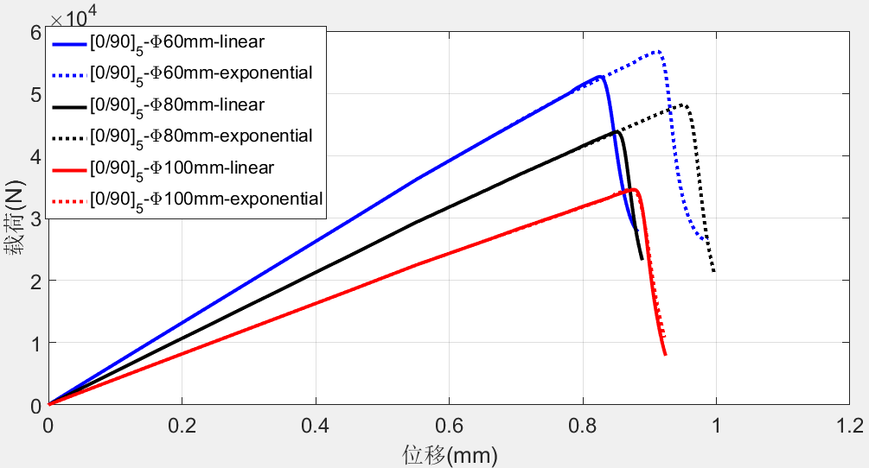
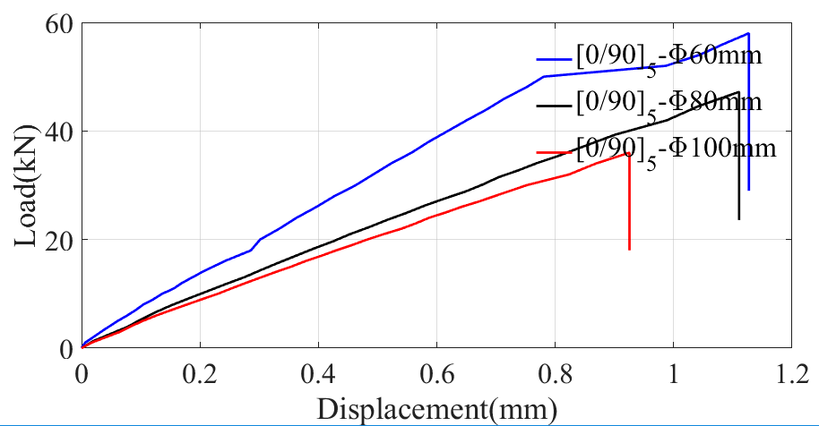
Results：
[0/90]₅
Ultimate loading：
Simulation
Experiment
[0/90]₅ | 60 |  |  | 80 |  |  | 100
 | Simul. | Exp. | Relative error | Simul. | Exp. | Relative error | Simul. | Exp. | Relative error
Linear | 52.67 | 59.32 | 11.2% | 43.83 | 47.20 | 7.1% | 34.56 | 37.54 | 7.9%
Exponential | 56.72 |  | 4.4% | 48.17 |  | 2.1% | 34.59 |  | 7.9%
1、从试验以及模拟的结果来看，裂纹的扩展和孔径大小无关，孔径越小，极限载荷越大
2、计算结果可以表现出[0/90]₅板的脆性断裂，
3、linear或是exponential模型对损伤演化的影响不太大，exponential比linear计算极限载荷的误差更小

Slide 9
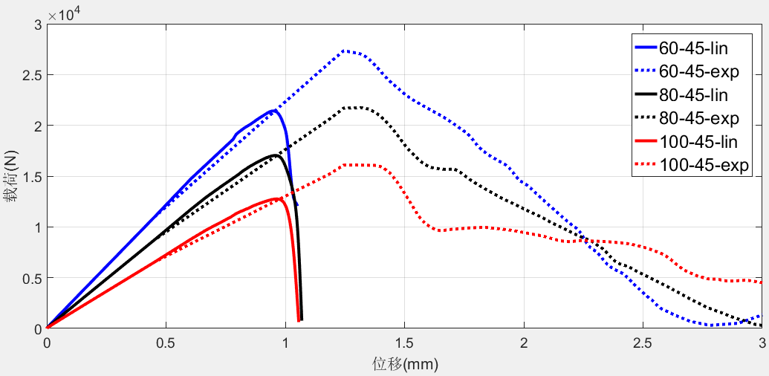
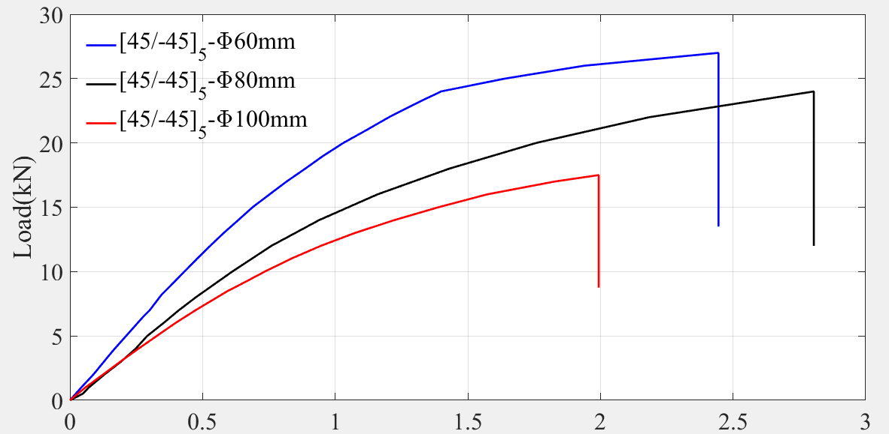
[±45]₅
Results：
Ultimate loading：
Simulation
Experiment
孔径 | 60 |  |  | 80 |  |  | 100
[±45]5 | Simul. | Exp. | Relative error | Simul. | Exp. | Relative error | Simul. | Exp. | Relative error
Linear | 21.41 | 28.72 | 25.5% | 17.03 | 23.79 | 28.4% | 12.75 | 17.60 | 27.6%
Exponential | 27.34 |  | 4.8% | 21.73 |  | 8.7% | 16.09 |  | 8.6%
1、从试验以及模拟的结果来看，裂纹的扩展和孔径大小无关，孔径越小，极限载荷越大
2、linear或是exponential模型对损伤演化的影响不太大，极限载荷：exponential比linear误差更小
4、位移载荷曲线的形状和实验相差大

Slide 10
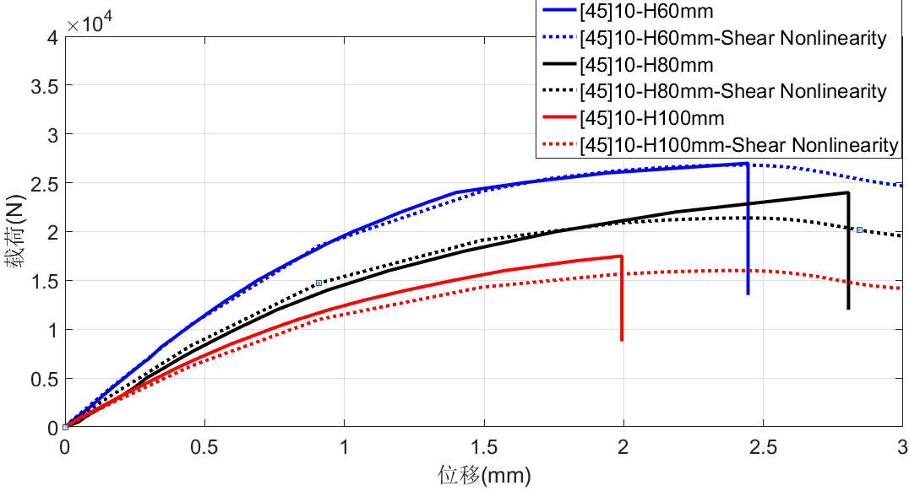
[±45]₅
Results：
Shear Nonlinearity:
shear nonlinearity constitutive relations for the laminates were defined with the Ramberg-Osgood equation:
n is a parameter define the shape of the nonlinear stress-strain relationship.
Problem:The load of the curve doesn't drop in the simulation result.
孔径 | 60 |  |  | 80 |  |  | 100
[±45]5 | Simul. | Exp. | Relative error | Simul. | Exp. | Relative error | Simul. | Exp. | Relative error
No shear nonlinearity | 27.34 | 28.72 | 4.8% | 21.73 | 23.79 | 8.7% | 16.09 | 17.60 | 8.6%
Shear nonlinearity | 26.81 |  | 6.7% | 21.39 |  | 10.1% | 16.01 |  | 9.0%

Slide 11
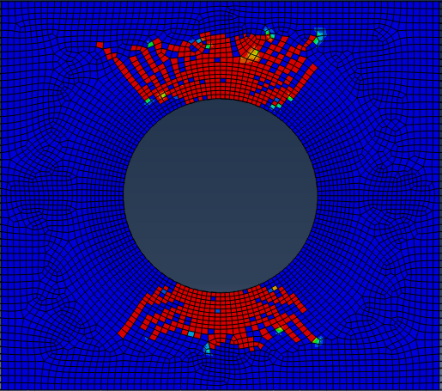
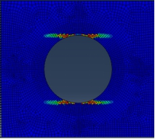
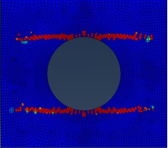
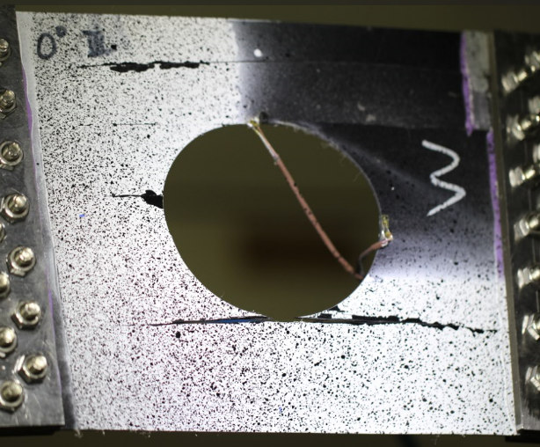
Results：in-situ effect
let A、B、C、D=1,we can obtain:
材料参数 铺层 | 纤维拉伸强度Xt | 剪切强度Sxy | 基体拉伸强度Yt | 基体断裂能Gm
[0]₁₀ | 970 | 63 | 36 | 0.5
[0/90]₅ | 1455 | 95 | 54 | 2.5
[±45]₅ | 1455 | 95 | 54 | 2.5
[0]₁₀
Sxy = 95;Gm = 5
Sxy=63;Gm = 5
Sxy=63;Gm = 0.5

Slide 12
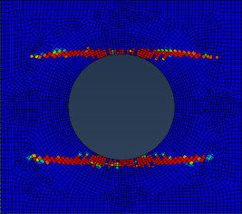
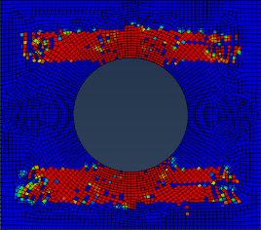
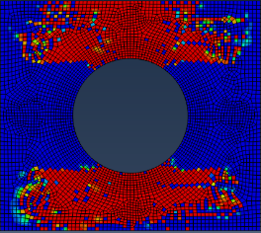
Conclusions：
1、The simulation using the continuum damage model exhibit the brittle failure of the composite laminates as the experiment shows, it also preforms well for predicting the failure evolution behavior of composite laminates with big cutouts;
2、The exponential degeneration law performs better than linear degeneration law fro pridecting the ultimate strength in this simultion.
3、The shear nonlinearity must be considered for the [±45]₅ layup laminates to obtain the displacement-force curve.
4、The in-situ effect should be considered,the strength should be calculated respectively for each layup of the laminates.
Problem：
1、The failure evolution of the [0]₁₀ layup laminate doesn’t correlate well with the experiment
2、The load of the curve doesn't drop in the simulation result after using the shear nonlinearity.
Future work：
1、paper and thesis
2、calculate the T700 laminates including the quasi-isotropic layup
2、bulking and failure(optimize and design for composite laminates)，cohesive element

