Slide 1
Continumm damage model
Degeneration Model(linear vs exponential)
Shear Nonlinearity
Abaqus simulation
Characteristic Length
coefficient of viscosity
implicit dynamic
Results

Slide 2
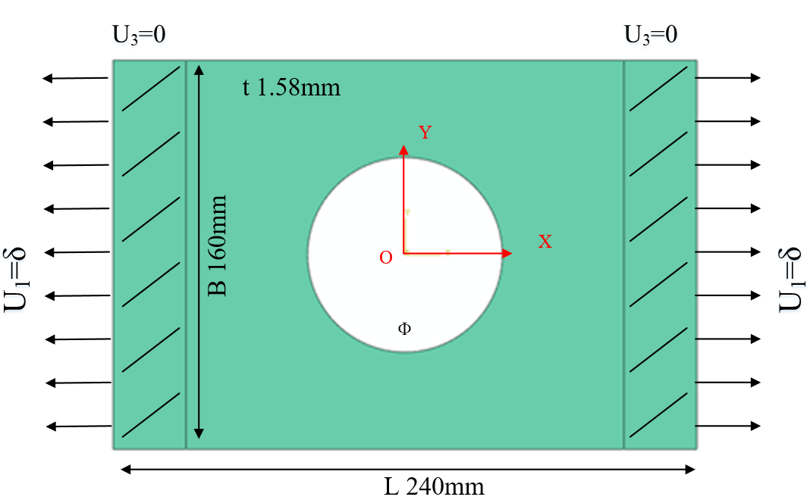
Simulation Model
FEM：Abaqus
Model: 3D Shell(SC8R)
Strength criterion：Hashin
Ф: 60mm, 80mm, 100mm
Layups: [0˚]₁₀, [0˚/90˚]₅, [±45˚]₅
Table 1 Material properties of a single lamina
ρ（kg/m³） | E₁(GPa) | E₂(GPa) | G₁₂(GPa) | υ₁₂
1520.7 | 127.70 | 9.67 | 6.50 | 0.30
Table 2 Strength parameters of a single lamina
Strength | X_{t} | X_{c} | Y_{t} | Y_{c} | S₁₂
(MPa) | 1518 | 764.3 | 36.0 | 160.3 | 60

Slide 3

UMAT subroutine：
after each increment
UMAT subroutine
calculate strain and undamaged stiffness matrix
calculate damage variable d and
calculate stress
damaged
calculate damaged stiffness matrix
checkout failure ( Hashin
criterion)
undamaged
calculate stress and Jacobian matrix; update damage variable d
quit UMAT,back to main program

Slide 4
Abaqus Simulation—Characteristic Length

Slide 5
Abaqus Simulation—coefficient of viscosity

Slide 6
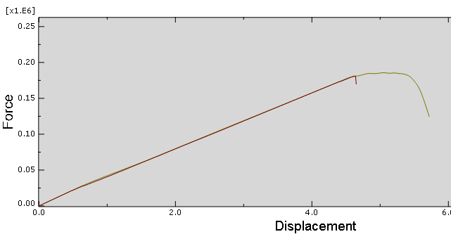
Abaqus Simulation—implicit dynamic
The use of an implicit dynamic finite element model enables the prediction of the load drop that occurs when the specimens fail catastrophically.
Prediction of size effects in notched laminates using continuum damage mechanics，P.P. Camanho a,*, P. Maimı´ b, C.G. Da´vila ,Composites Science and Technology 67 (2007) 2715–2727
此处分析步的time period设为60，时间长度越大，越接近脆性。
将密度设为小值，保持不受惯性力的影响
implicit dynamic analysis VS static analysis

Slide 7
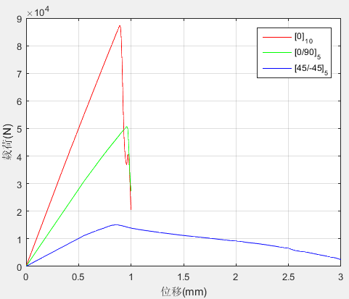
Former Results：
The ultimate strength:
Ultimate load （kN） Layer | Exp. | Linear degenaration
 |  | Simulation | Error
[0]₁₀ | 69.73 | 86.98 | 24.73%
[0/90]₅ | 47.20 | 45.37 | 3.88%
[±45]₅ | 23.79 | 14.31 | 39.85%
Exponential degenaration
Simulation | Error
87.32 | 25.23%
50.67 | 7.35%
15.04 | 36.78%
Linear degenaration
Exponential degenaration
Experiment

Slide 8
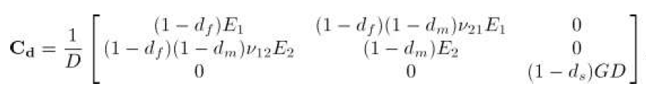
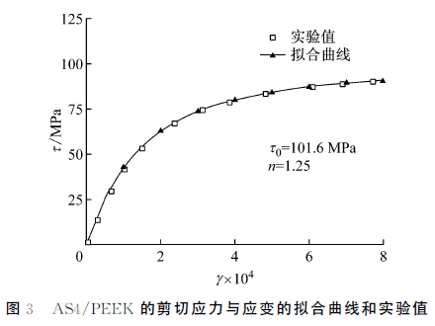
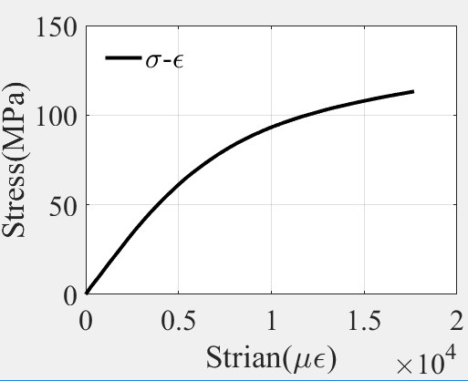

Shear Nonlinearity：
shear nonlinearity constitutive relations for the laminates were defined with the Ramberg-Osgood equation:
刘魏光, 余音, 汪海. 考虑剪切非线性的复合材料渐进损伤模型[J]. 上海交通大学学报, 2016, 50(2):194-199.

Slide 9
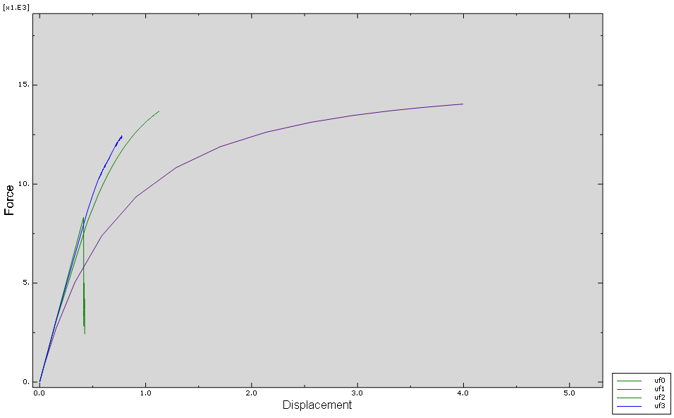
Results and Comparing
linear
Exponential degenaration
Displacement-Force curve of the [45/-45] ₅ with different shape parameters.
Experiment

Slide 10
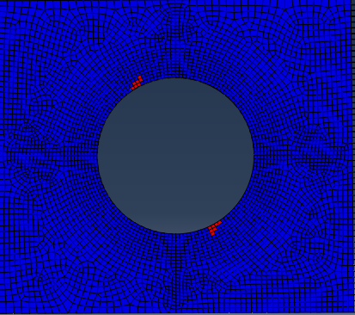
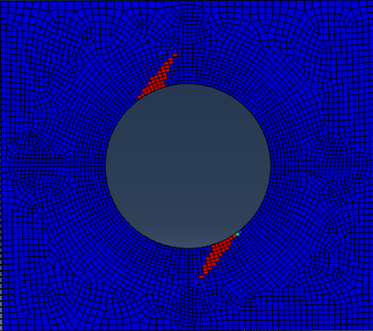
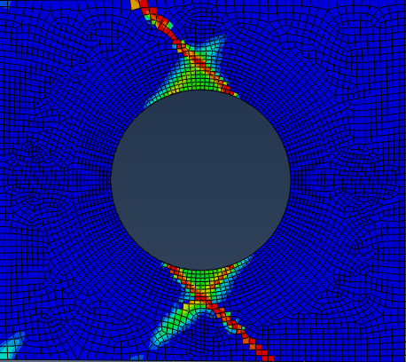
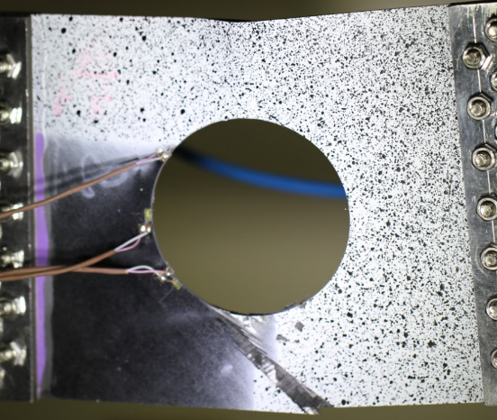
Results and Comparing
shear nonlinearity:
n = 2 n = 3
The position of the initial failure is the same and argrees well with the experiment.
experiment

Slide 11
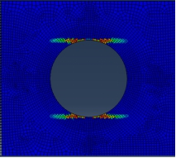
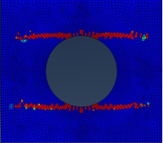
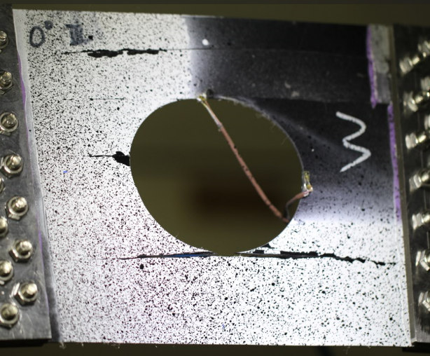


Improvement
Failure mode with different Fracture energe ：
Gm = 5 Gm = 0.5
Refer to other papers:
Laminate damage model for composite structures
A continuum damage model for composite laminates: Part II – Computational implementation and validation

