Slide 1
复合材料层合板的失效模拟相关文献
储鹏程

Slide 2
WWFE(World-Wide Failure Exercises)
Background
• None of the current predictive failure theories were considered to be credible for use in practical engineering applications.
Hinton 、soden和Kaddour 在英国的工程与自然科学研究委员会和机械工程师协会支持下于1991 年开始组织.
Objective
• Establish a benchmark(Closing the gap between the academic world and the design world)
Method
• Identify the leading failure theories for FRP laminates
• Test the general applicability of the theories across a range of problems
• Compare the theories against each other
• Compare the theories against experimental evidence
• Draw conclusions and recommend way forward

Slide 3
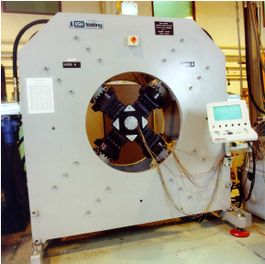
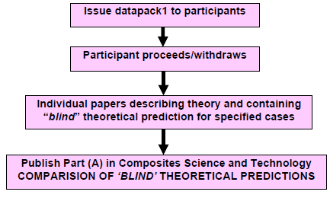
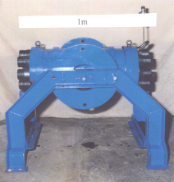
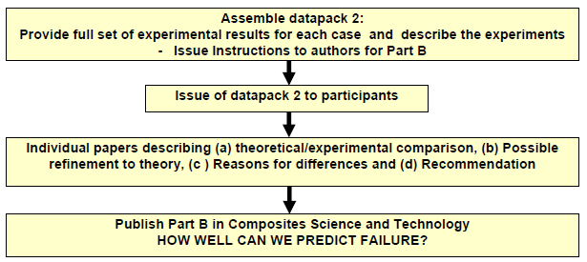
WWFE
Prof Mike Hinton,NAFEMS World Congress, Boston, 23rd-26th May 2011
Procedure
Cruciform Biaxial Test Rig
Cylindrical Biaxial Test Rig

Slide 4
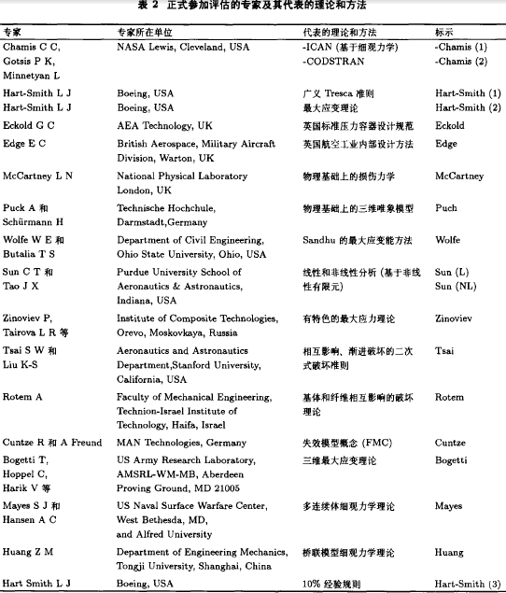
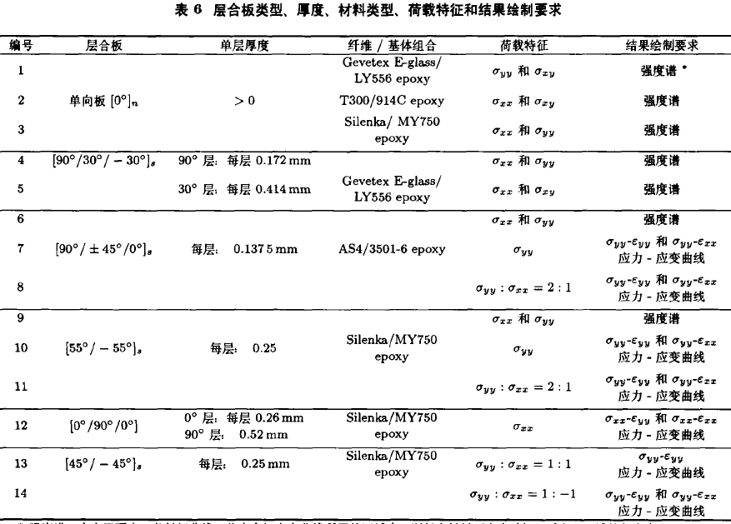
WWFE
19 theories +14 test problem
黄争鸣,张华山.纤维增强复合材料强度理论的研究现状与发展趋势—“破坏分析奥运会” 评估综述,力学进展
A

Slide 5
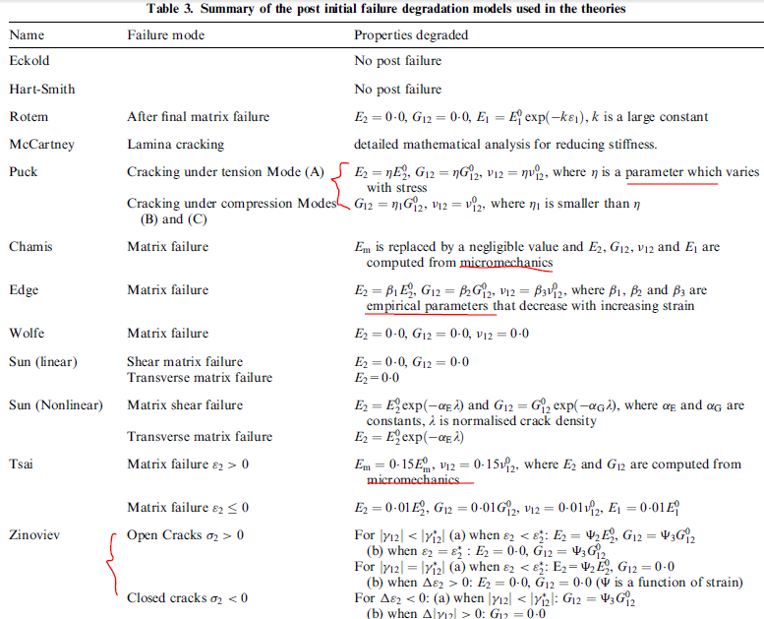
WWFE
P. D. Soden,a* M. J. Hintonb & A. S. Kaddoura，A COMPARISON OF THE PREDICTIVE CAPABILITIES OF CURRENT FAILURE THEORIES FOR COMPOSITE LAMINATES.Composites Science and Technology 58 (1998) 1225±1254

Slide 6
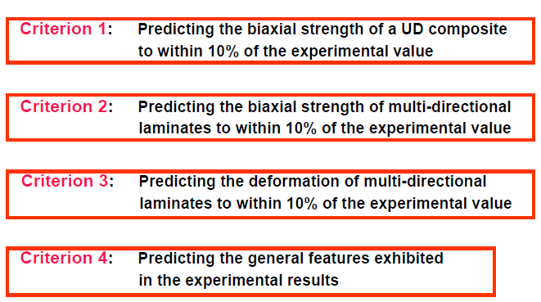
WWFE
Criteria used for ranking the WWFE theories
Prof Mike Hinton,NAFEMS World Congress, Boston, 23rd-26th May 2011

Slide 7

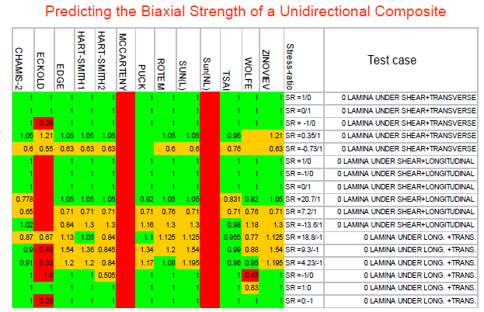
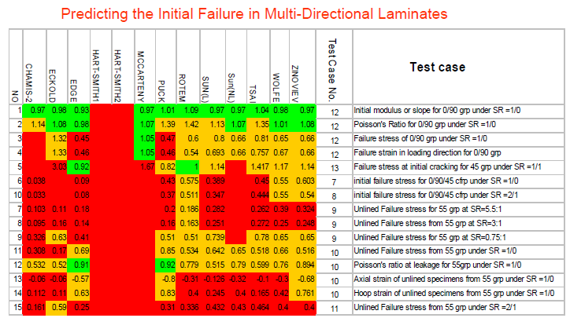
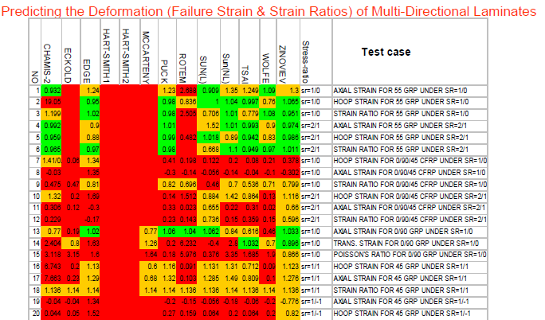
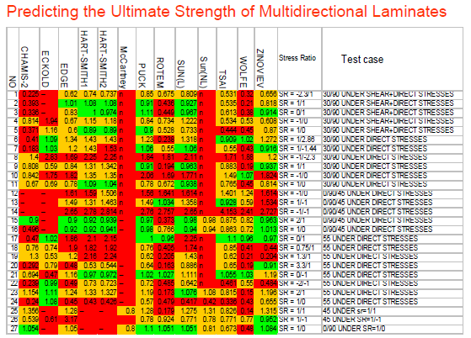
WWFE
Prof Mike Hinton,NAFEMS World Congress, Boston, 23rd-26th May 2011
Ranking Criteria

Slide 8
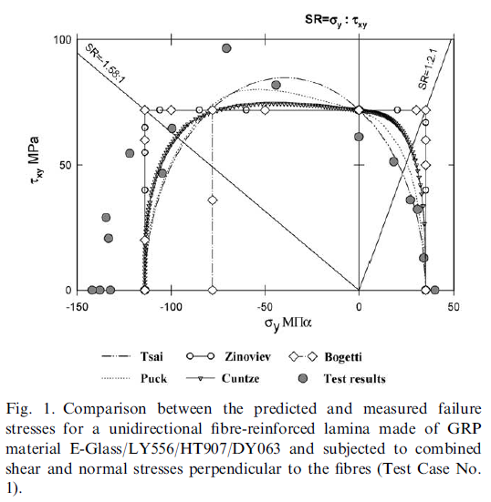
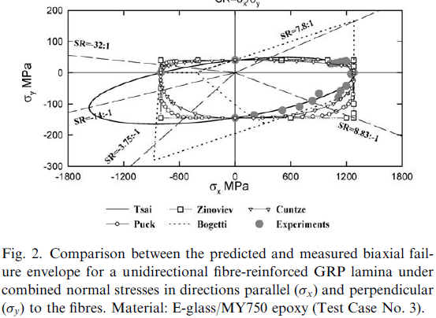
WWFE
Recommendations
The five approaches ranked most highly by the quantitative assessment procedure described above are the theories of Zinoviev, Bogetti, Puck, Cuntze and Tsai.
1. Predicting the response of a lamina
it is recommended that the theories of Puck (or Cuntze) and Tsai are used together for predicting the strength of unidirectional laminae under combined loading.
P.D. Sodena,*, A.S. Kaddourb,1, M.J. Hinton,Recommendations for designers and researchers resulting from the world-wide failure exercise.Composites Science and Technology64 (2004) 589–604

Slide 9
WWFE
Recommendations
2. Predicting initial strength of multidirectional
We shall refrain from making firm recommendations for designers in this case—there simply isn’t sufficient, definitive, information from the WWFE on this matter.
3. Predicting final strength of multidirectional
We recommend Puck and Cuntze’s theories for predicting final failure strength of composite laminates, although Zinoviev had much to offer.
4. Predicting the deformation of laminates
We recommend Zinoviev’s approach for predicting final deformations but it should be used in conjunction with one of the non-linear approaches, e.g. Puck when a better description is required of non-linear behaviour at moderate strains.
P.D. Sodena,*, A.S. Kaddourb,1, M.J. Hinton,Recommendations for designers and researchers resulting from the world-wide failure exercise.Composites Science and Technology64 (2004) 589–604

Slide 10
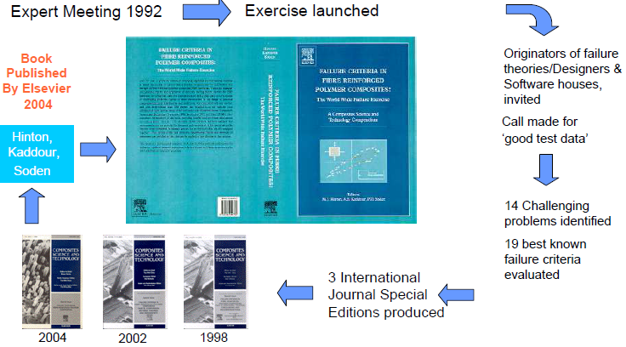
WWFE
Publiction

Slide 11
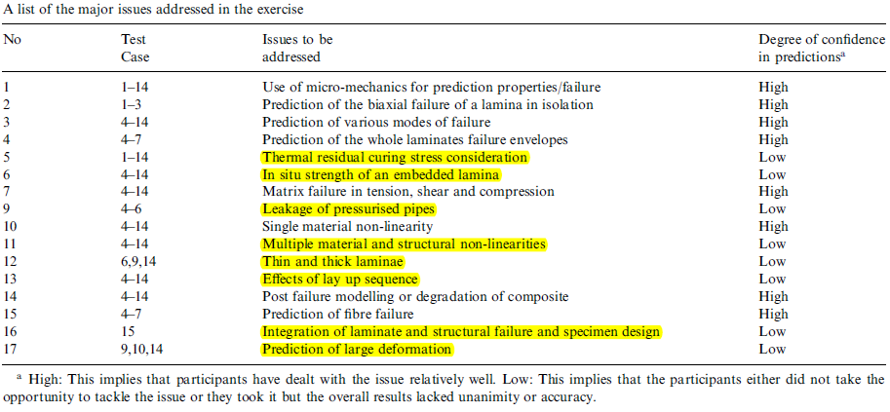
WWFE
major issues addressed in the exercise
P.D. Sodena,*, A.S. Kaddourb,1, M.J. Hinton,Recommendations for designers and researchers resulting from the world-wide failure exercise.Composites Science and Technology64 (2004) 589–604

Slide 12
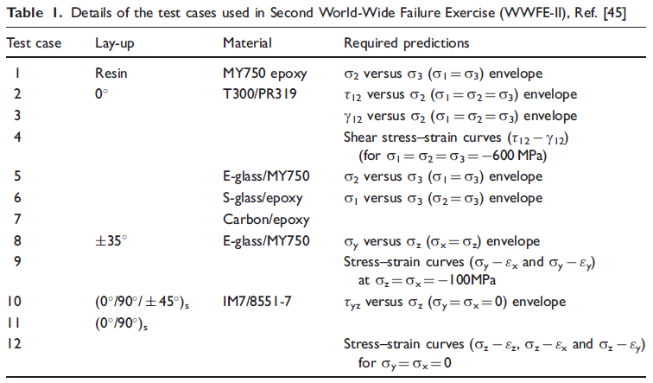
WWFE II
Cases used in WWFE II
MJ Hinton1 and AS Kaddour.The background to the Second
World-Wide Failure Exercise.Journal of Composite Materials
46(19–20) 2283–2294

Slide 13
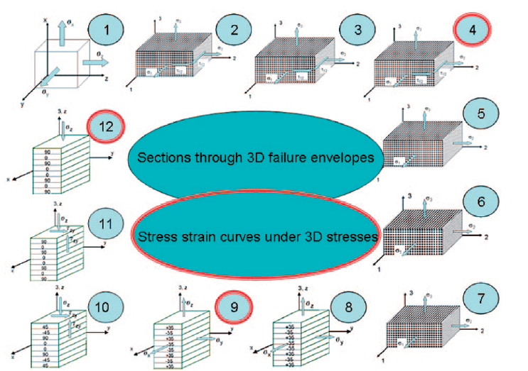
WWFE II
Cases used in WWFE II

Slide 14
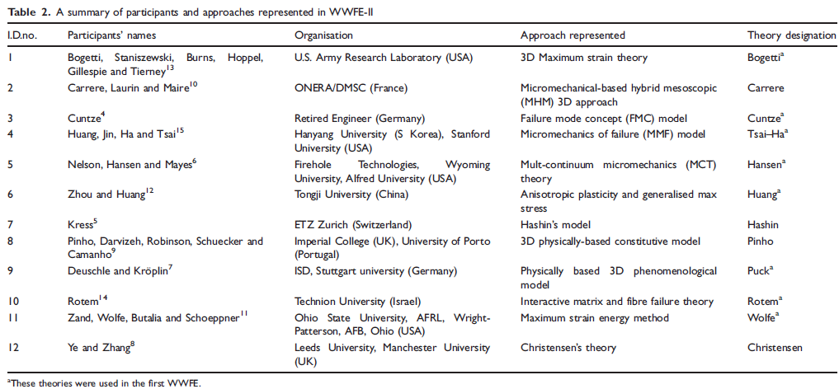
WWFE II
Approaches represented in WWFE II
AS Kaddour1 and MJ Hinton.Banchmarking of triaxial failure criteria for composite laminates:Comparison between models of ParA of WWFE-II.Journal of Composite Materials,47(20–21):2749–2779.

Slide 15
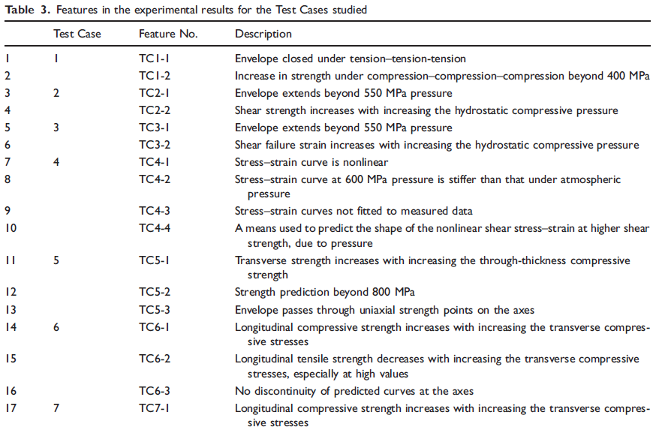
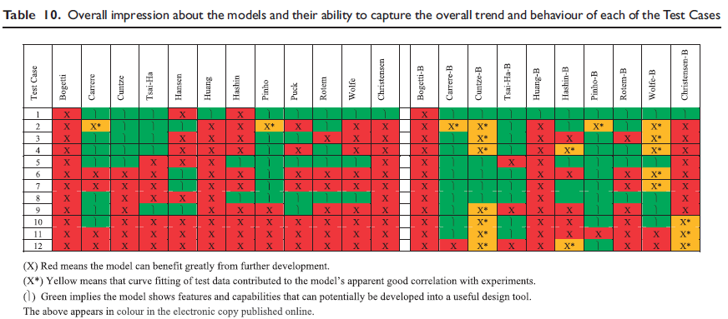
WWFE II
Ranking Criteria
AS Kaddour1 and MJ Hinton.Maturity of 3D failure criteria for fibrereinforced composites: Comparison between theories and experiments: Part B of WWFE-II.Journal of Composite Materials,47(6–7) 925–966

Slide 16
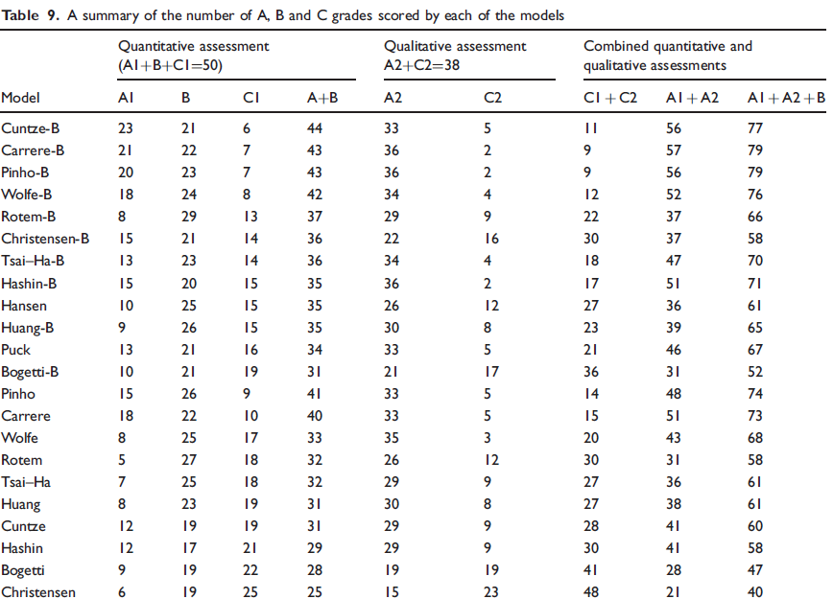
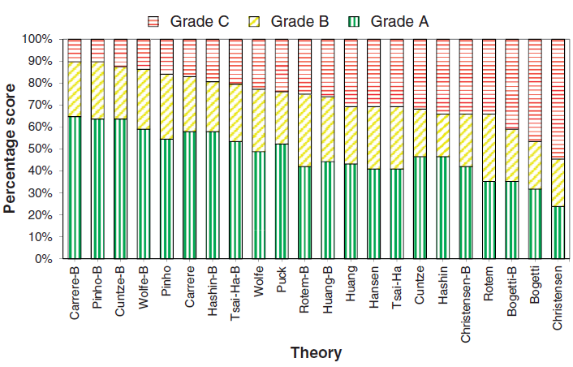
WWFE II
Ranking Criteria
AS Kaddour1 and MJ Hinton.Maturity of 3D failure criteria for fibrereinforced composites: Comparison between theories and experiments: Part B of WWFE-II.Journal of Composite Materials,47(6–7) 925–966

Slide 17
WWFE II
Ranking Criteria
For Part A theories: The better theories :Pinho, Carrere, Puck
For Part B theories:The better theories :Pinho, Carrere, Cuntze
AS Kaddour1 and MJ Hinton.Maturity of 3D failure criteria for fibrereinforced composites: Comparison between theories and experiments: Part B of WWFE-II.Journal of Composite Materials,47(6–7) 925–966

Slide 18
WWFE III
①The first world-wide failure exercise (WWFE) dealt with in-plane failure criteria
②The second world-wide failure exercise(WWFEII),dealing with 3-D failure criteria
③The third world-wide failure exercise (WWFE-III), addressing progressive damage under in-plane stresses,arising from in-plane, bending and thermal loadings;the effects of a stress concentration was also considered.
AS Kaddour1 and MJ Hinton.A comparison between the predictive capability of matrix cracking, damage and failure criteria for fibre reinforced composite laminates: Part A of the third world-wide failure exerciseJournal of Composite Materials,47(20–21) 2749–2779

Slide 19
小结
1 完整的失效分析：本构模型+断裂准则+退化模型
2 具体的问题需要不同的理论，（分层、应力集中、、、）
3 宏观力学到微观、细观力学，将两者结合是一个发展方向。

Slide 20
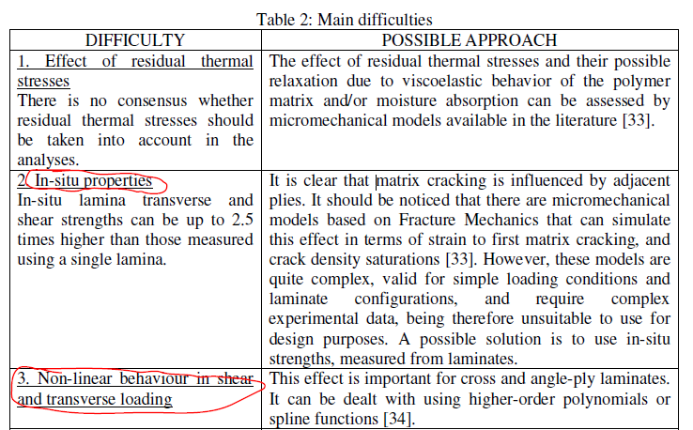
Main difficulties
Pedro Ponces Camanho.FAILURE CRITERIA FOR FIBRE-REINFORCED POLYMER COMPOSITES

Slide 21
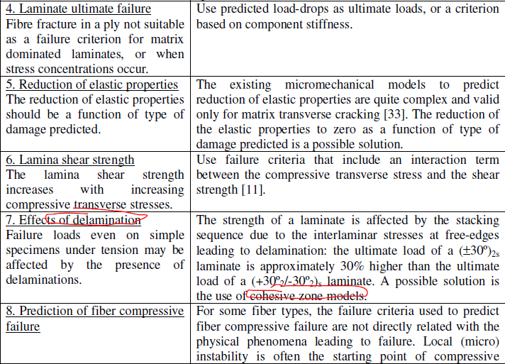
Main difficulties
Pedro Ponces Camanho.FAILURE CRITERIA FOR FIBRE-REINFORCED POLYMER COMPOSITES,2002

Slide 22
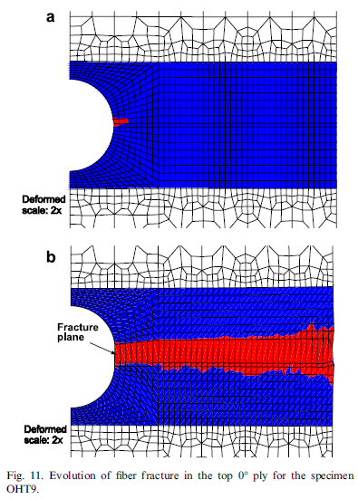


Continuum damage model
damage activation functions
based on the LaRC04 failure criteria
The constitutive model was implemented in the ABAQUS Finite Element (FE) code [45] as a user-written UMAT subroutine.
P.P. Camanho , P. Maimı, C.G. Da´vila.Prediction of size effects in notched laminates using continuum damage mechanics.Composites Science and Technology 67 (2007) 2715–2727

Slide 23




• 剪切非线性关系
τ为剪应力,γ为剪应变,Ｇ0为初始剪切模量,τ0为γ趋向于无穷大时τ 的渐进值,ｎ为形状参数
• 三维Hashin失效准则,Ｙe分层失效准则
• 采用指数函数折减的渐进损伤表达式对损伤后的材料刚度进行折减
• Abaqus,UMAT,C3D8R单元
刘魏光,余音,汪海.考虑剪切非线性的复合材料渐进损伤模型.上海交通大学学报2016,Vol50,NO2

Slide 24
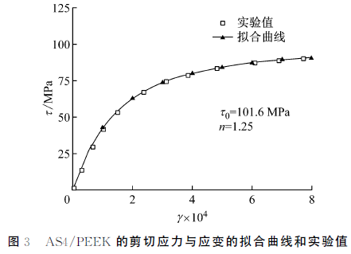
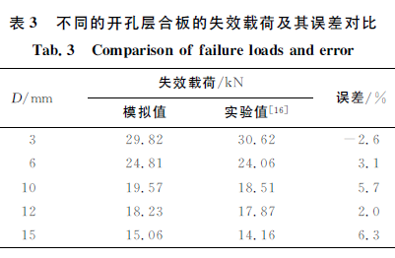
计算结果
刘魏光,余音,汪海.考虑剪切非线性的复合材料渐进损伤模型.上海交通大学学报2016,Vol50,NO2

Slide 25


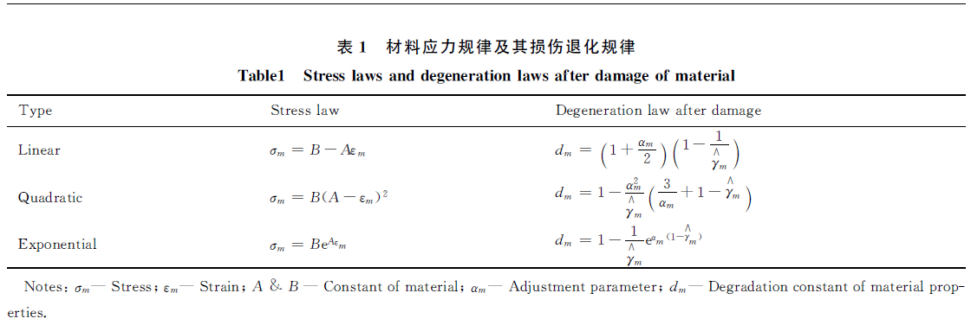
1.瞬间退化模型
2.渐进损伤退化模型
3.连续损伤退化模型
Hashin准则，Abaqus，UMAT
黄河源，赵美英，王文智，等．复合材料三维损伤模型在大开口结构强度预测中的应用［Ｊ］.复合材料学报，2015,32(3):881-887

Slide 26
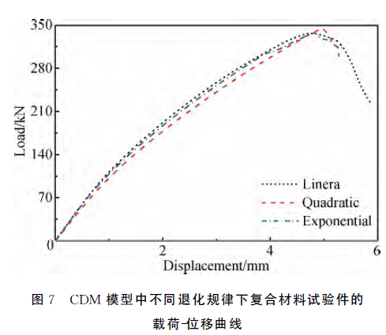
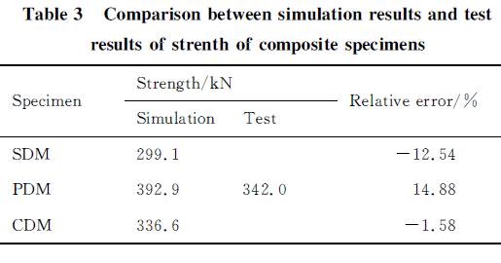
1.计算结果
黄河源，赵美英，王文智，等．复合材料三维损伤模型在大开口结构强度预测中的应用［Ｊ］.复合材料学报，2015,32(3):881-887

