Slide 1
Network Programming:
Basic Concepts
Shyan-Ming Yuan
CS Department, NYCU
smyuan@gmail.com

Slide 2
TCP/IP Reminder
IP: network layer protocol
  unreliable datagram delivery between hosts.
UDP: transport layer protocol
  unreliable datagram delivery between processes.
TCP: transport layer protocol
  reliable, byte-stream delivery between processes.
Applications (http, ftp, telnet,…)
UDP/TCP
IP
Ethernet/WiFi/
Physical

Slide 3
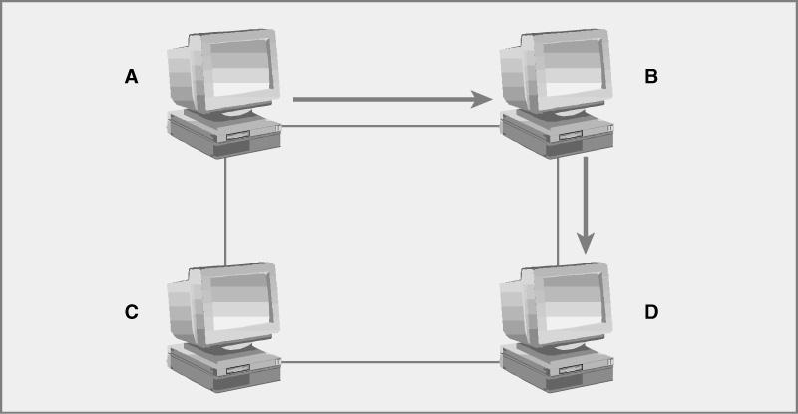
Internet Protocol (IP)
Packet oriented
Packets routed between computers
Unreliable

Slide 4
User Datagram Protocol (UDP)
Packet oriented
A message may be divided into datagrams (packets)
  Packets are sent independently on network layer (IP)
Unreliable but fast
Application must deal with lost and/or dulplicated packets
Examples
  Ping
  Online games

Slide 5
Transmission Control Protocol (TCP)
Connection oriented with full duplex
A message is treated as a logical byte stream.
  It may be divided into packets.
  Packets are sent in sequence on network layer (IP).
An illusion of reliable connection is provided
  Extra messages are required between the sender and the recipient.
  Packets may need to be resent if necessary.
  All packets are guaranteed to deliver.
  Packets are buffered and processed in the order of transmission.
Examples
  ftp (file transfer)
  telnet, ssh(remote terminal), rlogin
  http (web)

Slide 6
Application Protocols
Standard application protocols
  Included in the official TCP/IP protocol suite:
    telnet, ssh, ftp, http, …
Nonstandard application protocols
  Developed by application programmers for private use.
Usages of standard application protocols
  Using ssh to connect to a remote host.
  Using ftp to copy files to (or from) a remote host.

Slide 7
The Client Server Model
Key Concept – Request/Response
The basic paradigm for network applications.
The client-server model assigns asymmetric roles to two collaborating processes.
  One process, the server, plays the role of a service provider which waits passively for the arrival of requests.
  The other process, the client, issues a specific requests to the server and awaits its response.
Many well known internet services are client server applications.
  Telnet, HTTP, FTP, DNS, finger, gopher, etc

Slide 8
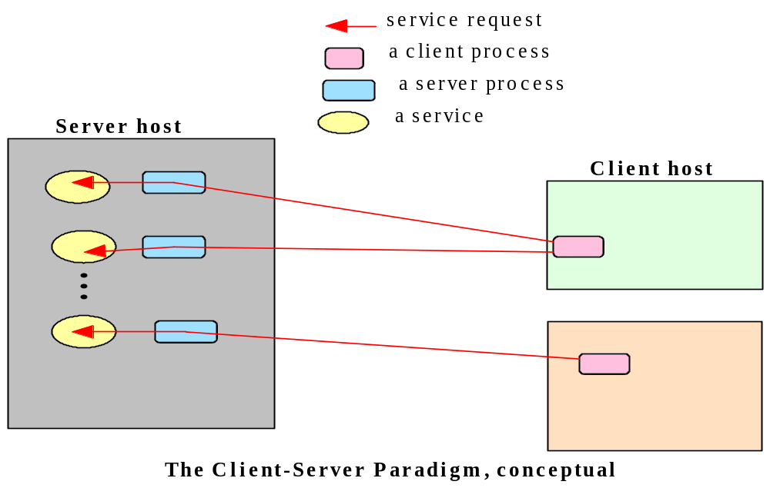
The Client Server Concept

Slide 9


A typical Client/Server Application
“I want to access
some information”
Client
Server

Slide 10
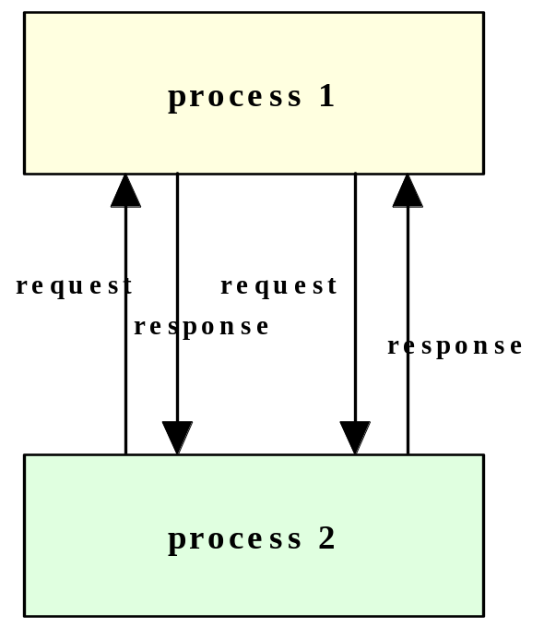
The Peer to Peer Model
  In the peer-to-peer model, the participating processes play equal roles, with similar capabilities and responsibilities.
  Each peer process may issue a request to another peer process and receive a response.
  Example: DHT (distributed hash table)

Slide 11
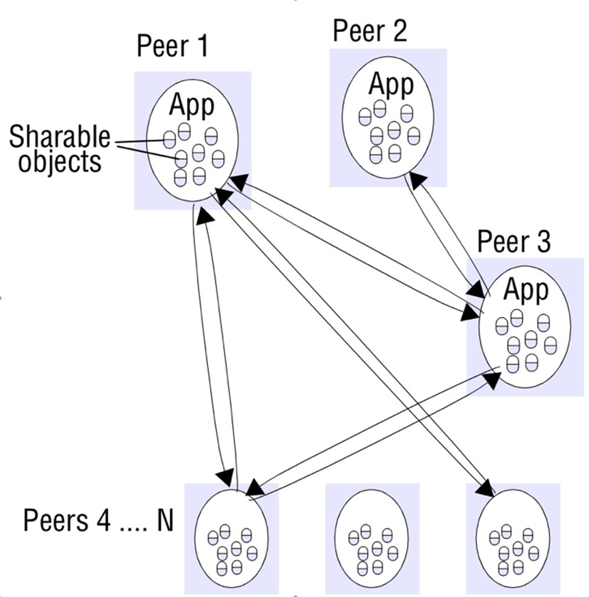
A Typical Peer-to-peer Application

Slide 12
A Simple Email Application
Server
Client
Client
An email client sends a message to the server
Later, the recipient’s email client retrieves the message from the server
The message is then stored on the server

Slide 13
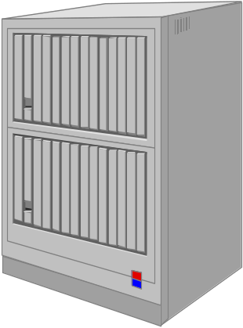
Three Tier Client Server Model
Application
Server
Presentation (client)
Note:
1. many clients can share one application server
2. several application servers may share one data server
Data Server

Slide 14
Hybrid of Client/Server and P2P
Napster and/or other p2p content sharing services
  Files are indexed by a few central servers.
    A peer needs to register its contents to a central server for sharing.
    Peers query central servers to locate the sources of desired contents.
  Shared Files are transferred among peers (P2P) directly
Instant messaging APPs & Internet phone APPs
  Data (or voice) exchanges among users are done by P2P.
  Presence detections are centralized by a few central servers.
    A user (peer) registers itself to a central server when it is online.
    Users contact the central servers to find online buddies.
    Users then can communicate with each other directly.

Slide 15
Clients and Servers
An application that initiates a communication is called a client.
  Users usually invoke a client software to use a network service.
  Clients are much easy to build and require no special system privileges to operate.
A server is a process that waits for incoming requests from clients.
  Upon receiving a request from a client, the server performs necessary computation and returns the result to the requesting client.

Slide 16
Privileges and Complexity of Servers
A server software usually needs to access protected system resources and runs with special privileges.
A server may contain codes that handles many security related issues.
  Authentication: identity verification
  Authorization: resource access control
  Privacy: prevention of unauthorized access
  Protection: free from system resource abuse

Slide 17
The Client Classifications
Standard vs Nonstandard Client Software
  A client software that uses a standard TCP/IP application service is classified as a standard client software.
    rlogin client, email client, ftp client, web browser
A Fully parameterized client software
  allows the user to fully specify the destination machine and destination protocol port number.
    telnet pttbbs.ntu.edu.tw 20003
    http://www.nycu.edu.tw:80

Slide 18
The Server Classifications
Connectionless vs Connection-Oriented Servers
  When the client and server use the UDP to communicate with each other, the interaction is connectionless.
    UDP provides best effort delivery.
    Messages may be lost, duplicated, delayed, or delivered out of order.
  If TCP is used, the interaction is connection-oriented.
    TCP provides reliable, FIFO, non-duplicated, and guaranteed byte stream delivery.
Stateless vs Stateful Servers
  State Information: information maintained by a server about the status of ongoing interactions with clients.
  Servers that do not keep any state information of clients are called stateless severs.
  The others are called stateful servers.

Slide 19
A Stateless File Server Example
A file server allows remote clients to access its local files.
  It waits for clients to request file accesses and operates as a file access application program.
  If the server is stateless, it maintains no information about the clients.
  Each request from a client must specify complete file access information.
  A message may need the following fields in a stateless file access request.
Item | Description
op | Operation (read or write)
Full path name | Complete name of the file
pos | Starting position in the file
size | Number of bytes to transfer
data | (used for a write request)

Slide 20
A Stateful File Server Example
In a stateful file server, the server may maintain a table that holds information about each client and the file currently being accessed.
A new request message does not have to specify all information.
  For previously opened file, the server can retain the file name, current position, and other related information.
  All subsequent request messages only need to contain:
    the number of bytes to read or
    the number of bytes to write and the data
Client | Filename | Current position | Granted operation
1 | Test.program.c | 0 | Read
2 | Tcp.book.txt | 456 | Read
3 | Dept.budget.txt | 38 | Write
4 | Tetris.exe | 128 | read

Slide 21
A Stateful File Server Example
The request messages may have the following two types.
Item | Description
op | open for (read, write, R/W)
full path name | complete name of the file
Item | Description
op | operation (read or write)
handle | entry id for the client
size | number of bytes to transfer
data | (used for a write request)

Slide 22
Other Issues for Stateful Servers
Identifying a Client
  Network Endpoints (client’s IP and port number)
  Handles (an abstract data type between a client and a server)
    When a client first send a request to a server, the server allocates an entry in its state table and generates an identifier for the entry (called a handle).
    The server sends the handle back to the client for the subsequent requests.
Statelessness is a protocol issue
  In an application protocol, if a message depends on previous messages, then it may be impossible to provide a stateless interaction.
  The server can be stateless if the application protocol is designed to make operations idempotent.

Slide 23
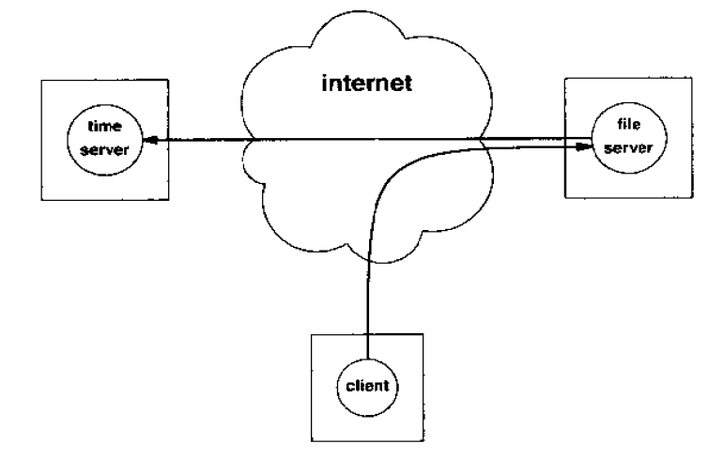
Servers as a Client
When a server application computes an answer for a request may need to access other network services, this server acts as a client also.

Slide 24
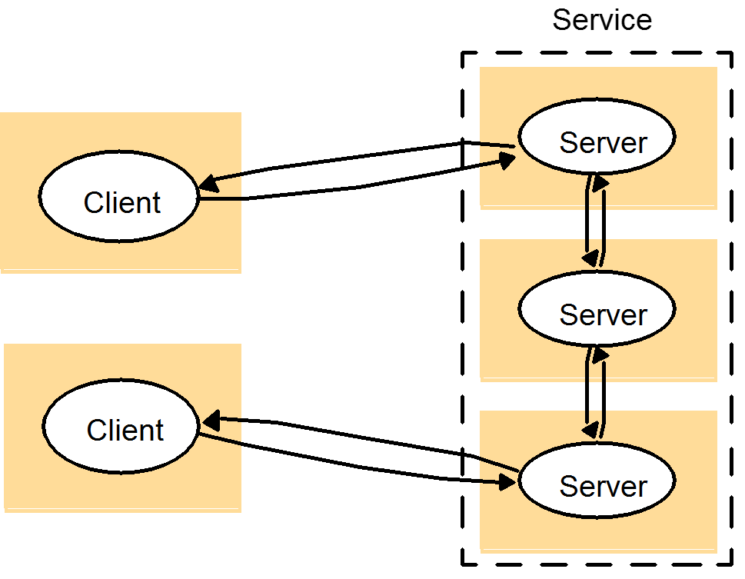
A service provided by multiple servers

Slide 25
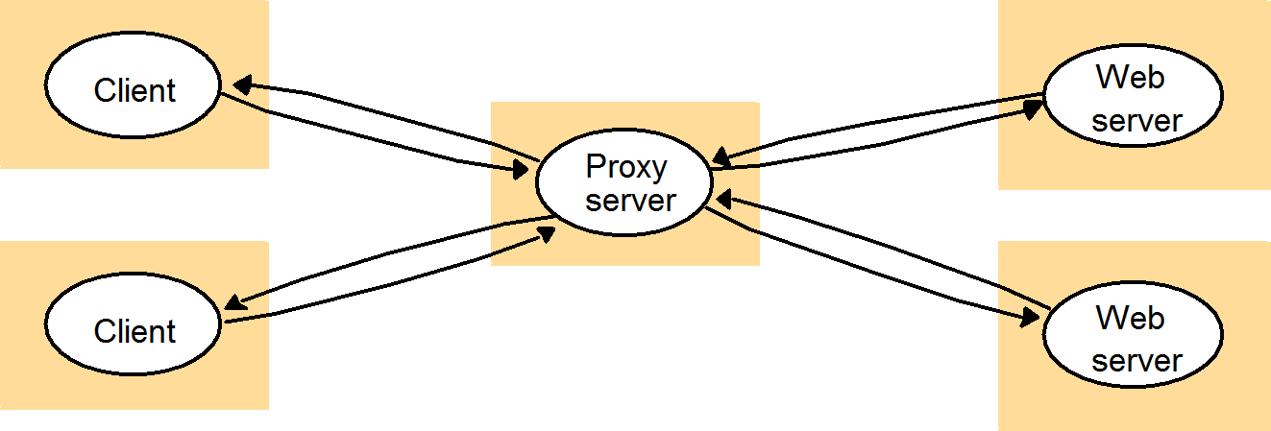
An agent represents multiple servers

Slide 26
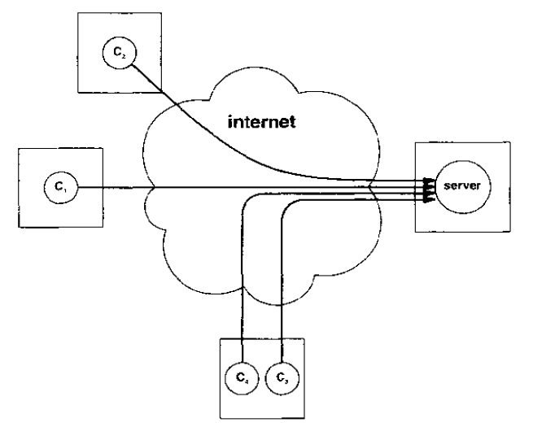
Concurrency in Servers
  A concurrent server must be programmed to handle concurrent requests from multiple clients using a single well-known protocol port.

Slide 27
Concurrency in Clients
A concurrent client implementation may be easier to program because functionalities are separated into conceptually separated components.
  It may also be easier to maintain and extend because of the better code modularity.
A concurrent client can contact several servers at the same time:
  to get a fast response
  to merge the results returned from different servers
Concurrency can allow the user to change parameters, inquire about the client status, or control processing dynamically
  It also allows a client to handle multiple tasks simultaneously without imposing a strict execution order on them.
  A modern web browser is usually designed as a concurrent client.

