Slide 1
Network Programming: The Socket API
Shyan-Ming Yuan
CS Department, NYCU
smyuan@gmail.com

Slide 2
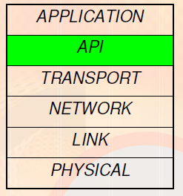
What is an API?
Application Programming Interface.
Interface to what?
Socket API is an interface to use the network.
A connection to the transport layer.
Functions at transport layer and below are very complex.
E.g. Imagine having to worry about errors on the wireless link and signals to be sent on the radio.

Slide 3
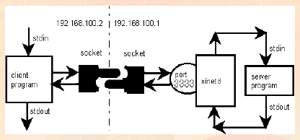
What is a Socket?
It is an abstraction that is provided to an application program to send data to or receive data from another application program.
Data can be sent to or received from another process running on the same machine or a different machine.

Slide 4
The Socket API
The Socket API was originated released with the 4.2 BSD system in 1983 - Berkeley Sockets
It is like an endpoint of a connection.
It exists on either side of a connection and is identified by IP Address and Port Number.
It is a way to speak to other programs using UNIX file descriptors.
A file descriptor is an integer associated with an opened file (or a network connection).
Two commonly used types of Internet Sockets
SOCK_STREAM (TCP): Connection oriented and Reliable
SOCK_DGRAM (UDP): Connectionless and Unreliable

Slide 5
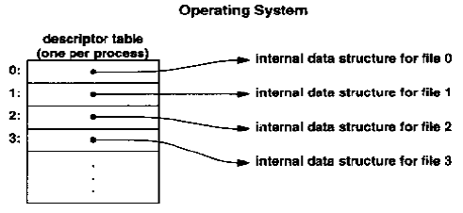
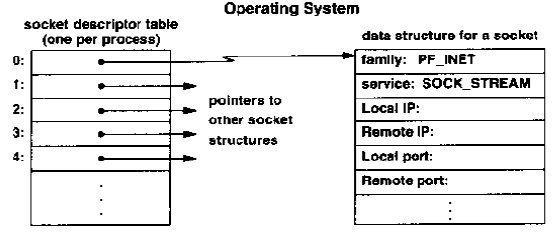
File & Socket Descriptors

Slide 6
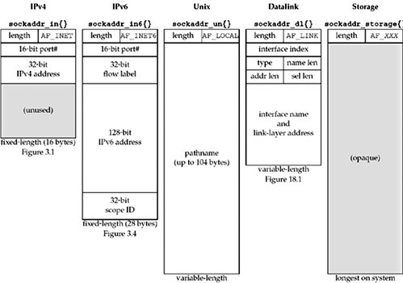
Socket Address Structures

Slide 7
Endpoint Address in Socket
The socket system defines a generic format for specifying an endpoint address.
struct sockaddr { // struct to hold an address
uint8_t sa_len; // total length
sa_family_t sa_family; // address family, AF_xxx
char sa_data[14]; // 14 bytes of address
};
struct sockaddr_in { // struct to hold an address for internet
uint8_t sin_len; // total length
sa_family_t sin_family; // address family
u_short sin_port; // port number
struct in_addr sin_addr; // IP address
char sin_zero[8]; // unused
};
Struct sockaddr_storage {
uint8_t ss_len; // length of this struct
sa_family_t ss_family; //address family
char ss_padding[SIZE];
}

Slide 8
Network Byte Order Conversions
Network byte order is big-endian byte order
htons() – "Host to Network Short“
htonl() -- "Host to Network Long“
ntohs() -- "Network to Host Short“
ntohl() -- "Network to Host Long“
inet_addr() converts a dotted decimal IP address into unsigned long in network byte order
ina.sin_addr.s_addr = inet_addr(“129.110.43.11”);
int inet_aton(const char *cp, struct in_addr *inp)
A better way to converts a dotted decimal IP address into unsigned long in network byte order
inet_ntoa() returns a string from a struct of type in_addr
char *s = inet_ntoa(ina.sin_addr);

Slide 9
Socket Functions
socket() – create a socket
bind() – bind a socket to a local IP address and a port number
connect() – connect to a remote host
listen() – wait for someone to connect to my port (used by servers)
accept() – accept a new connection and get a new socket for subsequent data transmissions
send() and recv() – Send and receive data over a connection
int send(int sockfd, const void *msg, int len, int flags);
int recv(int sockfd, void *buf, int len, int flags);
read() and write() – Send and receive data over a connection
read / write a particular number of bytes from a connected socket

Slide 10
More Socket Functions
sendto() and recvfrom() – Send and receive data without connection
int sendto(int sockfd, const void *msg, int len, int flags, const struct sockaddr *to, int tolen);
int recvfrom(int sockfd, void *buf, int len, int flags, struct sockaddr *from, int *fromlen);
close() and shutdown() - close a connection
int shutdown(int sockfd, int how) – close a connection for read, write, or both
how is 0, 1, 2 for read, write, and both
int close (int sockfd); is equivalent to int shutdown(int sockfd, 2);
On success, zero is returned.
On error, -1 is returned, and errno is set appropriately.
getpeername() - obtain the peer address of the connected socket
gethostbyname(const char *name); - obtain IP address of a computer
getservbyname() - obtain the struct servent by service name
getprotobyname() - obtain the struct protoent by protocol name

Slide 11
The gethostbyname function call
#include <netdb.h>
extern int h_errno;
struct hostent *gethostbyname(const char *name);
On success, a structure of type hostent is returned.
On error, a NULL pointer is returned, and the h_errno is set appropriately.
The gethostbyname() function returns a structure of type hostent for the given host name.
The host name is either a hostname, or an IPv4 address in standard dot notation or an IPv6 address in colon (and possibly dot) notation.
The struct hostent is defined in <netdb.h>

Slide 12
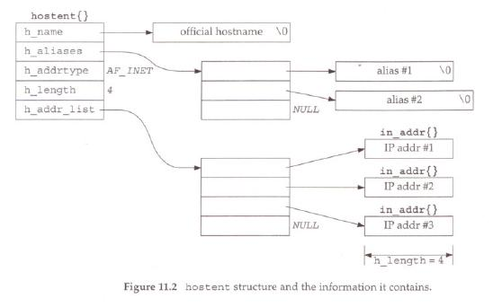
struct hostent {
char *h_name; /* official name of host */
char **h_aliases; /* alias list */
int h_addrtype; /* host address type, AF_INET or AF_INET6 */
int h_length; /* length of address */
char **h_addr_list; /* list of addresses */
}
#define h_addr h_addr_list[0] /* for backward compatibility */

Slide 13
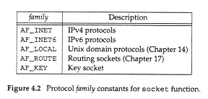
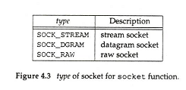
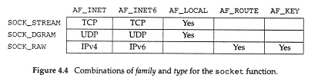
The socket function call
#include <sys/socket.h>
Int socket (int family, int type, int protocol);
On success, a file descriptor for the new socket is returned.
On error, -1 is returned, and errno is set appropriately.

Slide 14
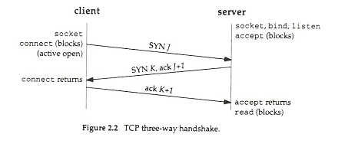
The connect function call
#include <sys/socket.h>
Int connect(int socket, const struct sockaddr *address socklen_t address_len);
On success, 0 is returned. On error, -1 is returned, and errno is set appropriately.
In TCP, It is used by a client to establish a connection with a server.
In UDP, it is used by a client to record the IP and port of a server.

Slide 15
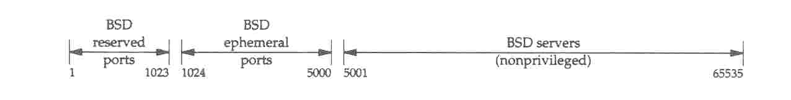
The bind function call
#include <sys/socket.h>
int bind(int sockfd, const struct sockaddr *addr, socklen_t addrlen);
On success, 0 is returned. On error, -1 is returned, and errno is set appropriately.
The bind assigns a local protocol address to a socket.
In the internet protocol, the address is the combination of
either a 32-bit IPv4 address or a 128-bit IPv6 address with
a 16-bit TCP or UDP port number.

Slide 16
The listen function call
#include <sys/socket.h>
int listen(int sockfd, int backlog);
On success, 0 is returned. On error, -1 is returned, and errno is set appropriately.
The listen converts an unconnected TCP socket into a passive mode for awaiting incoming connection requests.
The backlog argument specifies the maximum number of connection requests can be queued for this socket.
The listen can only be used by an awaiting TCP server process.
The listen is normally called after socket and bind function calls and must be called before the accept function call.

Slide 17
The accept function call
#include <sys/socket.h>
int accept(int socket, struct sockaddr *restrict address, socklen_t *restrict address_len);
On success, a new socket that accepts the connection is returned.
On error, -1 is returned, and errno is set appropriately.
The accept function is called by a TCP server to return the next completed connection from the connection request waiting queue.
If there is no completed connection, the calling process is put to sleep until a completed connection exists unless the socket is noblocking.
The accepted socket cannot itself accept more connections.
The original socket remains open and can accept more connections.

Slide 18
The send and sendto function calls
#include <sys/types.h>
#include <sys/socket.h>
ssize_t send(int sockfd, const void *buf, size_t len, int flags);
ssize_t sendto(int sockfd, const void *buf, size_t len, int flags,
const struct sockaddr *dest_addr, socklen_t addrlen);
On success, these calls return the number of characters sent.
On error, -1 is returned, and errno is set appropriately.
The system calls send() and sendto() are used to transmit a message to another socket.
The send() call can only be used in a connected socket.
The sendto() call can be used in both connected and connectionless sockets, where the target address is given by dest_addr and the size of the dest_addr is given by addrlen. .
send(sockfd, buf, len, flags); is equivalent to
sendto(sockfd, buf, len, flags, NULL, 0);

Slide 19
The recv and recvfrom function calls
#include <sys/types.h>
#include <sys/socket.h>
ssize_t recv(int sockfd, void *buf, size_t len, int flags);
ssize_t recvfrom(int sockfd, void *buf, size_t len, int flags,
struct sockaddr *src_addr, socklen_t *addrlen);
On success, these calls return the number of characters sent. When the peer has shutdown its socket, the return value will be 0.
On error, -1 is returned, and errno is set appropriately.
The system calls recv() and recvfrom() are used to receive a message sent from a peer socket.
The recv() call can only be used in a connected socket.
The recvfrom() call can be used in both connected and connectionless sockets, where the source address will be returned from src_addr and the size of the src_addr will be returned by addrlen. .
recv(sockfd, buf, len, flags); is equivalent to
recvfrom(sockfd, buf, len, flags, NULL, NULL);

Slide 20
The getpeername function call
#include <sys/socket.h>
int getpeername(int sockfd, struct sockaddr *addr, socklen_t *addrlen);
On success, 0 is returned. On error, -1 is returned, and errno is set appropriately.
The getpeername() call is used to obtain the address of the peer that is connected to the sockfd.
The peer address will be returned from the addr and the actual size of the peer address will be returned from the addrlen.
The addrlen argument should be initialized to indicate the amount of space pointed to by addr. On return, the addrlen contains the actual size of the addr returned (in bytes).
The returned addr will be truncated if the buffer provided is too small.

Slide 21
The getservbyname function call
#include <netdb.h>
struct servent *getservbyname(const char *name, const char *proto);
struct servent *getservbyport(int port, const char *proto);
On success, a structure of type servent is returned.
On error, a NULL pointer is returned.
The getservbyname() call returns a structure of type servent for the given service name with the given protocol.
The getservbyport() call returns a structure of type servent for the given port number with the given protocol.
The servent structure is defined in <netdb.h> as follows:
struct servent {
char *s_name; /* official service name */
char **s_aliases; /* alias list */
int s_port; /* port number */
char *s_proto; /* protocol to use */
}

Slide 22
The getprotobyname function call
#include <netdb.h>
struct protoent *getprotobyname(const char *name);
struct protoent *getprotobynumber(int proto);
On success, a structure of type protoent is returned.
On error, a NULL pointer is returned.
The getprotobyname() call returns a structure of type protoent for the given protocol name.
The getprotobynumber() call returns a structure of type protoent for the given protocol number.
The protoent structure is defined in <netdb.h> as follows:
struct protoent {
char *p_name; /* official protocol name */
char **p_aliases; /* alias list */
int p_proto; /* protocol number */
}

Slide 23
The host address functions
#include <arpa/inet.h>
Int inet_aton(const char * strptr, struct in_addr *addrptr);
Returns: 1 if string was valid, 0 one error
In_addr_t inet_addr(const char * strptr);
Returns: 32-bit IP address in NBO; INADDR_NONE if error
Char *inet_ntoa(struct in_addr *addrptr);
Returns: pointer to dotted decimal IP
Although the dotted-decimal 255.255.255.255 is used as a valid broadcast address, it can not be handled by inet_addr().

Slide 24
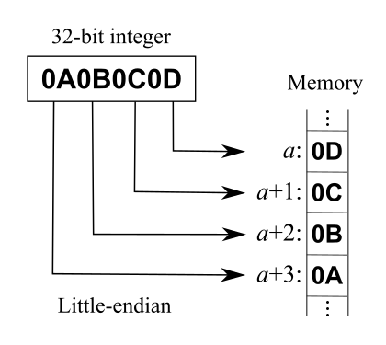
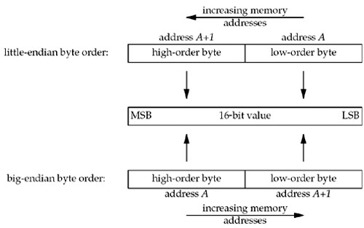
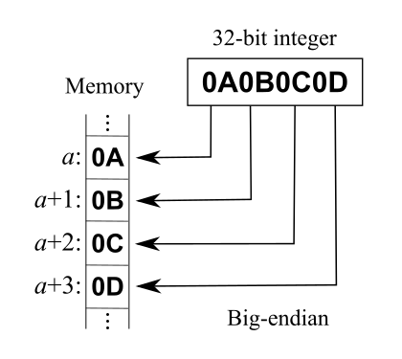
Big and Little Endian Byte Orders
Intel x86
Motorola 68x

