Slide 1
Solving Nonlinear Equations
Root r

Slide 2
Fixed-point Iteration Method
Rearrange f(x)=0 into an equivalent form x=g(x) f(x) = x – g(x) = 0
If r is a root of f, then f(r) = r-g(r) = 0 r=g(r)
In iterative form,

Slide 3
Fixed-point Iteration Method (Cont.)
Also called function iteration
For given equation f(x)=0, there may be many equivalent fixed-point problems x=g(x) with different choice of g
Will the method always converge?

Slide 4
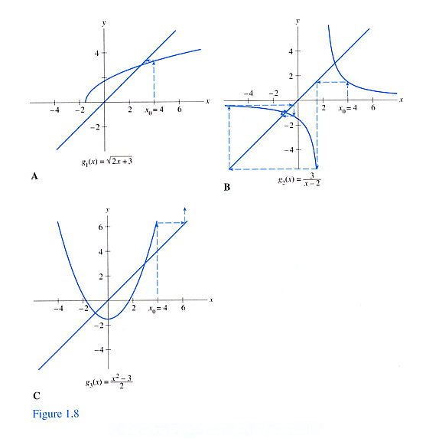
Example: Fixed-point Iteration

Slide 5
Example: Fixed-point Iteration (cont.)
Diverge!

Slide 6
Convergence Rate
For general iterative methods, define error at iteration n by e_{n} = x_{n} – R where x_{n} is an approximate solution and R is the true solution
For methods that maintain an interval known to contain a solution, rather than a specific approximate value for the solution, take the error to be length of the interval containing solution

Slide 7
Convergence Rate (cont.)
Sequence converges with rate r if
for some finite nonzero constant C
Some cases of interest
r=1 and C<1: linear
r>1: superlinear
r=2: quadratic
https://arnold.hosted.uark.edu/NA/Pages/OrderConv.pdf
Notes:
https://arnold.hosted.uark.edu/NA/Pages/pages.html
https://arnold.hosted.uark.edu/NA/Pages/OrderConv.pdf

Slide 8
Convergence Rate of Bisection
Length of interval containing solution reduced by half at each iteration
Linearly convergent
r = 1
C = 0.5

Slide 9
Convergence of Fixed-point Iteration
If R = g(R) and |g’(R)| < 1, then there is an interval containing R such that the iteration x_{n+1} = g(x_{n}) converges to R if starting within that interval
If |g’(R)| > 1, then the iterative scheme diverges

Slide 10
Proof of Convergent Condition
Mean Value Theorem
Fixed-point iteration is linearly convergent
If < 1
Notes:
When the iteration continuous, the interval (R, xn) converges to the root R. Therefore, g’(kersi_n) converges to g’(R), which is a constant!

Slide 11
Convergence of Newton’s Method
Represent Newton’s method in fixed-point iteration form
Condition for convergence |g’(R)|<1, where

Slide 12

Let’s first check if |g’(R)| < 1
Yes, if $f′(R)≠0$

Slide 13

Convergence rate of Newton’s method
The above can be derived as follows
$$ξ∈[x_{n},R]$$
Recall that
For simple roots, Newton’s method is quadratically convergent!

Slide 14

Newton’s Methods for Multiple Roots
Quadratically convergent for simple roots,
Linearly convergent for multiple roots as
Cannot be omitted
$$e_{n+1}=g′(ξ)e_{n}$$
Notes:
The proof of linearly convergent is the same as that in slide 13, except the Taylor expansion is now 1st order. Higher order convergence cannot be achieved.

Slide 15
Remedies for Multiple Roots with Newton’s method
If f(x) has a root of multiplicity k at x=R, we can factor out (x-R)^{k} from f(x) to get
With a slightly modified Newton’s method
It can be proved that and Newton’s method still converges quadratically

Slide 16
Proof by yourself that

Slide 17
Remedies for Multiple Roots with Newton’s method (cont.)
In practice, we don’t know k in advance
Remedies
1. Try and error
2. Deflate f(x) f(x)/(x-s) where s is an approximate R
Be warned that an indeterminate form at x=R is created
3. Acton’s method, see textbook
4. Estimation of the multiplicity of a root
Hansen, E., Patrick, M. Estimating the multiplicity of a root. Numer. Math. 27, 121–131 (1976).
Notes:
Estimation of the multiplicity of a root:
Hansen, E., Patrick, M. Estimating the multiplicity of a root. Numer. Math. 27, 121–131 (1976). https://doi.org/10.1007/BF01399090

Slide 18
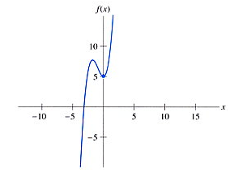
Example: Newton’s Method for Finding Complex Roots
f(x) = x³ + 2x² – x + 5

Slide 19
Start Newton’s method with a complex value

Slide 20
Systems of Nonlinear Equations
Solving systems of nonlinear equations is much more difficult than the scalar case because
Wide variety of behavior—determining existence and the number of solutions or good starting guess is much more complex
No simple way to guarantee convergence to the desired solution or to bracket solution to produce a absolutely safe method
Computational overhead increases rapidly with the dimension of the problem

Slide 21
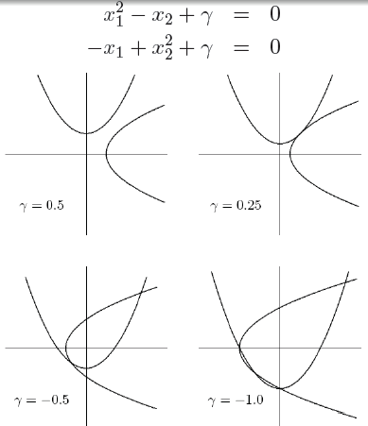
Example: Systems in Two Dimensions
From Michael T. Heath

Slide 22
Newton’s Method
In n dimensions, Newton’s method has form where J(x) is the Jacobian matrix of f
In practice, we do not explicitly invert J(x_{n}), but instead solve linear system for Newton step s_{n}, then take as next iterate

Slide 23
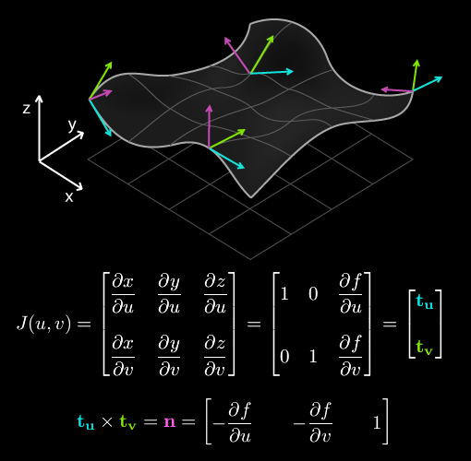
Side Note: Jacobian
F(u,v) = [x, y, z]
x(u,v) = u
y(u,v) = v
z(u,v) = f(u,v)
T

Slide 24
Example: Newton’s Method

Slide 25
Example: Newton’s Method

Slide 26
Fixed-Point Iteration
Fixed-point problem for is to find vector x such that
Corresponding fixed-point iteration is
Converges if
starts close enough to solution

Slide 27
Fixed-Point Iteration (cont.)
Convergence rate is normally linear, with constant C given by
If then convergence rate is at least quadratic, e.g., Newton’s method

Slide 28
Example: Fixed-point Iteration

Slide 29
Question from the class in previous years
Is the initial solution important for the convergence of fixed-point iteration?

Slide 30
Answer to the convergence problem of fixed-point Iteration
|g’(R)|<1 is a necessary condition
if |g’(R)|>1, the fixed-point iteration will diverge even if the initial condition is very close to a root since the iteration will eventually reach the region causing divergence
Initial solution is important but less critical
The algorithm may not converge if the initial solution is far from the true solution
Recall the conditions that Newton’s method does not converge?
Notes:
Answer to the question if the initial condition is important

