Slide 1
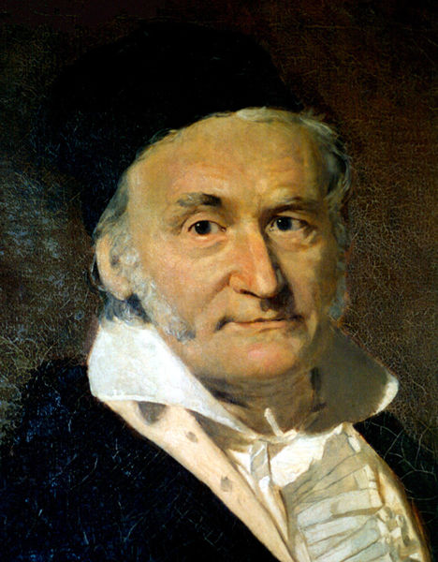
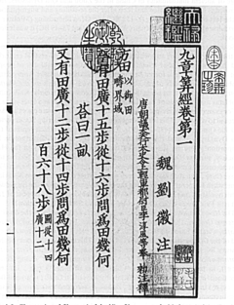
Solving Sets of Equations
150 B.C.E., 九章算術
Carl Friedrich Gauss, 1777-1855

Slide 2
Iterative Methods for Linear Systems
Gaussian elimination is a direct method for solving linear system, producing an exact solution (in exact arithmetic) in a finite number of steps
Iterative methods begin with an initial guess for the solution and successively improve it until the desired accuracy attained

Slide 3
Iterative Methods for Linear Systems
In theory, it might take an infinite number of iterations to converge to the exact solution, but in practice, iterations are terminated when the residual is as small as desired
For some types of problems, iterative methods have significant advantages over direct methods
Large system, sparse matrix
Jamil, “A Comparison of Direct and Indirect Solvers for Linear Systems of Equations” International Journal of Emerging Sciences, 2(2), 310-321, 2012

Slide 4
Jacobi Method
Apply fixed point iteration to a set of linear equations
We need to transform Ax = b into x = g(x)
An easy way to achieve this is:

Slide 5
Jacobi Method
Apply fixed point iteration to a set of linear equations
We need to transform Ax = b into x = g(x)
An easy way to achieve this is:

Slide 6
Convergence Criterion for Jocobi Method
Recall that the convergence criterion for the fixed point method is
The Jacobian matrix of is

Slide 7
Convergence Criterion for Jocobi Method (cont.)
To satisfy , the maximal eigenvalue of need be less than 1
A sufficient condition for this is the coefficient matrix A is diagonally dominant, i.e.,

Slide 8
Implementation of Jocobi Method
The updating equation can be implemented by component-wise updating rule
Each of the equations is simultaneously changed by using the x vector at last iteration

Slide 9
Example: Jacobi Method
Diagonally
Dominant

Slide 10
Gauss-Seidel Method
Jocobi method converges slowly as new component values are used only after the entire sweep has been completed
Gauss-Seidel method remedies this by using each new component of the solution as soon as it has been computed
Gauss-Seidel uses slightly different g(x),

Slide 11
Gauss-Seidel Method (cont.)
The different form of g(x) is due to the consideration of convergence rate, which is determined by the eigenvalues of Jocabian of g(x), that is
We’ll study this issue in Chapter 6

Slide 12
Convergence Criterion for Gauss-Seidel and Jacobi Methods
Sufficient condition for both to converge is A is diagonally dominant!
When A is not diagonally dominant, Gauss-Seidel can still converge if A is symmetric and positive definite
Gauss-Seidel converges faster than Jacobi when both methods converge

Slide 13
Convergence Criterion for Gauss-Seidel and Jacobi Methods
Gauss-Seidel converges under a weaker criterion and faster than Jacobi
In general, Gauss-Seidel is a better choice
However, Jacobi method is preferred on parallel processors since all n equations can be solved simultaneously

Slide 14
Implementation of Gauss-Seidel Method
The update equation can be expressed as
Looks familiar?
Right! Solve it using forward substitution!

Slide 15
Derivation of
Consider

Slide 16



Example: Gauss-Seidel Method
Diagonally
Dominant
$$x_{1}^{(k+1)}=\frac{11}{6}+\frac{2}{6}x_{2}^{(k)}−\frac{1}{6}x_{3}^{(k)}$$
$$x_{2}^{(k+1)}=\frac{5}{7}+\frac{2}{7}x_{1}^{(k+1)}−\frac{2}{7}x_{3}^{(k)}$$
$$x_{3}^{(k+1)}=\frac{1}{5}+\frac{1}{5}x_{1}^{(k+1)}+\frac{2}{5}x_{2}^{(k+1)}$$

Slide 17
Accelerating Convergence
Convergence rate of Gauss-Seidel (GS) can be accelerated by successive over-relaxation
Consider an iterative method as an optimization process: over-relaxation uses the step to the next GS iteration as a search direction, but with a fixed search parameter denoted by w
GS is a special case of the above if w = 1
Notes:
X_GS: original Gauss-Seidel solution

Slide 18
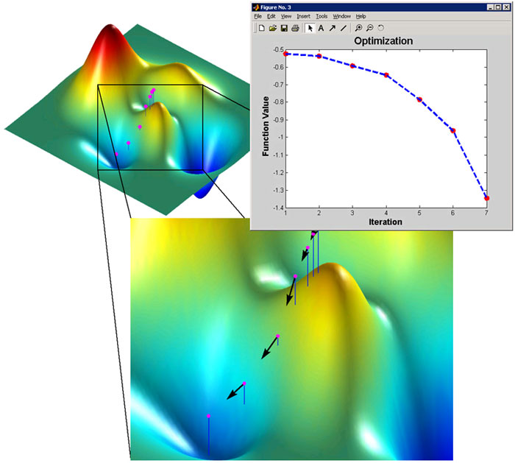
Accelerating Convergence (cont.)

Slide 19
Accelerating Convergence (cont.)

Slide 20
Accelerating Convergence
w is relaxation factor chosen to accelerate convergence
w > 1 gives over-relaxation, w < 1 gives under-relaxation, and w = 1 gives Gauss-Siedel
For convergence, w should be less than 2
Optimal choice lies between 1.0 and 2.0

Slide 21
Special Types of Linear Systems
Work and storage can often be saved in solving linear system if matrix has special properties
Example include
Symmetric: A = A^{T}, a_{ij} = a_{ji} for all i, j
Positive definite: x^{T}Ax > 0 for all x≠0
Sparse: most entries of A are zero
Band: a_{ij} = 0 for all |i-j| >β, where β is bandwidth of A

Slide 22
Symmetric Positive Definite Matrices
If A is symmetric and positive definite, then LU factorization can be arranged so that U = L^{T}, which gives Cholesky factorization where L is lower triangular with positive diagonal entries
Cholesky factorization can be done by equating entries of A and LL^{T}

Slide 23
Cholesky Factorization
In 2x2 case,
Implies

Slide 24
Cholesky Factorization
Features of Cholesky factorization algorithm
No pivoting is required
Only lower triangular of A is accessed; upper triangular portion need not be stored
Only n³/6 multiplications are required
Cholesky factorization requires only about half work and half storage compared with LU factorization of general matrix by Gaussian elimination, and also avoids pivoting

Slide 25
Band Matrices
Gaussian elimination for band matrices differs little from the general case – only the range of loops changes
Typically matrix is stored in an array by diagonals to avoid storing zero entries
If pivoting is required for numerical stability, bandwidth can grow
General purpose solver for arbitrary bandwidth is similar to code for Gaussian elimination for general matrices

Slide 26
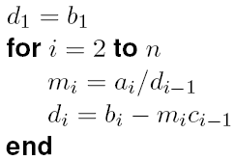
Tridiagonal Matrices
Consider tridiagonal matrix
Gaussian elimination without pivoting reduces to

Slide 27
Tridiagonal Matrices (cont.)
LU factorization of A is then given by

Slide 28
General Band Matrices
In general, band system of bandwidth β requires O(βn) storage, and its factorization requires O(β²n) work
Compared with full system, saving is substantial if β<< n

Slide 29
Software for Linear Systems
LAPPACK++
Eigen library

Slide 30
Software for Linear Systems
LINPACK is a software package for solving a wide variety of systems of linear equations, both general dense systems and special systems, such as symmetric or banded
Solving such linear systems has fundamental importance in numerical analysis that LINPACK has become a standard benchmark for comparing performance of computers

Slide 31
Software for Linear Systems (cont.)
LAPACK is more recent replacement for LINPACK featuring higher performance on modern computer architectures, including some parallel computers
LAPACK++
C++ implementation of LAPACK
Both LAPACK and LINPACK are available from Netlib

