Slide 1
Numerical Methods
Wen-Chieh (Steve) Lin
Department of Computer Science

Slide 2
Outline
About me
Administration
Course overview

Slide 3
About me
Ph.D. in Robotics, School of CS, CMU
M.S. & B.S. in Electrical Control Eng., NCTU
Research areas
Robotics
Human computer interaction
Visualization
Computer graphics
http://www.cs.nctu.edu.tw/~wclin
Lab: http://gpl.cs.nctu.edu.tw/

Slide 4
Administration
Course web: E3 http://e3new.nctu.edu.tw
Office hours
EC523, by appointments
TA:
黃映瑄 yshuang.cs11@nycu.edu.tw EC 612, ext. 54806

Slide 5
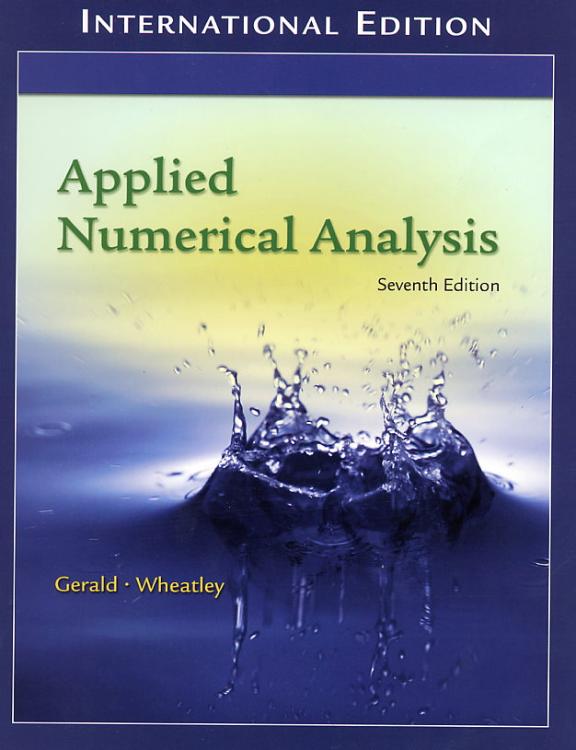
Textbook
Applied Numerical Analysis, 7th ed., by Gerald & Wheatley, Addison-Wesley.

Slide 6
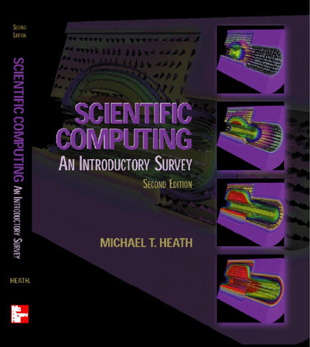
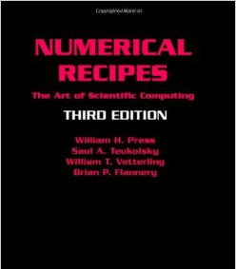
References
Scientific Computing: An Introductory Survey, by Michael Heath, McGraw-Hill
http://heath.cs.illinois.edu/scicomp/
Numerical Recipes in C++, by William H. Press, Saul A. Teukolsky, William T. Vetterling, Brian P. Flannery, Cambridge University Press

Slide 7
Perquisites and Grading
Perquisites
Calculus, Linear algebra
Assignments (40%)
Written homework
MATLAB programming
Quiz (depending on class attendance)
Midterm exam (30%)
Final exam (30%)

Slide 8
Policies
Late policies
Turn in assignments in the class of the due date
Penalty of 10 points per day
Cheating policies
0 points for any cheating on assignments or exams
Whether you plagiarize or help plagiarism is cheating
Allowing another student to examine your code is also considered as cheating

Slide 9
Class schedule?
Option 1:
9:30 – 12:10 on Thu, Physical classes
Option 2:
9:30 – 12:10 on Thu, Online classes with recording
Option 3:
10:10 – 12:00 on Thu, 2 Physical + 1 recorded classes
Midterm and Final Exams at EC015
Notes:
2, 6, 43, 38 votes for option 1, 2, 3, 4

Slide 10
Course Introduction & Overview

Slide 11
What is this course about?
This is not a course to teach you coding
This is a course to teach you computer algorithms for analyzing and solving science and engineering problems in numerical ways

Slide 12
Numerical Analysis/Methods
What is numerical analysis/method?
Analysis and design of algorithms for numerically solving mathematical problems in science and engineering
Why do we care about numerical analysis?
Simulation of real-world phenomena and events
Virtual prototyping of engineering designs

Slide 13
Analysis vs. Numerical Analysis
Consider solving
Analytically, we know that is a root of the equation
Numerically, how do we find the root of the equation using a computer program?
Computers can only do arithmetic operations
Design a procedure consisting of only arithmetic operations to find the root

Slide 14
A simple example
Solving
Too large
Too small
A bit closer
Close
Pretty close
This is actually a root finding method called “Bisection”!

Slide 15
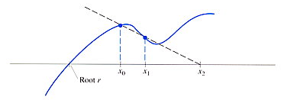

Course Overview
Approximation and errors
Solving nonlinear equations
Solving sets of equations

Slide 16
Interpolation and curve fitting
Find intermediate values from a table of data
Fit curves to data
If the curve passes all data points, we call it interpolation.
Interpolation

Slide 17
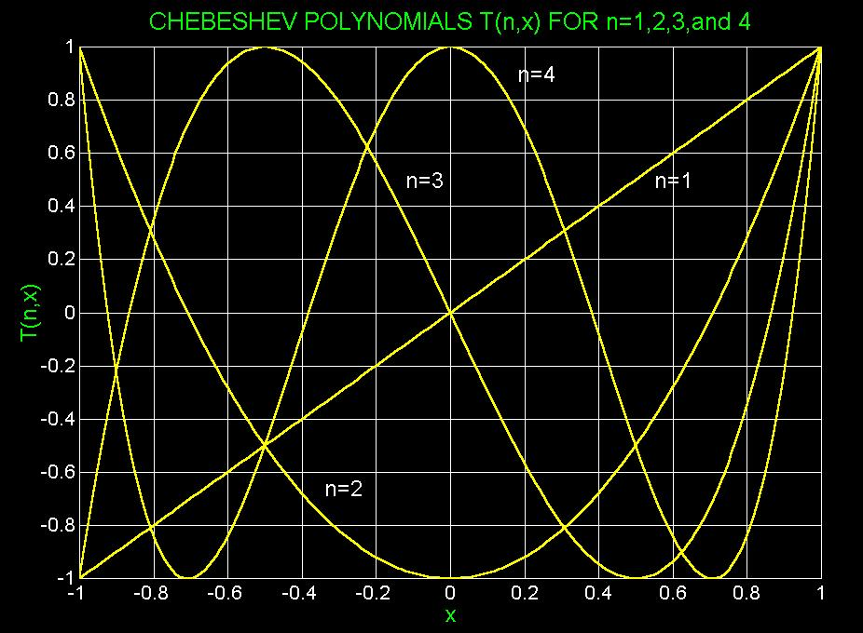
Approximation of functions
How does a computer approximate cos(x), exp(x), and other non-polynomial functions?
Use polynomials or ratio of polynomials to approximate a function
Taylor series
Chebyshev polynomials
Fourier series

Slide 18
Differentiation and Integration
Numerical differentiation and integration
approximate derivative values of a function
approximate definite integral, even when no analytical form exists
Numerical solution of ordinary differential equations (ODE)

Slide 19
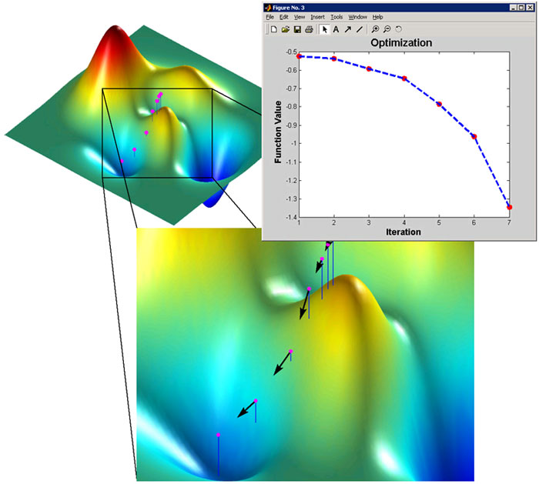
Optimization
Given a scalar function f of one or more independent variables
You want to find the value of those variables where f takes on a maximum or minimum

Slide 20
Applications of Numerical Methods

Slide 21
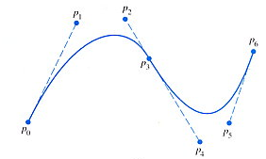
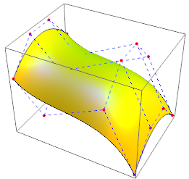
Computer Graphics
Geometry modeling
interpolation, curve fitting, optimization,
Physics-based animation
root finding, interpolation, curve fitting, optimization, ODE solver, Partial Differential Equation (PDE) solver, finite element method

Slide 22
Deformable Objects with Collisions
Collision detection by root finding
Deformation simulation by finite element method
Doug James et al., http://graphics.cs.cmu.edu/projects/bdtree/

Slide 23
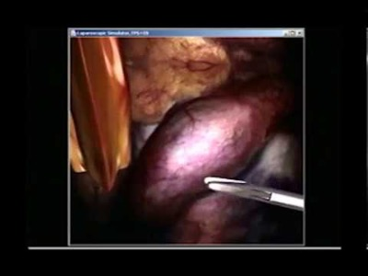
Simulated Deformable Objects
Doug James & Dinesh Pai, SIGGRAPH 2002

Slide 24

Fluid simulation by PDE solver
Realflow: commercial software
Notes:
Navier Stokes plus topology changes

Slide 25
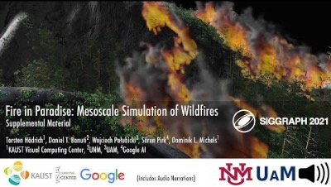
Simulated Wildfires
Notes:
Fire in Paradise: Mesoscale Simulation of Wildfires (SIGGRAPH 2021)
we present a novel method for simulating wildres with the goal to realistically capture the combustion process of individual trees and the resulting propagation of res at the scale of forests. We rely on a state-of-the-art modeling approach for large-scale ecosystems that enables us to represent each plant as a detailed 3D geometric model. We introduce a novel mathematical formulation for the combustion process of plants – also considering effects such as heat transfer, char insulation, and mass loss – as well as for the propagation of re through the entire ecosystem.

Slide 26
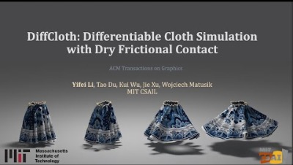
Cloth Simulation by ODE solver
Dynamics described by differential equations
Implicit solver uses root finding or function approximation
Notes:
Our differentiable simulator extends a state-of-the-art cloth simulator based on Projective Dynamics (PD) and with dry frictional contact.
We propose a fast and novel method for deriving gradients in PD-based cloth simulation with dry frictional contact.
Furthermore, we conduct a comprehensive analysis and evaluation of the usefulness of gradients in contact-rich cloth simulation.
Finally, we demonstrate a number of downstream applications, including system identification, trajectory optimization for assisted dressing, closed-loop control, inverse design, and real-to-sim transfer.

Slide 27
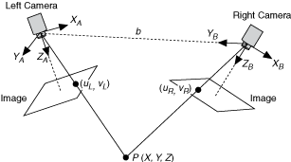
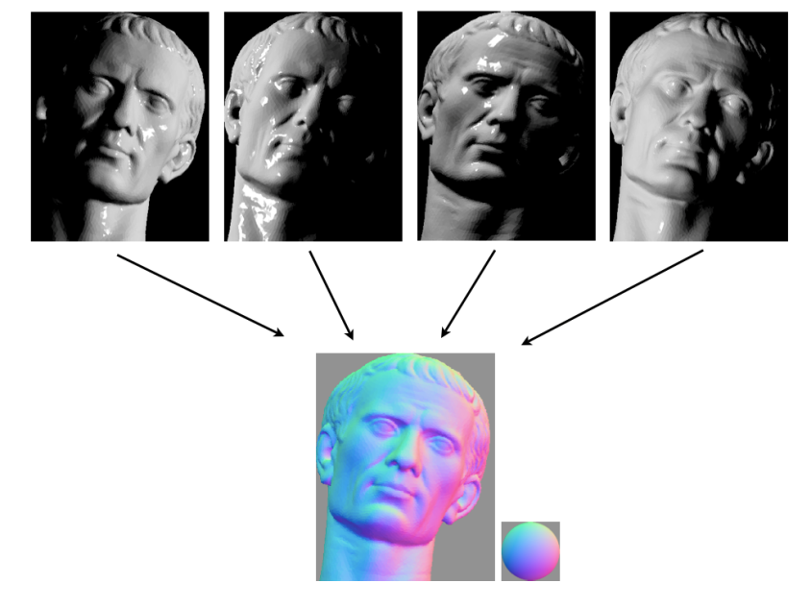
Computer Vision
Stereo vision
solving linear equations, optimization
Shape from shading
optimization

Slide 28
Machine Learning
Pattern recognition
curve fitting, linear equations, function approximation
Artificial neural network
Many algorithms are based on optimization methods
back propagation (BP)

Slide 29
Simulation for prototyping
ODE solver, PDE solver, optimization, numerical integration, interpolation, finite element method
Circuit design
Mechanical design
CAD/CAM

Slide 30

Any Question?

