Slide 1
Solving Nonlinear Equations
Root r

Slide 2
Nonlinear Equations
Given function f, we find value x for which
Solution x is a root of equation, or zero of function f
So problem is known as root finding or zero finding

Slide 3


Nonlinear Equations: two cases
Single nonlinear equation in one unknown, where Solution is scalar x for which f(x) = 0
System of n coupled nonlinear equations in n unknowns, where Solution is vector x for which all components of f are zero simultaneously, f(x) = 0

Slide 4
Examples: Nonlinear Equations
Example of 1-D nonlinear equation for which x = 0.3604 is one approximate solution
Example of system of nonlinear equations in two dimensions for which x = [-1.8, 0.8] is one approximate solution vector

Slide 5
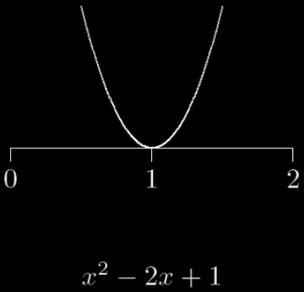
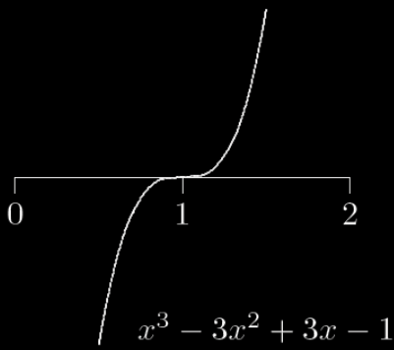
Multiplicity
If f(R) = f’(R) = f”(R) = … = f^{(m-1)}(R) = 0 but f^{(m)}(R) ≠ 0, then root R has multiplicity m
If m = 1 (f(R) = 0, f’(R) ≠ 0 ), then R is simple root

Slide 6
Interval Halving (Bisection)
Bisection method begins with initial bracket and repeatedly halves its length until solution has been isolated as accurately as desired
while |b-a| > tol,
m = (b+a)/2;
If f(a)*f(m) < 0,
b = m;
else
a = m;
end;
end;
a
m
b
Notes:
*** If you cannot execute a Java web, you need to add http://web.engr.illinois.edu
to the exception list of Java control panel of your PC.
Please follow the instructions in https://www.java.com/zh_TW/download/help/jcp_security.xml

Slide 7
Properties of Bisection
Simple and guaranteed to work if
f is continuous in [a, b]
[a, b] brackets a root
Needed iterations to achieve a specified accuracy is known in advance
Error after n iterations < |b - a| / 2^{n}
Slow to converge

Slide 8
Proper Use of Bisection
Good for initial guess for other root finding algorithms
Finding the initial bracket may be a problem if f is not given explicitly
Use graphing to assist root finding
Set the initial bracket
Detect multiple roots

Slide 9
Can we find a root in a better way?
Bisection only utilizes function values f(x)
We can find a root with fewer iterations if other information is used
Linear approximation of f(x)
Secant line → secant method
Tangent line → Newton’s method
Polynomial approximation of f(x)
Muller’s method

Slide 10
Secant Method
Approximate a function by a straight line
Compute the intersection of the line and x-axis
Root r

Slide 11
Secant Method (cont.)
Update endpoints
Repeat
Root r

Slide 12
Example
f(x) = 3x + sin(x) – exp(x)
Find the root in [0, 1]
Notes:
http://heath.cs.illinois.edu/scicomp/

Slide 13
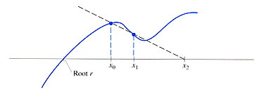
Problem of secant method
Remedy
Always bracket a root in the interval [x₀, x₁]
How to do this?

Slide 14
Method of False Position
Update the intersection as the bisection does
Start with [x₀, x₁] that bracket a root
Repeat
If f(x₂)f(x₀) < 0, Set x₁ = x₂
Else x₀ = x₂
Until |f(x₂)| < tolerance value
Root r

Slide 15
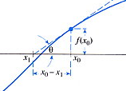
Newton’s method
Better approximation using the first derivative

Slide 16
Interpretation of Newton’s method
Truncated Taylor series is a linear function of h approximating f near x
Replace the nonlinear function f by this linear function, whose zero is h = - f(x)/f’(x)
Zeros of the original function and linear approximation are not identical, so repeat process

Slide 17
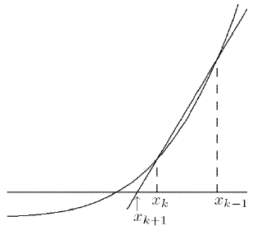
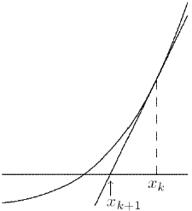
Comparison of Secant and Newton’s methods
Secant method
Newton’s method

Slide 18
Pros and Cons of Newton’s method
Pros
efficient
Cons
Need to know the derivative function

Slide 19
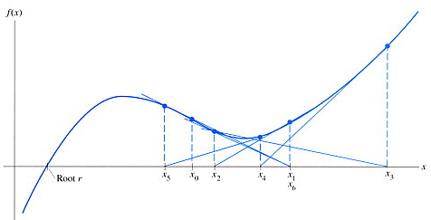
When will Newton’s method not converge?
passing
maximum/minimum
x₁=x₆, loop
Notes:
1. looping,

Slide 20
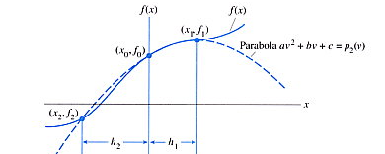
Muller’s method
Instead of linear approximation, Muller’s method uses quadratic approximate
Evaluation of derivatives are not required
See the textbook for details

