Slide 1
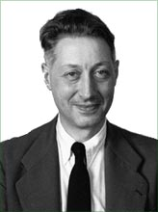
Interpolation & Curve Fitting: Spline Curves
Pierre Bézier
De Casteljau construction of Bezier curve
From www.wikipedia.org
Notes:
Pierre Étienne Bézier (September 1, 1910 – November 25, 1999) (pronounced "bay zee ay“)
Received his Ph.D. in mathematics at age 67, (1977)

Slide 2
Midterm Exam?
In the class of Apr 18 (10:10 AM)
The exam shall cover the course materials from the 1st week until one week before the exam date (i.e., Apr 11)

Slide 3
Final Exam?
June 1 or June 8 (10:10 AM)
The exam shall cover the course materials from the 1st week until one week before the exam date

Slide 4
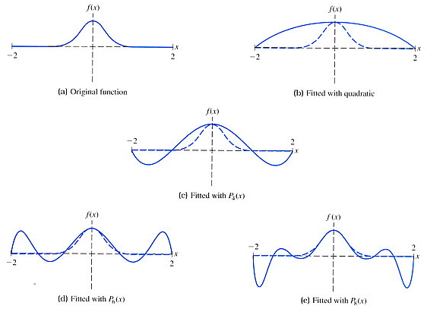
Interpolating Data with a High-Degree Polynomial is Bad!
Often causes undesirable wiggling in a flat region!
Original Function
Fitting with P₂(x)
Fitting with P₄(x)
Fitting with P₆(x)
Fitting with P₈(x)

Slide 5
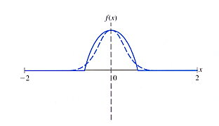
Remedy to High-Degree Polynomial
Break up an interval into subintervals
Employ piecewise polynomial interpolation

Slide 6
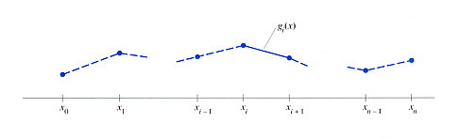
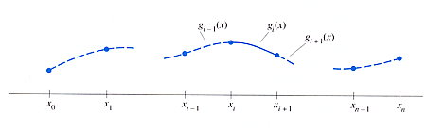
Spline Curves
Linear spline
Cubic spline
Slope is discontinuous!

Slide 7
Cubic Spline
g_{i-1}(x)
g_{i}(x)
g_{i+1}(x)
knots
x₀
x₁
x_{i-1}
x_{i}
x_{i+1}
x_{n-1}
x_{n}
For each segment
Unique solution exists if 4 constraints are specified— solving a system of 4 equations for 4 unknowns
Need additional constraints for g₀(x) and g_{n-1}(x)

Slide 8
Cubic Spline
g_{i-1}(x)
g_{i}(x)
g_{i+1}(x)
knots
x₀
x₁
x_{i-1}
x_{i}
x_{i+1}
x_{n-1}
x_{n}
Continuous position
Continuous slope
Continuous curvature

Slide 9
Sketch for Computing Spline Coefficients
Define
We’ll compute coefficients, a_{i}, b_{i}, c_{i}, d_{i} by
Representing a_{i}, b_{i}, c_{i}, d_{i} as S_{i}
Forming a matrix equation by stacking constraint equations of all segments

Slide 10
Computing d_{i} , a_{i} and b_{i}
From , we know
From , we have
Using and , we obtain

Slide 11
Computing d_{i} , a_{i} and b_{i} (cont.)
Since ,
From , we get
Hence

Slide 12
Computing c_{i}
Substitute the relations for a_{i}, b_{i}, c_{i}, d_{i} obtained so far into
Then solve for c_{i}

Slide 13
Relating S and h
From , we know that
Plug x = x_{i} into g_{i}’(x)
Similarly, we have

Slide 14
Relating S and h (cont.)
Equating results obtained from previous slide
Plugging c_{i} , a_{i-1}, b_{i-1}, c_{i-1} (derived in slides 10&11) into the above equation, we can obtain

Slide 15
Matrix for Computing Cubic Spline Coefficients

Slide 16
Conditions at Extremities
Natural spline: S₀ = S_{n} = 0
Assume linearity at extremities (2nd derivative = 0)
Specify slopes at extremities
f’(x₀) = A and f’(x_{n}) = B,
Left: i = 0
Right: i = n
Notes:
Note that h_n is not defined since h0 = x1-x0, hn = x_n+1 – x_n

Slide 17
Conditions at Extremities (cont.)
S₀ = S₁ , S_{n} = S_{n-1}
Assume approaching parabolas at extremities
“Not a knot” Linear extrapolating from inner points
Left:
Right:

Slide 18
Modified HS=Y based on Condition 3
S₀ = S₁ , S_{n} = S_{n-1}

Slide 19
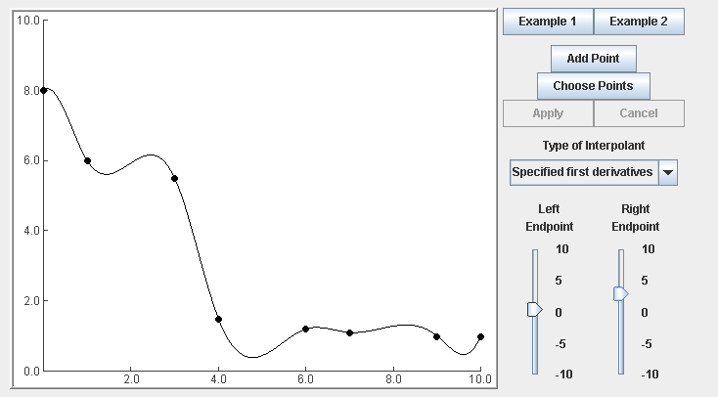
Example: Cubic Spline
Evan VanderZee and Michael Heath
http://heath.cs.illinois.edu/iem/iem.jar

