Slide 1
Character.js
Obstacle.js
Enemy.js
Item.js
animation.js
Index.html
PLAY_GAME.html

Slide 2
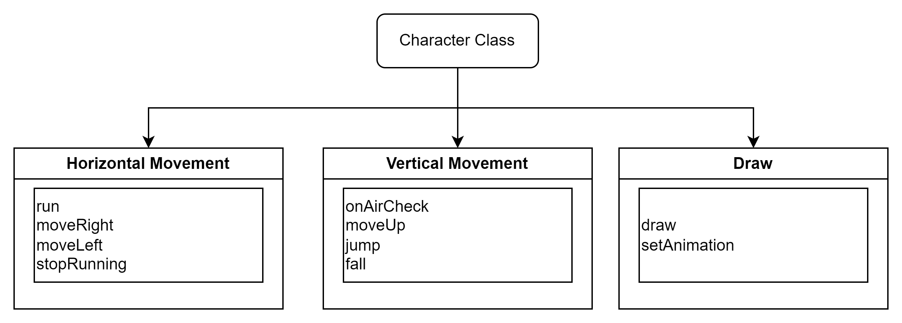
1/ CHARACTER CLASS

Slide 3
draw() has 2 cases: draw a hitbox and 1 frame at a time from a sprites sheet
Right: this is default.
Left: Move origin of canvas to the top right => Flip the whole canvas horizontally => the hitbox coordinate is changed accordingly => Restore hitbox coordinate
Origin
Origin
Flip
x
width
CANVAS_WIDTH - this.width- this.x
CANVAS WIDTH

Slide 4
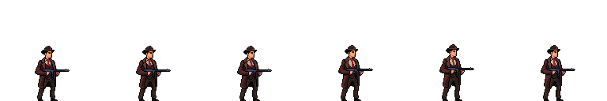
ctx.drawImage(this.characterImg, frameX*this.spriteWidth , frameY*this.spriteHeight , this.spriteWidth ,this.spriteHeight, this.x ,this.y ,this.width ,this.height);
this.spriteWidth , this.spriteHeight : Size of each Frame in spriteSheet
this.x ,this.y : Position on the Canvas
this.width ,this.height: Size of the image
frameX*this.spriteWidth, frameY*this.spriteHeight : the start position of the spriteSheet to crop the image.
Along with this.spriteWidth ,this.spriteHeight, we can cropout 1 Frame to show at a time
this. spriteHeight
this.spriteWidth

Slide 5
setAnimation() use switch case for each state of Character.
In each state, FrameStats.maxFrames and FrameStats.staggerFrames is different based on each spritesSheet. These will specify the speed to loop through each frame of the sprite, thus help us customize the speed which the spriteSheet is animated.

Slide 6
2/ OBSTACLE CLASS
this.x = this.hover_horizontal_range*Math.sin(this.angle) + this.hover_horizontal_Xoffset; this.angle += this.angle_horizontal_speed;
this.hover_horizontal_range*Math.sin(this.angle_reset)
this.hover_horizontal_Xoffset

Slide 7
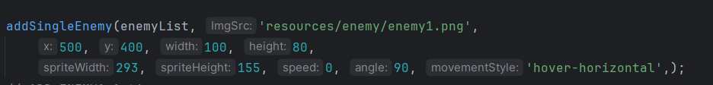
‘speed’ parameter is irrelevant to ‘hover-horizontal’ case.
‘angle’ parameter will be set for this.angle_reset and the first this.angle. Then this.angle will be incremented after each iteration to animate hovering: this.angle += this.angle_vertical_speed;

Slide 8
‘angle’ parameter should be 90 => If collide to the right of this.hover_horizontal_Xoffset, enemy will appear in position 1 and If collide to the left of this.hover_horizontal_Xoffset, enemy will appear in position 2
if (char_x > this.hover_horizontal_Xoffset ){ this.angle = this.angle_reset; this.hover_horizontal_range = -this.hover_horizontal_range_OFFSET;}
else { this.angle = this.angle_reset; this.hover_horizontal_range = this.hover_horizontal_range_OFFSET; }
1
2

Slide 9
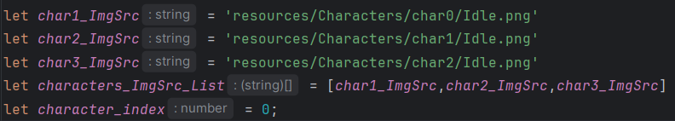
1/ In animation_Character_Select.js

Slide 10
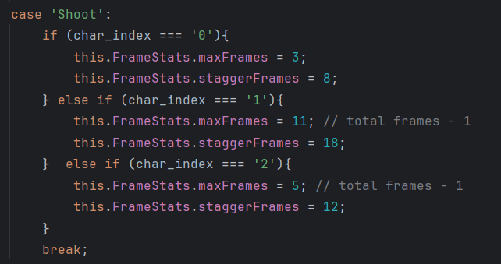
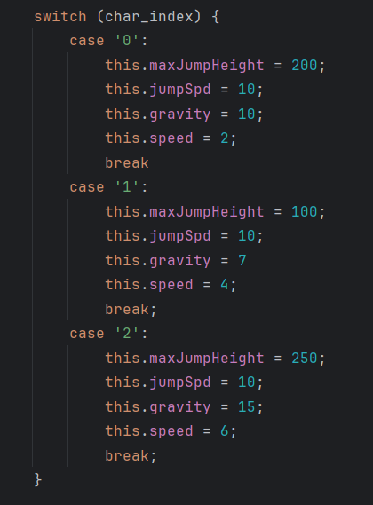
2/ In Constructor of class Character in Character.js
3/ In setAnimation() of class Character in Character.js

Slide 11
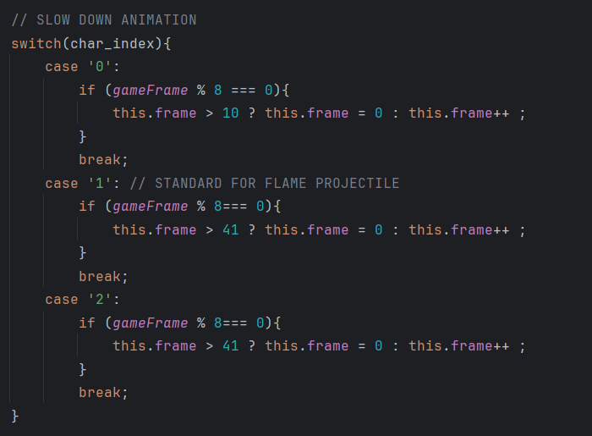
4/ In update() of class Projectile in Projectile.js

Slide 12
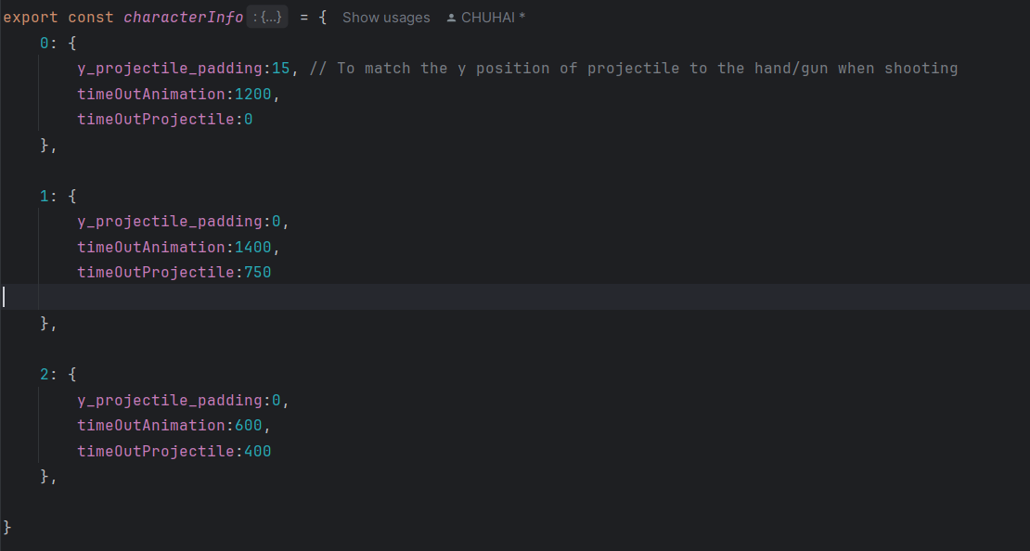
5/ In Character.js

Slide 13
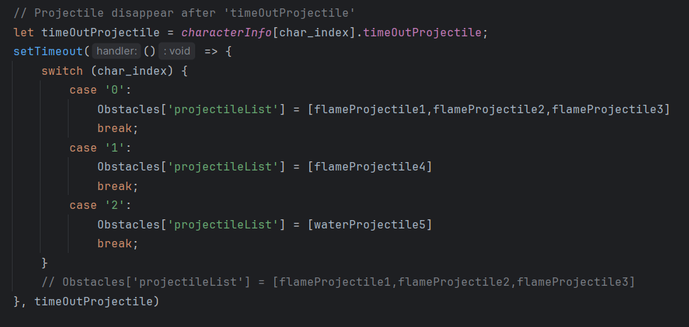
6/ In EVENT HANDLING in eventHandling.js
You can change projectile object in SET UP PROJECTILE OBJECTS in animation.js

