Slide 1
KP1 A&B
Fuel line diesel filter to engine

Slide 2
General requirements
All parts should comply with PF.90197; functional requirements must demonstrate P99C90, and durability requirements must demonstrate P95C90;
Diesel filter to engine Feed line size: Ø 8x6mm
Return line from Pump to tank: Ø10x8mm
The QC engine bay side must be metallic with second latch.
Recommend tube material: monolayer or multilayer pipe.
All lines should be capped on all ends, shall be protected from contamination during shipping and handling (Cap.9.91220)
The 3D models in SP for all clips are designed based on current fuel and vapor line size, only for supplier reference. If supplier have the different size of Nylon line with 3D models in SP, supplier have the responsibilities to revise the design of clip in order to make sure the fuel bundle can comply with the following requirements (DV test is mandatory):
Assembly force of the clip to vehicle: maximum 35N; removal force: minimum 100N
Insertion force of tube into the clip: maximum 40N; removal force:80N

Slide 3
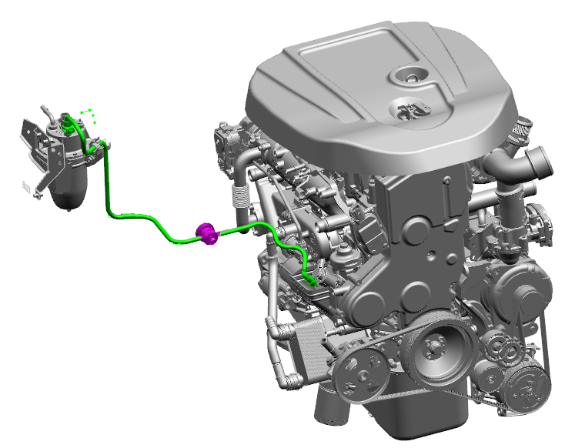
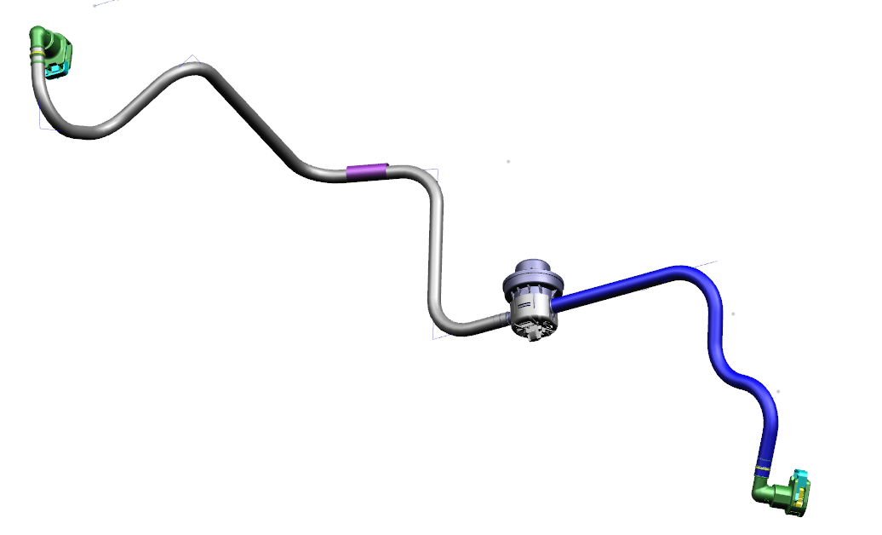
FC00SAA78530 Fuel line diesel filter to engine
FUEL FILTER
SIDE
QC Female 90°SAE 5/16” w/ seck lock
Damper:
Supplier Nobel Auto.
Working Pressure:4.5bar
Anti-abrasion sleeve
Plastic Pipe (Feed)
- Ø 8mm x 6mm
QC Female 90°SAE 3/8’’ wi/ seck lock
Engine bay side

Slide 4
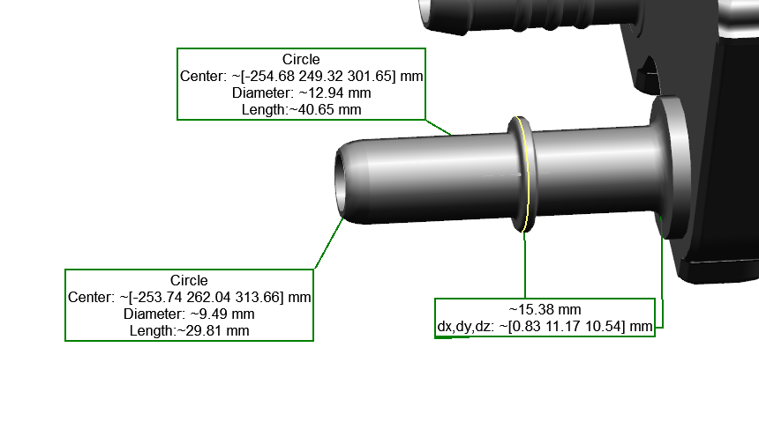
FC00SAA78530-Fuel SUPPLY LINE FILTER TO ENGINE
LEVEL |  |  | ITEM | FCA PART N° | SUPPLIER PART N° | QTY | MATERIAL | SPEC. | SUPPLIER | NOTE
0 |  |  | Assembly Feed Line | FC00SAA78530 |  | 1
 | 1 |  | QC Female 90° 5/16’’ | - |  | 1 |  | PF.90298
 | 1 |  | QC Female 90° 3/8’’ | - |  | 1 |  | PF.90298 |  | PLASTIC WITH SECK-LOCK METAL WITH SECK LOCK
 | 1 |  | Plastic pipe | - |  | 1 | 8x6mm | PF.90197
 | 1 |  | Damper | 52183408 |  | 1 |  |  | Nobel
 | 1 |  | Anti-abrasion sleeve | - |  | 1 | Ref. Type B Braided sleeve(CPN 5302) <Meihe> | SP.91220/02 |  | PF.90271

Slide 5
Backup

