Slide 1
Group 3 Midterm Project 2
Chuan Chen, Mehrshad Eshaghianpour, Ralph Granata,
Kenneth Hasiholan, Savaze Khattak, Ryan King, Jimmy Puli
CSCI-381 Data Modeling
Professor P. Heller

Slide 2
Contents
Modeling Strategy
Schemas
Domains
Sequences
Defaults
Validation Rules
DDL Generation & Database Creation
SQL Server 2019
PostgreSQL
MySQL
Conclusion

Slide 3
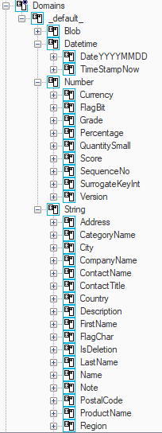
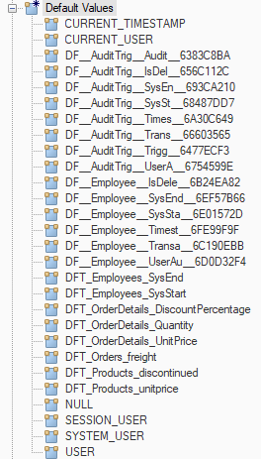

Modeling Strategy
Notes:
After restoring the backup into MSSQL and reverse engineering into Erwin, we can see that there are some schemas, domains, defaults, and validation rules already in place.
Our first step was to tie the model to a template so that we could easily load in the appropriate settings and diagrams for the model.

Slide 4
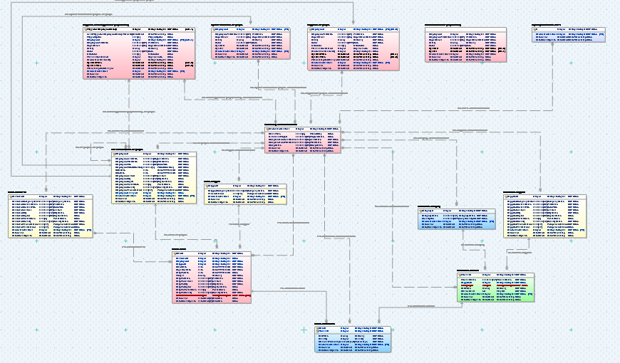
Modeling Strategy
Notes:
Our modeling strategy was to first refine all existing domains into a proper and fully qualified taxonomy format. Then we would go through all attributes in the model to make any changes necessary with schemas and sequence objects being added as needed. Defaults and validation rules were also edited or added to promote reusability and applied across the entire data model.

Slide 5
Schemas
Domains | Sequences | Tables
dGroup3Midterm sdDatetime sdKey sdNumber sdBit sdDecimalNumber sdIntegerNumber sdString sdDescription sdFlagChar sdName sdTitle | SequenceIdInsert | Audit DbSecurity DigitRepresentation HumanResources JsonOutput Production Sales SystemVersioned Triggered Utils
Notes:
When discussing our model, its best to approach it top down in terms of Schemas.
Our schemas can be thought of in terms of Domains, Sequences, and Tables.

Slide 6
Domains
Domain Schemas | Domains/UDTs
dGroup3Midterm sdDatetime sdKey sdNumber sdBit sdDecimalNumber sdIntegerNumber sdString sdDescription sdFlagChar sdName sdTitle | sdDatetime sdKey sdNumber sdString
Notes:
Lets look at how our domains map to their parent domain schema names in order to be considered fully qualified.
First, all our top level subdomains map appropriately to the schema dGroup3Midterm.

Slide 7
Domains
Domain Schemas | Domains/UDTs & Usage Count
dGroup3Midterm sdDatetime sdKey sdNumber sdBit sdDecimalNumber sdIntegerNumber sdString sdDescription sdFlagChar sdName sdTitle | DateTimestamp: 38 DateYYYYMMDD: 5
Notes:
sdDateTime is the subdomain used for dates and timestamps.
We can see a large reuse of our UDTs here with DateTimestamp being used 38 times, and DateYYYYMMDD being used 5 times.

Slide 8
Domains
Domain Schemas | Domains/UDTs & Usage Count
dGroup3Midterm sdDatetime sdKey sdNumber sdBit sdDecimalNumber sdIntegerNumber sdString sdDescription sdFlagChar sdName sdTitle | SurrogateKeyInt: 14
Notes:
SurrogateKeyInt is the UDT used for keys in our model. These fall under the parent domain of sdKey and are being reused 14 times.

Slide 9
Domains
Domain Schemas | Domains/UDTs & Usage Count
dGroup3Midterm sdDatetime sdKey sdNumber sdBit sdDecimalNumber sdIntegerNumber sdString sdDescription sdFlagChar sdName sdTitle | FlagBit: 1 Currency: 7 Percentage: 1 Quantity: 1 SequenceNo: 2
Notes:
For numerical values we have the following:
FlagBit maps to the parent domain sdBit and is used to represent flags of 0 or 1.
Currency and Percentage are under the parent domain of sdDecimalNumber.
Quantity and SequenceNo fall under sdIntegerNumber.

Slide 10
Domains
Domain Schemas | Domains/UDTs & Usage Count
dGroup3Midterm sdDatetime sdKey sdNumber sdBit sdDecimalNumber sdIntegerNumber sdString sdDescription sdFlagChar sdName sdTitle | Address: 4 Note: 4 PostalCode: 4 TelephoneNumber: TimeOfDay: TriggerOption: LongDescription: 1 isDeletion: 1 CategoryName: 1 CityName: 4 CompanyName: 3 CountryName: 4 DepartmentName: 4 FirstName: 2 FullName: 11 GroupName: 1 LastName: 2 ProductName: 1 ProjectName: 1 RegionName: 4 RoleTitle: 5 TitleOfCourtesy: 1
Notes:
For String values, we have the the subdomain sdString, which is further divided into 4 subdomains: sdDescription, sdFlagChar, sdName, and sdTitle.
We can see on the right the UDTS that map to each by their color coding.

Slide 11
Sequences
Sequence | Starting Values:
Triggered_AuditTriggeredEmployeeHistory_TriggeredEmployeeHistoryId Sales_Shipper_ShipperId Sales_Order_OrderId Sales_Customer_CustomerId Production_Supplier_SupplierId Production_Product_ProductId Production_Category_CategoryId HumanResources_Employee_EmployeeId DigitRepresentation_Nums_N DbSecurity_UserAuthorization_UserAuthorizationId | 1000 700 600 500 400 300 200 100 1 800
NEXT VALUE FOR [SequenceIdInsert].[%SequenceObject]
Notes:
Here we have our sequence objects for the data model. All sequence objects are under the schema “SequenceIdInsert” and have different starting values.
Due to Erwin not being able to use a single default for all sequences, we have a 1:1 mapping for these. The default value for each one appears as “NEXT VALUE FOR [SequenceIdInsert][SequenceObjectName]

Slide 12
Table Schemas: Audit
Notes:
Now we will walkthrough each table schema, identifying all attributes, domains, defaults, and any validation rules applied.

Slide 13
Table Schemas: DbSecurity

Slide 14
Table Schemas: DigitRepresentation
Name | Type | Domain | Default/Check Constraint
N(PK) | integer | SurrogateKeyInt | DF_DigitRepresentation_Nums_N
UserAuthorizationId(FK) | integer | SurrogateKeyInt
DateAdded | DateTime2 | DateTimestamp | CK_DigitRepresentation_Nums_DateAdded/DF_DigitRepresentation_Nums_DateAdded
DateOfLastUpdate | DateTime2 | DateTimestamp | CK_DigitRepresentation_Nums_DateOfLastUpdate/DF_DigitRepresentation_Nums_DateOfLastUpdate
Notes:
Next we will talk about the DigitRepresentation’s Table Schema
Base default/check constraints
N – DF_DigitRepresentation_Nums_N which is a sequence object attached to the default with Next Value For [SequenceIdInsert].[DigitRepresentation_Nums_N]
DateAdded – BCK_TemplateTable_EndDateGTEStartDate/BDF_TemplateTable_TimestampNow
DateOfLastUpdate - BCK_TemplateTable_EndDateGTEStartDate/BDF_TemplateTable_TimestampNow
UDP – DateAdded and DateOfLastUpdate uses the same UDP of checking and ensuring that %ColumnProp(udpColumnEndDate) >= %ColumnProp(udpColumnStartDate) in this case DateOfLastUpdate >= DateAdded

Slide 15
Table Schemas: HumanResources
Name | Type | Domain | Default/Check Constraint
EmployeeId(PK) | integer | SurrogateKeyInt | DF_HumanResources_Employee_EmployeeId
EmployeeFirstName | nvarchar(35) | LastName | NA
EmployeeLastName | nvarchar(25) | FirstName | NA
EmployeeTitle | nvarchar(30) | RoleTitle | NA
EmployeeTitleOfCourtesy | nvarchar(4) | TitleOfCourtesy | CK_HumanResources_Employee_EmployeeTitleOfCourtesy
BirthDate | date | DateYYYYMMDD | CK_HumanResources_Employee_Birthdate/DF_HumanResources_Employee_Birthdate
HireDate | date | DateYYYYMMDD | CK_HumanResources_Employee_HireDate/DF_HumanResources_Employee_HireDate
EmployeeAddress | nvarchar(60) | Address | NA
EmployeeCity | nvarchar(40) | CityName | NA
EmployeeRegion | nvarchar(30) | RegionName | NA
EmployeePostalCode | char(5) | PostalCode | CK_HumanResources_Employee_EmployeePostalCode
EmployeeCountry | nvarchar(40) | CountryName | NA
EmployeePhoneNumber | char(10) | TelephoneNumber | CK_HumanResources_Employee_EmployeePhoneNumber
EmployeeManagerIdUserAuthorizationId(FK) | Integer | SurrogateKeyInt | NA
UserAuthorizationId(FK) | integer | SurrogateKeyInt | NA
DateAdded | DateTime2 | DateTime2 | CK_HumanResources_Employee_DateAdded/DF_HumanResources_Employee_DateAdded
DateOfLastUpdate | DateTime2 | DateTime2 | CK_HumanResources_Employee_DateOfLastUpdate/DF_HumanResources_Employee_DateOfLastUpdate
Notes:
We will be going over the HumanResources Table Schema.
-Go over each row and column.
Base default/check constraints
EmployeeId – NA/DF_HumanResources_Employee_EmployeeId
EmployeeTitleOfCourtesy - BCK_TemplateTable_TitleOfCourtesy / NA
BirthDate – BCK_TemplateTable_BirthDate/BDF_TemplateTable_19000101
HireDate – BCK_TemplateTable_ValidDate/BDF_TemplateTable_TimestampNow
EmployeePostalCode – BCK_TemplateTable_PostalCode
EmployeePhoneNumber – BCK_TemplateTable_Phone
DateAdded – BCK_TemplateTable_EndDateGTEStartDate/BDF_TemplateTable_TimestampNow
DateOfLastUpdate - BCK_TemplateTable_EndDateGTEStartDate/BDF_TemplateTable_TimestampNow
UDP – DateAdded and DateOfLastUpdate uses the same UDP of checking and ensuring that %ColumnProp(udpColumnEndDate) >= %ColumnProp(udpColumnStartDate) in this case DateOfLastUpdate >= DateAdded
We feel that the currently chosen UDT works best for each attribute because for example EmployeeFirstName uses the Domain sdName.LastName and has nvarchar(35) where we feel is sufficient for the first name. Another example could be EmployeePostalCode which uses the domain sdString.PostalCode with char(5) which is sufficiently enough to provide for US based postal codes.

Slide 16
Table Schemas: JsonOutput

Slide 17
Table Schemas: Production

Slide 18
Table Schemas: Sales

Slide 19
Table Schemas: SystemVersioned

Slide 20
Table Schemas: Triggered

Slide 21
Table Schemas: Utils

Slide 22
DDL & Database Creation: SQLServer2019

Slide 23
DDL & Database Creation: PostgreSQL

Slide 24
DDL & Database Creation: MySQL

Slide 25
Conclusion

