Slide 1
Analysis of Genetic Inheritance in a Family Quartet by Whole-genome Sequencing
Chuan Jiang

Slide 2
1: Miller Syndrome
2: primary ciliary dyskinesia

Slide 3
peripheral nucleated white blood cells of individuals
Neither Intergenerational transmission nor consanguinity in affecteds
51x in the mother, 88x in the father, 54x in the daughter and 52x in the son
The intermarker distance is 802 bp based on SNPs that are heterozygous in at least one member of the family.
4,471,510 SNPs at least in one member
3,665,772 SNPs were variable within family
323,255 are novel compared to the knowns

Slide 4
Two merits:
detect errors
sequencing errors
assembly error(CNVs, compression)
identify the precise location of recombination

Slide 5
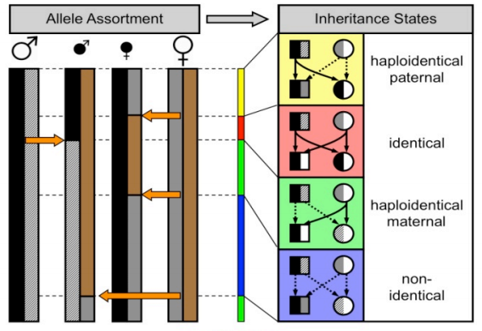
4 inheritance patterns
"twins"

Slide 6
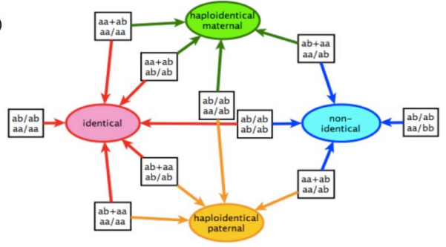
10 genotype patterns
P1
P2
C1
C2
“aa+ab” means the father is
homozygous for the most frequent allele, while the mother is heterozygous. A “/” symbol
is used to indicate that the order is not important

Slide 7
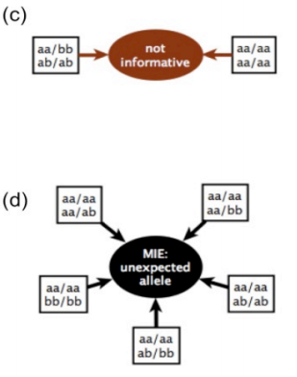
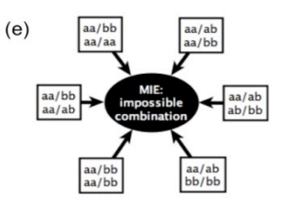
aa/-b => a-/a-
MIE: Mendelian Inheritance Error:
hemizygous
False base calls, mis-mapped reads, or more rarely, inherited deletions heterozygous in one or both parents and de novo mutations
Sequencing error? De novo mutation?

Slide 8
HMM algorithm to identify the boundaries
X_{n} ∈ S {identical,maternal,paternal,non-identical}
Y_{n} ∈ O{aa+ab aa/aa, ab/ab aa/aa,...}
t(i, j) ,π(i), and e(x | i)

Slide 9
y1
y2
y3
y4
y5
O₁
O₂
O₃
O₄
O₅
Patterns?
π(i)
T₁
T₂
T₃
T₄
?
?
?
?
?
Identical
Maternal
Paternal
Non-iden

Slide 10
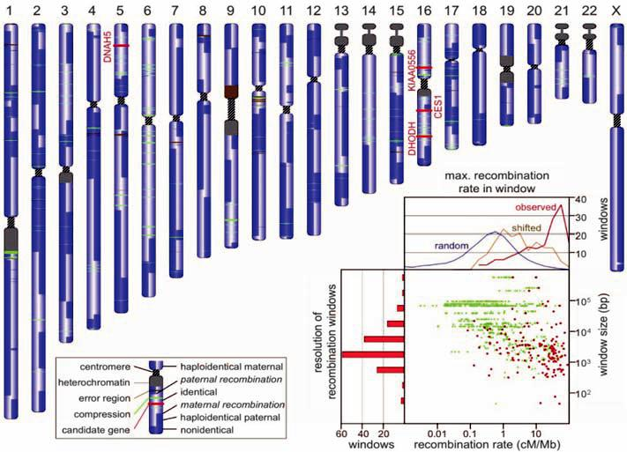

Slide 11
92 of the 155 regions
(median length 2.6 kb) in which we calculate a recombination to have taken place, they
contain a HapMap hotspot or the closest HapMap position is a hotspo

Slide 12
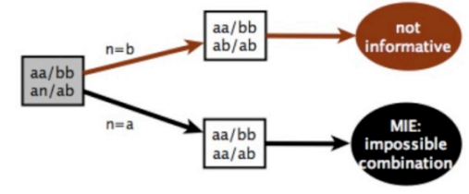

Slide 13
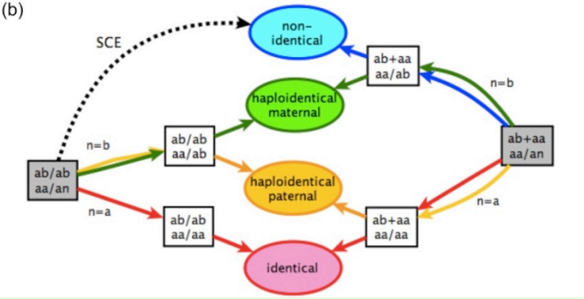

Slide 14
