Slide 1
Result

Slide 2
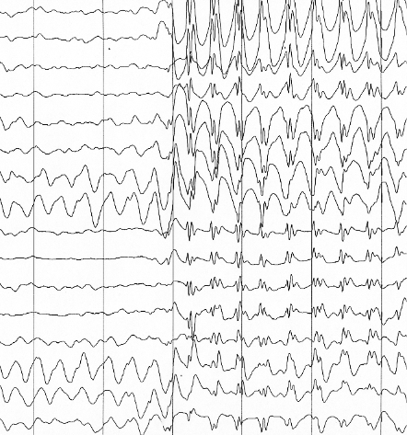
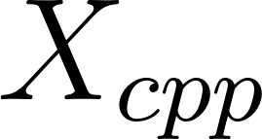
build-up rate
Trial-wise
amplitude
Nine pipelines
Bin-wise
peak amplitude
Condition-wise
Background

Slide 3
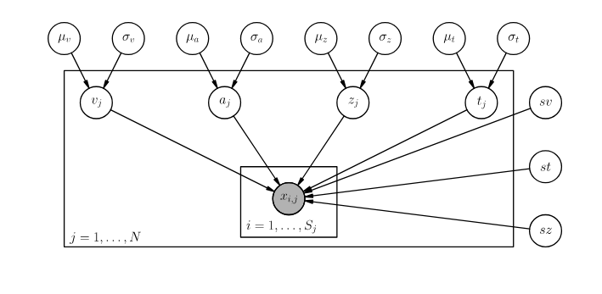
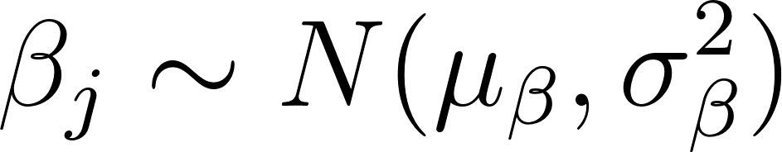
Xcondition
GLM(Joint modeling)
Background
Result

Slide 4
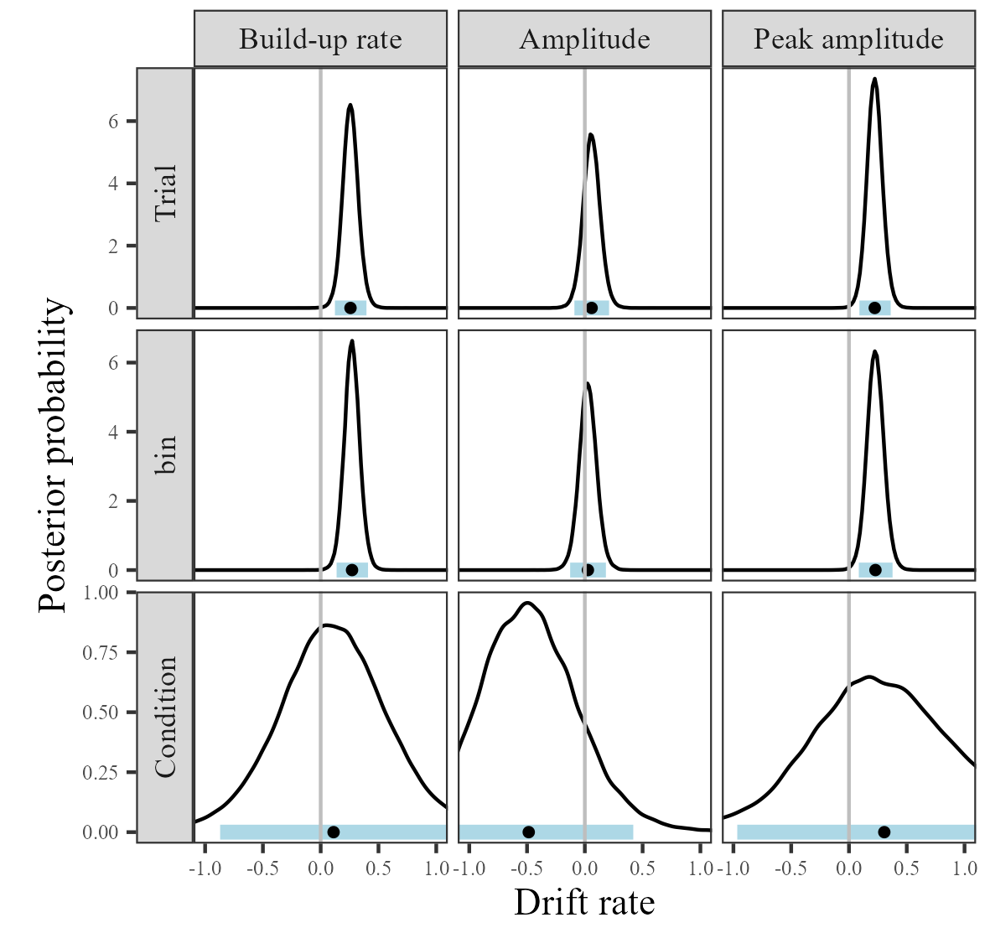

Slide 5
Background
Method

Slide 6
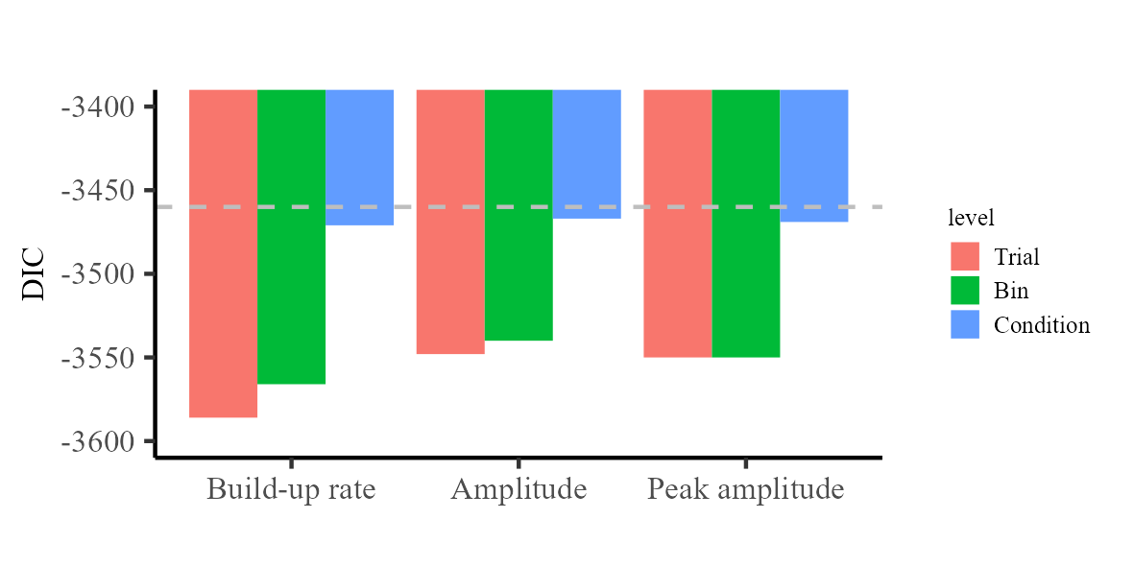

Slide 7
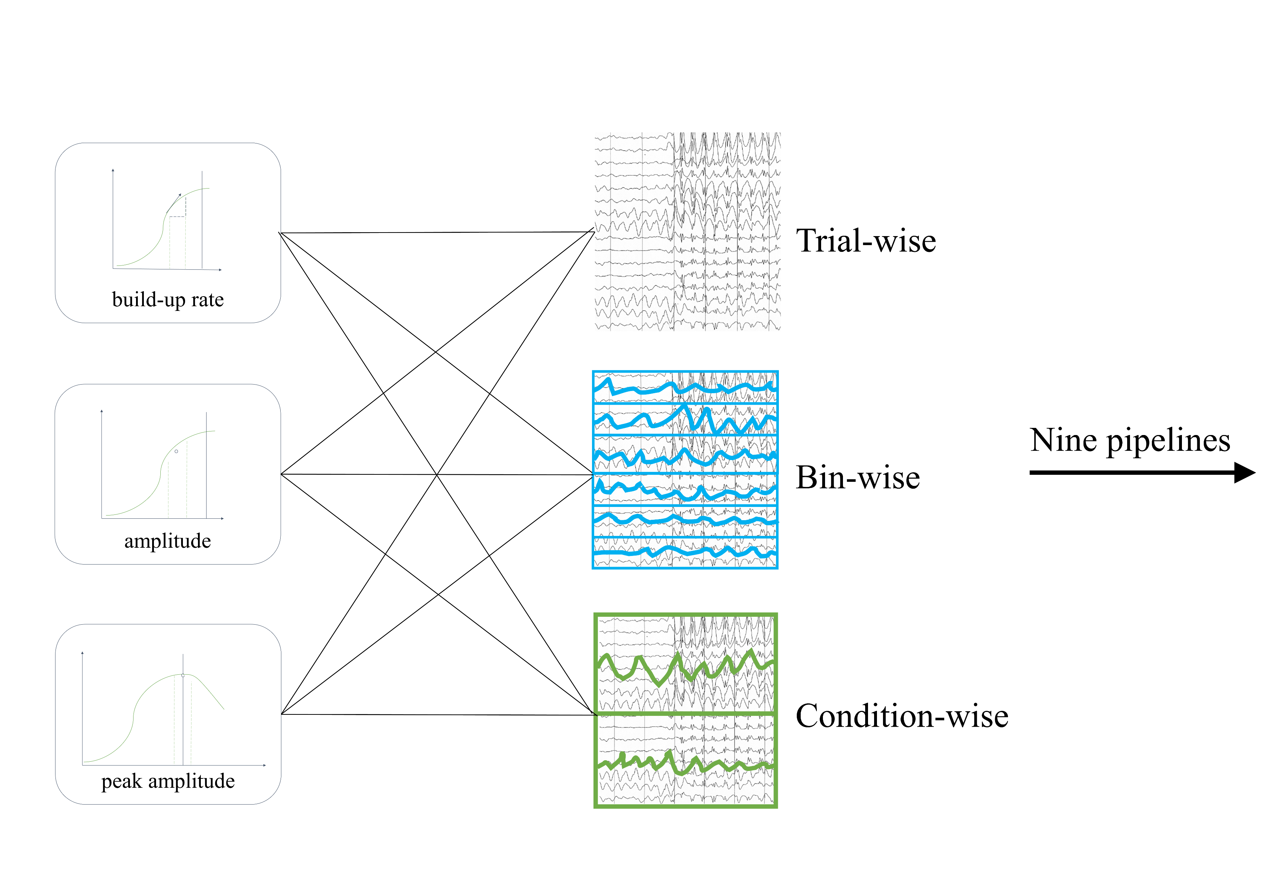
A
B
Xcondition

