Slide 1
CPP as a neuro-marker of evidence accumulation in perceptual decision-making. A multiverse study
Presenter: Liu Yikang, liuyk11@ 126.com
Advisor: Hu Chuan-Peng, PhD
School of Psychology, Nanjing Normal University
Notes:
大家好，我是来自xxx的xxx，指导老师是xxx。今天我报告的主题是xxx。

Slide 2
Table of Contents
An introduction: DV and CPP
Investigating CPP as a neuro-maker of perceptual decision-making
Using joint modeling to improve model fit using CPP
Exploring the impact of different features on perceptual decision-making
Notes:
接下来我将从xxx，xxx，xxx三个方面来论述这一主题

Slide 3
An introduction: DV and CPP
Notes:
首先是xxx

Slide 4
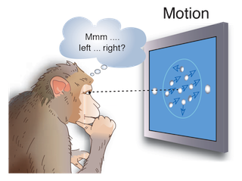
Perceptual decisions entail translating sensory information into judgments, beliefs, or actions.
(O’Connell, R. G., & Kelly, S. P. 2021)
Notes:
也就是说，xxx。

Slide 5
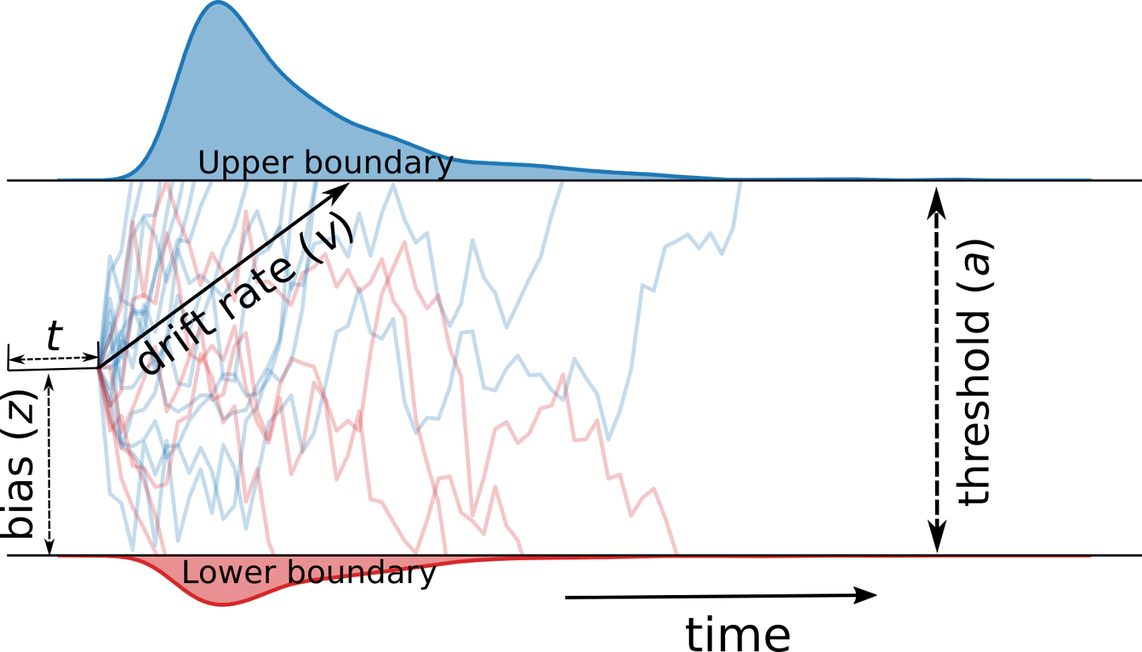
The drift diffusion model(DDM) is a model of the cognitive processes involved in simple two-choice decisions.
drift rate(v): The rate of accumulation of information
bias(z): A priori bias or preference for one or the other choice alternative.
threshold(a): The level of caution.
non-decision time(t): Time for peripheral processes
(Source：Hu et al. 2022)

Slide 6
drift rate(v): The rate of accumulation of information
bias(z): A priori bias or preference for one or the other choice alternative.
threshold(a): The level of caution.
non-decision time(t): Time for peripheral processes
(Source：Hu et al. 2022)

Slide 7
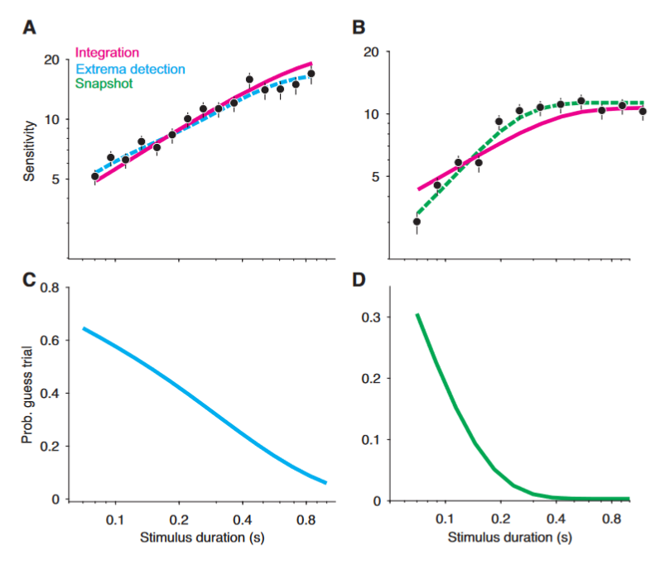
Sometimes it's possible to fit data to a model that doesn't match the assumptions of the model by adjusting the parameters used in the fitting process. This can involve counterintuitive parameter settings.

Slide 8
DDM assumes that decisions are made by a noisy process that accumulates information over time from a starting point toward one of two response boundaries.
Research on decision-making has mainly used evidence accumulation models to analyze decision data, but has not directly tested the validity of the underlying assumptions of the drift-diffusion model (DDM) in specific decision tasks.

Slide 9
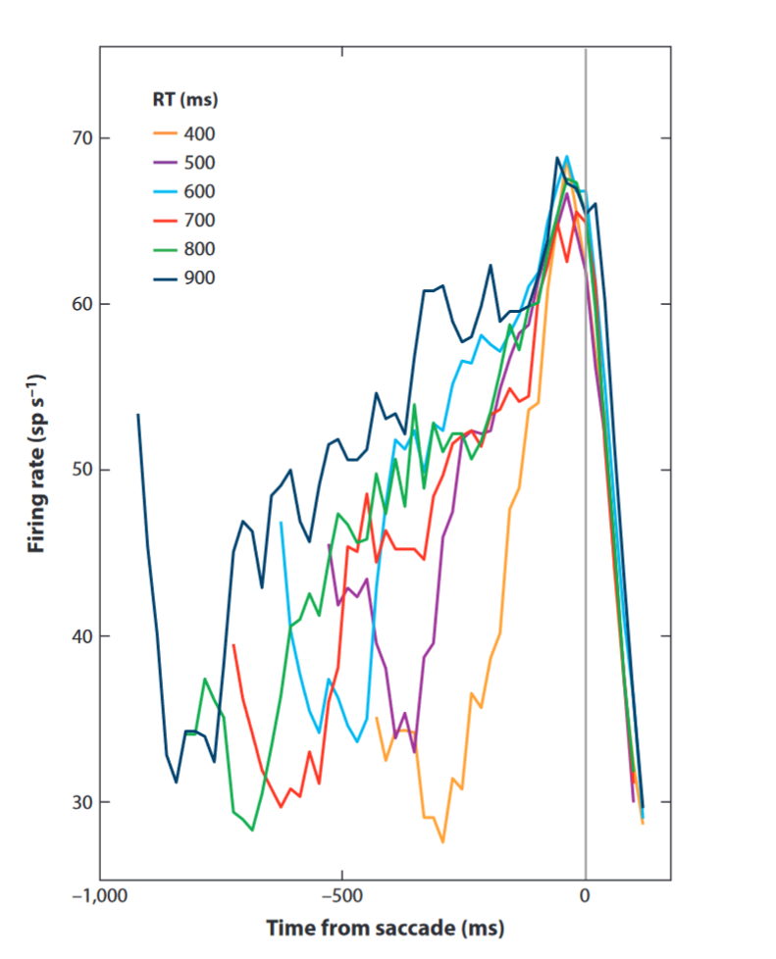
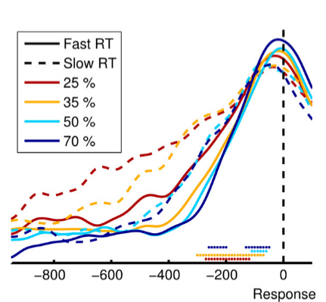
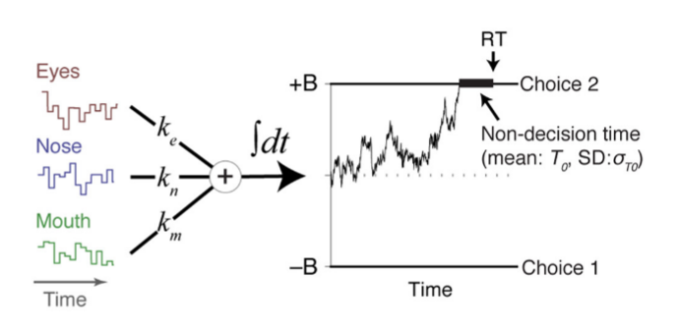
Research validating the DDM model's assumptions primarily focuses on inferring evidence accumulation processes through experimental design and observing neural markers of evidence accumulation through neural signal recordings.
Experimental design
Single-cell recording in animal studies
EEG recording in the human brain
(Gold & Shadlen, 2007; O'Connell et al., 2012; Okazawa rt al., 2021)
Notes:
研究者除了使用行为数据拟合证据积累模型，也对这一模型的神经基础进行了大量的探索。研究者在动物和人类神经活动中均发现了符合证据积累模型的神经活动。使用单电极记录的方法，研究者发现，当猴子进行知觉决策（如随机点移动任务）时，其外侧内顶叶区(lateral intraparietal area, LIP)的神经放电随着感觉证据积累而增强并在猴子决定选择某一选项前达到峰值。
近年来，通过新的信号处理技术和基于模型的方法，研究者使用实验设计来分离决策相关的神经活动(O’Connell et al., 2012)。这些研究发现，人类知觉决策中证据积累过程也有相应的神经基础，通过头皮电极能够记录到一些相对稳定的模式。而CPP则反映了证据积累中的认知过程

Slide 10
Investigating CPP as a neuro-maker of perceptual decision-making
CPP as

Slide 12
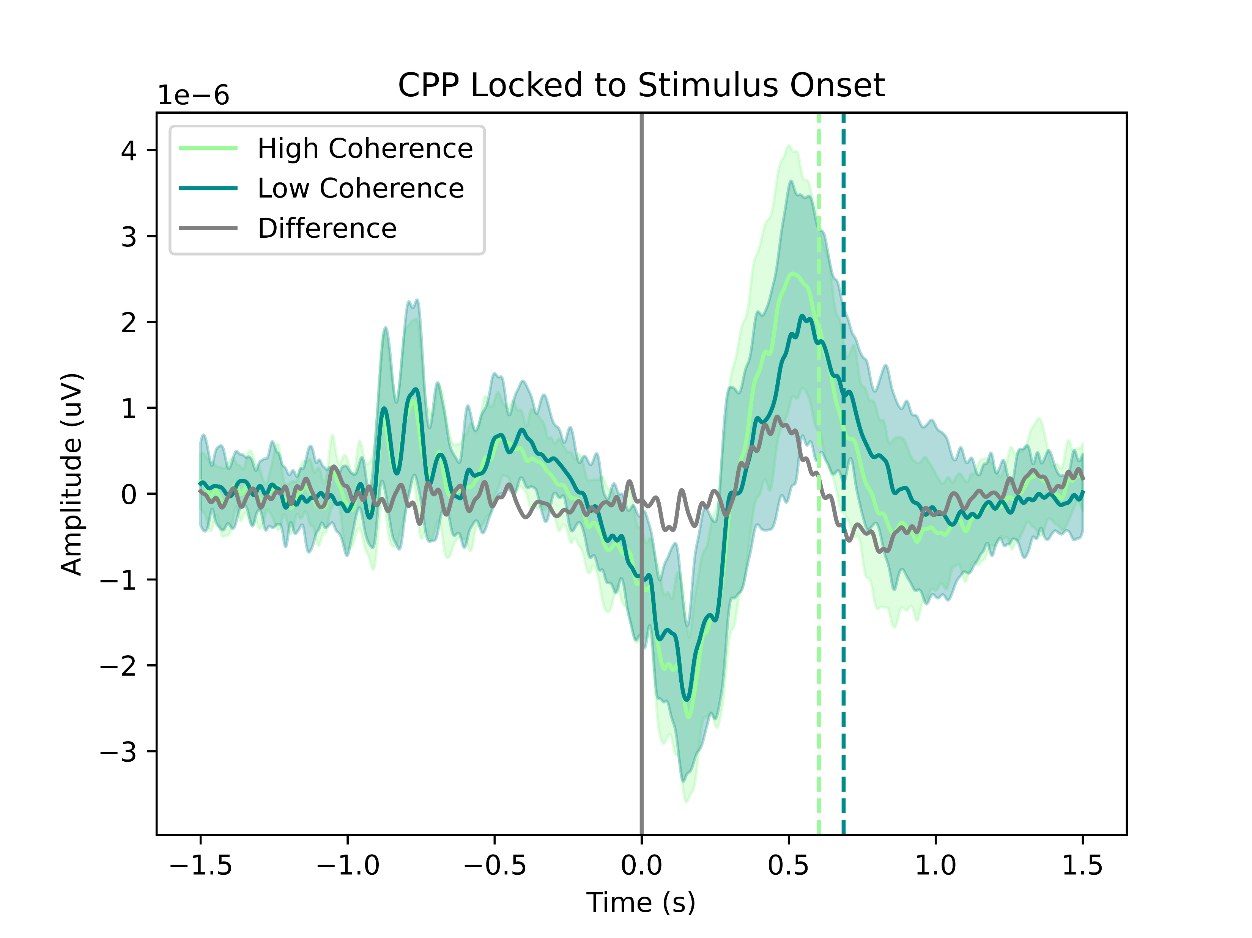
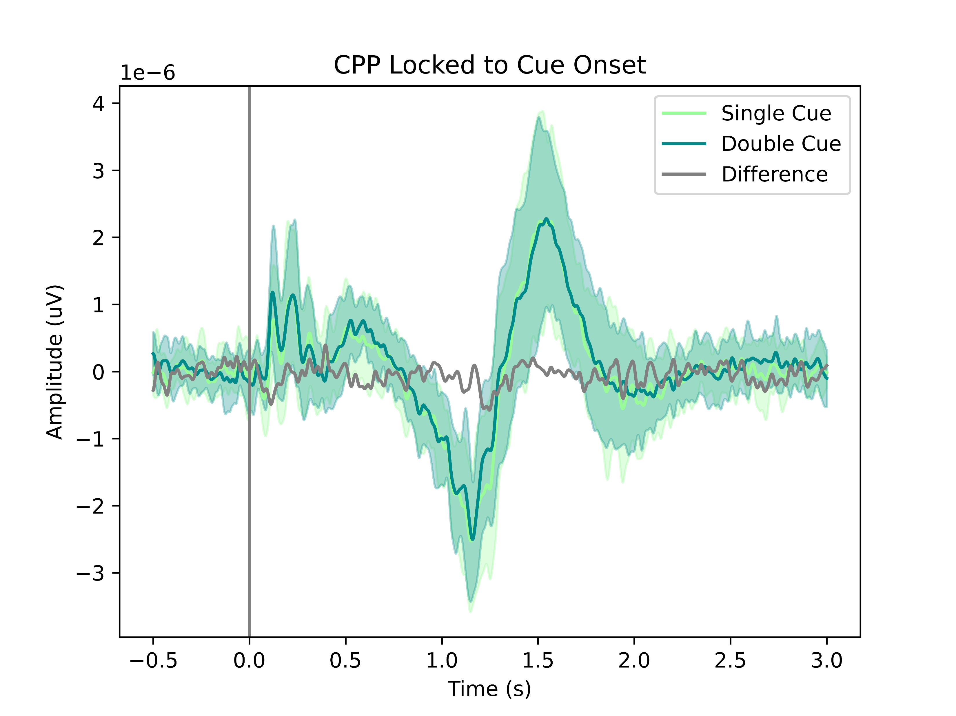
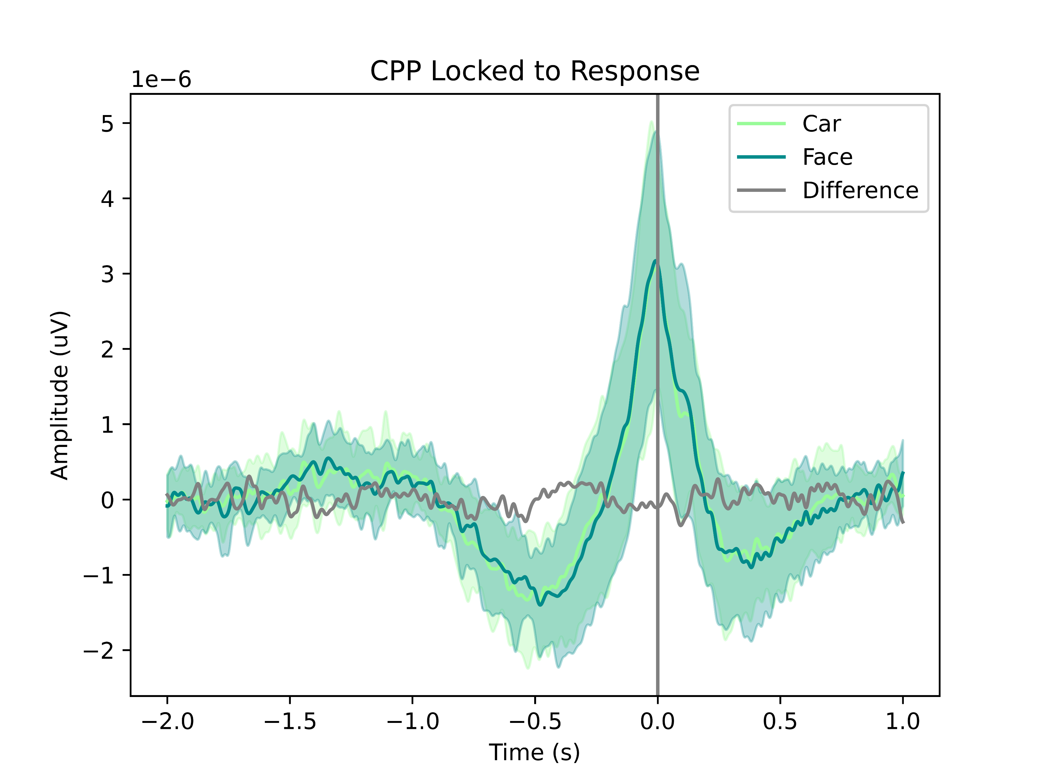
ERP

Slide 14
Thank you！

