Slide 1

Hello ~
R of SPMT
Reliability of Self-Prioritization Effect as Measured by the Perceptual Matching Task:
Evidence from Multiple Datasets
Zheng Liu (Helen), Mengzhen Hu (YuKi), Yuanrui Zheng, Jie Sui, Hu Chuan-Peng
01 / 41
by YuKi
https://github.com/yuki-961004/Reliability_SPMT

Slide 2
Parts
R of SPMT
Introduction
Method
Result
Discussion
Folder System
02 / 41
by YuKi

Slide 3
Introduction
R of SPMT
Introduction
03 / 41
by YuKi

Slide 4
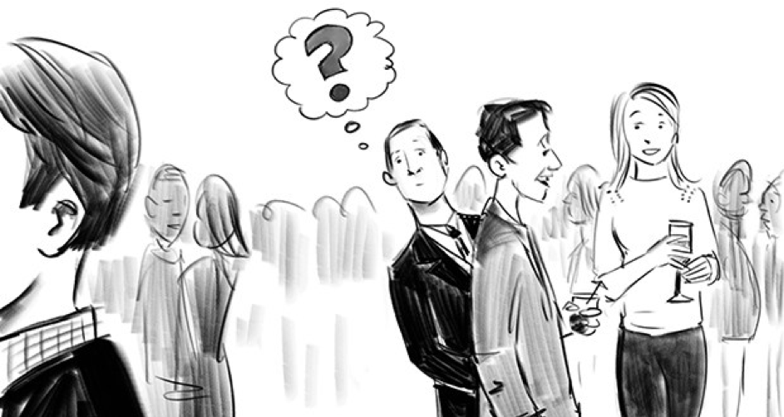
Introduction
R of SPMT
Self-Prioritization Effect (SPE)
The cocktail effect
A memory advantage in recalling information encoded with self-relevance compared with those encoded with non-self relevance. (Rogers et al., 1977)
04 / 41
by YuKi
Notes:
鸡尾酒效应

Slide 5

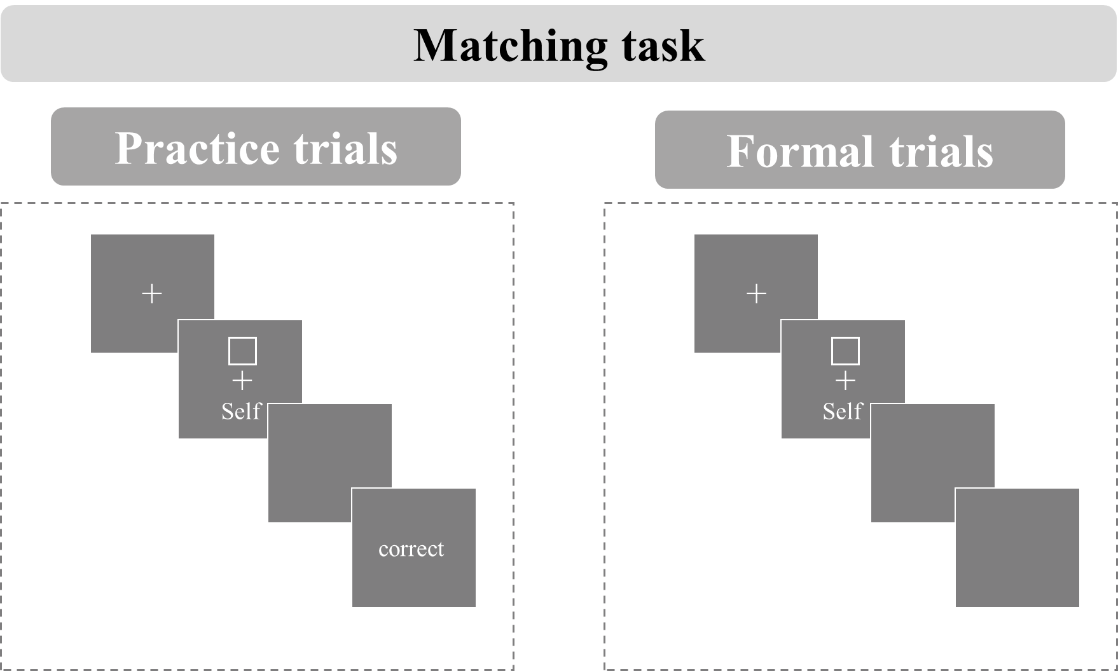
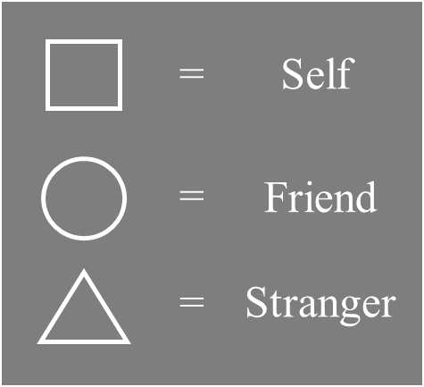
Introduction
R of SPMT
3 * Identity
2 * Matching
A new paradigm to study the self-reference effect named shape-matching task was proposed (Sui et al., 2012).
05 / 41
by YuKi
Notes:
SPMT的实验流程

Slide 6
Introduction
R of SPMT
While SPMT has become a mainstream method for investigating the mechanism underlying the SPE, little attention has been paid to the exact indices of the effect and their reliability, which require careful examination (Parsons et al., 2019; Zorowitz & Niv, 2023).
06 / 41
by YuKi
Notes:
SPMT越来越被普遍用于测量自我优势效应
这意味着我们需要检验这个范式是否具有稳定性，也就是信度

Slide 7
Introduction
R of SPMT
A growing number of cognitive experimental paradigms are being directly used to examine personality traits. (Kucina et al., 2023)
The reaction time differences in the Stroop paradigm are used to reflect individuals' varying executive control abilities. (Eriksen, 1995; Hommel, 2011; MacLeod, 1991)
07 / 41
by YuKi
Notes:
此外，越来越多的认知实验被用来测量稳定的个体差异（类似于问卷被用于测量人格特质）
自我相关刺激反应更快速（自我优势效应）也是具有个体差异的
如果SPMT要被用于测量这样的个体差异，那么这个范式需要具有较高的信度
就像问卷一样

Slide 8
Introduction
R of SPMT
Does the SPMT paradigm have reliability (split-half reliability and test-retest reliability)?
There are many indices that reflect SPE (such as RT, ACC, etc.), do all these indicators have reliability?
Which indice has the highest reliability?
08 / 41
by YuKi
Notes:
SPMT这个范式是否具有信度（分半信度和重测信度）
体现SPE的指标有很多（比如RT, ACC, ..)，这些指标是否都具有信度
哪种SPE的指标信度最高

Slide 9
Method
R of SPMT
Method
09 / 41
by YuKi

Slide 10

Method
R of SPMT
Flow Chart
3 * Identity × 2 * Matching
Subject,
Matching, Identity, Session,
RT_ms, RT_sec, ACC
SPE = Self - <Target>
Intraclass Correlation Coefficient
Split Half Reliability
10 / 41
by YuKi

Slide 11
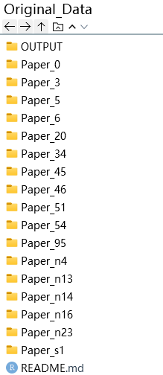
Meta of SPMT
R of SPMT
by YuKi
by YuKi

Slide 12
Method
R of SPMT
Variables
X: Groups
Y: Indices
Reaction Time,
Accuracy,
d prime,
Efficiency
DDM Drift Rate (v)
DDM Start Point (z)
Subject
Matching
Identity
(Session)
Matching
Nonmatching
Close
Celebrity
Stranger
NonPerson
12 / 41
by YuKi
Notes:
需要按照自变量分组，每个实验条件下，都需要计算六种（八种）因变量指标
Session在数据集1中意味着重复度量，在其他数据集中如果没有这个变量，则会编码为1，
如果有其他做实验中组间平衡的变量，则会放在这里

Slide 13
Method
R of SPMT
SPE
SPE = Self - <Target>
e.g.
RT_SPE = SelfRT - <Target>RT
Close
Friend, Mother, Father...
Celebrity
<Target>
Stranger
NonPerson
none
13 / 41
by YuKi

Slide 14

Method
R of SPMT
SPE
Indices | Indices Calculation | SPE Calculation Based on Indices | Source
Mean Reaction Times (RT) | $$\frac{∑RT}{n_{(trials)}}$$ | $${Self}_{(matching)}−{Other}_{(matching)}$$ | Sui et al. (2012)
Accuracy (ACC) | $$\frac{n_{(correct response)}}{n_{total response}}$$ | $${Self}_{(matching)}−{Other}_{(matching)}$$ | Sui et al. (2012)
d prime | $$Z_{ACC(Matching)}−Z_{1−ACC(Nonmatching)}$$ | $$Z_{Self}−Z_{other}$$ | Sui et al. (2012)
Efficiency | $$\frac{{RT}_{mean}}{ACC}$$ | $${Self}_{(matching)}−{Other}_{(matching)}$$ | Humphreys and Sui (2015); Stoeber and Eysenck (2008)
Drift rate (v) | DDM：parameters will be identified through model selection | $${Self}_{(matching)}−{Other}_{(matching)}$$ | Golubickis et al. (2017)
Starting Point (z) |  | $${Self}_{(matching)}−{Other}_{(matching)}$$ | Golubickis et al. (2017)
14 / 41
by YuKi
Notes:
然后计算自我与他人，在这六种指标上的差异，即自我优势效应SPE

Slide 15

Method
R of SPMT
Split Half Reliability
Subject
Matching
Identity
(Session)
First-Second
Odd-Even
Permuted
Monte Carlo
RT
ACC
d
Eff
DDM v
DDM z
RT
ACC
d
Eff
DDM v
DDM z
15 / 41
Split Half Reliability
by YuKi
Notes:
每个被试在每个实验条件下，
按照四种分半方法
数据被均等的分为两份。
每一个两半都需要计算六种表示SPE的指标

Slide 16
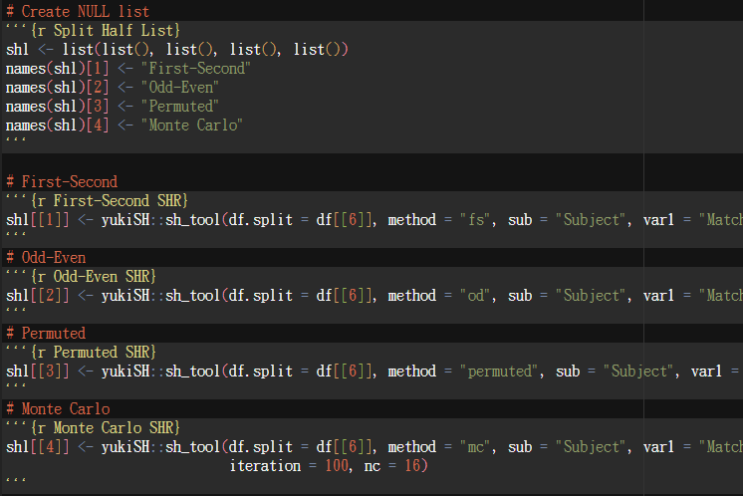
Method
R of SPMT
devtools::install_github("yuki-961004/yukiSH")
16 / 41
by YuKi
https://github.com/yuki-961004/yukiSH
Notes:
除了被试序号外，接受最多三个变量
会对每个实验条件下的试次进行分半
可以选择四种分半方法
其中蒙特卡洛分半是多线程的，线程数越多分半速度越快

Slide 17
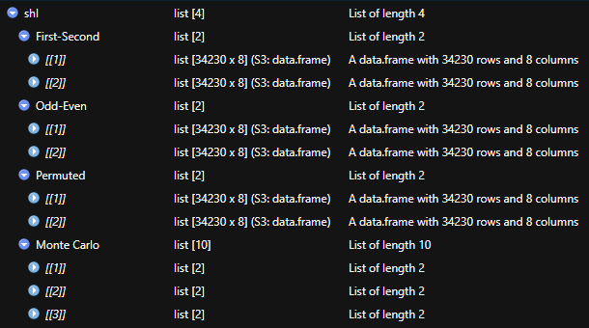
Method
R of SPMT
17 / 41
by YuKi

Slide 18
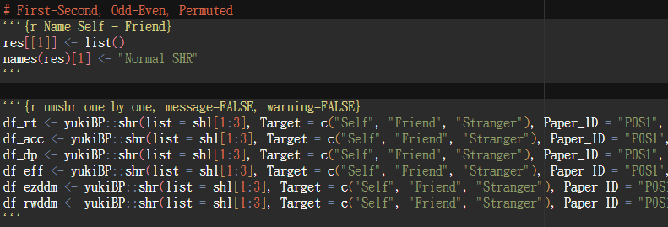
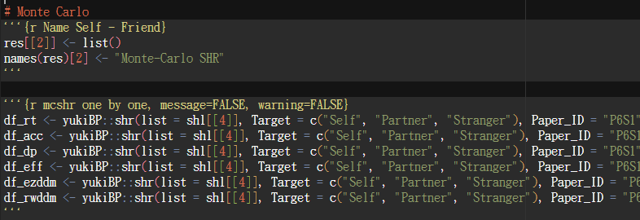
Method
R of SPMT
devtools::install_github("yuki-961004/yukiBP")
18 / 41
by YuKi
https://github.com/yuki-961004/yukiBP
Notes:
对6个指标都求四种分半信度
这里写的是ezddm和rwddm，这个伏笔后面再讲

Slide 19
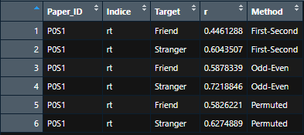
Method
R of SPMT
19 / 41
by YuKi

Slide 20
Method
R of SPMT
Intraclass Correlation Coefficient (ICC)
SPMT
SPMT
SPMT
…
…
How much of the variation in the data can be attributed to differences between raters or repeated measurements.
How much can be attributed to differences within the subjects being measured.
20 / 41
by YuKi

Slide 21
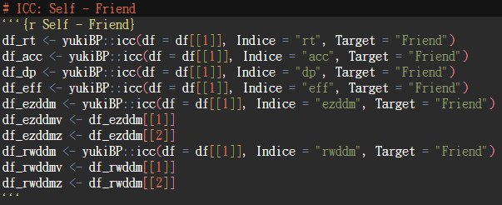
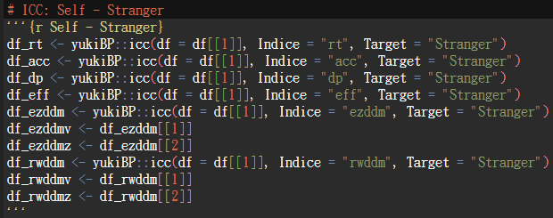
Method
R of SPMT
devtools::install_github("yuki-961004/yukiBP")
21 / 41
by YuKi
https://github.com/yuki-961004/yukiBP

Slide 22
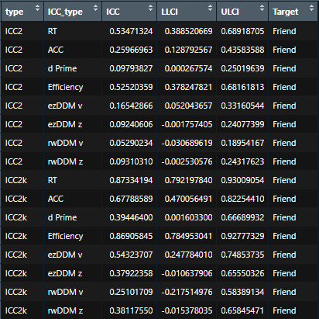
Method
R of SPMT
22 / 41
by YuKi

Slide 23
Result
R of SPMT
Result
23 / 41
by YuKi

Slide 24
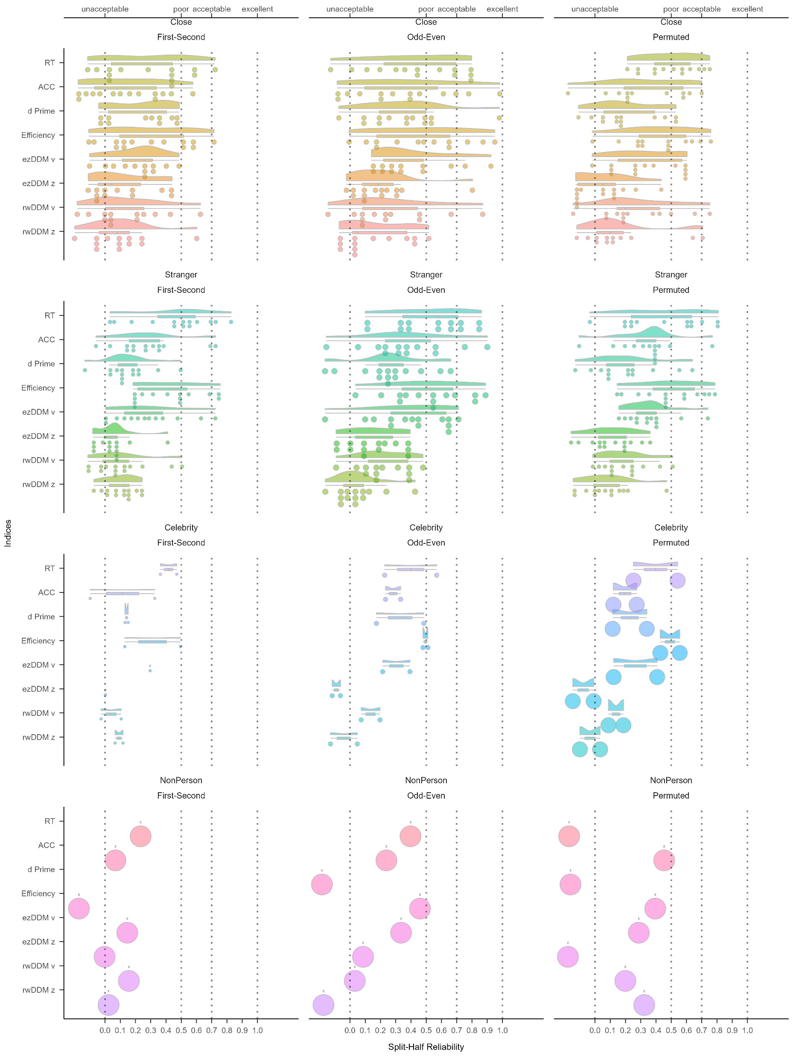
Result
Split Half Reliability
First-Second, Odd-Even, Permuted
R of SPMT
24 / 41
by YuKi
Notes:
可以看到，其实大多数分半信度都在0-0.5之间
相较于与friend的SPE
与stranger的SPE更稳定
其中最稳定的两个指标是RT和efficiency

Slide 25
Result
Split Half Reliability
First-Second, Odd-Even, Permuted
R of SPMT
RT:
M_{Close} = .38, M_{Stranger} = .48,
t = 1.67, df = 82, p = .10,
Cohen’s d = .36
Efficiency:
M_{Close} = .34, M_{Stranger} = .48,
t = 2.18, df = 82, p = .03,
Cohen’s d = .48,
24 / 41
by YuKi
Notes:
可以看到，其实大多数分半信度都在0-0.5之间
相较于与friend的SPE
与stranger的SPE更稳定
其中最稳定的两个指标是RT和efficiency

Slide 26
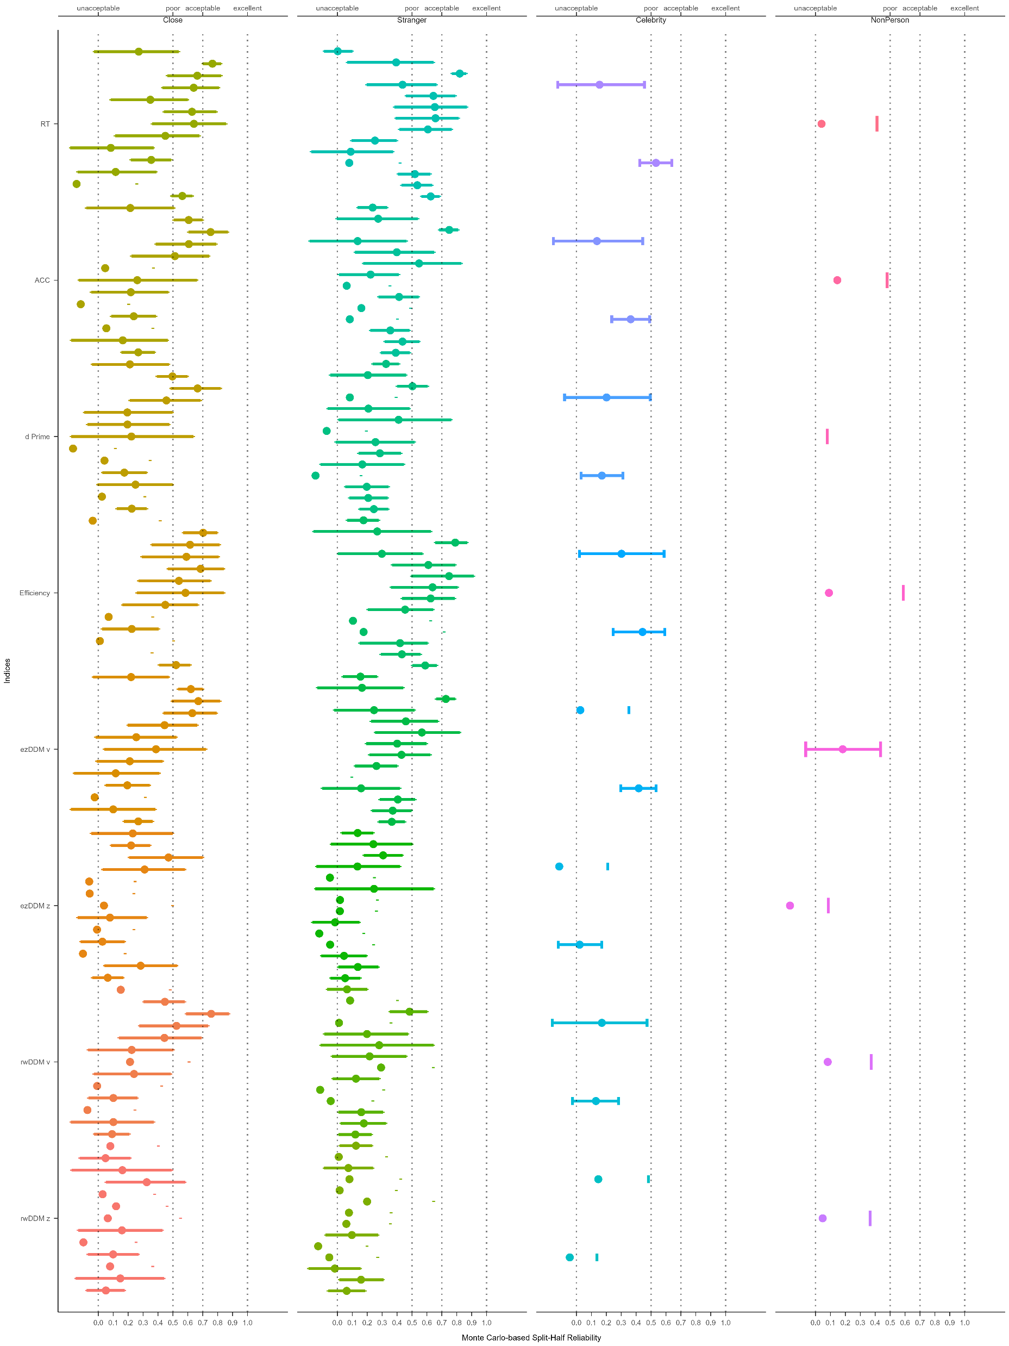
Result
Split Half Reliability
Monte Carlo
R of SPMT
25 / 41
by YuKi
Notes:
这是蒙特卡洛分半十次的结果
每个点代表一个实验的蒙特卡洛分半信度的95%置信区间
RT 和 efficiency的蒙特卡洛分半信度能达到0.5-0.7

Slide 27
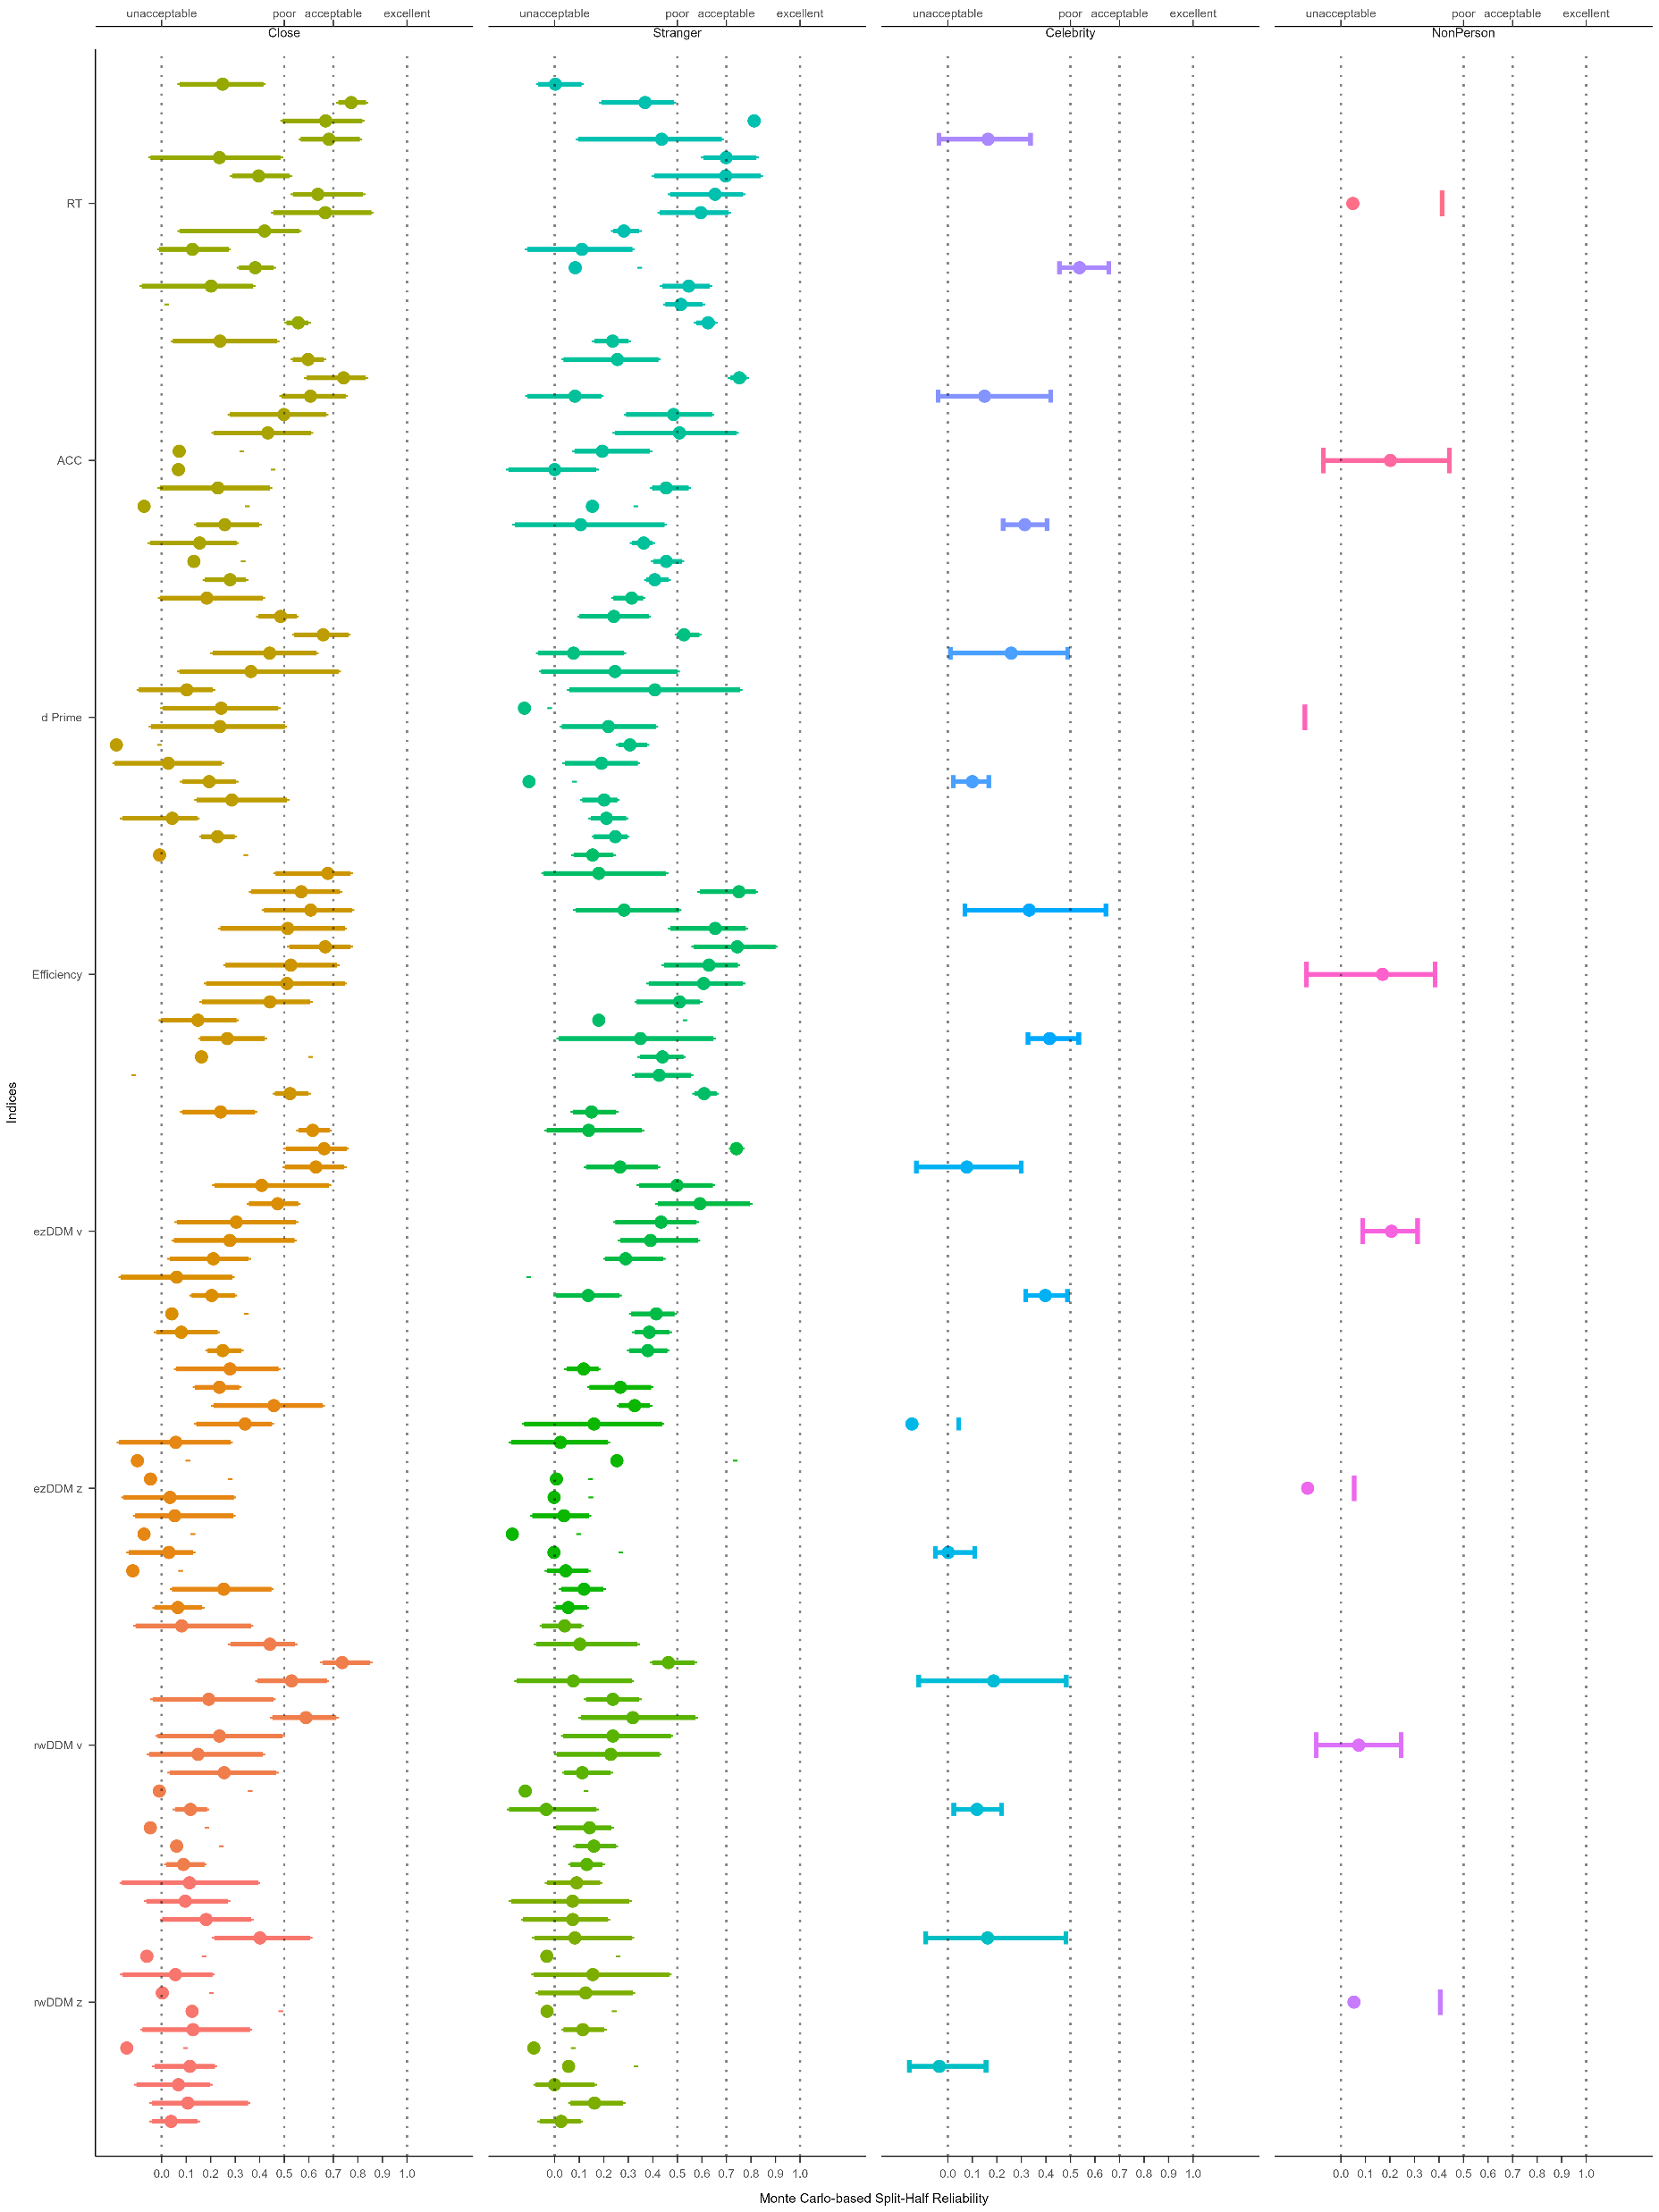
Result
Split Half Reliability
Monte Carlo
R of SPMT
MC= 10
MC= 5k
25 / 41
by YuKi
Notes:
这是蒙特卡洛分半十次的结果
每个点代表一个实验的蒙特卡洛分半信度的95%置信区间
RT 和 efficiency的蒙特卡洛分半信度能达到0.5-0.7

Slide 28
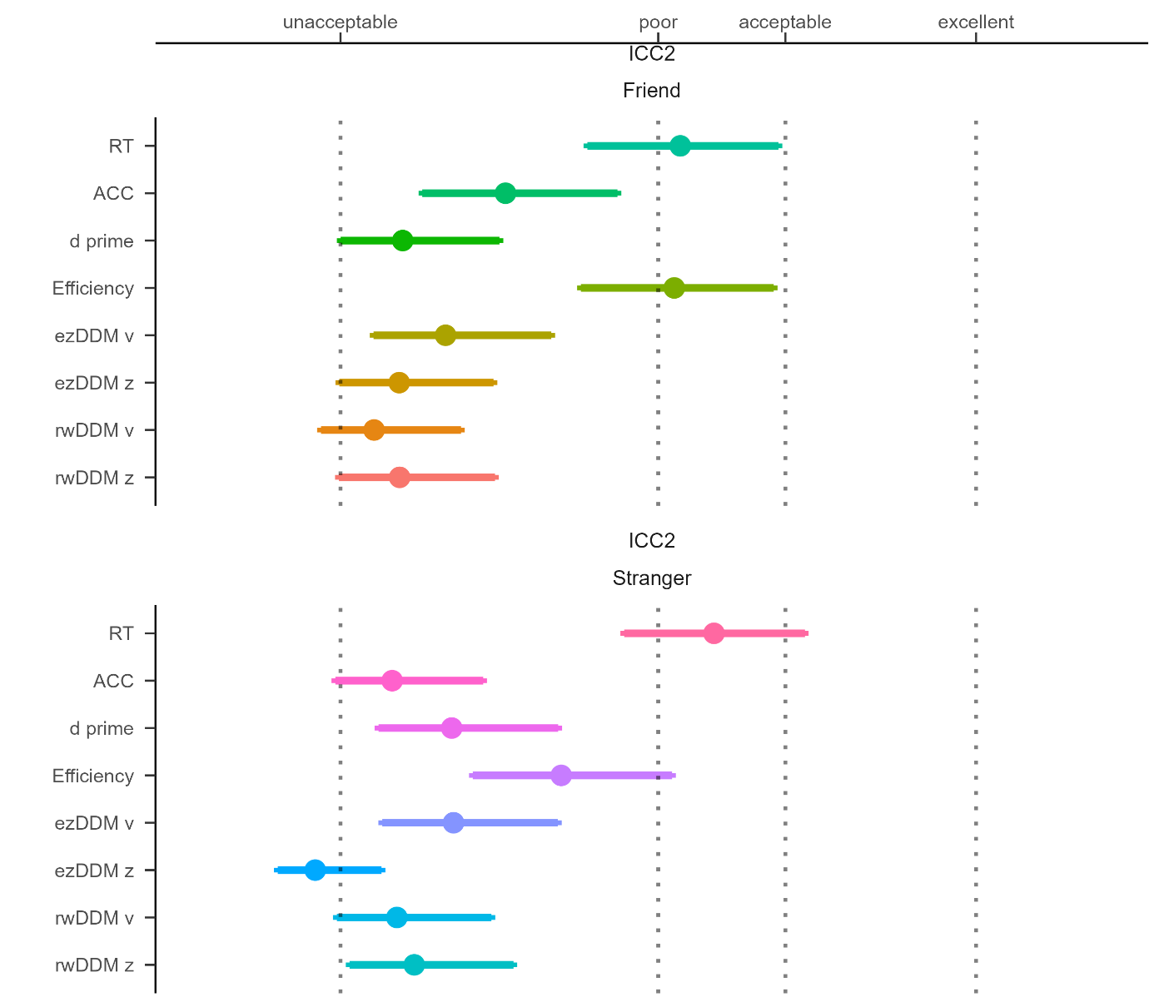


Result
Intraclass Correlation Coefficient
ICC2 & ICC2K
R of SPMT
26 / 41
by YuKi
Notes:
ICC2和ICC2k越大说明重复度量的稳定性越高
RT和efficiency的ICC2k较大，说明这两个指标具有较好的重测信度

Slide 29
Discussion
R of SPMT
Discussion
27 / 41
by YuKi

Slide 30

Discussion
R of SPMT
Wagenmakers, E. J., Van Der Maas, H. L., & Grasman, R. P. (2007). An EZ-diffusion model for response time and accuracy. Psychonomic bulletin & review, 14(1), 3-22.
28 / 41
by YuKi
Notes:
Ezddm不会对z进行估计，而是假定z为a/2
为了得到对z的准确估计，我们对比了R里各种可以计算ddm参数的包

Slide 31
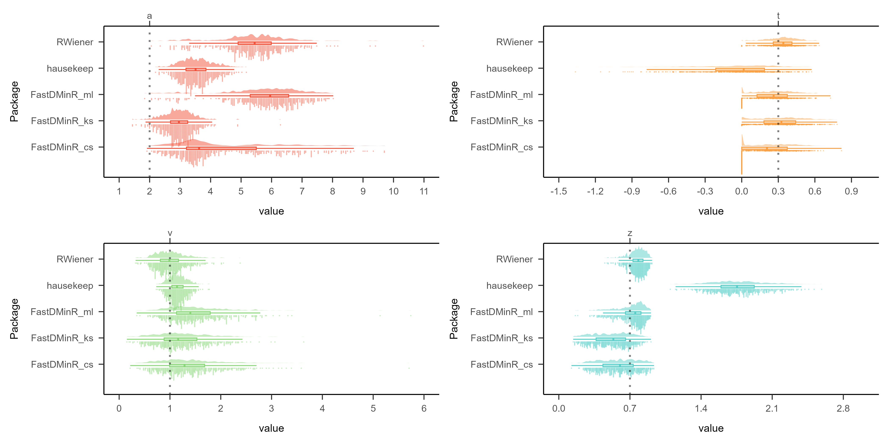
Discussion
R of SPMT
29 / 41
by YuKi
https://github.com/yuki-961004/Reliability_SPMT/tree/main/5_Analysis/DDM_Packages_Comparison
Notes:
我们设定了a = 2, t = 0.3, v = 1, z = 0.7
由hddm这个包生成了符合这四个参数的一百个，含有60试次的数据集
然后让Rwiener，hausekeep，fastDMinR，这三个包，一共五种估计方法估计这四个参数
从而筛选出估计最准确，耗时最低的那个包
结果是，对于a的估计，三个包都不太准确
对于t的估计，RW最准确
对于v的估计，RW最准确，hausekeep也不错
对于z的估计，RW最准确

Slide 32
Discussion
R of SPMT
RT and Efficiency are the most reliable among all indices, both in terms of split-half reliability and test-retest reliability.
Overall, the reliability of the SPMT paradigm is not high, with only the split-half reliability of RT exceeding 0.5. It does not reach the reliability level of 0.8-0.9.
The split-half reliability of the indicators DDM v & z, d prime and ACC is relatively low.
30 / 41
by YuKi
Notes:
RT和Eff是所有指标里最稳定的，不论是分半信度还是重测信度
总体而言，SPMT范式的信度并不高，只有RT的分半信度超过了0.5。并没有达到0.8-0.9的信度
DDM v & z, d prime和acc的信度较低

Slide 33
Folders
R of SPMT
Folder System
31 / 41
by YuKi

Slide 34
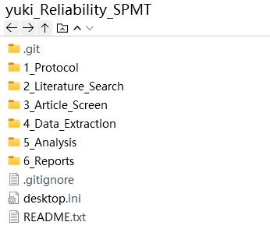
Folders
R of SPMT
Root
32 / 41
by YuKi

Slide 35
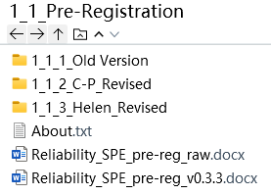
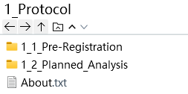
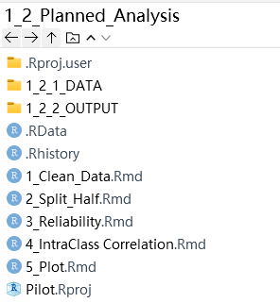
Folders
R of SPMT
1_Protocol
33 / 41
by YuKi

Slide 36
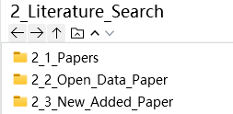
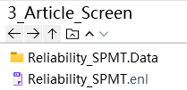
Folders
R of SPMT
2_Literature_Search
3_Article_Screen
34 / 41
by YuKi
Notes:
Papers 最开始文章中的引用文献的pdf。当时还不知道endnote文件，每次都把pdf下载下来了
Opendata paper，有公开数据的文章
New added，cp让我读的文章
Enl文章，用于endnote插入word。一般没有pdf

Slide 37
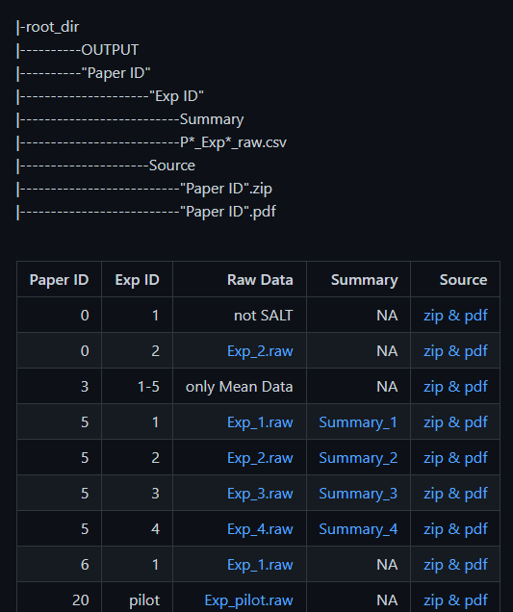
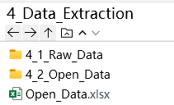
Folders
R of SPMT
4_Data_Extraction
35 / 41
by YuKi

Slide 38
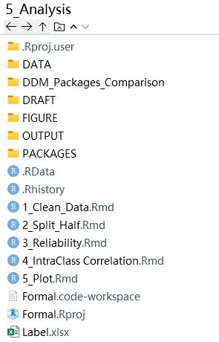
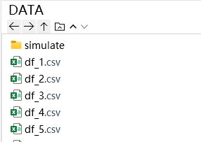
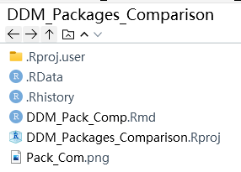
Folders
R of SPMT
5_Analysis
36 / 41
by YuKi

Slide 39
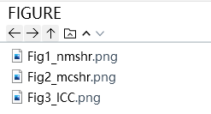
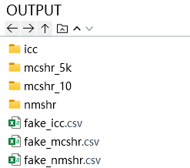
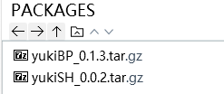
Folders
R of SPMT
5_Analysis
37 / 41
by YuKi

Slide 40
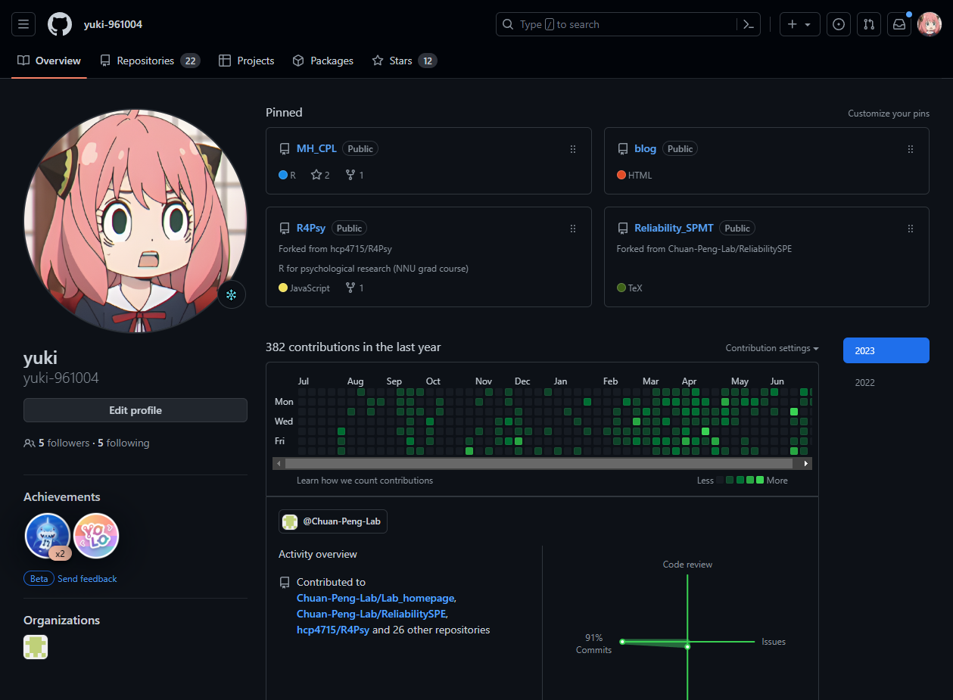
Website
R of SPMT
38 / 41
by YuKi
https://github.com/yuki-961004

Slide 41
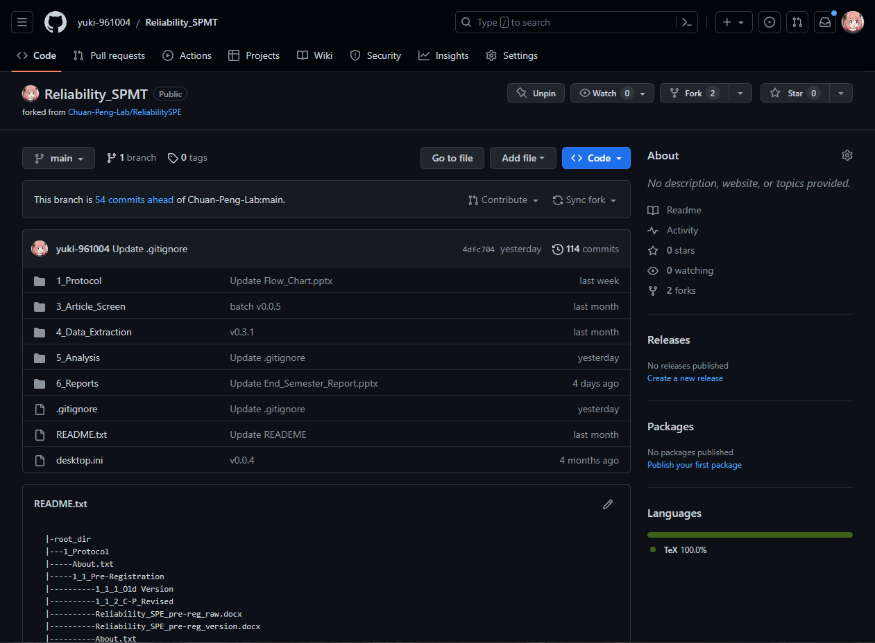
Website
R of SPMT
39 / 41
by YuKi
https://github.com/yuki-961004/Reliability_SPMT

Slide 42
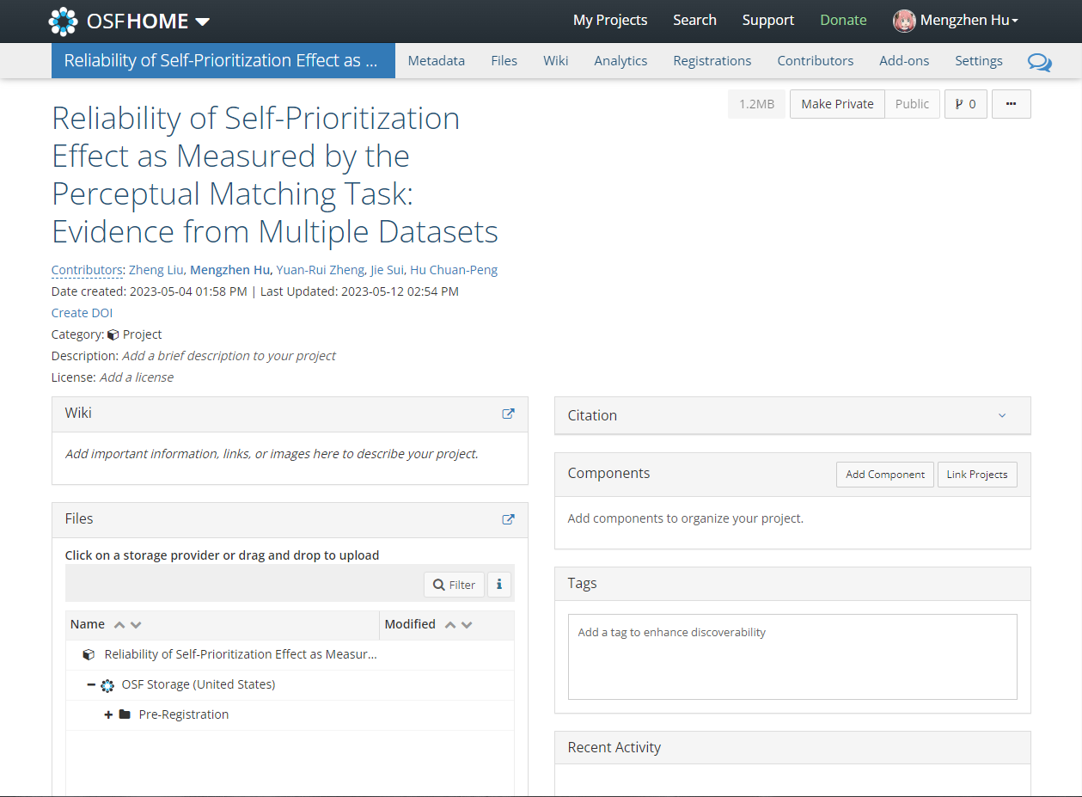
Website
R of SPMT
40 / 41
by YuKi
https://osf.io/6dghm/

Slide 43
Thanks
R of SPMT
Thanks
41 / 41
by YuKi

