Slide 1
Estimating Reliability of the Self-Associative Learning Task as a Measure of Self-Prioritization Effect: Re-analyses of a Longitudinal Dataset
Group： 刘铮，郑元瑞，刘逸康
Notes:
Hi. The project I’m going to report next is” Estimating Reliability of the Self-Associative Learning Task as a Measure of the Self-Prioritization Effect: Re-analyses of a Longitudinal Dataset”. Our group members include me，yuanrui, and yikang. This is a pretty new project, we just started it in april this year. Our project seeks to assess the reliability of the self-associative learning task as well as the stability and applicability of the generally used indices of the self-prioritization effect (SPE) in the self-associative learning task.

Slide 2
CONTENTS
1
Background
2
Aim of the Current Study
3
Methods
4
Current Process
Notes:
The content of our group’s report is divided into four part, the background, aim of the current study, methods and progress. Finally we can have a short Q & A section.

Slide 3



Background
The self-associative learning task (SALT) has provided an effective means to study the regulation of self-related information in individual cognitive processing in recent years.
The use of the associative learning paradigm has grown considerably over the past ten years.
trans-diagnostic framework
(e.g., Gillespie‐Smith et al., 2018; Nijhof & Bird, 2019)
cross-culture study
(e.g., Jiang et al., 2019)
child development
(e.g., Maire et al., 2020)
Notes:
In recent years, the self-associative learning task (SALT) devised by Professor Sui and her colleagues has provided an efficient approach to studying the regulation of self-related information in the individual cognitive processing. In recent years, the use of the associative learning paradigm has grown considerably. For example, because SPE can serve as a trans-diagnostic framework for psychological diseases, clinical and health psychologists have adopted the paradigm to understand impared self-processing in the clinical population.Also, SALT is widely applied in understanding group processes and cross-culture variations. It is also modified to be child-friendly to study the automatic self-advantage through child development.

Slide 4
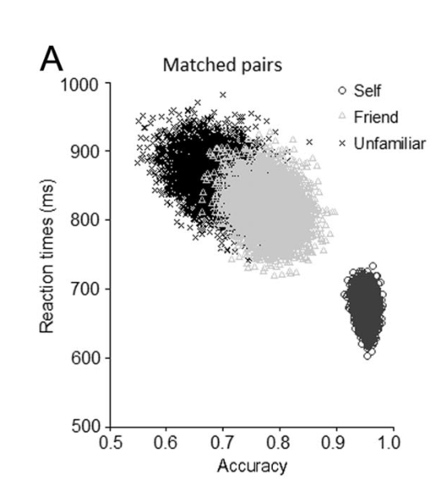
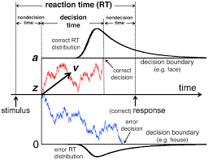
Background
In tasks simple as SALT, there are multiple ways to quantify the self-prioritization effect: reaction time, accuracy, sensitivity scores,evidence accumulation rate, ect.
Sui et al., 2012
Golubickis et al. (2017)
Notes:
Typically, the self-prioritization effect was found with shorter response time, better accuracy and higher sensitivity scores for self-shapes than those of friend and stranger.. The drift-diffusion model was also used to illustrate the main effect of self-prioritization, which is indicated by a faster rate of evidence accumulation in the drift-diffusion model – the drift rate v, and a bias at the start of the accumulation of information – the starting point (z). These effects seem to be robustly replicated in a large number of subsequent studies.

Slide 5
Unsolved issue in previous studies
There has been microscopic examination and report of the psychometric properties of the self-associative learning paradigm outcomes.
It remains unknown whether theses indices reliably capture the self-prioritization effect across times, and if yes, which indices is mostly suitable for repeated measurements?
Notes:
But Surprisingly, although the SALT has been widely applied, there has been very little examination and report of the psychometric properties of the self-associative learning paradigm outcomes. Thus, it remains unknown whether theses indices reliably capture the SPE across times, and if yes, which indices is mostly suitable for repeated measurements?

Slide 6
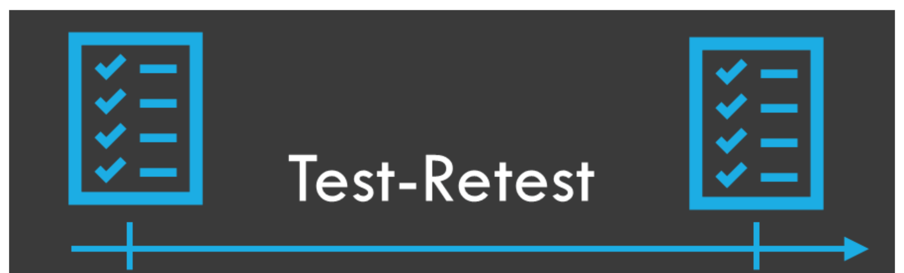
Aim of the Current Study
Using a pre-collected dataset containing six testing sessions with time intervals for one week, we plan to assess the reliability of the self-associative learning task as well as the stability and applicability of the generally used indices of the self-prioritization effect (SPE) in SALT.
Time 1
…..
Time 6
Notes:
To fill the current gap, our work seeks to assess the reliability of the self-associative learning task， adn the stability of the generally used indices of the SPE in SALT. To this end, we plan to re-analyze a pre-collected dataset in 2016 where participants were asked to associate three different shapes with labels for themselves, a friend, or a stranger across six testing sessions.

Slide 7
Hypothesis
(1) a) Model-based measurements and Reaction time-based measurement are appropriately reliable as group-level SPE indicators in the associative learning task b) accuracy-based measurement exhibits different degrees of inconsistency from one time point to another.
(2) a) Model-based measurements, which reflect the critical underlying generative process of individuals, are appropriately reliable as individual-level SPE indicators in the associative learning task. b) RT and accuracy-based measurements exhibits different degrees of inconsistency from one time point to another.
Notes:
(1) a) Model-based measurements and Reaction time-based measurement are appropriately reliable as group-level SPE indicators in the associative learning task b) accuracy-based measurement exhibits different degrees of inconsistency from one time point to another.
(2) a) Model-based measurements, which reflect the critical underlying generative process of individuals, are appropriately reliable as individual-level SPE indicators in the associative learning task. b) RT and accuracy-based measurements exhibits different degrees of inconsistency from one time point to another.

Slide 8
About the Secondary Data
Pre-collected dataset collected by the Hu Chuan-Peng at Tsinghua University in 2016.
The dataset provides six waves (separated by 1 week) of long-term data on 34 non-depressed and 6 depressed participants.
In each wave, participants completed three parts of tasks: experiment A (a modified SALT), experiment B (a modified SALT) and questionnaires.We plan to use the subset consisting of the neutral condition in SALT B result of the 34 participants (Mage = 21.06, SD=2.52) with relatively low DBI score.
Notes:
Pre-collected dataset collected by the Professor Hu at Tsinghua University in 2016. The purpose of the original study was to compare the SPE between sub-clinical depressed participants and non-depressed participants. In each wave, participants completed two types of modified SALTs:A and B .We plan to use the subset consisting of the neutral condition in SALT B result of the 34 participants (Mage = 21.06, SD=2.52) with relatively low DBI score.

Slide 9
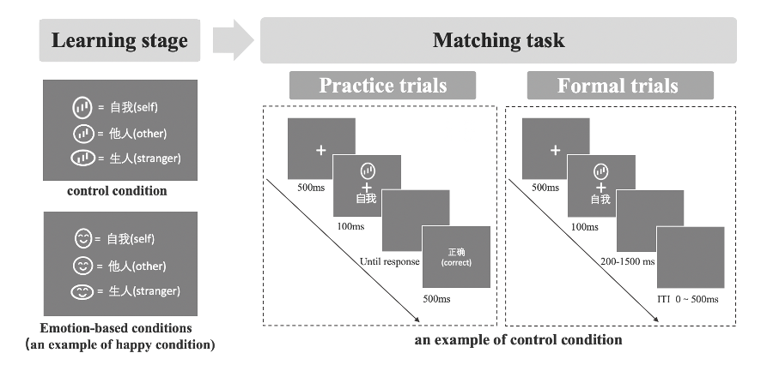
About the Secondary Data
2 (match vs. not-match) ×3 (id: self, friend, stranger) × 4 (emotion: control, neutral, happy, sad) × 6 (sessions: 1-6) experiment.
Studies selection
Studies selection
Examples of stimuli and time course of the experimental procedure in Experiment B.
Notes:
SALTS B is a 2 (match vs. not-match) by ×3 (id: self, friend, stranger) × 4 (emotion: control, neutral, happy, sad) × 6 (sessions: 1-6) experiment. It is originally designed to compare the self-bias under different emotions (happy, sad, neutral, control).
In each wave, the participants were recorded on their keypress, the reaction time and accuracy in each trial.

Slide 10
Analysis plan
Overview
We will use the Python toolkit HDDM of Bayesian Hierarchical Model (Wiecki et al., 2013) to fit the behavioral data into the drift diffusion model (DDM). All the other analyses will be performed using the statistical software R (R Development Core Team, 2010).
We plan to adopt hierarchical linear mixed model (HLM) and intraclass correlations (ICC) to test our hypotheses.
Studies selection
Studies selection

Slide 11
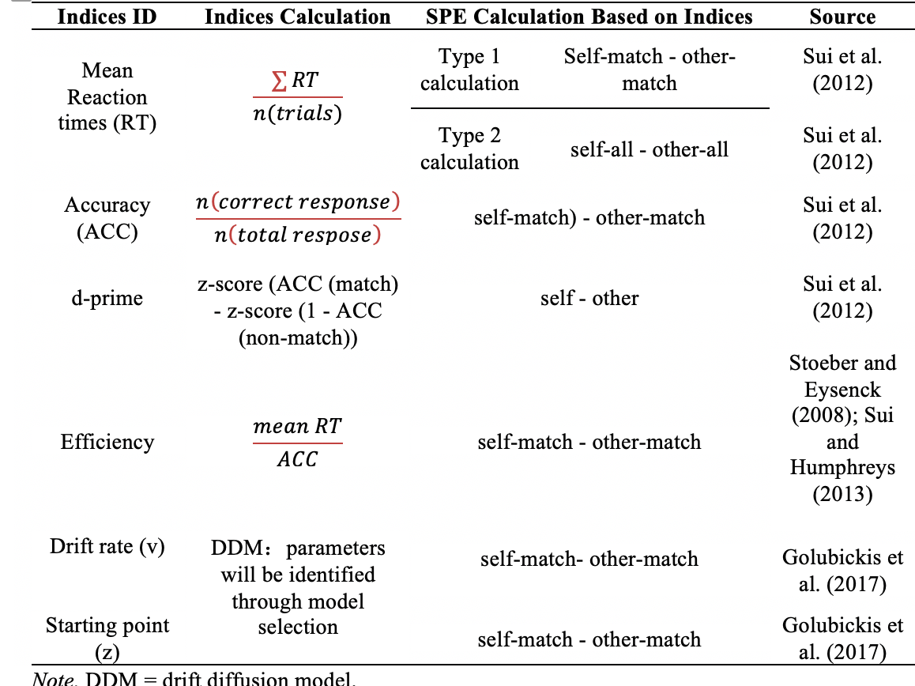
Analysis plan
Data pre-processing
Calculation of indices & quantifying SPE in the SALT
Estimate the reliability of indices in SALT as individual-level/group-level using hierarchical modelling and ICC
Studies selection
Studies selection
Notes:
we do not pre-process/ analyse the secondary data at stage 1 registration.
We plan to analyze 6 indices which are commonly used in the SALT.

Slide 12
Current progress
Data simulation ☑️
We simulated a dataset that has an identical data format as the secondary data.
Calculation of indices based on the simulated data ☑️
Preparing stage-1 registered report
Constructing the HLM to estimate the test-retest reliability of indices
Notes:
To eliminate possible bias in forming hypothesis, we do not perform any statistical analysis based on the secondary data at stage 1 registration. Instead, we simulated a dataset that has an identical data format as the secondary data.

Slide 13
Thank you very much for your attention
Any questions?

Slide 14
About the Secondary Data
Pre-collected dataset collected by the Hu Chuan-Peng at Tsinghua University in 2016.
The dataset provides six waves (separated by 1 week) of long-term data on 34 non-depressed and 6 depressed participants who were recruited from Tsinghua University community.
In each wave, participants completed three parts of tasks: experiment A (a modified SALT), experiment B (a modified SALT) and questionnaires.We plan to use the subset consisting of the neutral condition in SALT B result of the 34 participants (Mage = 21.06, SD=2.52) with relatively low DBI score.
Notes:
The purpose of the original study was to compare the SPE between sub-clinical depressed participants and non-depressed participants. However, the original study only collected the health control group due to the difficult to recruit sub-clinical depressed participants (only 6 participants were collected).

Slide 15
About the Secondary Data
Studies selection
Studies selection
Examples of stimuli and time course of the experimental procedure in Experiment B.
Notes:
Experiment is a 2 (match vs. not-match) ×3 (id: self, friend, stranger) × 4 (emotion: control, neutral, happy, sad) × 6 (sessions: 1-6) experiment. It is originally designed to compare the self-bias under different emotions (happy, sad, neutral, control).
In each wave, the participants were recorded on their keypress, the reaction time and accuracy in each trial.

Slide 16
About the Secondary Data
Experimental design
Experiment B is a 2 (match vs. not-match) ×3 (id: self, friend, stranger) × 4 (emotion: control, neutral, happy, sad) × 6 (sessions: 1-6) experiment. It is originally designed to compare the self-bias under different emotions (happy, sad, neutral, control).
Collected variables
In each wave, the participants were recorded on their keypress, the reaction time and accuracy in each trial.
Notes:
The purpose of the original study was to compare the SPE between sub-clinical depressed participants and non-depressed participants. However, the original study only collected the health control group due to the difficult to recruit sub-clinical depressed participants (only 6 participants were collected).

Slide 17
Simulated Data
To eliminate possible bias in forming hypothesis, we do not perform any statistical analysis based on the secondary data at stage 1 registration. Instead, we simulated a dataset that has an identical data format as the secondary data.
We applied the Bootstrap methods where samples are drawn from the open data of Hu et al. (2020) (accessible at https://osf.io/mhdsn/) with replacement.
Studies selection
Studies selection
Notes:
To eliminate possible bias in forming hypothesis, we do not perform any statistical analysis based on the secondary data at stage 1 registration. Instead, we simulated a dataset that has an identical data format as the secondary data.
We applied the Bootstrap methods where samples are drawn from the open data of Hu et al. (2020) (accessible at https://osf.io/mhdsn/) with replacement (allowing the same sample to appear more than once in the pilot data). Following the format of the secondary data, the pilot data has 6 sessions of 34 participants’ data, where for each participant in each session, there are 24 practice trials and 360 experimental trials (six types of shape-label associations: two matches (matched/mismatched) x three identity associations (self, friend, stranger), with 60 trials per association).

Slide 18
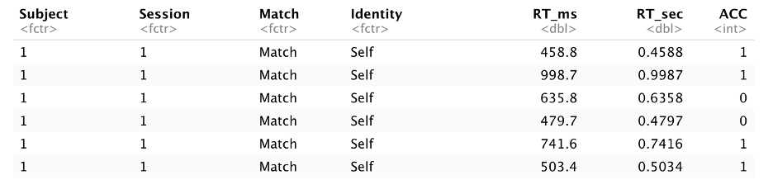
Simulated Data
Following the format of the secondary data, the pilot data has 6 sessions of 34 participants’ data, where for each participant in each session, there are 24 practice trials and 360 experimental trials (six types of shape-label associations: two matches (matched/mismatched) x three identity associations (self, friend, stranger), with 60 trials per association).
Studies selection
Studies selection
Notes:
To eliminate possible bias in forming hypothesis, we do not perform any statistical analysis based on the secondary data at stage 1 registration. Instead, we simulated a dataset that has an identical data format as the secondary data.
We applied the Bootstrap methods where samples are drawn from the open data of Hu et al. (2020) (accessible at https://osf.io/mhdsn/) with replacement (allowing the same sample to appear more than once in the pilot data). Following the format of the secondary data, the pilot data has 6 sessions of 34 participants’ data, where for each participant in each session, there are 24 practice trials and 360 experimental trials (six types of shape-label associations: two matches (matched/mismatched) x three identity associations (self, friend, stranger), with 60 trials per association).

