Slide 1
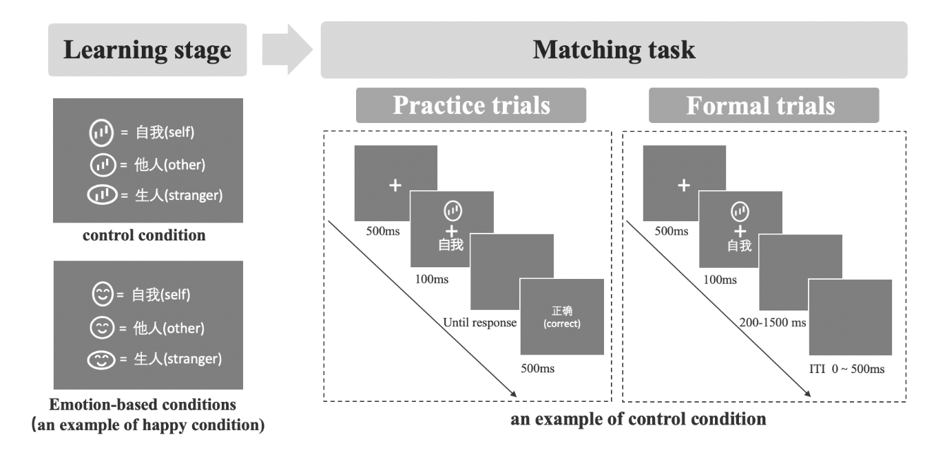

Slide 2
Instruction Stage
Instruction Stage
=
Self
=
Self
=
Friend
=
Friend
=
Stranger
=
Stranger

Slide 3
Matching Task
Practice Trials
Formal Trials
+
+
500ms
+
500ms
+
Self
Self
100ms
100ms
Until response
correct
200ms ~ 1500ms
500ms
ITI 0 ~ 500ms

Slide 4
Matching Task
Practice Trials
Formal Trials
+
+
500ms
+
500ms
+
Self
Self
100ms
100ms
Until response
correct
200ms ~ 1500ms
500ms
ITI 0 ~ 500ms

Slide 5
Matching Task
Practice Trials
Formal Trials
+
+
500ms
+
500ms
+
Self
Self
100ms
100ms
Until response
correct
200ms ~ 1500ms
500ms
ITI 0 ~ 500ms

Slide 6

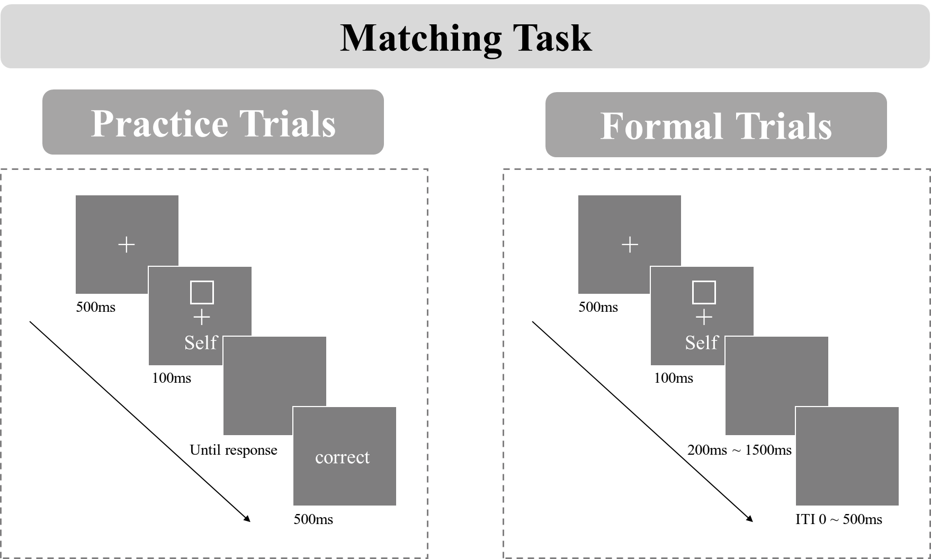
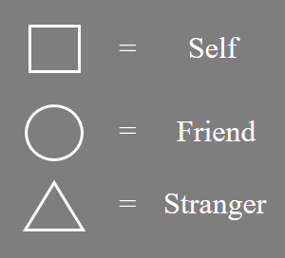

Slide 7

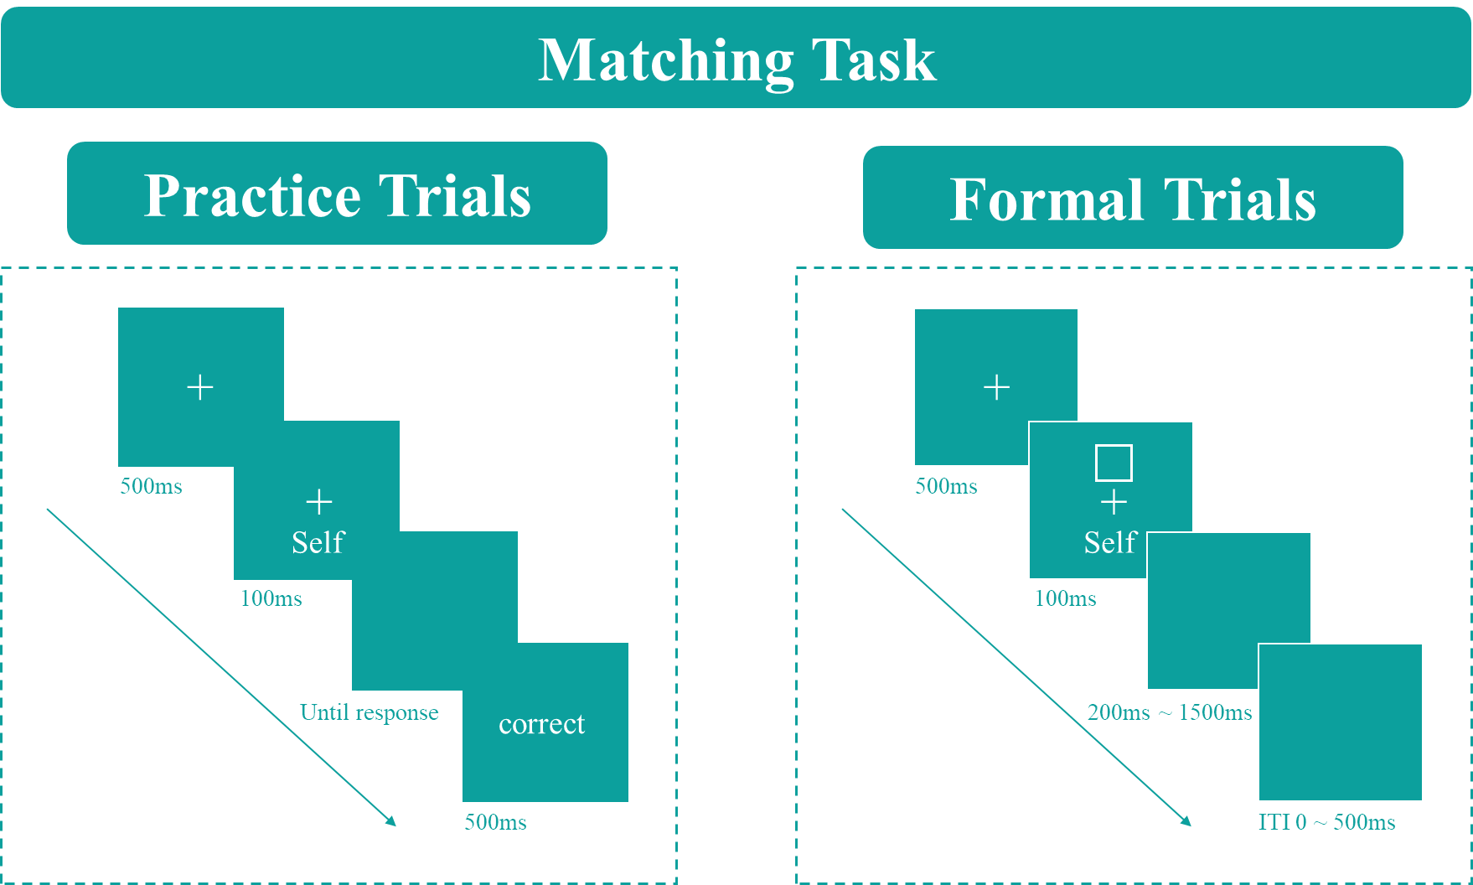
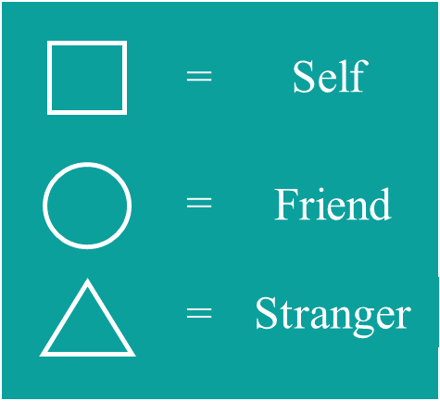

Slide 9
