Slide 1

Introduction
R of SPMT
99 / 99
by YuKi

Slide 2
Introduction
R of SPMT
Reliability of Self-Prioritization Effect as Measured by the Perceptual Matching Task:
Evidence from Multiple Datasets
Zheng Liu (Helen), Mengzhen Hu (YuKi), Yuanrui Zheng, Jie Sui, Hu Chuan-Peng
99 / 99
by YuKi

Slide 3
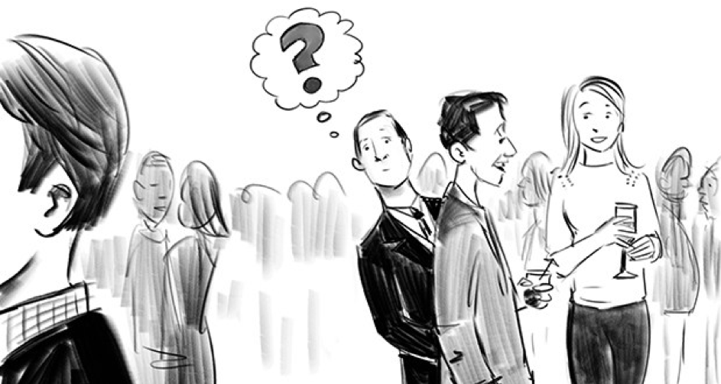
Introduction
R of SPMT
Self-Prioritization Effect (SPE)
The cocktail effect
A memory advantage in recalling information encoded with self-relevance compared with those encoded with non-self relevance. (Rogers et al., 1977)
99 / 99
by YuKi
Notes:
鸡尾酒效应

Slide 4

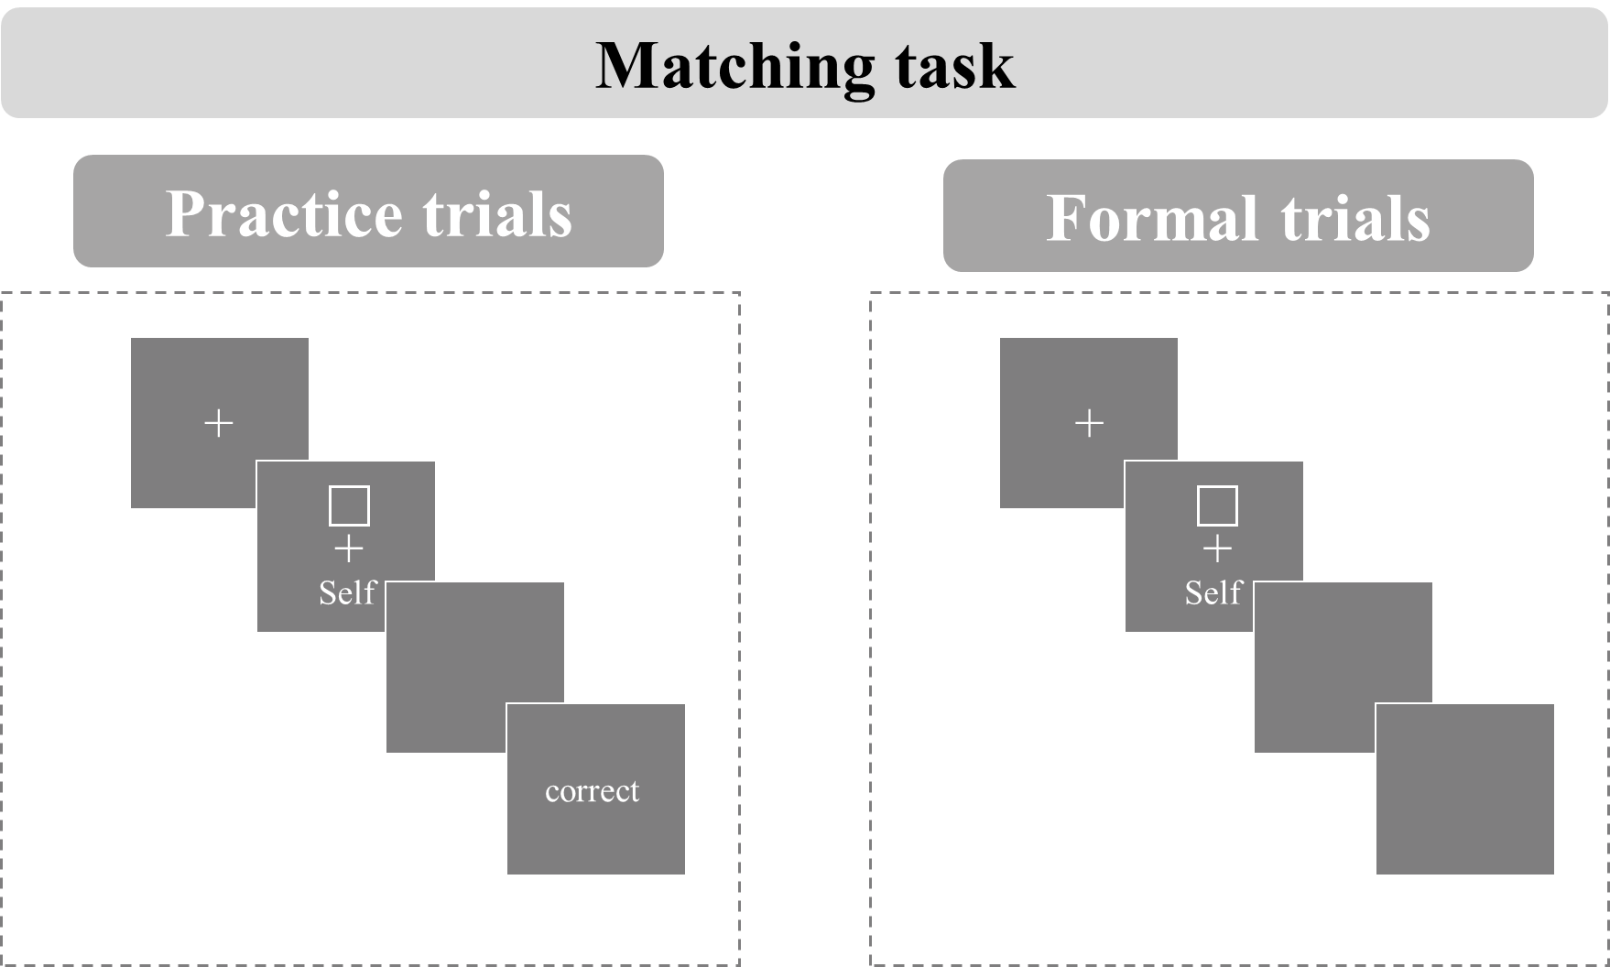
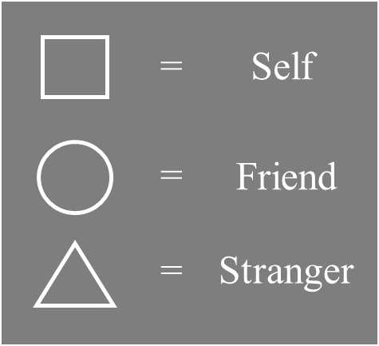
Introduction
R of SPMT
A new paradigm to study the self-reference effect named shape-matching task was proposed (Sui et al., 2012).
99 / 99
by YuKi
Notes:
SPMT的实验流程

Slide 5
Introduction
R of SPMT
While SPMT has become a mainstream method for investigating the mechanism underlying the SPE, little attention has been paid to the exact indices of the effect and their reliability, which require careful examination (Parsons et al., 2019; Zorowitz & Niv, 2023).
99 / 99
by YuKi
Notes:
SPMT越来越被普遍用于测量自我优势效应

Slide 6
Introduction
R of SPMT
A growing number of cognitive experimental paradigms are being directly used to examine personality traits. (Kucina et al., 2023)
The reaction time differences in the Stroop paradigm are used to reflect individuals' varying executive control abilities. (Eriksen, 1995; Hommel, 2011; MacLeod, 1991)
99 / 99
by YuKi
Notes:
此外，越来越多的认知实验被用来测量稳定的个体差异（类似于问卷被用于测量人格特质）
自我相关刺激反应更快速（自我优势效应）也是具有个体差异的
如果SPMT要被用于测量这样的个体差异，那么这个范式需要具有较高的信度

Slide 7
Method
R of SPMT
X: Groups
Y: Indices
Reaction Time,
Accuracy,
d prime,
Efficiency
DDM Drift Rate (v)
DDM Start Point (z)
Subject
Matching
Identity
Session
99 / 99
by YuKi
Notes:
需要按照自变量分组，每个实验条件下，都需要计算六种（八种）因变量指标

Slide 8

Introduction
R of SPMT
Subject
Matching
Identity
Session
Split Half Reliability
99 / 99
by YuKi
Notes:
每个被试在每个实验条件下，数据被均等的分为两份。

Slide 9

Method
R of SPMT
Indices | Indices Calculation | SPE Calculation Based on Indices | Source
Mean Reaction Times (RT) | $$\frac{∑RT}{n_{(trials)}}$$ | $${Self}_{(matching)}−{Other}_{(matching)}$$ | Sui et al. (2012)
Accuracy (ACC) | $$\frac{n_{(correct response)}}{n_{total response}}$$ | $${Self}_{(matching)}−{Other}_{(matching)}$$ | Sui et al. (2012)
d prime | $$Z_{ACC(Matching)}−Z_{1−ACC(Nonmatching)}$$ | $$Z_{Self}−Z_{other}$$ | Sui et al. (2012)
Efficiency | $$\frac{{RT}_{mean}}{ACC}$$ | $${Self}_{(matching)}−{Other}_{(matching)}$$ | Humphreys and Sui (2015); Stoeber and Eysenck (2008)
Drift rate (v) | DDM：parameters will be identified through model selection | $${Self}_{(matching)}−{Other}_{(matching)}$$ | Golubickis et al. (2017)
Starting Point (z) |  | $${Self}_{(matching)}−{Other}_{(matching)}$$ | Golubickis et al. (2017)
99 / 99
by YuKi
Notes:
然后计算自我与他人，在这六种指标上的差异，即自我优势效应SPE

Slide 10

Method
R of SPMT
99 / 99
by YuKi

