Slide 1




.
.
2023.10.15
.
Reliability Assessment of the Self Perceptual Matching Task as a Measurement of the Self-Prioritization Effect
Zheng Liu, Mengzhen Hu, Yuanrui Zheng, Jie Sui, Chuan-Peng Hu*
Notes:
大家好，我是刘铮，目前是香港中文大学深圳应用心理学专业的在读博士生，之前在南京师范大学hcp老师组做ra，本研究是在ra期间开展的。
今天我要报告的题目是，知觉匹配任务作为自我优势效应测量的信度评估

Slide 2
Outline
Background
Self-Prioritization Effect
Self Perceptual Matching Task
The Reliability Paradox
Method
Results
Discussion, Implication & Limitation
Notes:
我将从以下几个部分展开今天的报告，首先是文章背景，其次是运用的方法，文章结果以及文章的讨论。同时我会谈到文章的启示和一些局限性。

Slide 3
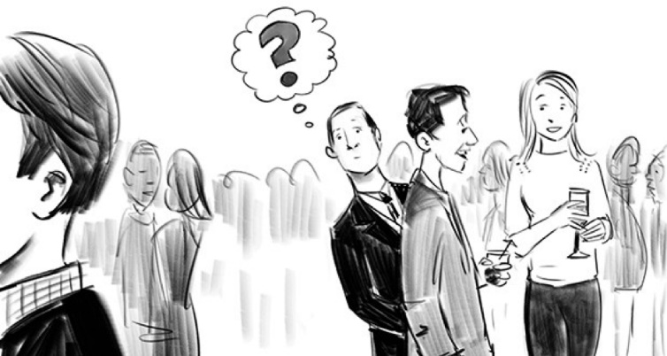
The Self-Prioritization Effect (SPE)
A memory advantage in recalling information encoded with self-relevance compared with those encoded with non-self relevance.
Despite SPE is often argued to be a self-specific effect, it has been challenging to be disassociated from familiarity effect.
The Cocktail Party Effect (Cherry, 1953)
Notes:
我看到这个session其实有好几个工作都是自我优势效应相关的，所以我就不更多介绍了。
自我优势效应呢，就是指大脑会优先加工与自己相关的信息，该效应对人类的生存和社会适应具有重要意义。
比如早在上世纪50年代，心理学家就提出了的鸡尾酒会效应，也就是在嘈杂的酒会上，人们也可以将注意力集中在自己的名字，而忽略背景中其他的对话或噪音。
那么对于自我优势效应的测量，也存在许多测量范式，但大多数范式都运用的是自己相关的东西，比如自己的名字，面孔，所有物等，那么这里就存在一个问题，对于这些东西的优先加工是因为自己相关，还是因为我们更熟悉这些东西，也就是引入了familiarity这个混淆变量。

Slide 4
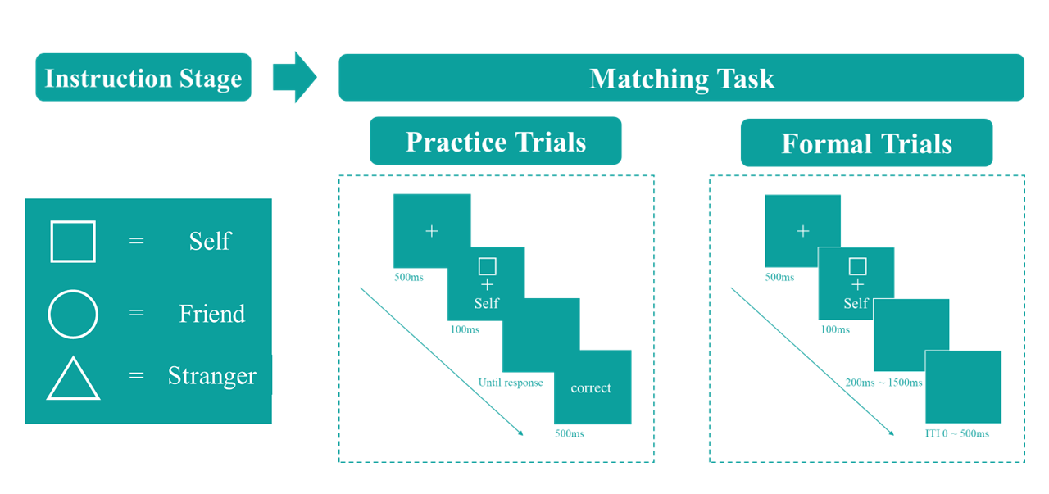
The Self Perceptual Matching Task (SPMT)
Sui et al. (2012) introduced the Self-Perceptual Matching Task (SPMT), where the self-relatedness (and other-relatedness) was acquired in the lab.
Notes:
知觉匹配范式。在这个范式里，自我相关性是被即使习得的。
这个范式具体流程如下，首先是一个学习的过程，被试将学到label与简单几何图形之间的对应关系，在正式实验中，被试将需要判断出现的图型和文字是否与之前学到的一致，一致就按match，不一致就是non-match。

Slide 5
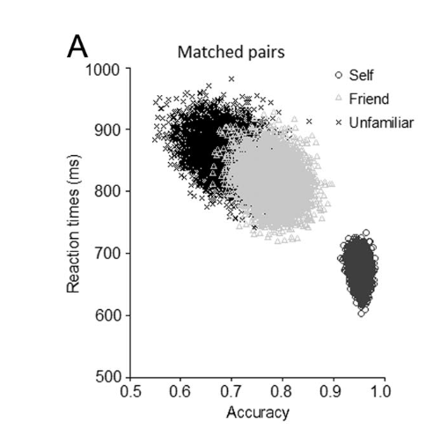
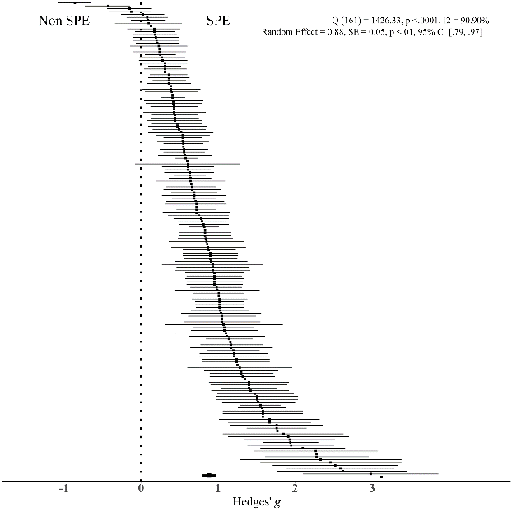

SPE in SPMT
A typical pattern in this task is that shapes associated with the “Self” demonstrate a response advantage over shapes related to “Others” in the matching pairs.
Hedge’s g = .88 (SE = 0.05, p < .001, 95% CI [.79, .97])
Q (166) = 1426.33, p < .001, $I^{2 }$= 90.90%
Sui et al. (2012), J. Exp. Psychol.: Hum. Percept.
Liu, Hu, Hu, & Sui, (2023), Pre-registration
Notes:
一个被最常发现的现象就是自我相比较其他的target会被更优先的加工，

Slide 6
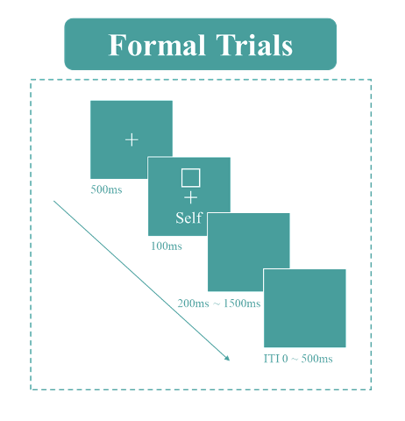
Variability in Quantifying SPE using SPMT
Variability in Indicators:
Two direct outcomes are generated from SPMT: Reaction Times (RT) and Choices. Several other indicators can be derived:
Reaction Time
v, z from DDM
Efficiency
Accuracy
Choice
d-prime from SDT
Variability in Baseline:
“Close other” (e.g., Friend), “Stranger”,
“Celebrity” (e.g., “鲁迅”) “Non-person” (e.g., None).
Which way of quantifying SPE is the most reliable one(s)?
Notes:
但是在这个范式被使用的过程中呢，一个最直接的问题出现了。那就是已有的文献中，存在多种自我优势效应的测量指标。具体而言，我们有
同时，与自我做对照的基线指标也有很多种。

Slide 7
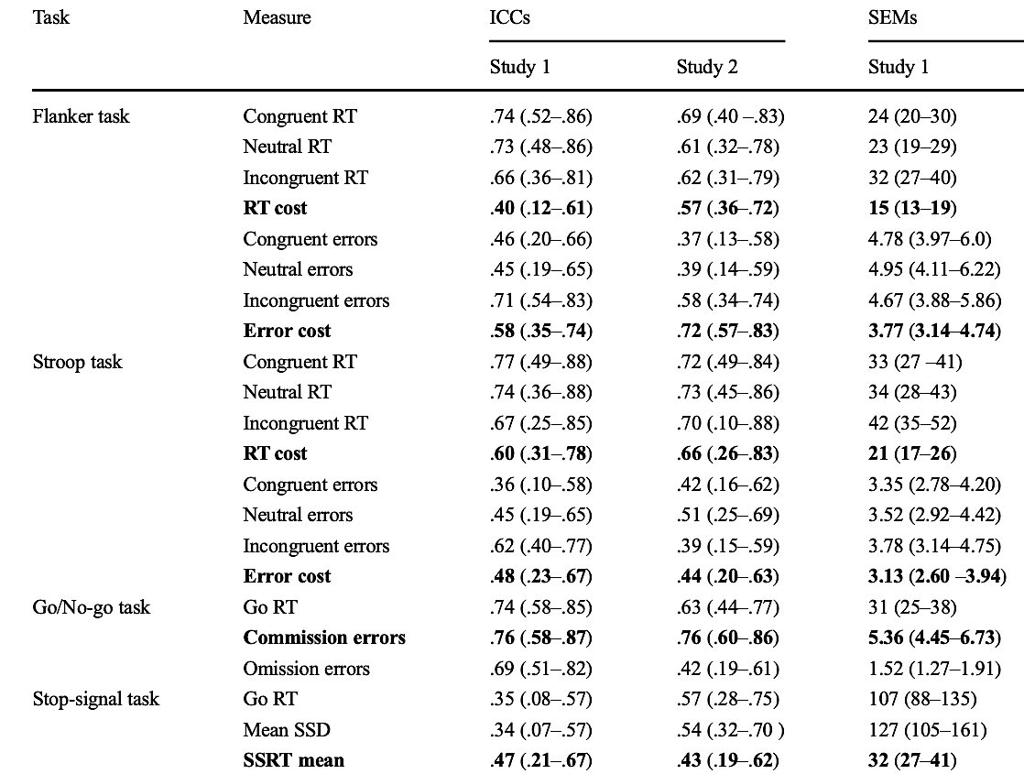
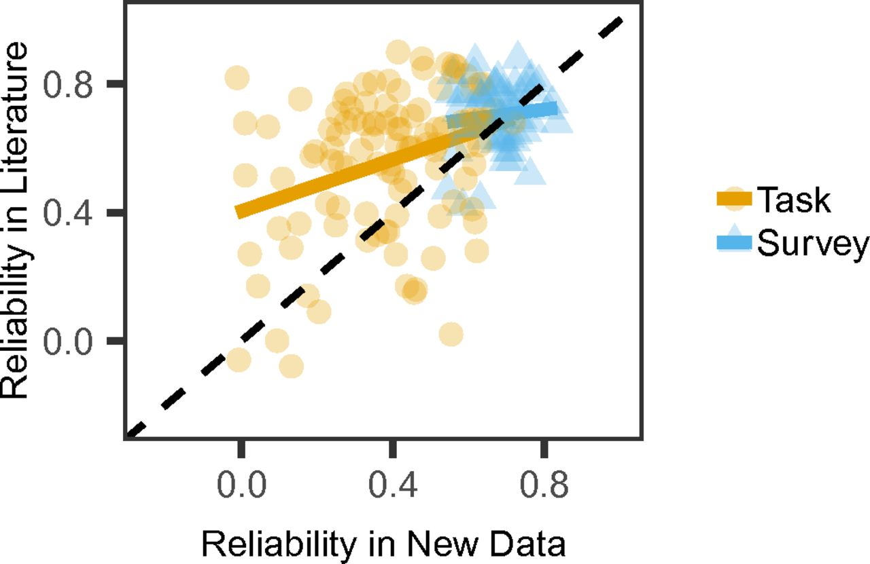
The Reliability Paradox
While cognitive tasks yield consistent experimental effects, they do not exhibit the same reliability when assessing individual differences (Logie et al., 1996).
Hedge et al., (2018), BRM
Enkavi et al., (2019), PNAS
Notes:
信度悖论就是说认知任务往往实验效应很好，很稳定，但在测量个体水平时信度往往不那么好。例如在
冲动性

Slide 8
Why is it Crucial to Pay Attention to the Reliability of SPMT?
SPMT is now used in more than 200 studies (Liu, Hu, Hu, & Sui, 2023).
SPMT is widely used for measuring individual differences and SPE mechanism.
Psychiatry (Liu et al., 2022)
Brain imaging studies (Zhang et al., 2023)
A lack of attention to the reliability of SPMT
Many cognitive tasks reported the reliability paradox (Hedge et al., 2018).

Slide 9
The Current Study
Research Questions
Which way of quantifying SPE is the most reliable one(s)?
RT, ACC, d′, η, v, z
“Close other”, “Stranger”, “Celebrity”, and “Non-person”
Is the SPE measured by SPMT suitable for assessing individual differences?
Is there a reliability paradox in the assessment of SPE using SPMT?

Slide 10
Method
Re-analyzed 17 independent datasets (N = 805) from 9 papers and 2 unpublished projects that employees SPMT. Preregistered on OSF (https://osf.io/pcv3u/).
Roadmap of the current study

Slide 11
Analysis
Estimating the Robustness of SPE
Meta-analytical assessments using random effects model.
Reaction Time (RT),
Accuracy (ACC),
d Prime (d’),
Efficiency (η),
DDM Drift Rate (v),
DDM Start Point (z)
Hedges’ g
Self - <Baseline>

Slide 12

Estimating the Reliability of SPE
Split-half Reliability
Stratified Trial Level Data
Identity
Matching
Session (if applicable)
Four Split-half Methods
First-Second
Odd-Even
Permuted
Monte Carlo
Pearson Correlation Coefficients (r)
Trial numbers (Kucina et al., 2023)
Weighted-average Reliabilities
Interpreting Split-half Reliability (Cicchetti & Sparrow, 1981)
Unacceptable
Poor
Acceptable
Excellent
0
0.5
0.7
1

Slide 13
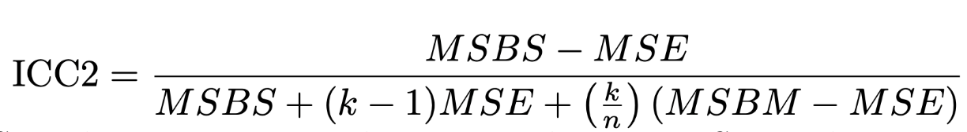
Estimating the Reliability of SPE
Test-retest Reliability
Intraclass Correlation Coefficient, Two-way Random Effect Model
between-subjects variability (individual differences)/ total variance
MSBS: mean square between subjects
MSE: mean square error
MSBM: the mean square between measurements
k: number of measurements
n is number of participants
Interpreting ICC (Cicchetti & Sparrow, 1981; Kupper & Hafner, 1989).
Excellent
Poor
Moderate
Good
0
0.5
0.75
0.9
1
Notes:
个体的变异度除以总的变异度

Slide 14
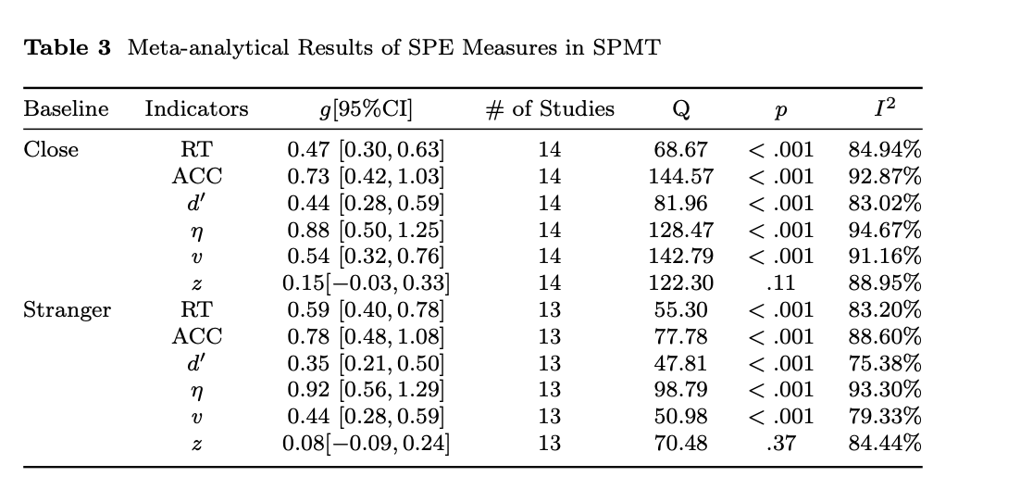
Results
Estimating the Robustness of SPE
All the measures of SPE, except the parameter z estimated from DDM, exhibited moderate to large effect sizes.

Slide 15
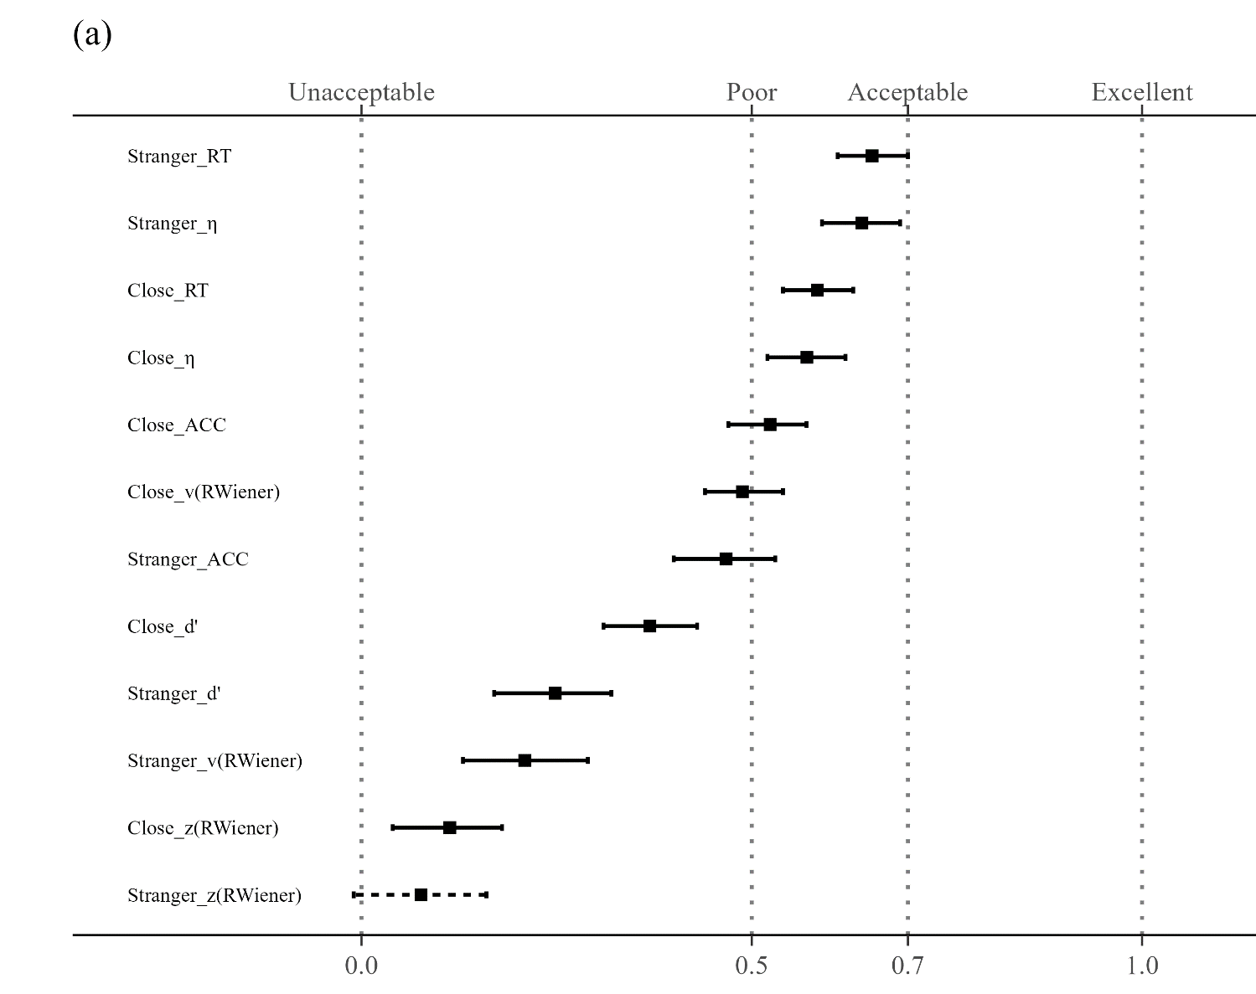
Split-half Reliability of SPMT
“Stranger” as Baseline
Reaction Time (RT)
r = .65, SE = .02, 95%CI [.61, .70]);
Efficiency (η)
r = .64,SE = .03, 95%CI [.59, .69]);
“Close other” as Baseline
Reaction Time (RT)
r = .58, SE = .02, 95%CI [.54, .63]);
Efficiency (η)
r = .57, SE = .02, 95% CI [.52, . 62]
all other SPE measures < 0.5
SHR with Monte Carlo split-half Method

Slide 16

Test-retest Reliability of SPMT
“Close other” as Baseline
Reaction Time (RT)
0.53 (95% CI = [.39, .69]),
Efficiency (η)
0.52 (95% CI = [.38, .68]).
“Stranger” as Baseline
Reaction Time (RT)
0.58 (95% CI = [.45, .73])
Efficiency (η)
0.35 (95% CI = [.21, .52]).
All other measures < 0.4.

Slide 17
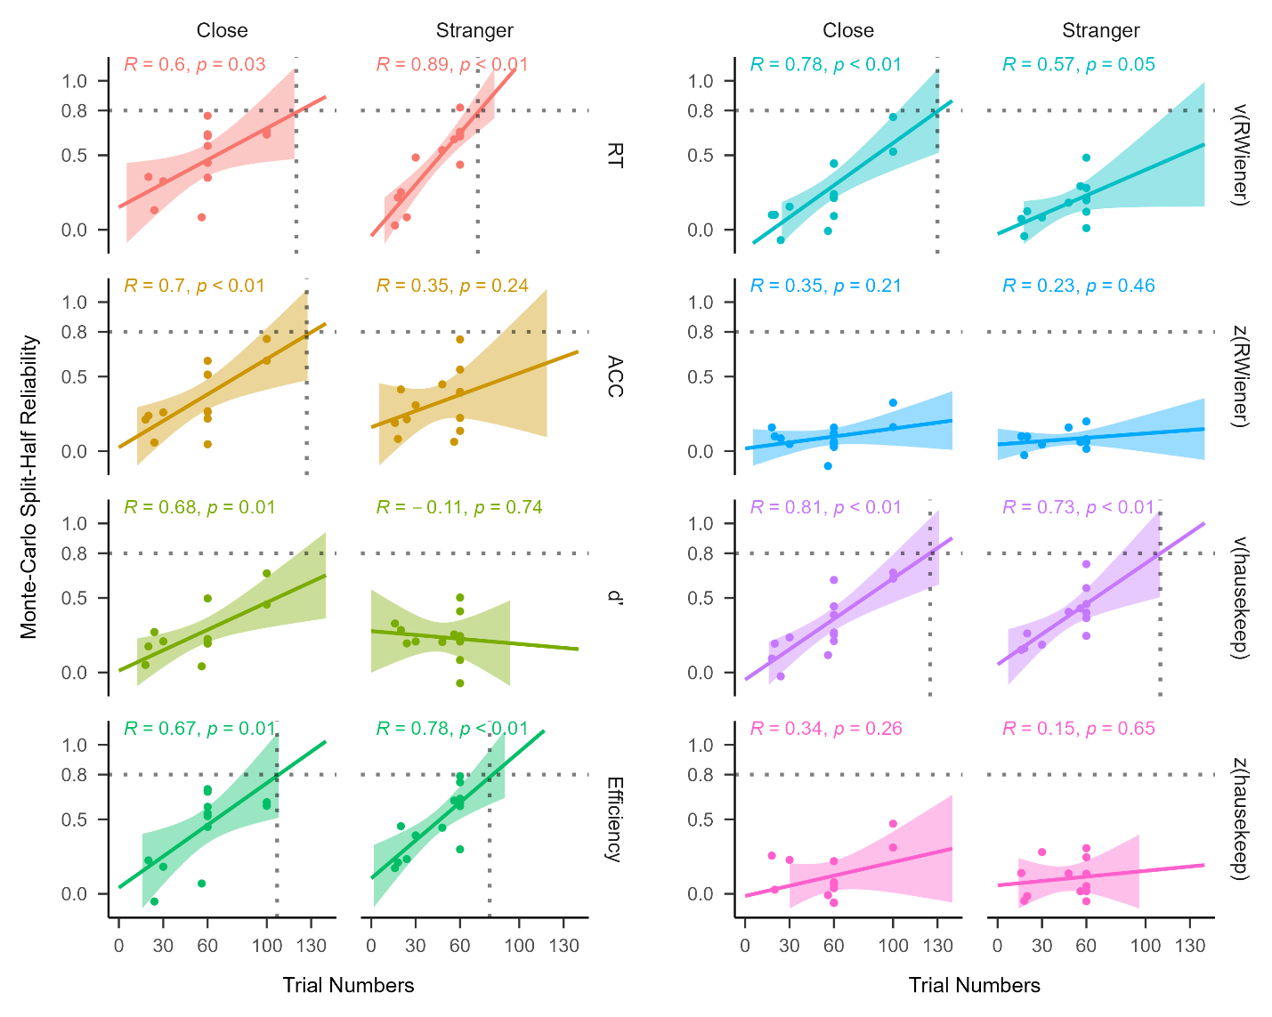
Exploratory Analysis
Correlation Analysis Results
Monte Carlo split-half reliability
P > .05
P < .05
P > .05
Hedges’ g
Trial Numbers
Correlations between trial numbers and Monte Carlo split-half reliability

Slide 18
In Answering the Research Questions
Which way of quantifying SPE is the most reliable one(s)?
RT, ACC, d′, η, v, z
“Close other”, “Stranger”, “Celebrity”, and “Non-person”
Is the SPE measured by SPMT suitable for assessing individual differences?
The current version is not suitable.
Is there a reliability paradox in the assessment of SPE using SPMT?
Yes, given the robust experimental effect and relatively low reliability.

Slide 19


The Reliability Paradox
SPMT, like other cognitive tasks, tends to exhibit minimal variability among participants while maximizing the detection of SPE at the group level.
Little variations between individuals
I have SPE!
My SPE is higher than you!
So do I!
Substaintial variations between individuals
Robust Experimental Effect
A “Good” Scale
Notes:
那么提到信度，一个最直接的问题就是，信度是什么？
这里就不得不提到心理学的两个领域，研究相关性的测量派和因果的实验心理学派。
对于做心理测量的人来说，信度是非常基本的，因为心理测量的基础就是要有好的量表，在心理测量里，信度被定义为測量結果的一致性、穩定性及可靠性。
但是在实验学派，信度是什么？往往实验心理学都会关注效应是否稳定，比如经典的stroop task，我们总能发现颜色和字意不匹配是人们的反应更慢。

Slide 20
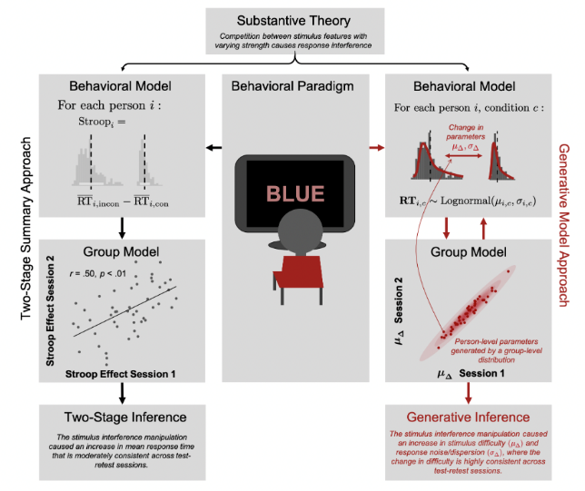
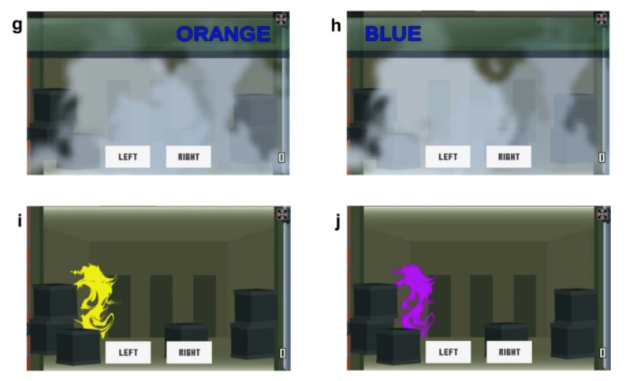
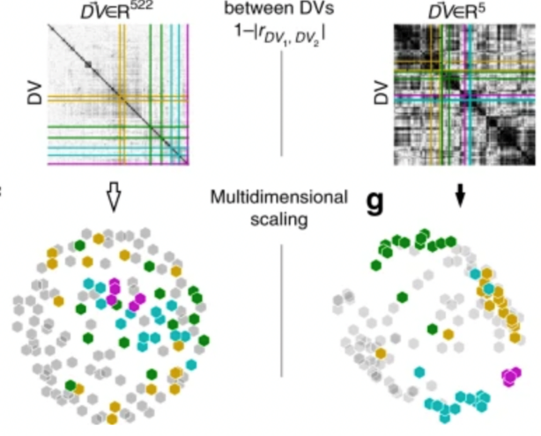
The Future of SPMT for Individual Differences
As the SPMT was designed to achieve robust group-level SPE rather than to measure individual differences, researchers need to re-design the task if they are interested in assessing individual difference.
Gamification of the Stroop Task
Kucina et al. (2023), Nature Communication
Using Generative Model
Haines et al., 2020)
Using Latent Model
Enkavi et al., (2019), PNAS
Eisenberg et al., (2019), Nature Communication

Slide 21
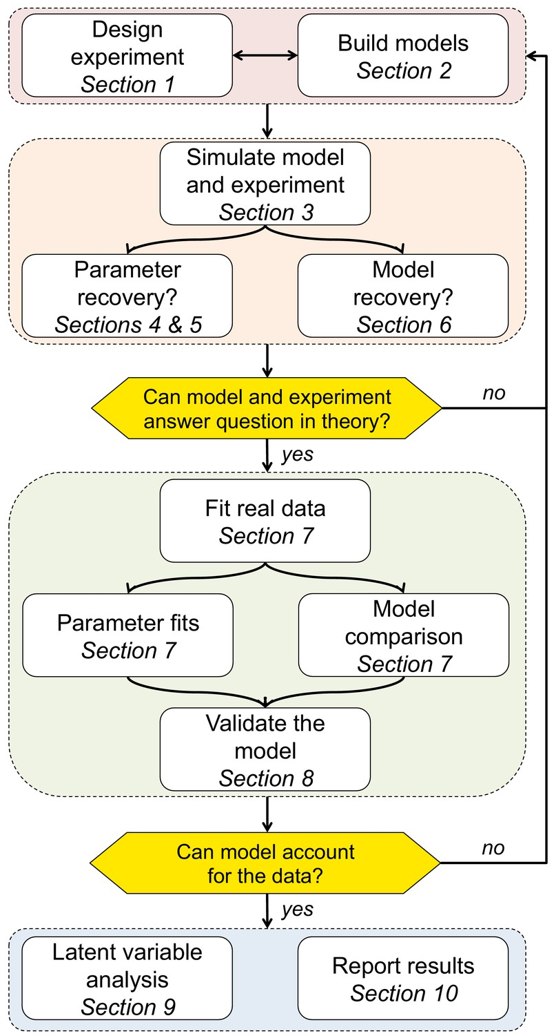
Low Reliability in the Parameters (v and z) from Standard DDM
The reliability of both the drift rate (v) and the starting point (z) fell well below acceptable levels.
Raised concerns about applying the standard drift-diffusion to data from SPMT directly.
Called for a more principled approach.
Wilson and Collins (2019), Elife

Slide 22
Implication
An Initial Guide for Researchers Considering the Use of SPMT.
We recommend reaction times and efficiency as the indicators of SPE.
Considering the use of “Stranger” as baseline.
Increasing the number of trials is advisable.
Against the indiscriminate application of the standard DDM.
We advocate for a principled modelling approach.

Slide 23
Limitations
The majority of our samples still consisted of individuals from what is commonly referred to as “(W)EIRD” populations (Rad et al., 2018; Yue et al., 2023).
Necessary to include a more diverse sample to ensure greater generalizability of the paradigm.
The robustness and reliability of different variants of SPMT still need further investigation.
Only one dataset had longitudinal data available, which could potentially limit the representativeness of the ICC2 result.
Additional analysis of another dataset (in supplementary) that with different design showed similar results.

Slide 24
.
.
.
Thanks for Attention！
Any Questions?
Notes:
以下就是我今天的报告，谢谢大家。

