Slide 1




.
.
2023.10.15
.
Reliability Assessment of the Self Perceptual Matching Task as a Measurement of the Self-Prioritization Effect
Zheng Liu, Mengzhen Hu, Yuanrui Zheng, Jie Sui, Chuan-Peng Hu*
*
Notes:
题目

Slide 2
Outline
Background
Self-Prioritization Effect
Self Perceptual Matching Task
The Reliability Paradox
Method
Results
Discussion & Implication

Slide 3
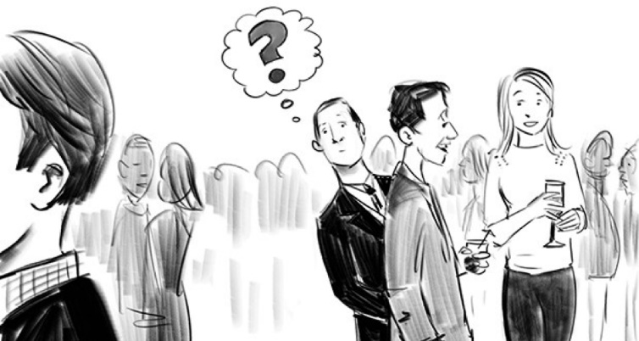
The Self-Prioritization Effect (SPE)
A memory advantage in recalling information encoded with self-relevance compared with those encoded with non-self relevance.
Despite SPE is often argued to be a self-specific effect, it has been challenging to be disassociated from familiarity effect.
The Cocktail Party Effect (Cherry, 1953 )

Slide 4
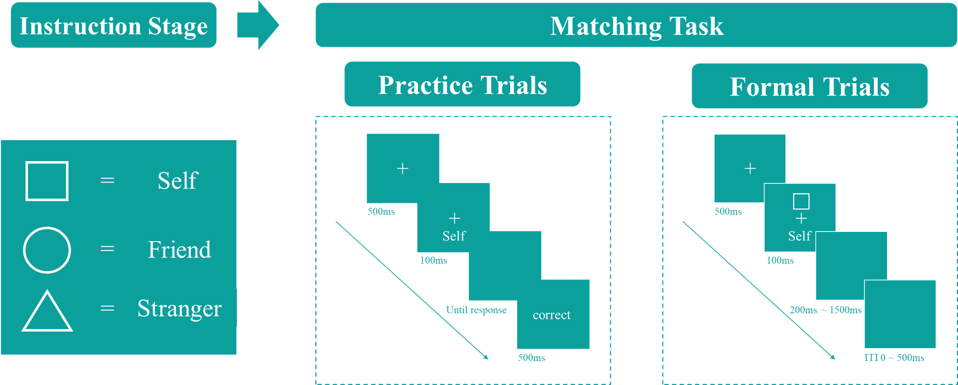
The Self Perceptual Matching Task (SPMT)
Sui et al. (2012) introduced the Self-Perceptual Matching Task (SPMT), where the self-relatedness (and other-relatedness) was acquired in the lab.

Slide 5
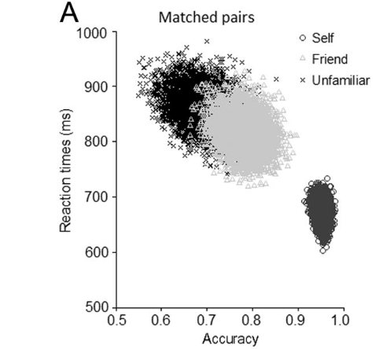
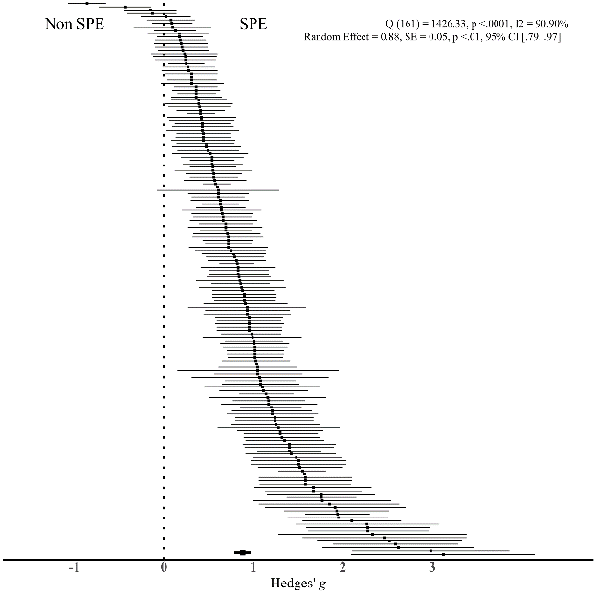

SPE in SPMT
A typical pattern in this task is that shapes associated with the “Self” demonstrate a response advantage over shapes related to “Others” in the matching pairs.
Hedge’s g = .88 (SE = 0.05, p < .001, 95% CI [.79, .97])
Q (166) = 1426.33, p < .001, $I^{2 }$= 90.90%
Sui et al. (2012), J. Exp. Psychol.: Hum. Percept.
Liu, Hu, Hu, & Sui, (2023), PsyArXiv

Slide 6
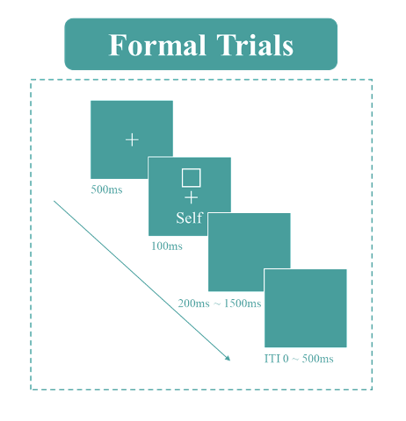
Variability in Quantifying SPE using SPMT
Variability in Indicators:
Two direct outcomes are generated from SPMT: Reaction Times (RT) and Choices. Several other indicators can be derived:
Reaction Time
v, z from DDM
Efficiency
Accuracy
Choice
d-prime from SDT
Variability in Baseline:
“Close other” (e.g., Friend), “Stranger”,
“Celebrity” (e.g., “鲁迅”) “Non-person” (e.g., None).
Which way of quantifying SPE is the most reliable one(s)?

Slide 7


The Reliability Paradox
While cognitive tasks yield consistent experimental effects, they do not exhibit the same reliability when assessing individual differences (Logie et al., 1996).
+
Self
+
Stranger
+
Self
+
Stranger
Experiment
Group
Control
Group
Experiment Effect
Individual Difference

Slide 8
Why is it crucial to pay attention to the reliability of SPMT?
While SPMT is widely used for investigating the SPE mechanism, there's a lack of attention to its reliability (Parsons et al., 2019; Zorowitz & Niv, 2023).
SPMT is increasingly being used to measure individual differences
Psychiatry (Liu et al., 2022) , and social psychology (Enock et al., 2018).

Slide 9
The Current Study
Research Questions
Which way of quantifying SPE is the most reliable one(s)?
RT, ACC, d′, η, v, z
×
“Close other”, “Stranger”, “Celebrity”, and “Non-person”
Is the SPE measured by SPMT suitable for assessing individual differences?

Slide 10
Method
Re-analyzed 17 independent datasets (N = 805) from 9 papers and 2 unpublished projects that employees SPMT.
Analysis plans for this study were preregistered on OSF (https://osf.io/pcv3u/).
Roadmap of the current study

Slide 11
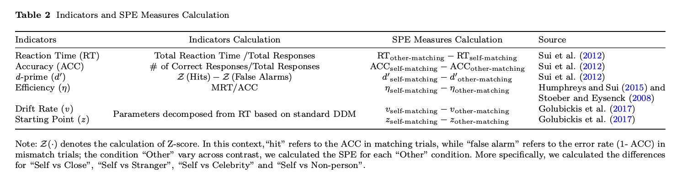
Analysis
Calculating the Indicators and SPE Measures
Estimating the Robustness of SPE
Meta-analytical assessments using random effects model.

Slide 12

Analysis
Estimating the Robustness of SPE
Meta-analytical assessments using random effects model.
Reaction Time (RT),
Accuracy (ACC),
d Prime (d’),
Efficiency (η),
DDM Drift Rate (v),
DDM Start Point (z),
Hedges’ g
Self - <Target>

Slide 13

Estimating the Reliability of SPE
Subject
Matching
Identity
(Session)
First-Second
Odd-Even
Permuted
Monte Carlo
RT
ACC
d
Eff
DDM v
DDM z
RT
ACC
d
Eff
DDM v
DDM z

Slide 14
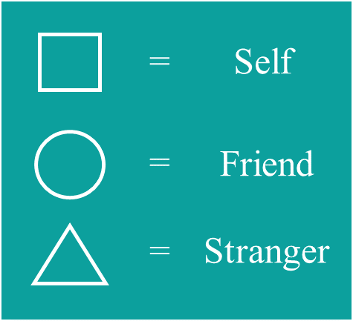
Estimating the Reliability of SPE
Test-retest Reliability
SPMT
SPMT
SPMT
…
…
Variance between Subjects
Variance within Subjects (Session)
SPE ~ 1 + (1 | Subject) + (1 | Session) + COV

Slide 15
Results
Estimating the Robustness of SPE
Table 3 Meta-analytical Results of SPE Measures in SPMT
Notes:
14 of datasets contain data for the Close other, 13 of datasets contain data for Stranger, 1 dataset has the data for Celebrities, 1 has the data for Nonperson
We found that all measures of SPE, except the parameter z estimated from DDM, exhibited moderate to large effect sizes, indicating a robust and substantial experimental effect of SPE.

Slide 16
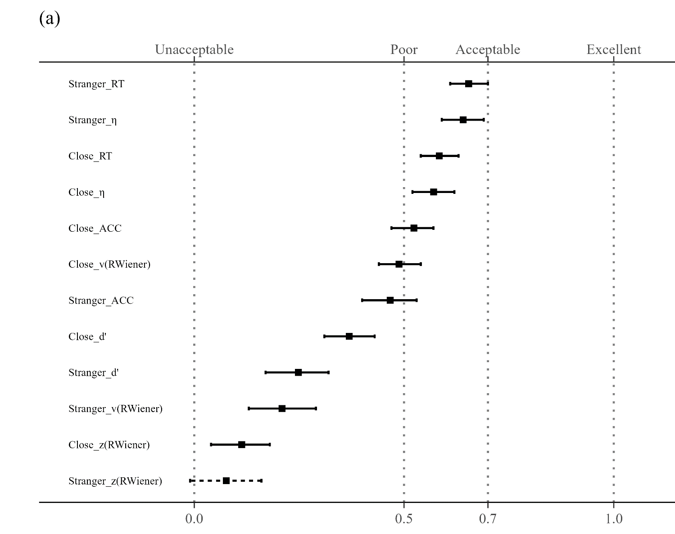
Split-half Reliability of SPMT
“Stranger” as baseline
Reaction Time (RT)
r = .65, SE = .02, p < .001,95%CI [.61, .70]);
Efficiency (η)
r = .64,SE = .03, p < .001, 95%CI [.59, .69]);
“Close other” as baseline
Reaction Time (RT)
r = .58, SE = .02, p < .001, 95%CI [.54, .63]);
Efficiency (η)
r = .57, SE = .02, p < .001, 95% CI [.52, . 62]
For all other SPE measures, the reliability is around 0.5 or lower, indicating poor reliability.
SHR with Monte Carlo split-half Method

Slide 17

Test-retest Reliability of SPMT
“Close other” as baseline,
Reaction Time (RT)
0.53 (95% CI = [.39, .69]),
Efficiency (η)
0.52 (95% CI = [.38, .68]).
“Stranger” was used as baseline,
Reaction Time (RT)
0.58 (95% CI = [.45, .73])
Efficiency (η)
0.35 (95% CI = [.21, .52]).
All other measures of SPE exhibited reliability lower than 0.5.

Slide 18
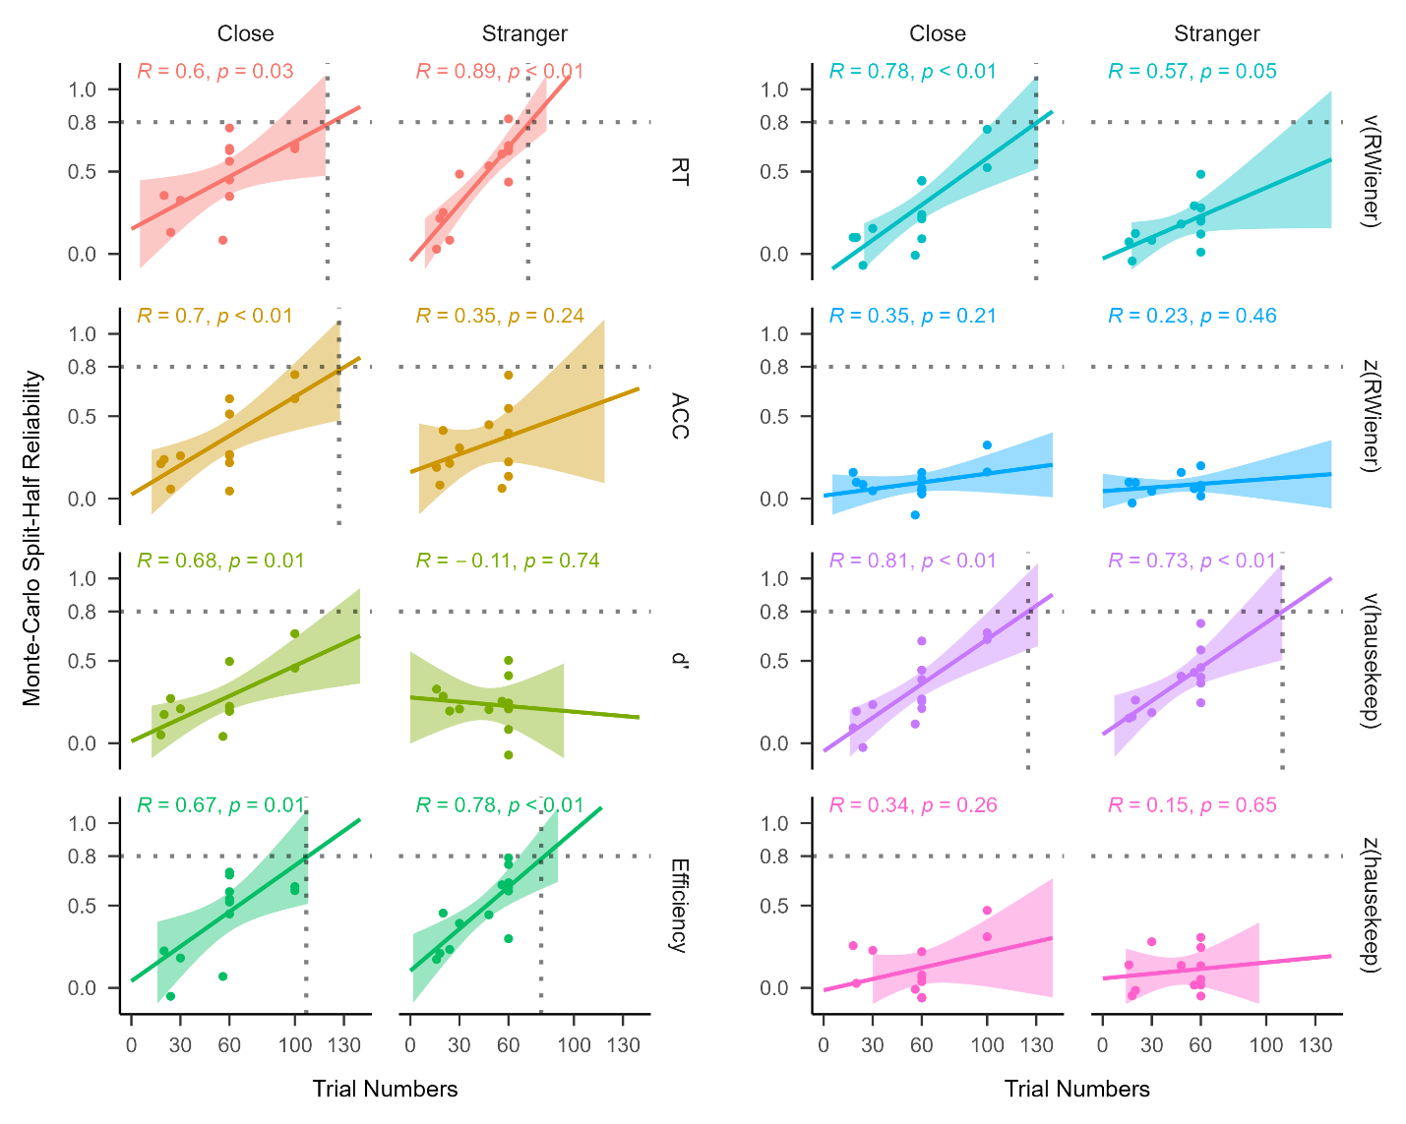
Exploratory Analysis
Monte Carlo split-half reliability
P > .05
P < .05
P > .05
Hedges’ g
Trial Numbers
Correlations between trial numbers and Monte Carlo split-half reliability
Notes:
Significant correlations between and Monte Carlo split-half reliability for some indicators, such as Reaction Time and Efficiency.
Non-significant correlations between g and split-half reliability, g and n trials.

Slide 19
Discussion
Except parameters z from DDM, all the other measures exhibited robust SPE
When it came to the reliability, only two measures of SPE, Reaction Time and Efficiency, exhibited acceptable to moderate reliability, among all indicators that has been reported in the literature.
The current implementation of SPMT was not well-suited for assessing individual differences.
Taken together, our study revealed a “reliability paradox” of SPE as measured by SPMT.

Slide 20
Reaction Time and Efficiency are the Best Measures (Comparably) to Measure SPE
The reaction time and efficiency performed relatively well on both group-level and individual-level.
For different baseline conditions used for calculating SPE in the literature, “Stranger” produced slightly higher effect size for almost all the six indicators and demonstrated greater reliability when it came to reaction time.

Slide 21
The “Reliability Paradox” of SPMT
The majority of the SPE measures demonstrated moderate to large effect sizes when analysed at the group level. However, when considering individual differences, only the SPE measures derived from reaction times (RT) and Efficiency (η) displayed comparatively higher values than other SPE measures but still did not meet the criteria for a satisfactory reliability.
One of the most plausible explanations is that the SPMT, like other cognitive tasks, tends to exhibit minimal variability among participants while maximizing the detection of SPE at the group level.

Slide 22
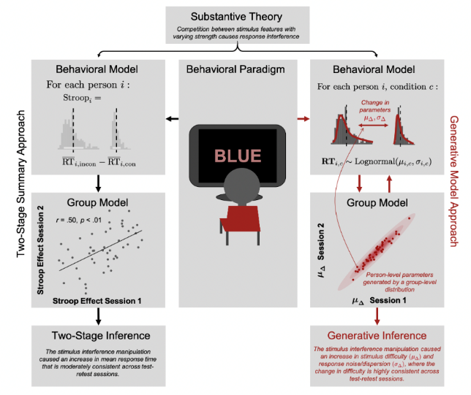
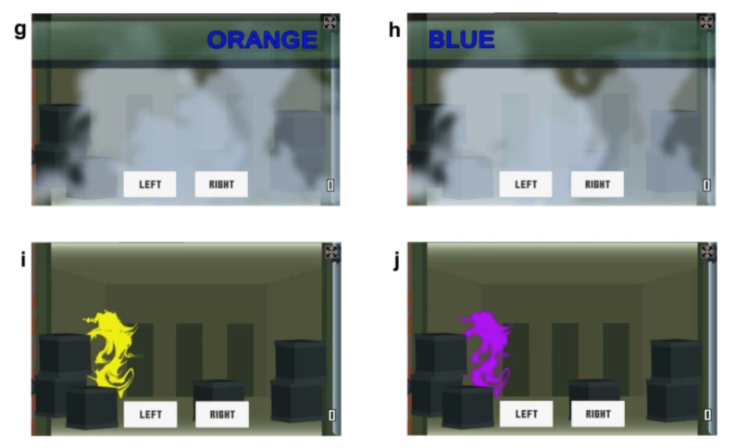
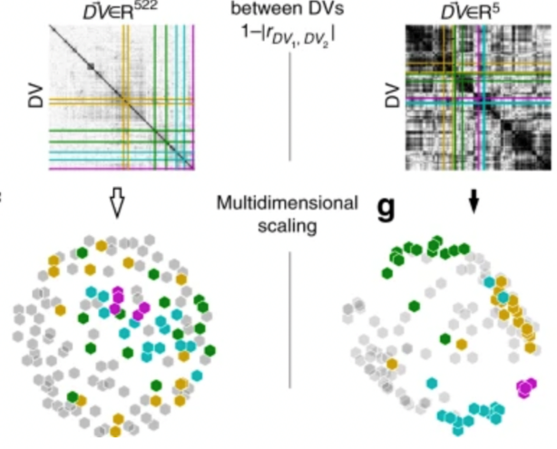
A Re-design of SPMT for Individual Differences
As the SPMT was designed to achieve robust group-level SPE rather than to measure individual differences, researchers need to re-design the task if they are interested in assessing individual difference.
Gamification of the Stroop Task
Kucina et al. (2023), Nature Communication
Using Generative Model
Haines et al., 2020)
Using Latent Model
Enkavi et al., (2019), PNAS
Eisenberg et al., (2019), Nature Communication

Slide 23
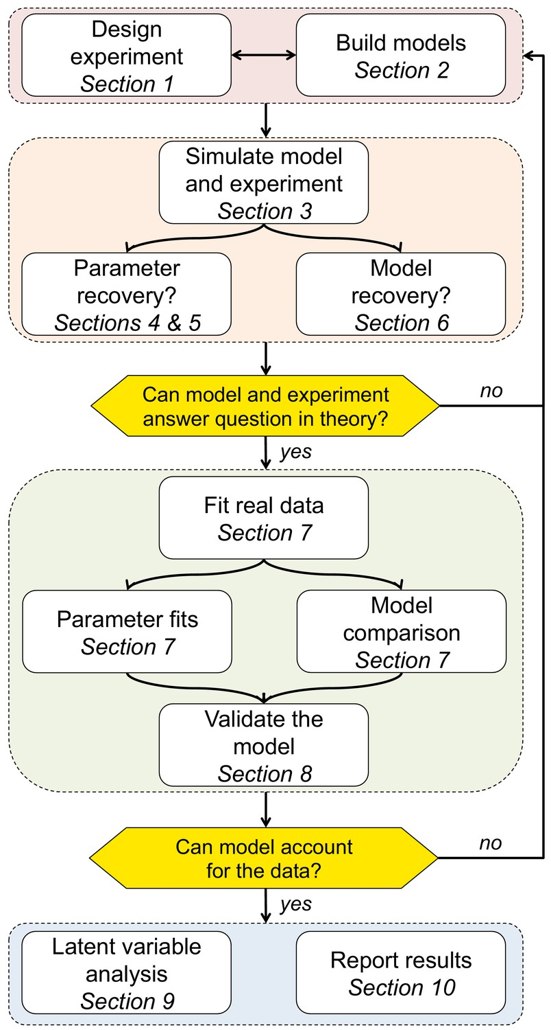
Low Reliability in the Parameters (v and z) from Standard DDM
The reliability of both the drift rate (v) and the starting point (z) fell well below acceptable levels.
Raised concerns about applying the standard drift-diffusion to data from SPMT directly.
Called for a more principled approach when modelling behavioural data to more accurately capture the fundamental cognitive processes at play.
Wilson and Collins (2019), Elife

Slide 24
Implication
An Initial Guide for Researchers Considering the Use of SPMT.
We recommend reaction times and efficiency as the indicators of SPE.
RT and efficiency strike a balance between achieving a substantial effect size at the group level and ensuring reliability at the individual level.
Considering the use of “Stranger” as baseline.
Increasing the number of trials is advisable.
Against the indiscriminate application of the standard DDM.
We advocate for a principled modelling approach.

Slide 25
Limitations
The majority of our samples still consisted of individuals from what is commonly referred to as “(W)EIRD” populations (Rad et al., 2018; Yue et al., 2023).
Necessary to include a more diverse sample to ensure greater generalizability of the paradigm.
The robustness and reliability of different variants of SPMT still need further investigation.
Only one dataset had longitudinal data available, which could potentially limit the representativeness of the ICC2 result.
Additional analysis of two datasets (in supplementary) that with different design showed similar results.

Slide 26
.
.
.
Thanks for Attention！
Any Questions?
*
Notes:
题目

