Slide 1

Hello ~
R of SPMT
Reliability Assessment of Self-Prioritization Effect as Measured by the Perceptual Matching Task
Zheng Liu (Helen), Mengzhen Hu (YuKi), Yuanrui Zheng, Jie Sui, Hu Chuan-Peng
Start

Slide 2

Parts
R of SPMT
Introduction
Method
Result
Discussion
02 / 31
by YuKi

Slide 3
Introduction
R of SPMT
Introduction
03 / 31
by YuKi

Slide 4
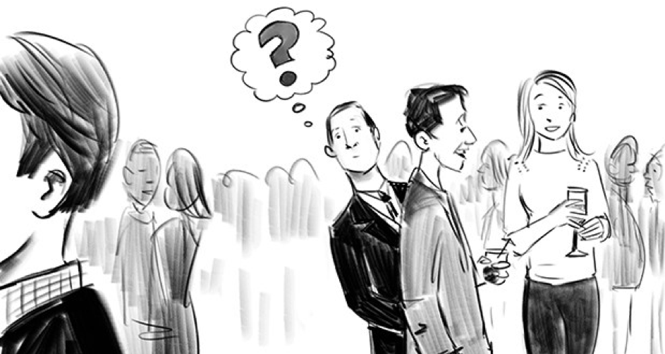
Introduction
Background
R of SPMT
Self-Prioritization Effect (SPE)
The cocktail effect
A memory advantage in recalling information encoded with self-relevance compared with those encoded with non-self relevance. (Rogers et al., 1977)
04 / 31
by YuKi
Notes:
鸡尾酒效应

Slide 5
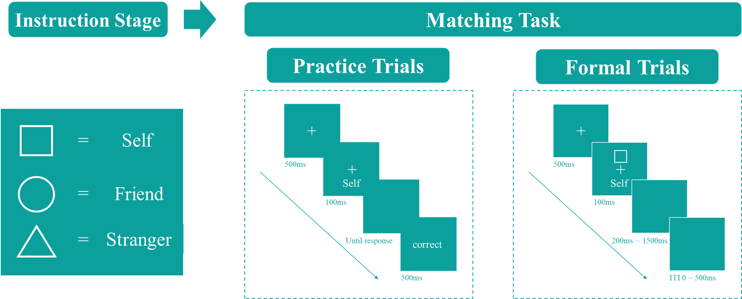
Introduction
Experiment Design
R of SPMT
3 * Identity
2 * Matching
A new paradigm to study the self-reference effect named shape-matching task was proposed (Sui et al., 2012).
05 / 31
by YuKi
Notes:
SPMT的实验流程

Slide 6
Introduction
R of SPMT
While SPMT has become a mainstream method for investigating the mechanism underlying the SPE, little attention has been paid to the exact indices of the effect and their reliability, which require careful examination (Parsons et al., 2019; Zorowitz & Niv, 2023).
06 / 31
by YuKi
Notes:
SPMT越来越被普遍用于测量自我优势效应
这意味着我们需要检验这个范式是否具有稳定性，也就是信度

Slide 7
Introduction
R of SPMT
A growing number of cognitive experimental paradigms are being directly used to examine personality traits (Kucina et al., 2023).
The reaction time differences in the Stroop paradigm are used to reflect individuals' varying executive control abilities (Eriksen, 1995; Hommel, 2011; MacLeod, 1991).
07 / 31
by YuKi
Notes:
此外，越来越多的认知实验被用来测量稳定的个体差异（类似于问卷被用于测量人格特质）
自我相关刺激反应更快速（自我优势效应）也是具有个体差异的
如果SPMT要被用于测量这样的个体差异，那么这个范式需要具有较高的信度
就像问卷一样

Slide 8
Introduction
R of SPMT
Recent years have witnessed a growing focus on the reliability of cognitive tasks, driven in part by the reliability paradox (Kucina et al., 2023).
This paradox stems from the observation that while cognitive tasks yield consistent experimental effects, they do not exhibit the same reliability when assessing individual differences (Logie et al., 1996).
08 / 31
by YuKi
Notes:
信度悖论

Slide 9
Introduction
R of SPMT
Does the SPMT paradigm also provide evidence for the existence of the reliability paradox?
There are many indices that reflect SPE (such as RT, ACC, etc.), do all these indicators have reliability?
Which indice has the highest reliability?
09 / 31
by YuKi
Notes:
SPMT这个范式是否具有信度（分半信度和重测信度）
体现SPE的指标有很多（比如RT, ACC, ..)，这些指标是否都具有信度
哪种SPE的指标信度最高

Slide 10
Method
R of SPMT
Method
10 / 31
by YuKi

Slide 11
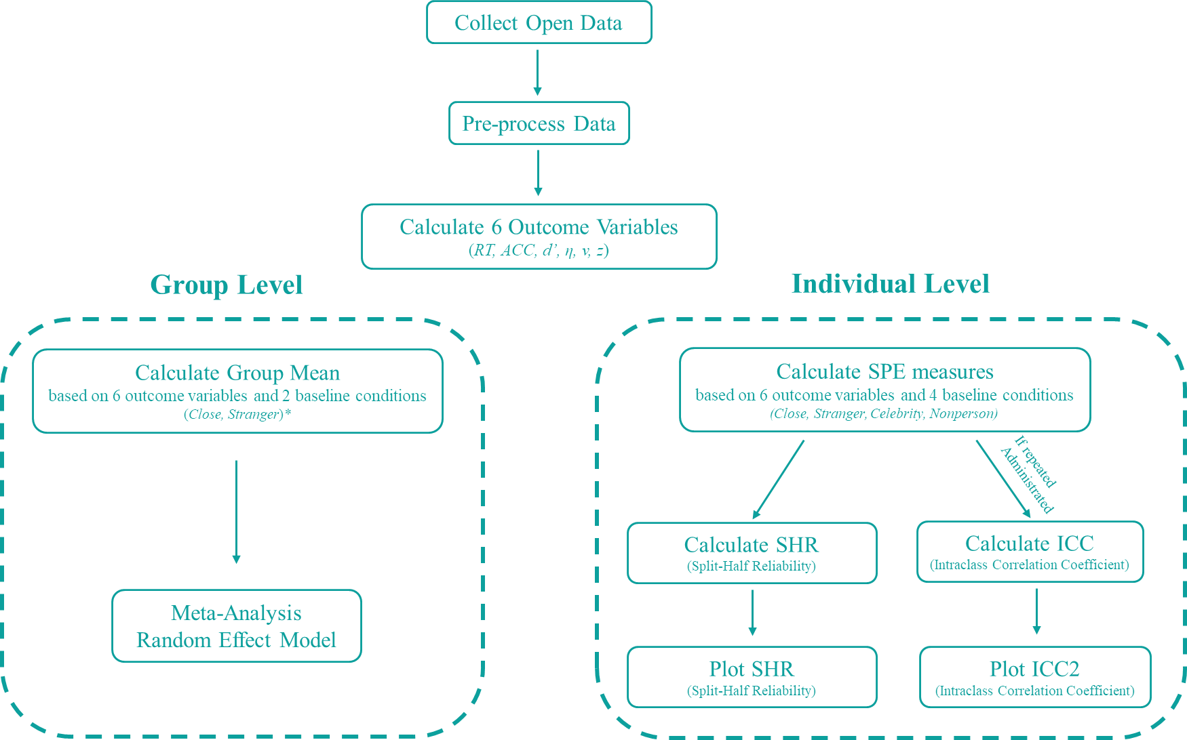
Method
Flow Chart
R of SPMT
Flow Chart
11 papers
(17 datasets)
11 / 31
by YuKi

Slide 12
Method
Variables
R of SPMT
X: Groups
Y: Indices
Reaction Time (RT),
Accuracy (ACC),
d Prime (d’),
Efficiency (η),
DDM Drift Rate (v),
DDM Start Point (z),
Subject
Matching
Identity
(Session)
Matching
Nonmatching
Close
Celebrity
Stranger
NonPerson
12 / 31
by YuKi
Notes:
需要按照自变量分组，每个实验条件下，都需要计算六种（八种）因变量指标
Session在数据集1中意味着重复度量，在其他数据集中如果没有这个变量，则会编码为1，
如果有其他做实验中组间平衡的变量，则会放在这里

Slide 13
Method
How to calculate SPE ?
R of SPMT
SPE = Self - <Target>
e.g.
RT_SPE = Self RT - <Target> RT
Close
Friend, Mother, Father...
14 Datasets
Stranger
<Target>
13 Datasets
Celebrity
鲁迅
1 Dataset
NonPerson
none
1 Dataset
13 / 31
by YuKi

Slide 14
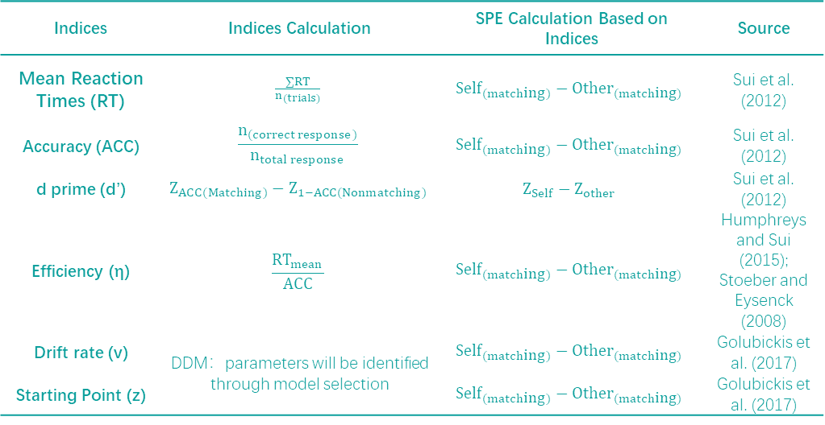
Method
Functions of SPE
R of SPMT
Indices | Indices Calculation | SPE Calculation Based on Indices | Source
Mean Reaction Times (RT) | $$\frac{∑RT}{n_{(trials)}}$$ | $${Self}_{(matching)}−{Other}_{(matching)}$$ | Sui et al. (2012)
Accuracy (ACC) | $$\frac{n_{(correct response)}}{n_{total response}}$$ | $${Self}_{(matching)}−{Other}_{(matching)}$$ | Sui et al. (2012)
d prime (d’) | $$Z_{ACC(Matching)}−Z_{1−ACC(Nonmatching)}$$ | $$Z_{Self}−Z_{other}$$ | Sui et al. (2012)
Efficiency (η) | $$\frac{{RT}_{mean}}{ACC}$$ | $${Self}_{(matching)}−{Other}_{(matching)}$$ | Humphreys and Sui (2015); Stoeber and Eysenck (2008)
Drift rate (v) | DDM：parameters will be identified through model selection | $${Self}_{(matching)}−{Other}_{(matching)}$$ | Golubickis et al. (2017)
Starting Point (z) |  | $${Self}_{(matching)}−{Other}_{(matching)}$$ | Golubickis et al. (2017)
14 / 31
by YuKi
Notes:
然后计算自我与他人，在这六种指标上的差异，即自我优势效应SPE

Slide 15

Method
Group Level :
Meta-analysis
R of SPMT
Group Level :
Meta-Analysis
Reaction Time (RT),
Accuracy (ACC),
d Prime (d’),
Efficiency (η),
DDM Drift Rate (v),
DDM Start Point (z),
Hedges’ g
Self - <Target>
15 / 31
by YuKi
Notes:
每个被试在每个实验条件下，
按照四种分半方法
数据被均等的分为两份。
每一个两半都需要计算六种表示SPE的指标

Slide 16

Method
Individual Level :
Split-Half Reliability
R of SPMT
Subject
Matching
Identity
(Session)
First-Second
Odd-Even
Permuted
Monte Carlo
RT
ACC
d
Eff
DDM v
DDM z
RT
ACC
d
Eff
DDM v
DDM z
Split Half Reliability
15 / 31
by YuKi
Notes:
每个被试在每个实验条件下，
按照四种分半方法
数据被均等的分为两份。
每一个两半都需要计算六种表示SPE的指标

Slide 17
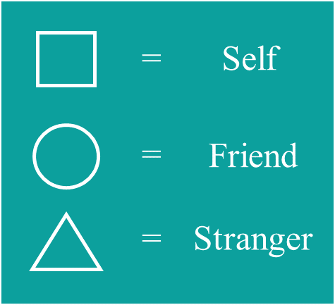
Method
Individual Level :
Intraclass Correlation Coefficient
R of SPMT
SPMT
SPMT
SPMT
…
…
Variance between Subjects
Variance within Subjects (Session)
SPE ~ 1 + (1 | Subject) + (1 | Session) + COV
20 / 31
by YuKi

Slide 18
Result
R of SPMT
Result
23 / 31
by YuKi

Slide 19
Result
Group Level :
Meta-Analysis
R of SPMT
Baseline | Indicators | g [95% CI] | No. of Studies | Q | p | I²
Close
 | RT | 0.47 [0.30, 0.63] | 14 | 68.67 | <.001 | 84.94%
 | ACC | 0.73 [0.42, 1.03] | 14 | 144.57 | <.001 | 92.87%
 | d | 0.44 [0.28, 0.59] | 14 | 81.96 | <.001 | 83.02%
 | η | 0.88 [0.50, 1.25] | 14 | 128.47 | <.001 | 94.67%
 | v | 0.54 [0.32, 0.76] | 14 | 142.79 | <.001 | 91.16%
 | z | 0.15 [-0.03, 0.33] | 14 | 122.30 | .11 | 88.95%
Stranger
 | RT | 0.59 [0.40, 0.78] | 13 | 55.30 | <.001 | 83.20%
 | ACC | 0.78 [0.48, 1.08] | 13 | 77.78 | <.001 | 88.60%
 | d | 0.35 [0.21, 0.50] | 13 | 47.81 | <.001 | 75.38%
 | η | 0.92 [0.56, 1.29] | 13 | 98.79 | <.001 | 93.30%
 | v | 0.44 [0.28, 0.59] | 13 | 50.98 | <.001 | 79.33%
 | z | 0.08 [-0.09, 0.24] | 13 | 70.48 | .37 | 84.44%
23 / 31
by YuKi

Slide 20
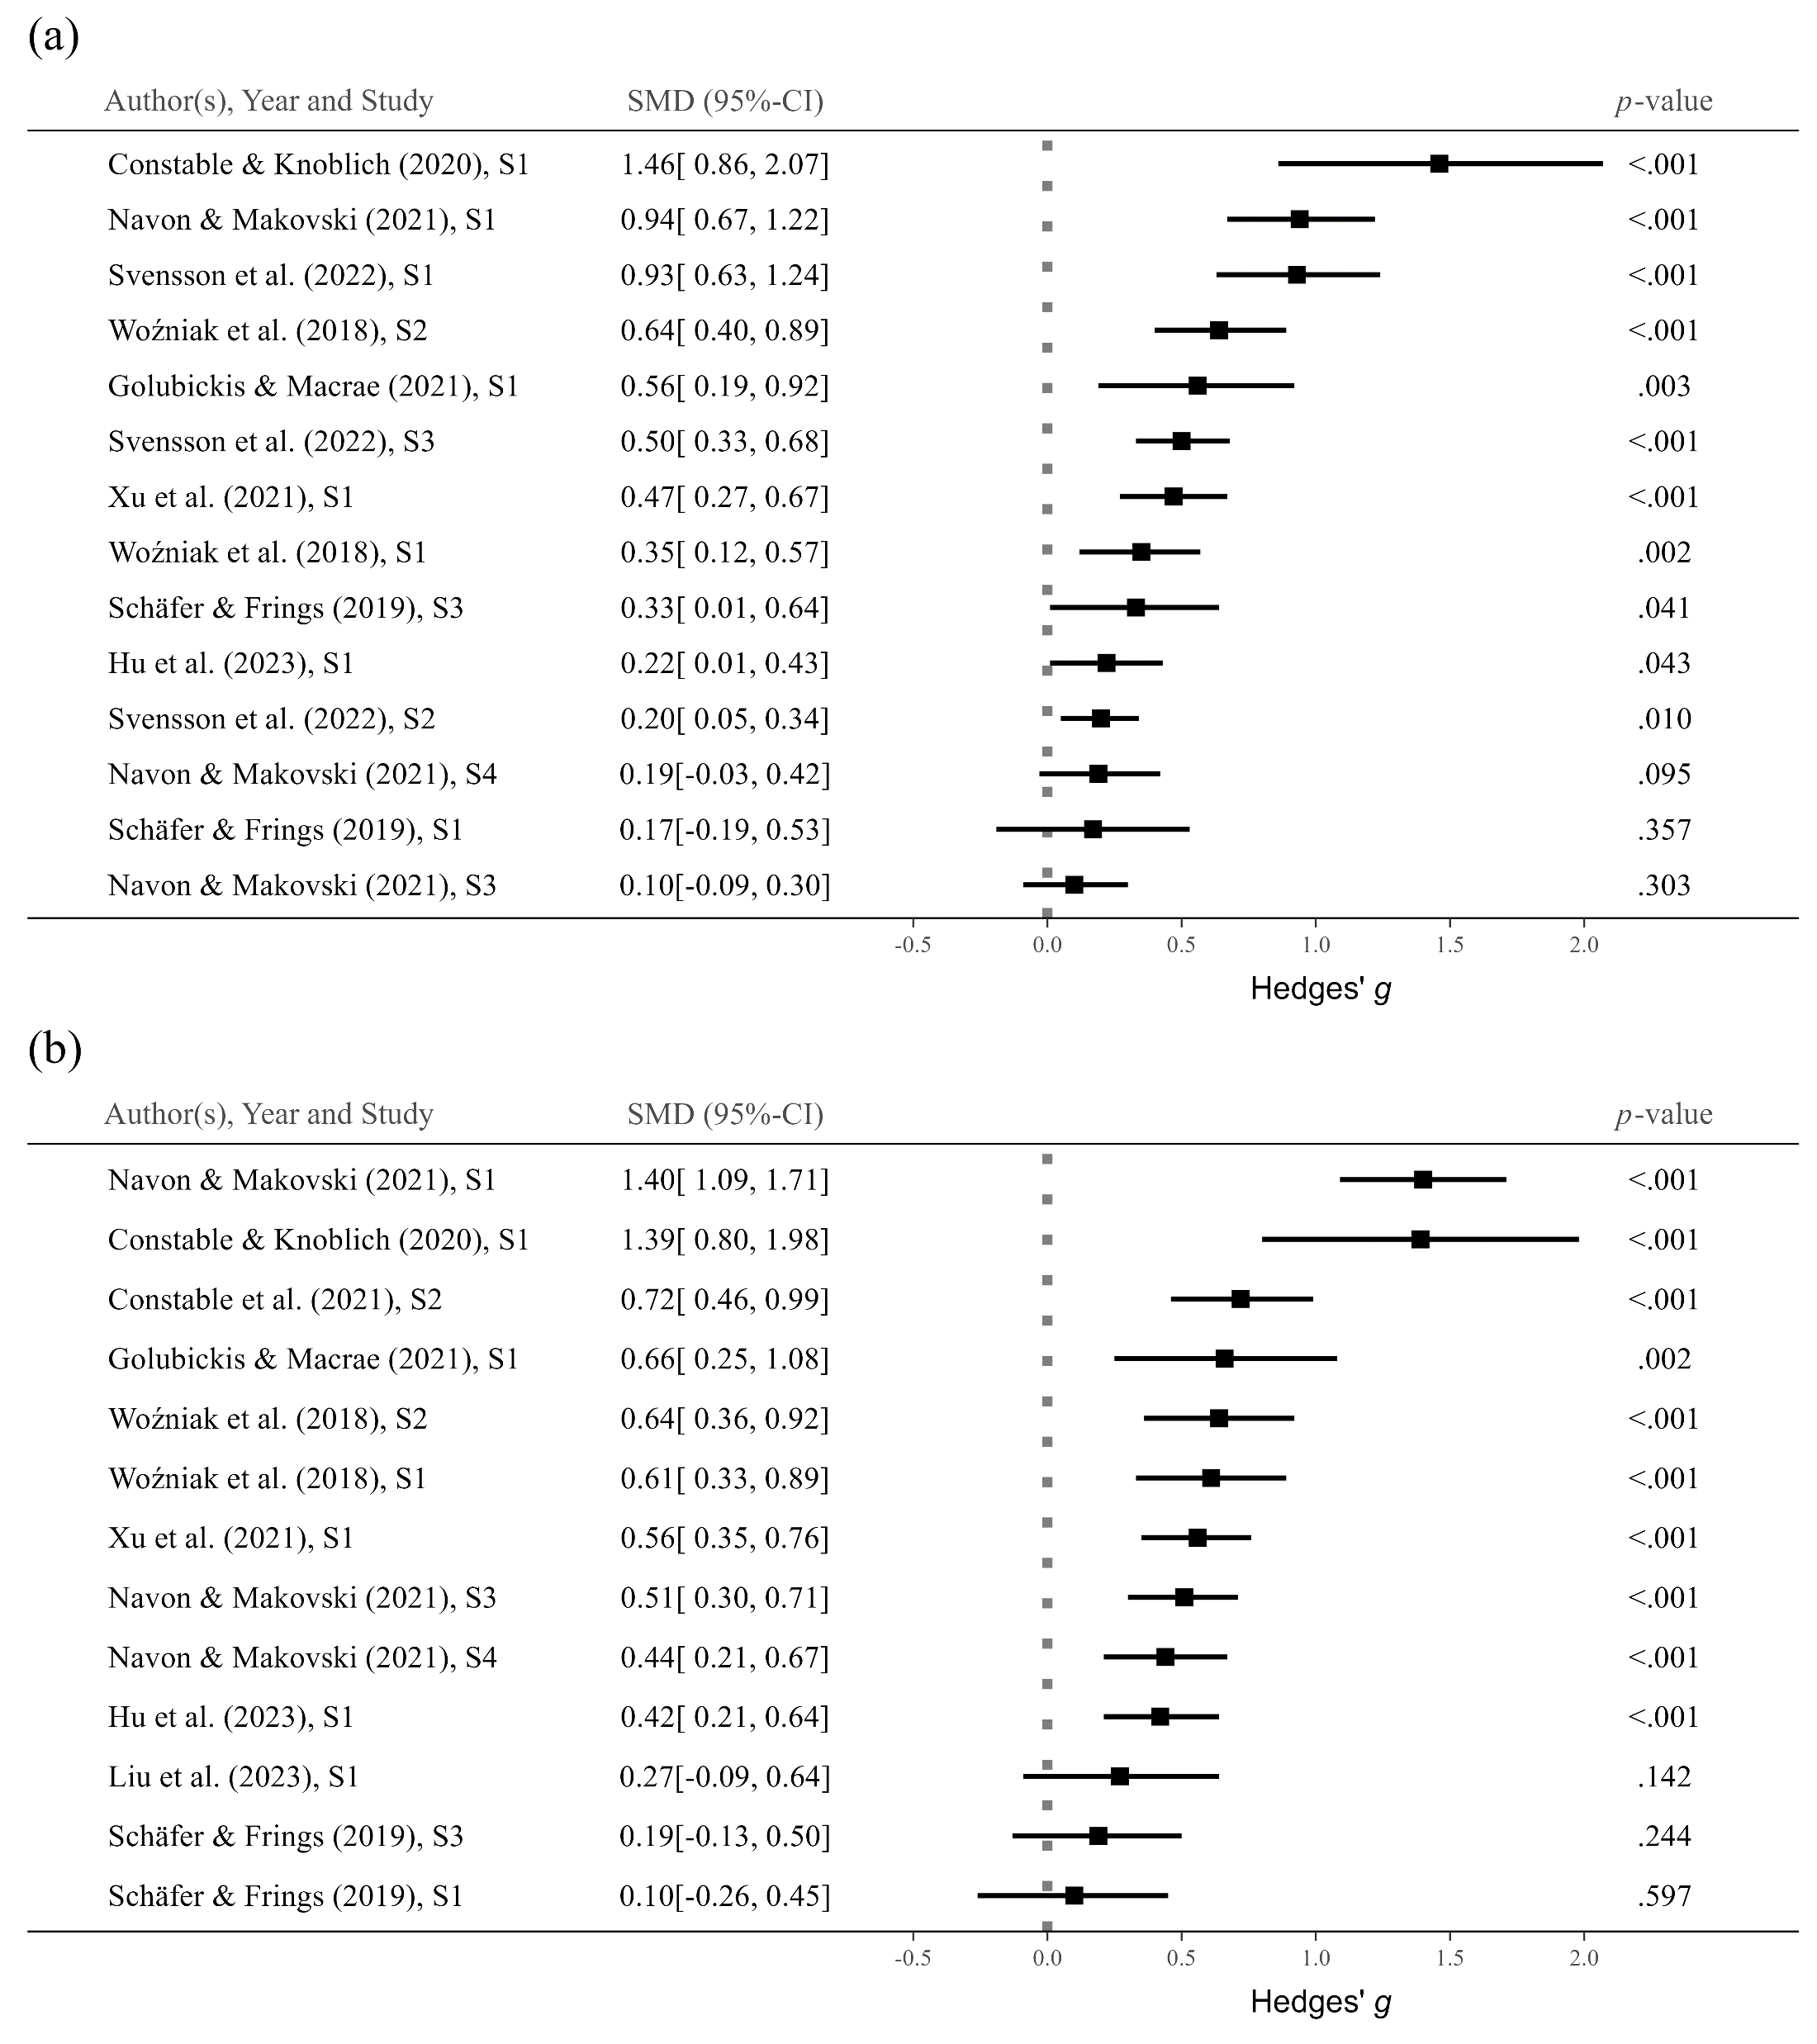
Result
Group Level :
Forest Plot of RT (Self – Close)
R of SPMT
23 / 31
by YuKi

Slide 21
Result
Group Level :
Forest Plot of RT (Self – Stranger)
R of SPMT
23 / 31
by YuKi

Slide 22
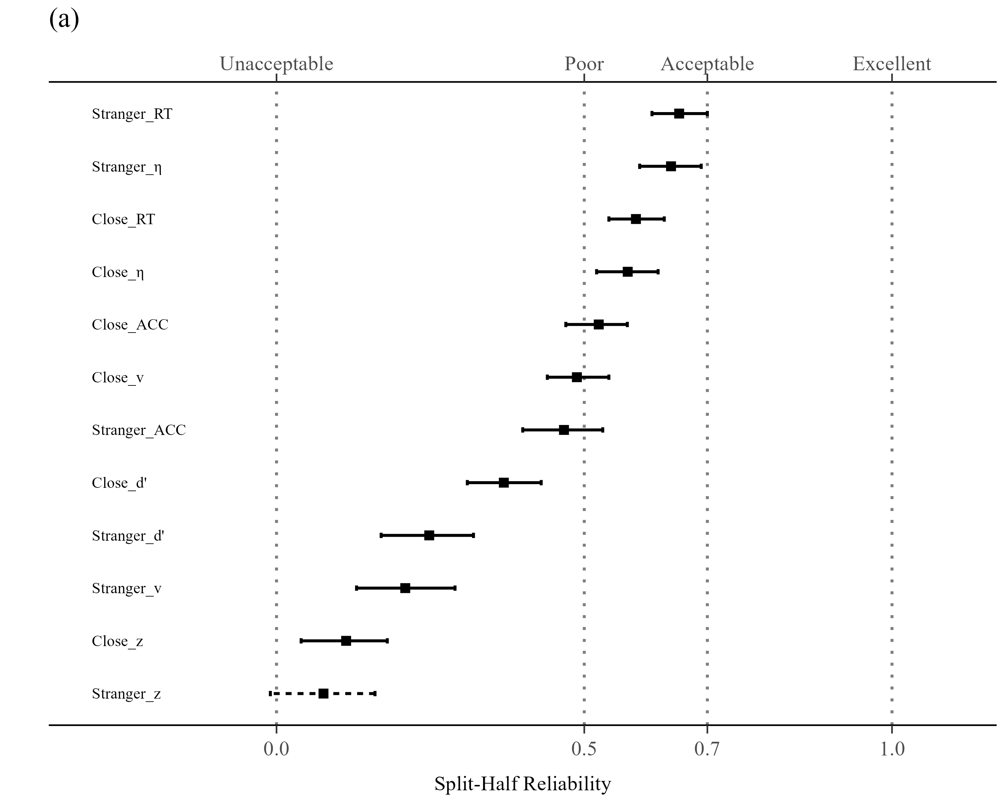
Result
Individual Level :
Split Half Reliability
R of SPMT
23 / 31
by YuKi
Notes:
Reaction Time (RT) with "Stranger" contrast (r = .65, SE = .02, p <.001, 95% CI [.61, .70]);
Efficiency (η) with "Stranger" contrast (r = .64, SE = .03, p <.001, 95% CI [.59, .69]);
RT with "Close other" contrast (r = .58, SE = .02, p <.001, 95% CI [.54, .63]);
η with "Self vs Close" contrast (r = .57, SE = .02, p <.001, 95% CI [.52, . 62]).

Slide 23
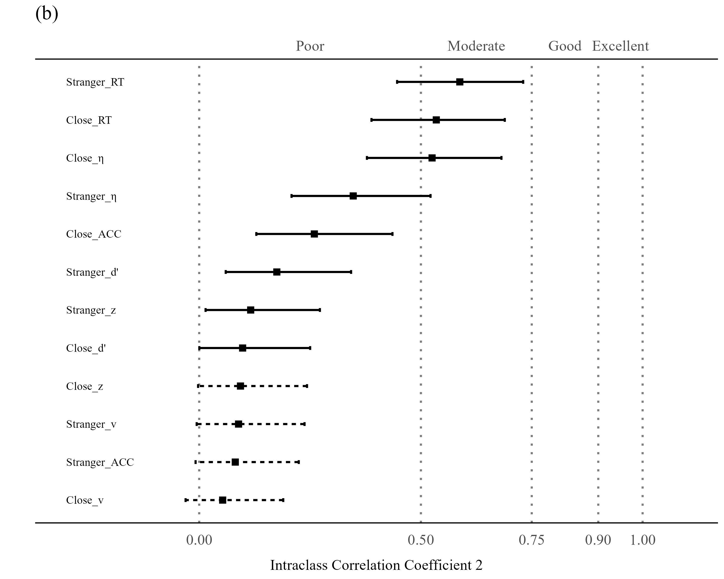
Result
Individual Level :
Intraclass Correlation Coefficient
R of SPMT
26 / 31
by YuKi
Notes:
ICC2和ICC2k越大说明重复度量的稳定性越高
RT和efficiency的ICC2k较大，说明这两个指标具有较好的重测信度
多了一个两天的数据
四天的由于混杂了情绪，效果很早。就像celebrity

Slide 24
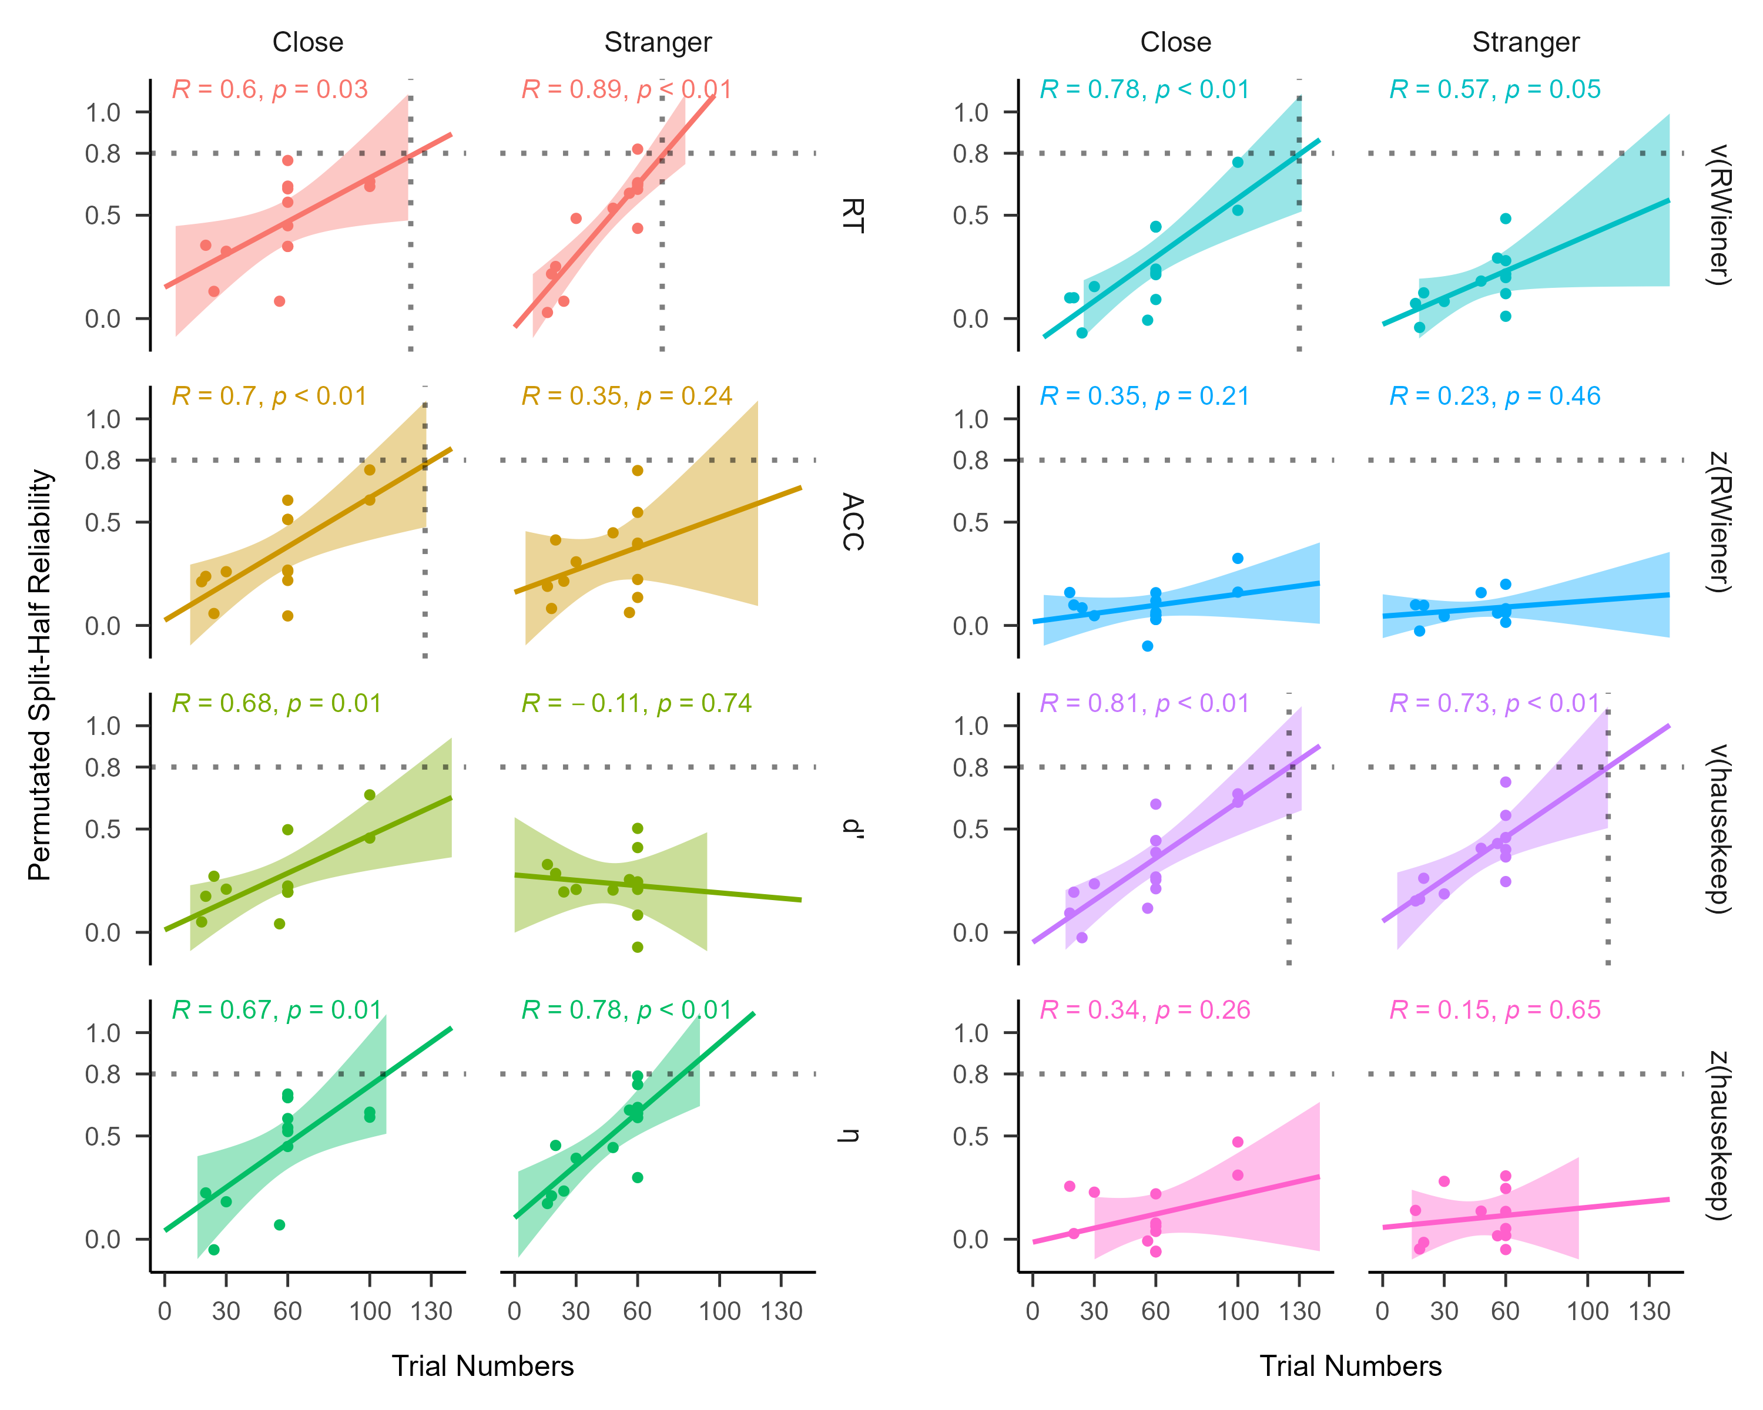
Result
Exploratory Analysis :
Regression: SHR ~ Trial Numbers
R of SPMT
27 / 31
by YuKi
Notes:
试次数越高, 分半信度越高
Q: 大概需要多少试次数, 才能让信度达到0.8?
A: Stranger 80；close 110-120
DDM V 约130

Slide 25
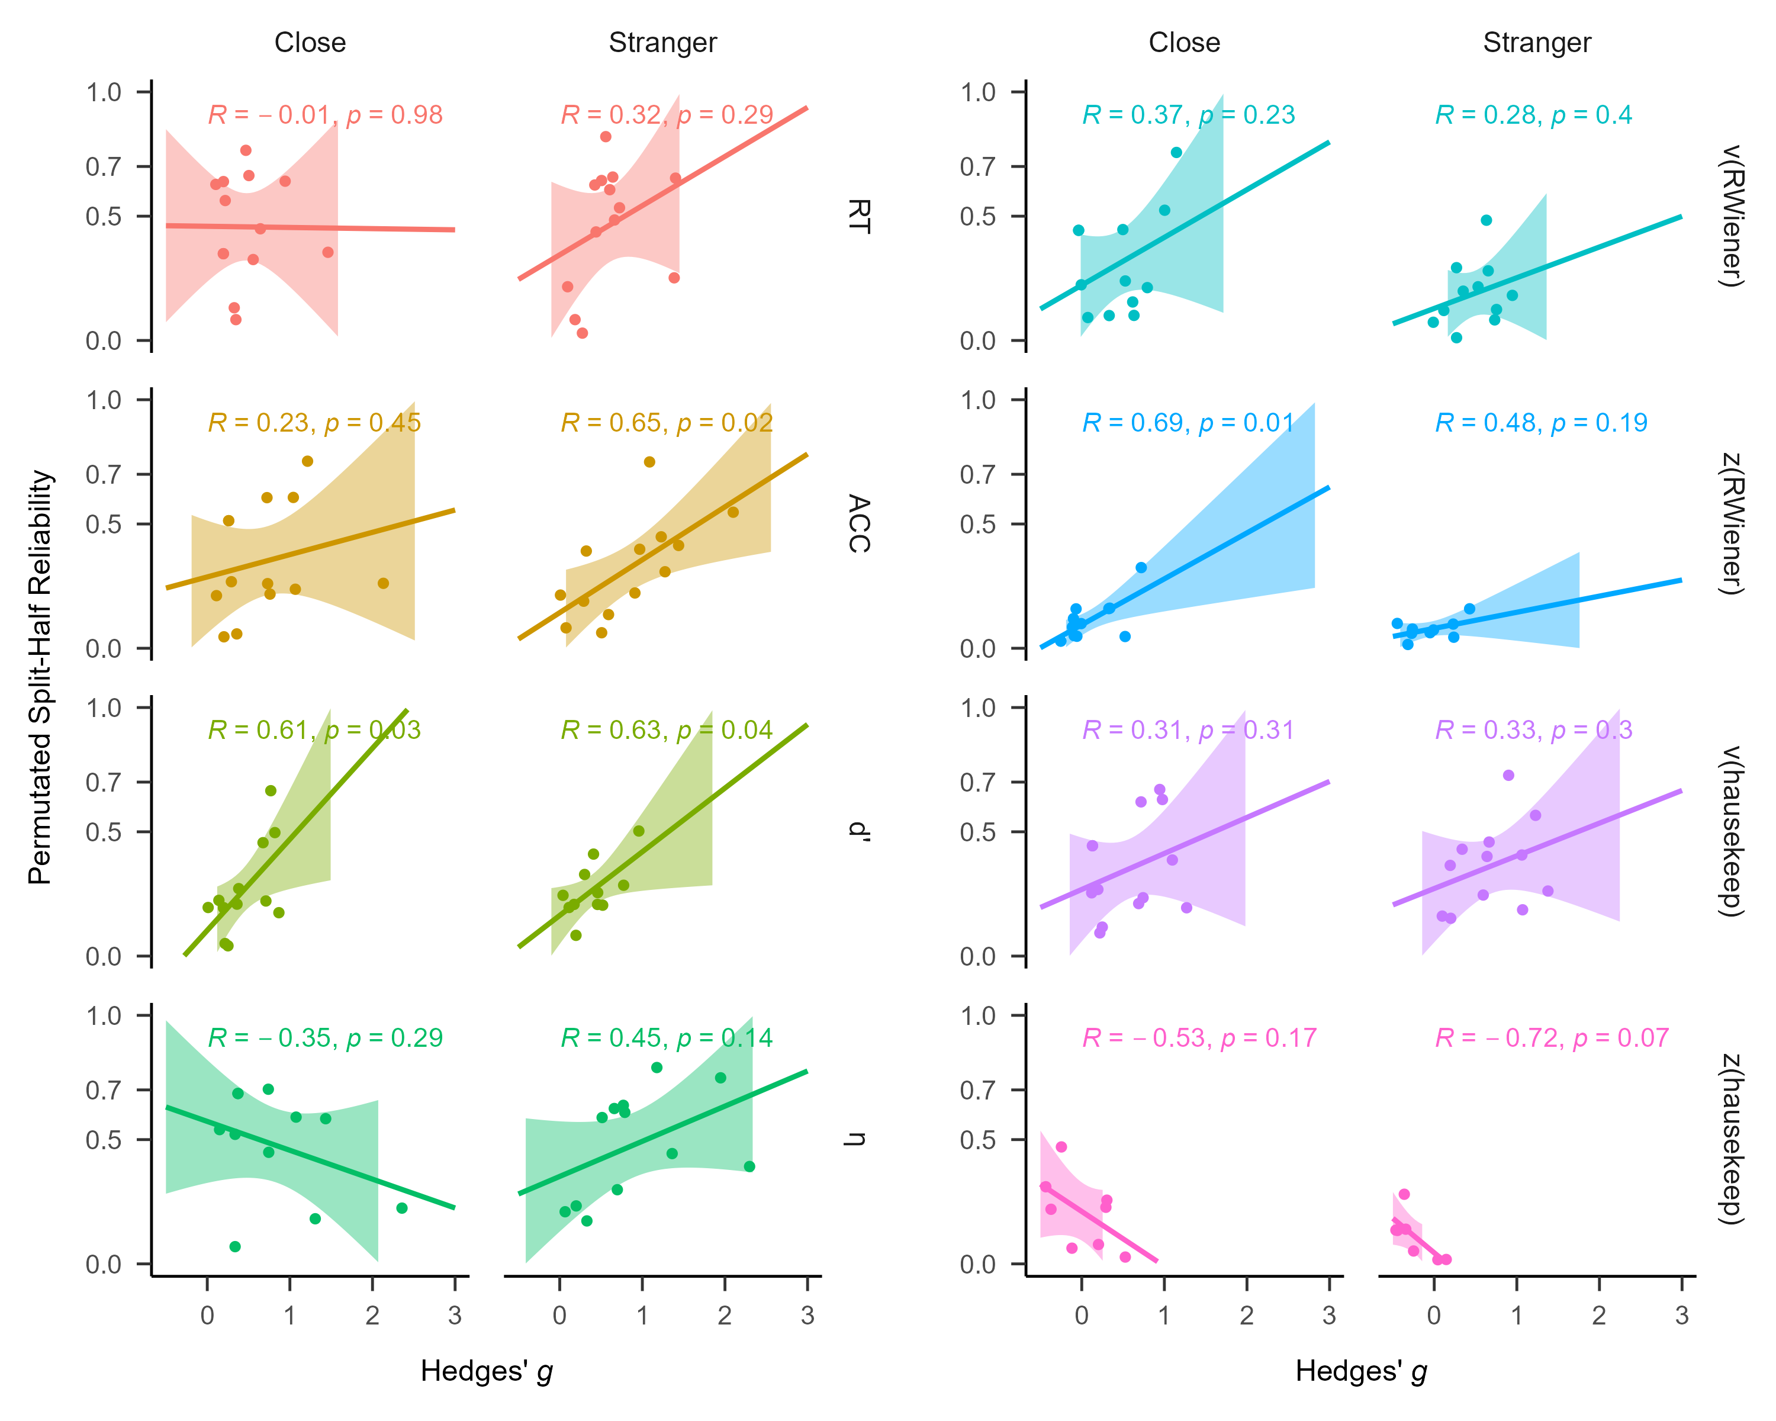
Result
Exploratory Analysis :
Regression: SHR ~ Hedges’ g
R of SPMT
27 / 31
by YuKi
Notes:
分半信度与效应量g无关

Slide 26
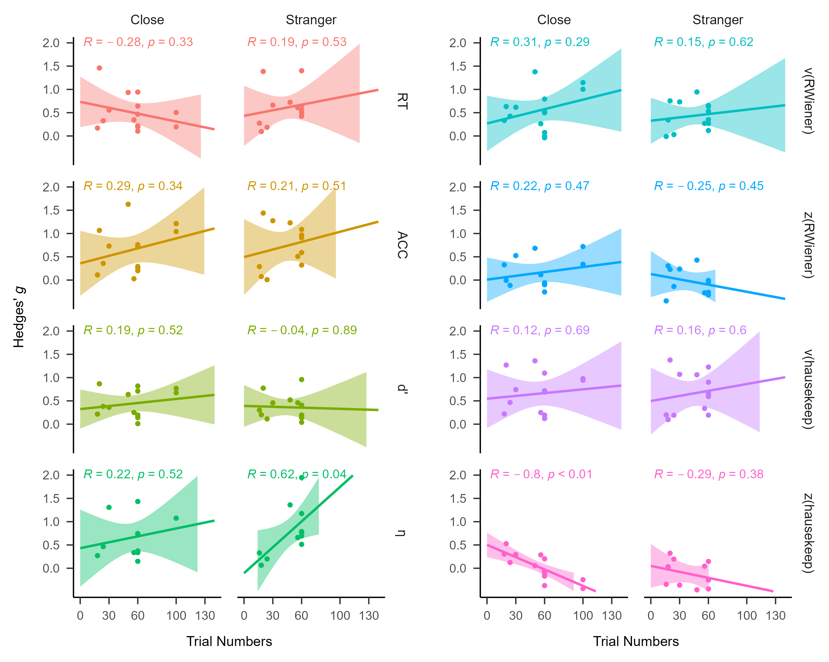
Result
Exploratory Analysis :
Regression: Hedges’ g ~ Trial Numbers
R of SPMT
27 / 31
by YuKi
Notes:
效应量g与试次数无关

Slide 27
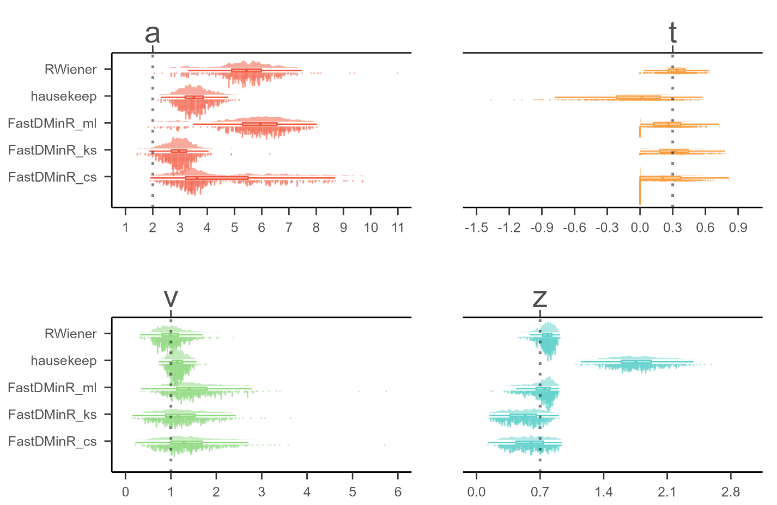
Result
Exploratory Analysis :
DMM Packages Comparison
R of SPMT
30 / 31
by YuKi
Notes:
Ezddm不会对z进行估计，而是假定z为a/2
为了得到对z的准确估计，我们对比了R里各种可以计算ddm参数的包
Wagenmakers, E. J., Van Der Maas, H. L., & Grasman, R. P. (2007). An EZ-diffusion model for response time and accuracy. Psychonomic bulletin & review, 14(1), 3-22.
我们设定了a = 2, t = 0.3, v = 1, z = 0.7
由hddm这个包生成了符合这四个参数的一百个，含有60试次的数据集
然后让Rwiener，hausekeep，fastDMinR，这三个包，一共五种估计方法估计这四个参数
从而筛选出估计最准确，耗时最低的那个包
结果是，对于a的估计，三个包都不太准确
对于t的估计，RW最准确
对于v的估计，RW最准确，hausekeep也不错
对于z的估计，RW最准确

Slide 28
Discussion
R of SPMT
Discussion
28 / 31
by YuKi

Slide 29
Discussion
R of SPMT
Consistent with reliability paradox.
“Robust experimental effects do not consistently correspond with robust correlations among individual differences” (Logie et al., 1996)
Based on the result of meat-analysis (Group-Level), SPMT does indeed exhibit a stable experimental effect.
Based on the result of split-half reliability and test-retest reliability (Individual-Level). The reliability of SPMT is relatively low.
RT and η are relatively the most reliable among all these indices, both in terms of split-half reliability and test-retest reliability; The reliability of the other indicators (DDM v & z, d prime and ACC) is relatively low.
31 / 31
by YuKi
Notes:
RT和Eff是所有指标里最稳定的，不论是分半信度还是重测信度
总体而言，SPMT范式的信度并不高，只有RT的分半信度超过了0.5。并没有达到0.8-0.9的信度
DDM v & z, d prime和acc的信度较低

Slide 30
Discussion
R of SPMT
Thanks
End
by YuKi

