Slide 1

Introduction
R of SPMT
99 / 99
by YuKi

Slide 2
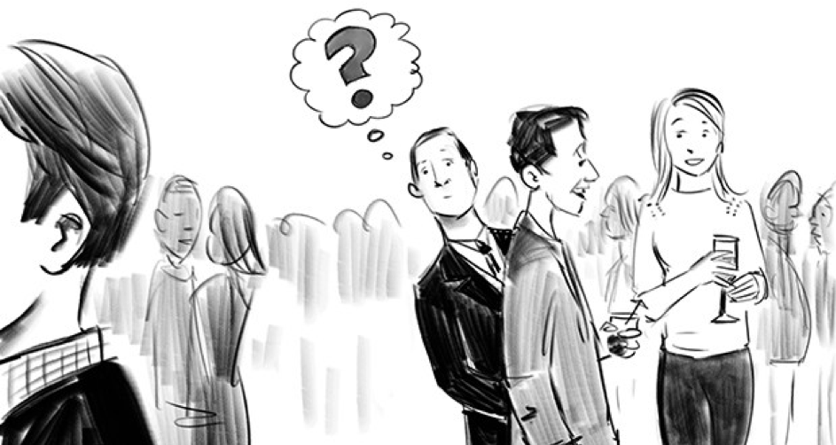
Introduction
R of SPMT
Self-Prioritization Effect (SPE)
The cocktail effect
A memory advantage in recalling information encoded with self-relevance compared with those encoded with non-self relevance. (Rogers et al., 1977)
99 / 99
by YuKi

Slide 3

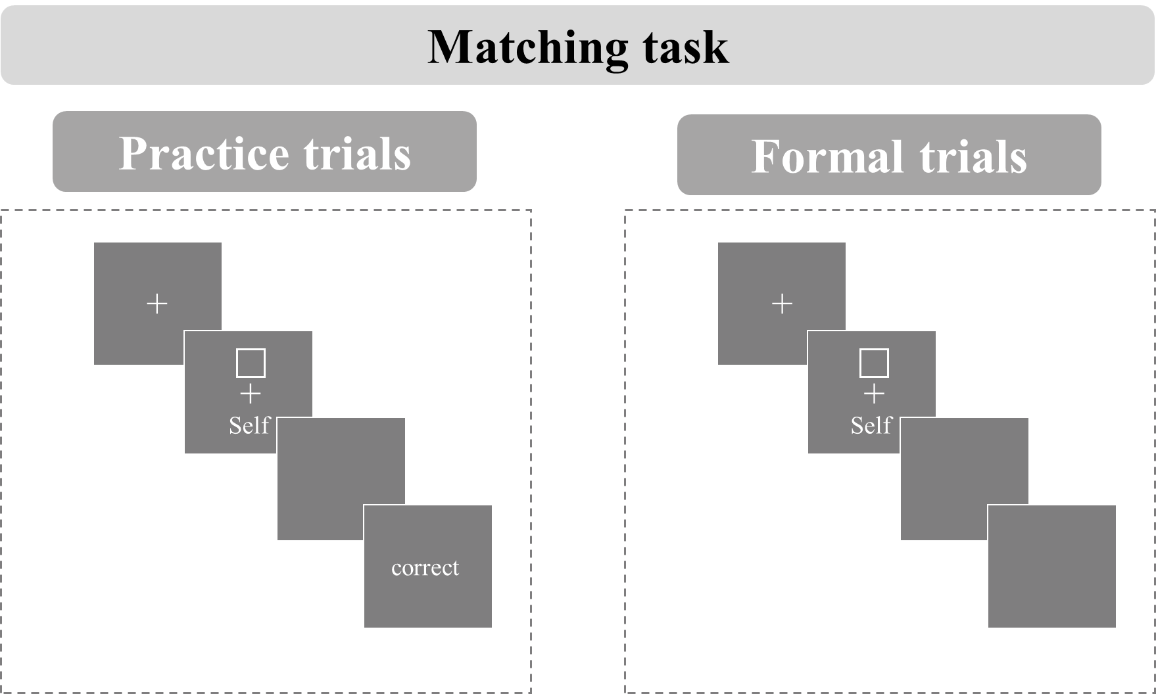
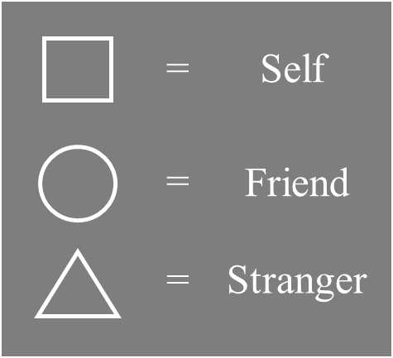
Introduction
R of SPMT
A new paradigm to study the self-reference effect named shape-matching task was proposed (Sui et al., 2012).
99 / 99
by YuKi

Slide 4
Introduction
R of SPMT
99 / 99
by YuKi

