Slide 1


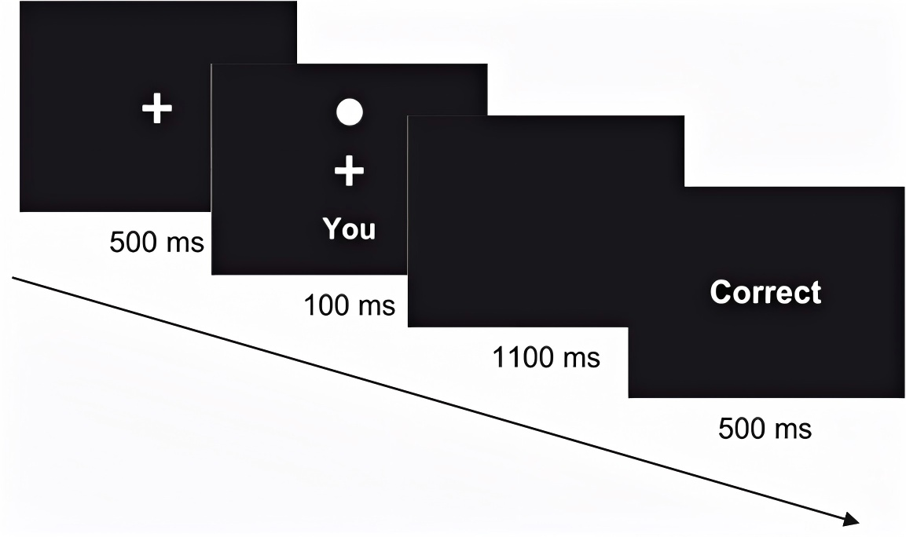
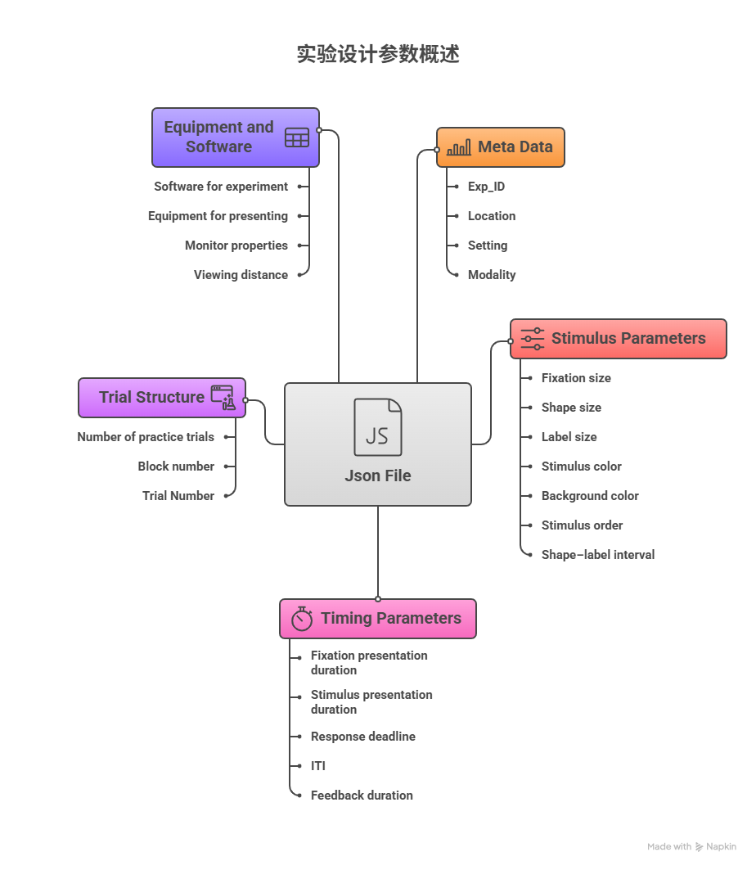
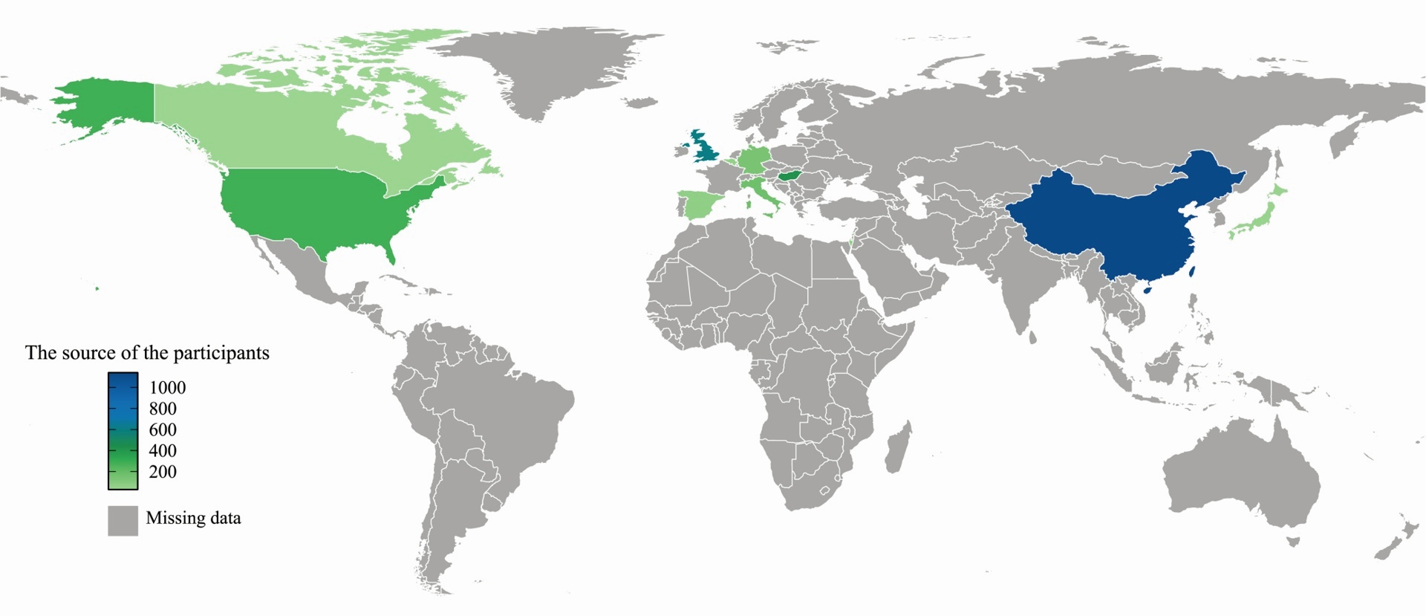
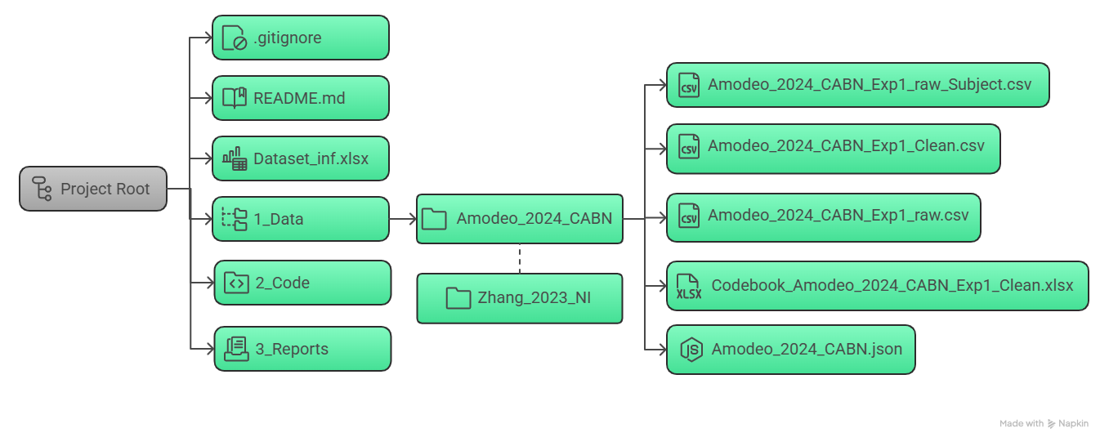
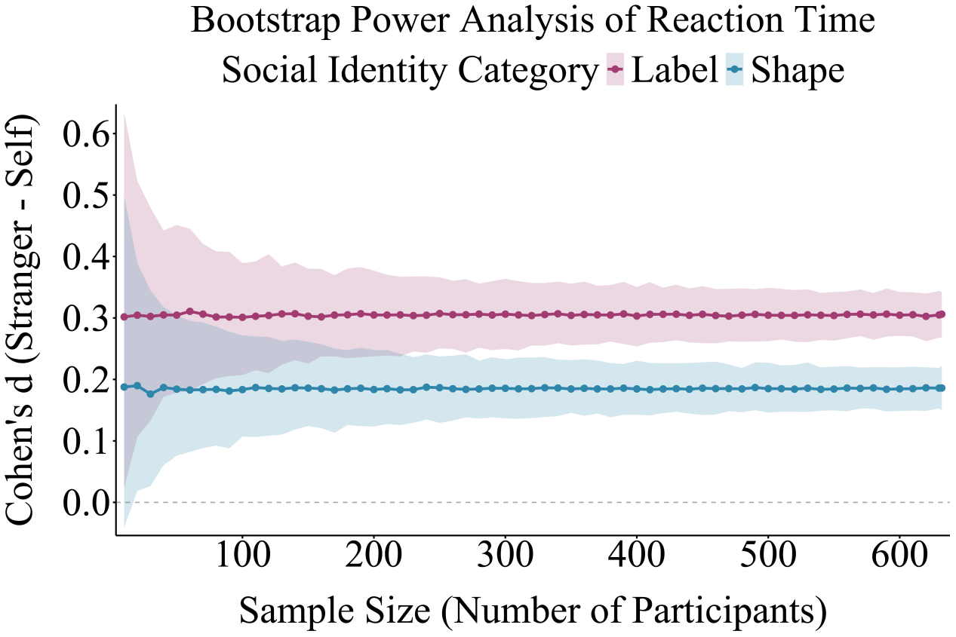
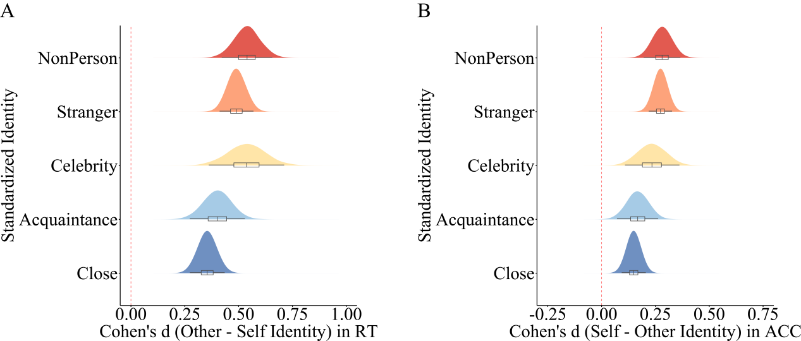
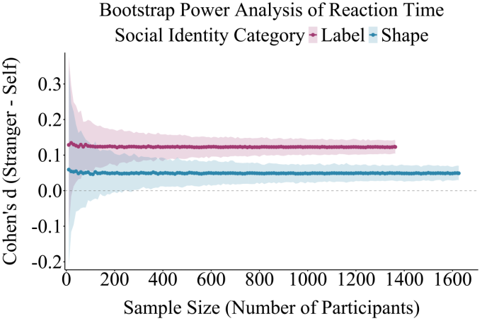
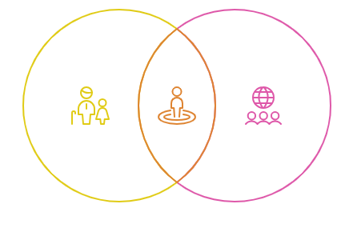
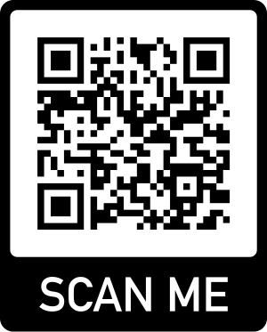
The Self-Prioritization Effect Database
Cai Zhenxin¹,Wang Qihui¹,Tuo Liu²,Hu Chuan-Peng¹,Sui Jie³
1.School of Psychology, Nanjing Normal University, Nanjing, Jiangsu, China
2.Department of Psychology, Goethe University Frankfurt, Germany
3.School of Psychology, University of Aberdeen, Aberdeen, UK
Self Matching Task
What is the Self-Matching Task?
What is the Self-Prioritization Effect?
Introduced by Sui et al. (2012) to investigate self-prioritization in perception.
Procedure:
  Participants learn arbitrary associations between geometric shapes or faces and social labels (e.g., You, Friend, Stranger).
  In each trial, they judge whether a presented pair (shape–label or face–label) matches the learned association.
SPE refers to the cognitive advantage for self-associated stimuli, shown as faster reaction times (RTs) or higher accuracy (ACC) compared to stimuli associated with others.
Measurement in Task:
  In the Self-Matching Task, SPE is typically measured by comparing RTs or ACC between Self-Matching and Other-Matching trials.
上
Self-prioritization Effect Database
Database Introduce
Database Folder Structure
    The SPE Database:
    Focused on the Self-Matching Task (Sui, He, & Humphreys, 2012)
    Includes data from 44 articles, 70 experiments, and 3,603+ participants
    Contains trial-level RT and ACC
    Enriched with detailed experimental design and subject metadata
Variable | Example Value
Subject | 1,2,3,4,..,88
Block | 1,2,..,6
Trial | 1,2,3,4,..,60
Shape | S.bmp,C.bmp,T.bmp
Label | Ikzelf,Bekende,Bekende
Matching | Matching,Nonmatching
Label_Origin_Identity | Ikzelf,Bekende,Bekende
Label_English_Identity | Self,Friend,Stranger
Label_Standardized_Identity | Self,Close,Stranger
Shape_Origin_Identity | Self,Friend,Stranger
Shape_English_Identity | Self,Friend,Stranger
Shape_Standardized_Identity | Self,Close,Stranger
Response | m,n
RT_ms | 876
RT_sec | 0.876
ACC | 0,1
Preliminary Analyses Enabled by Database-Driven Research
Does increased sample size reveal a robust Self-Prioritization Effect in nonmatching trials?
For Strict Approach:
  For reaction time, Cohen’s d (Self - Stranger) remains consistently positive (Label: ~0.3; Shape: ~0.2) as sample size increases (up to 600). This indicates a robust, persistent SPE in reaction time under strict data screening.
For Loose Approach:
  Cohen’s d values hover near 0.1 (for both Label and Shape), indicating a small effect size. Even with sample sizes up to 1600, this effect does not reach a magnitude considered robust, so there is no robust SPE under loose data screening.
How does social distance modulate the self-prioritization effect in RT and ACC?
With increasing social distance, Self-Prioritization Effect is more significant in RT and ACC .
Take Home Message
Contribution
  Resolves existing theoretical debates
  Enables novel research question exploration
  Advances self-bias cognitive model development & validation
Limitation
Manual operation is inefficient and cannot automatically incorporate new research.
The existing data standardization template only includes behavioral data.
Join and Grow the SPE Database
Contribute your data using the Self-Matching Task (SMT)
Use the database in your own research and meta-analysis
Collaborate with us on expanding this open-access resource
Contact: 1372279952@qq.com

