Slide 1
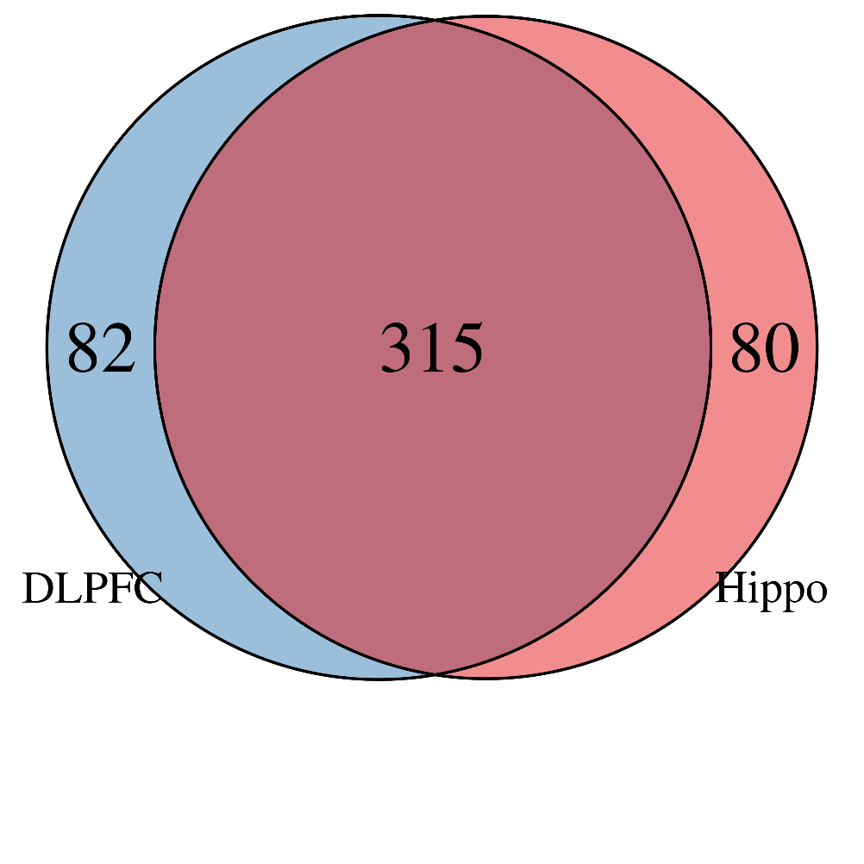
eQTL Analysis
Sample information
Brain overlaps by region:
 | Hippo | DLPFC
Total | 395 | 397
Control / Schiz | 262 / 133 | 244 / 153
Female / Male | 126 / 269 | 124 / 273
AA / Asian / Cauc / Hisp | 213 / 0 / 182 / 0 | 204 / 9 / 174 / 10
Mean Age (SD) [min, max] | 45.5 (16.4) [13.0, 96.9] | 45.8 (16.5) [13.0, 96.9]
Hippo | F | M
Control | 79 | 183
Schiz | 47 | 86
DLPFC | F | M
Control | 75 | 169
Schiz | 49 | 104

Slide 2
eQTL Analyses
Performed genome-wide cis (<500kb) eQTL analysis
Tested four features: gene, transcript, exon, and junction
Adjusting for diagnosis, sex, expression PCs and genetic ancestry components
Mean expression cut-offs:
Gene 0.25 (RPKM)
Exon 0.30 (RPKM)
Jxn 0.35 (RP10M)
Tx 0.40 (TPM)
Cutoff applied to sACC & Amygdala expression – then take those same features in DLPFC (note 3 exons missing in DLPFC)
rAggr SNPs
881 PGC suggestive SNPs + neighboring proxies
10,777 SNPs total
Results can be subsetted to 31 genome-wide significant SNP + proxy results
1226 SNPs total
FDR recalculated. P-value, beta, etc. will be identical to previous numbers.
Genome wide analysis
____ SNPs total

Slide 3
eQTL Analyses
rAggr SNPs
179 PGC suggestive SNPs + neighboring proxies
10,981 SNPs total
Notes:
- 116 proxy SNPs that map to multiple indexes (see Excel file).
- Three index SNPs that are all also proxies for each other:
SNP1 Name | SNP1 Chr | SNP1 Pos
rs58411478:1699077:T:C | 11 | 1699077
rs61509608:1697786:C:T | 11 | 1697786
rs73404742:1704107:G:A | 11 | 1704107

Slide 4
eQTL Analysis - rAggr
881 Index SNPs plus proxies
Inputs to eQTL analysis:
 | Amygdala (n=243) | DLPFC (n=167)
# SNPs (# index) | 10,777 (456) | 10,777 (456)
# Genes | 25,136 | 25,136
# Transcripts (from # Genes) | 73,214 (27,077) | 73,214 (27,077)
# Exons (from # Genes) | 396,818 (23,628) | 396,815 (23,628)
# Junctions (from # Genes) | 266,197 (20,024) | 258,774 (19,850)

Slide 5
Overall eQTLs at FDR < 1% - rAggr
 | Amygdala | DLPFC
# unique SNPs (unique index SNPs) | 2943 (102) | 2619 (93)
# unique features | 998 | 807
# Unique genes | 105 | 89
# Unique transcripts | 130 | 146
# Unique exons | 506 | 378
# Unique junctions | 257 | 194
# SNP-Feature Pairs (from # gene symbols) | 22,572 (229) | 14,669 (249)
# SNP-Gene Pairs | 2638 (85) | 1886 (89)
# SNP-Transcript Pairs | 3129 (91) | 2837 (121)
# SNP-Exon Pairs | 10,370 (133) | 6019 (126)
# SNP-Junction Pairs | 6435 (120) | 3927 (106)

