Slide 1
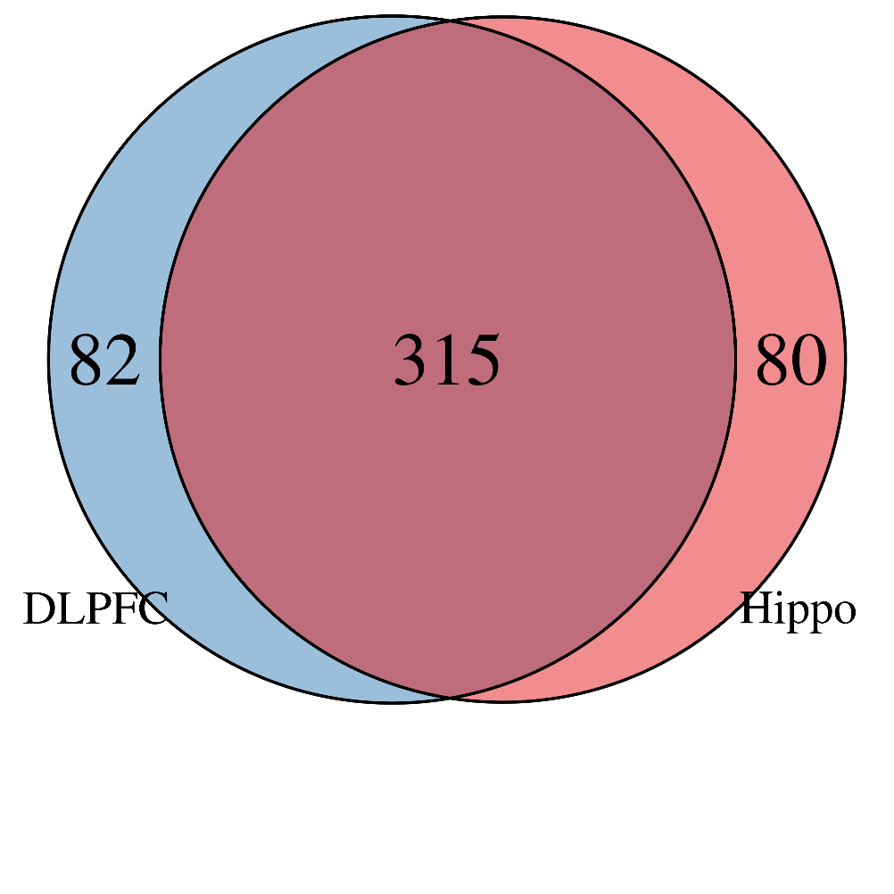
eQTL Analysis
Sample information
Brain overlaps by region:
 | Hippo | DLPFC
Total | 395 | 397
Control / Schiz | 262 / 133 | 244 / 153
Female / Male | 126 / 269 | 124 / 273
AA / Asian / Cauc / Hisp | 213 / 0 / 182 / 0 | 204 / 9 / 174 / 10
Mean Age (SD) [min, max] | 45.5 (16.4) [13.0, 96.9] | 45.8 (16.5) [13.0, 96.9]
Hippo | F | M
Control | 79 | 183
Schiz | 47 | 86
DLPFC | F | M
Control | 75 | 169
Schiz | 49 | 104

Slide 2
eQTL Analyses
Performed genome-wide cis (<500kb) eQTL analysis
Tested four features: gene, transcript, exon, and junction
Adjusting for diagnosis, sex, expression PCs and genetic ancestry components
Mean expression cut-offs - calculated with all samples (both regions, all ages):
Gene 0.25 (RPKM)
Exon 0.30 (RPKM)
Jxn 0.46 (RP10M)
Tx 0.38 (TPM)
Age cutoff > 13

Slide 3
eQTL Analysis - rAggr
179 Index SNPs plus proxies
Inputs to eQTL analysis:
 | Hippo (n=395) | DLPFC (n=397)
# SNPs (# index) | 9692 (135)
# Genes | 24,652
# Transcripts (from # Genes) | 92,732 (31,707)
# Exons (from # Genes) | 396,583 (23,943)
# Junctions (from # Genes) | 297,181 (18,330)

Slide 4
Overall eQTLs at FDR < 1% - rAggr
 | Hippocampus | DLPFC
# unique SNPs (unique index SNPs) | 5510 (45) | 6780 (52)
# unique features | 1731 | 2525
# Unique genes | 123 | 171
# Unique transcripts | 244 | 332
# Unique exons | 857 | 1363
# Unique junctions | 507 | 659
# SNP-Feature Pairs (from # gene symbols) | 66,923 (334) | 106,438 (412)
# SNP-Gene Pairs | 4795 (123) | 7358 (171)
# SNP-Transcript Pairs | 9629 (170) | 13,218 (216)
# SNP-Exon Pairs | 33,122 (216) | 57,986 (270)
# SNP-Junction Pairs | 19,377 (165) | 27,876 (204)

Slide 5
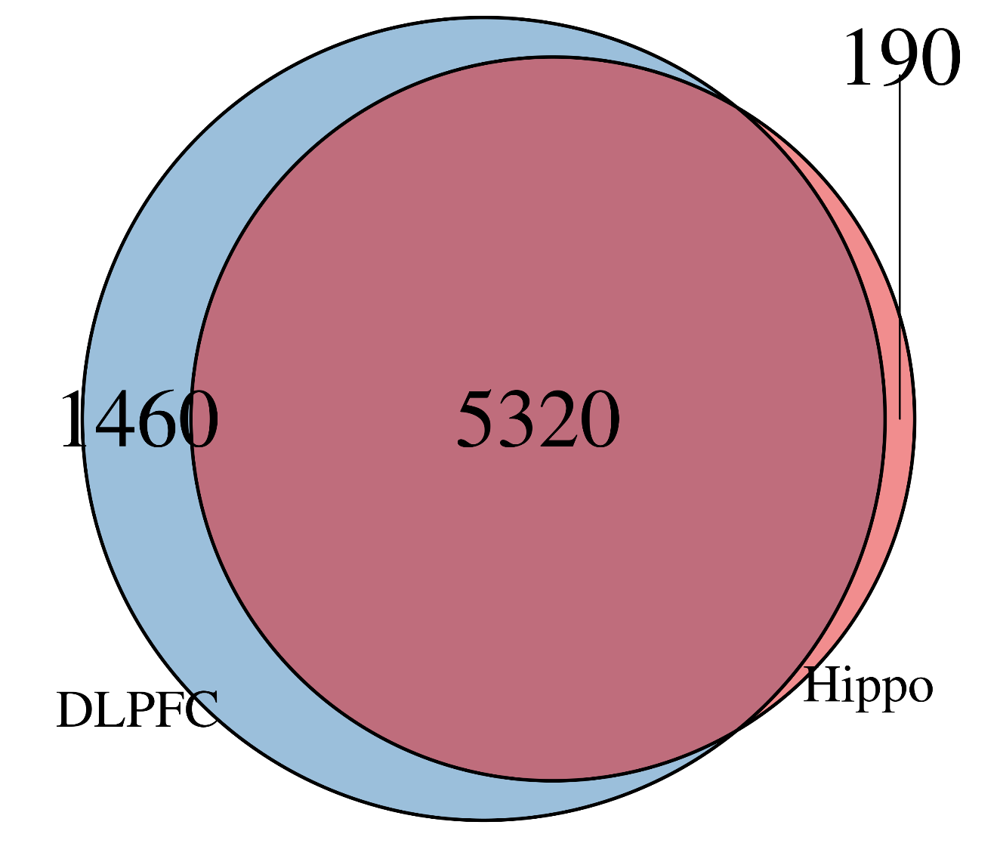
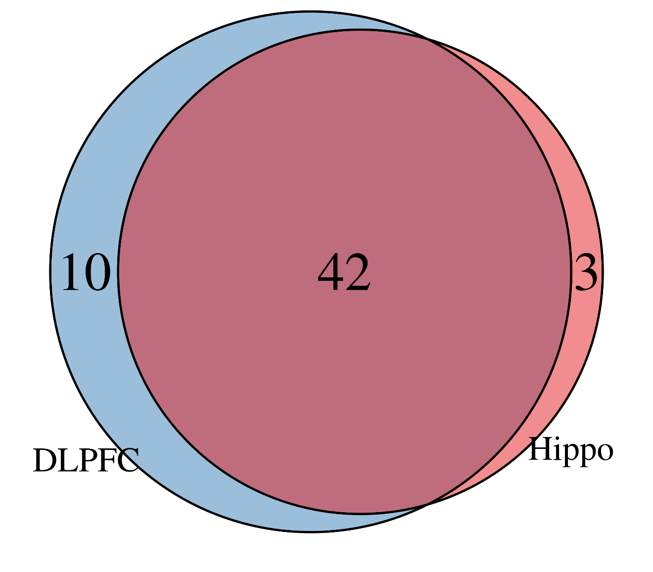
Overall eQTLs at FDR < 1% - rAggr
 | Hippocampus | DLPFC
# unique SNPs (unique index SNPs) | 5510 (45) | 6780 (52)
# unique SNPs:
# unique index SNPs:

Slide 6
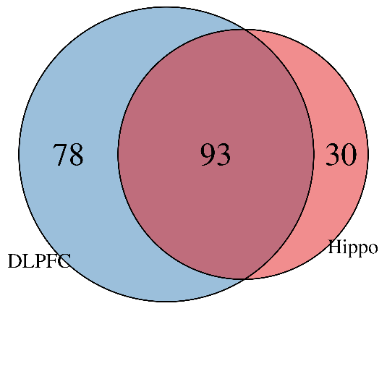
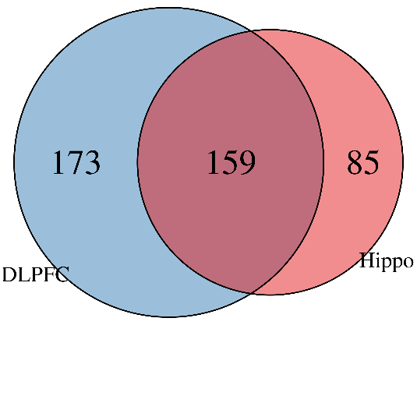
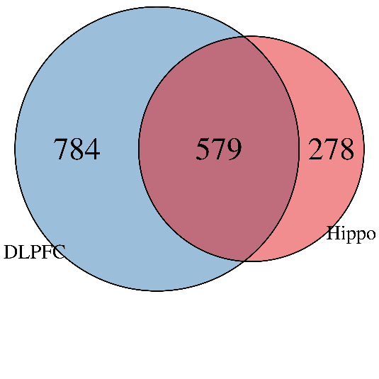
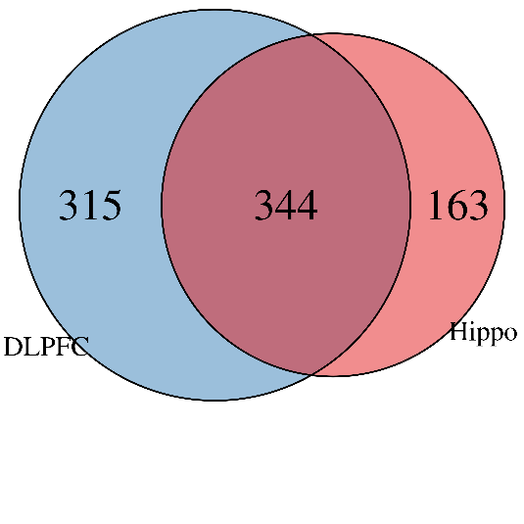
Overall eQTLs at FDR < 1% - rAggr
 | Hippocampus | DLPFC
# unique SNPs (unique index SNPs) | 5510 (45) | 6780 (52)
# unique features | 1731 | 2525
# Unique genes | 123 | 171
# Unique transcripts | 244 | 332
# Unique exons | 857 | 1363
# Unique junctions | 507 | 659
Genes
Transcripts
Exons
Junctions

Slide 7
Overall eQTLs at FDR < 1% - rAggr
 | Hippocampus | DLPFC
# unique SNPs (unique index SNPs) | 5510 (45) | 6780 (52)
Number of SNPs that pair to n genes:
Hippo | 1 | 2 | 3 | 4 | 5 | 6 | 7 | 8 | 9 | 10 | 11 | 12 | 13 |  |  |  | Total
 | 1982 | 1353 | 653 | 580 | 317 | 91 | 229 | 28 | 106 | 47 | 58 | 59 | 7 | - | - | - | 5510
DLPFC | 1 | 2 | 3 | 4 | 5 | 6 | 7 | 8 | 9 | 10 | 11 | 12 | 13 | 14 | 15 | 16
 | 2447 | 1790 | 679 | 686 | 329 | 292 | 107 | 136 | 50 | 49 | 70 | 73 | 36 | 28 | 7 | 1 | 6780

