Slide 1

Workshop 1
Head Tutor: Luke Rosa

Slide 2

About Me
Final year Master of Engineering (Software) student
Software Engineer @ ANZ
Supervisor of COMP30022
Head Tutor of SWEN90007 Software Design and Architecture
Notes:
Explain it's not like a typical tutorial - I'm not there to directly teach you - my role is to teach you how to use and learn software tools and deliver a large piece of software

Slide 3


Please turn on your camera
1
You can blur your background or use a wallpaper to guard your privacy.
2
If you have a team, please add the team-name to your Zoom name.
Please also add your preferred name.

Slide 4
Icebreaker
01
02
03
Where are you currently based?
Where’s the first place you’ll go on holidays?
About you
Your preferred name
Your current degree

Slide 5
Today’s Workshop
Get to know your team!
Discuss assessments
Discuss templates and GitHub Classroom
Create breakout rooms
….or stick around in the main room to learn PlantUML
Notes:
Make sure they have a team and get github username.

Slide 6

Due: 15/08
Assessments
Part 1:
Detail the use cases
Once you decide on your project description, identify the use cases necessary to meet the requirement specification for the application users.
Part 2:
Design the app
Design and implement your app as described in Application Domain and as defined by the use cases identified in Part 1.
Part 3:
Manage concurrency
The ability to have multiple users in the application will be enabled. This gives place to concurrency issues that you must address.
Part 4:
Analyse performance
Produce a report reflecting on the performance of your system.
15%
40%
35%
10%
Notes:
Talk about FeedbackFruits due early Sep and mid Oct.
Even if you get 100% on the assignment but receive bad feedback, you can still fail the class.

Slide 7
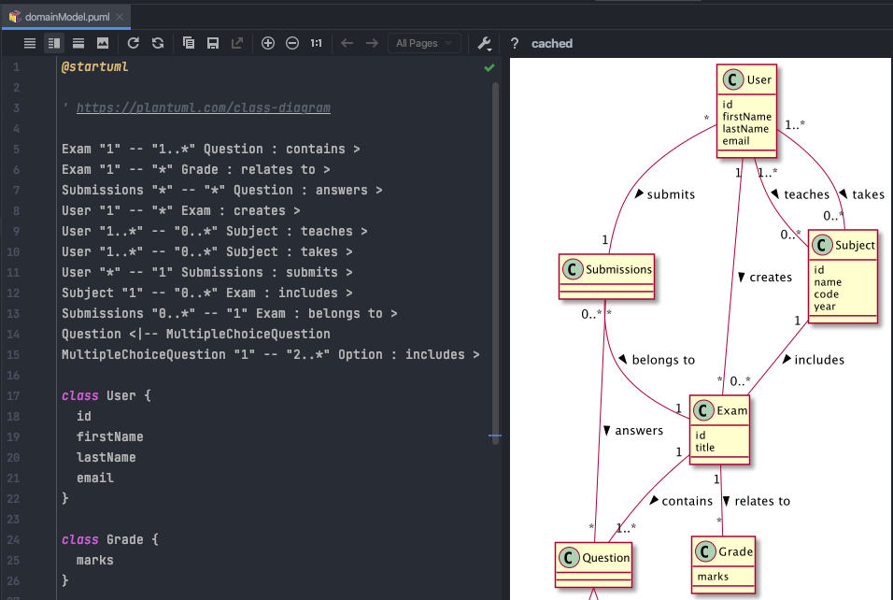
Time for breakout rooms
Stick around in the main room if you want a 10-minute PlantUML tutorial to help with part 1 of the project.
Put your hand up if you want to go to a break-out room. You should start working on:
Download use cases template from LMS
Accept GitHub Classrooms invitation
Start setting up your development environment: https://github.com/SWEN900072021/Resources/tree/main/how_to
I’ll be coming around to the break-out rooms, but if you need me, use the Ask for Help button.

