Slide 1

Game of Bunco
Applied System Software

Slide 2
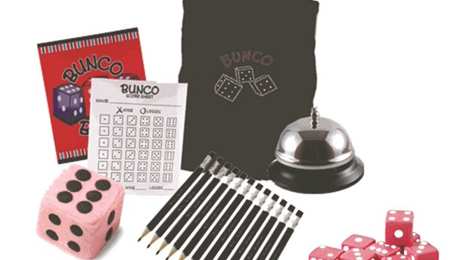
Introduction. Project Overview
Our final project is a software program for playing the Bunco Game. Advantage of the game, which is used by the software is allowing for the multiple players to participate. Software tracks the number of players, game options, and displays a graphical user interface.

Slide 3
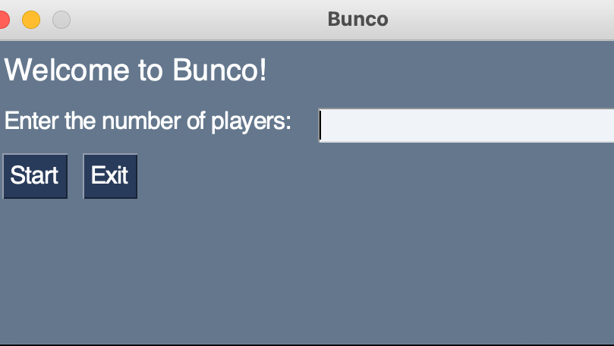
Design
Main focus in this project is directed towards speed, efficiency and simplicity. Visual attributes of graphical user interface are based on this idea. There is a closed list of standard pale blue colors, textboxes and textspaces, buttons and windows. What is more interesting that the user experience factor is highly influenced by interactive sound design with sonics for the game.

Slide 4
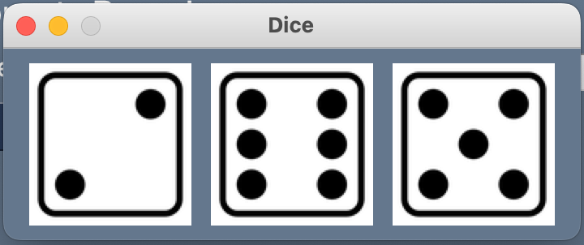
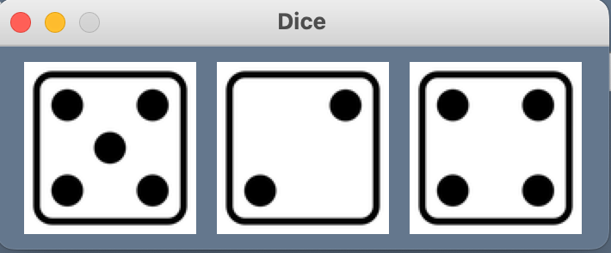
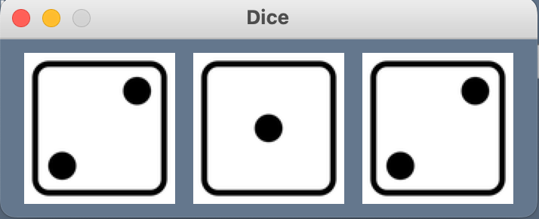
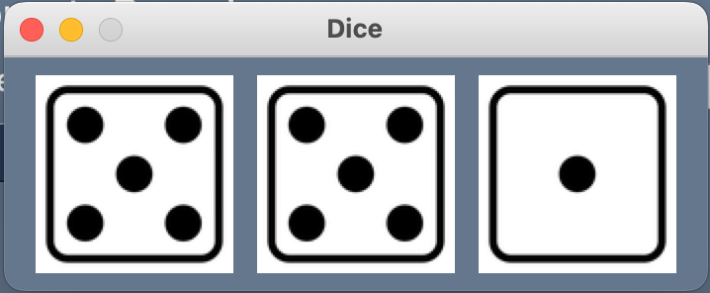
Design
For the dices variations, we have searched for minimalistic PNG materials and depict them when a player makes a move.

Slide 5
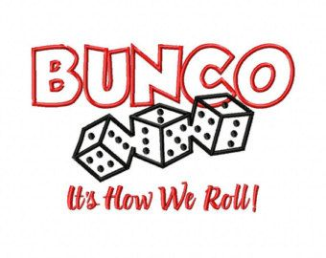
Requirements
Like it was already mentioned, the aim of this project is to create a software program that enables players to participate in Bunco, which is a straightforward dice game. So, entering requirements are:
■ the capacity to roll three dice
■ the capacity to keep track of scores for each round
■ to facilitate multiple players
■ to indicate the current player's turn.

Slide 6
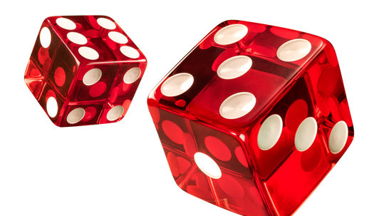
Requirements
Such questions were raised:
What kind of design we are going to use ?
What are the terms and when are the deadlines?
Will we use advertisement inside the product?
What are the rules of Privacy Policy we are going to use?

Slide 7
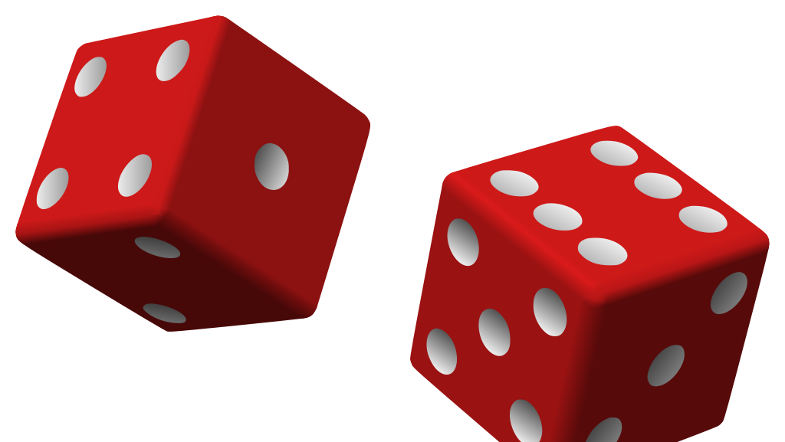
Requirements
Possible age categories for the product:
○ Junior player category (13-18)
○ Adult player category (18-65)
○ Seniour player category (65~)

Slide 8

Requirements
First-feature requirements:
Sound effects: Sound effects can add to the fun and excitement of playing Bunco, so the software should have a feature that plays different sound effects when certain events occur during the game.
Dice rolling: Since Bunco is a game that revolves around rolling dice, the software should have a feature that allows players to roll the dice virtually.
Easy to use: The software should be intuitive and easy to use,

Slide 9
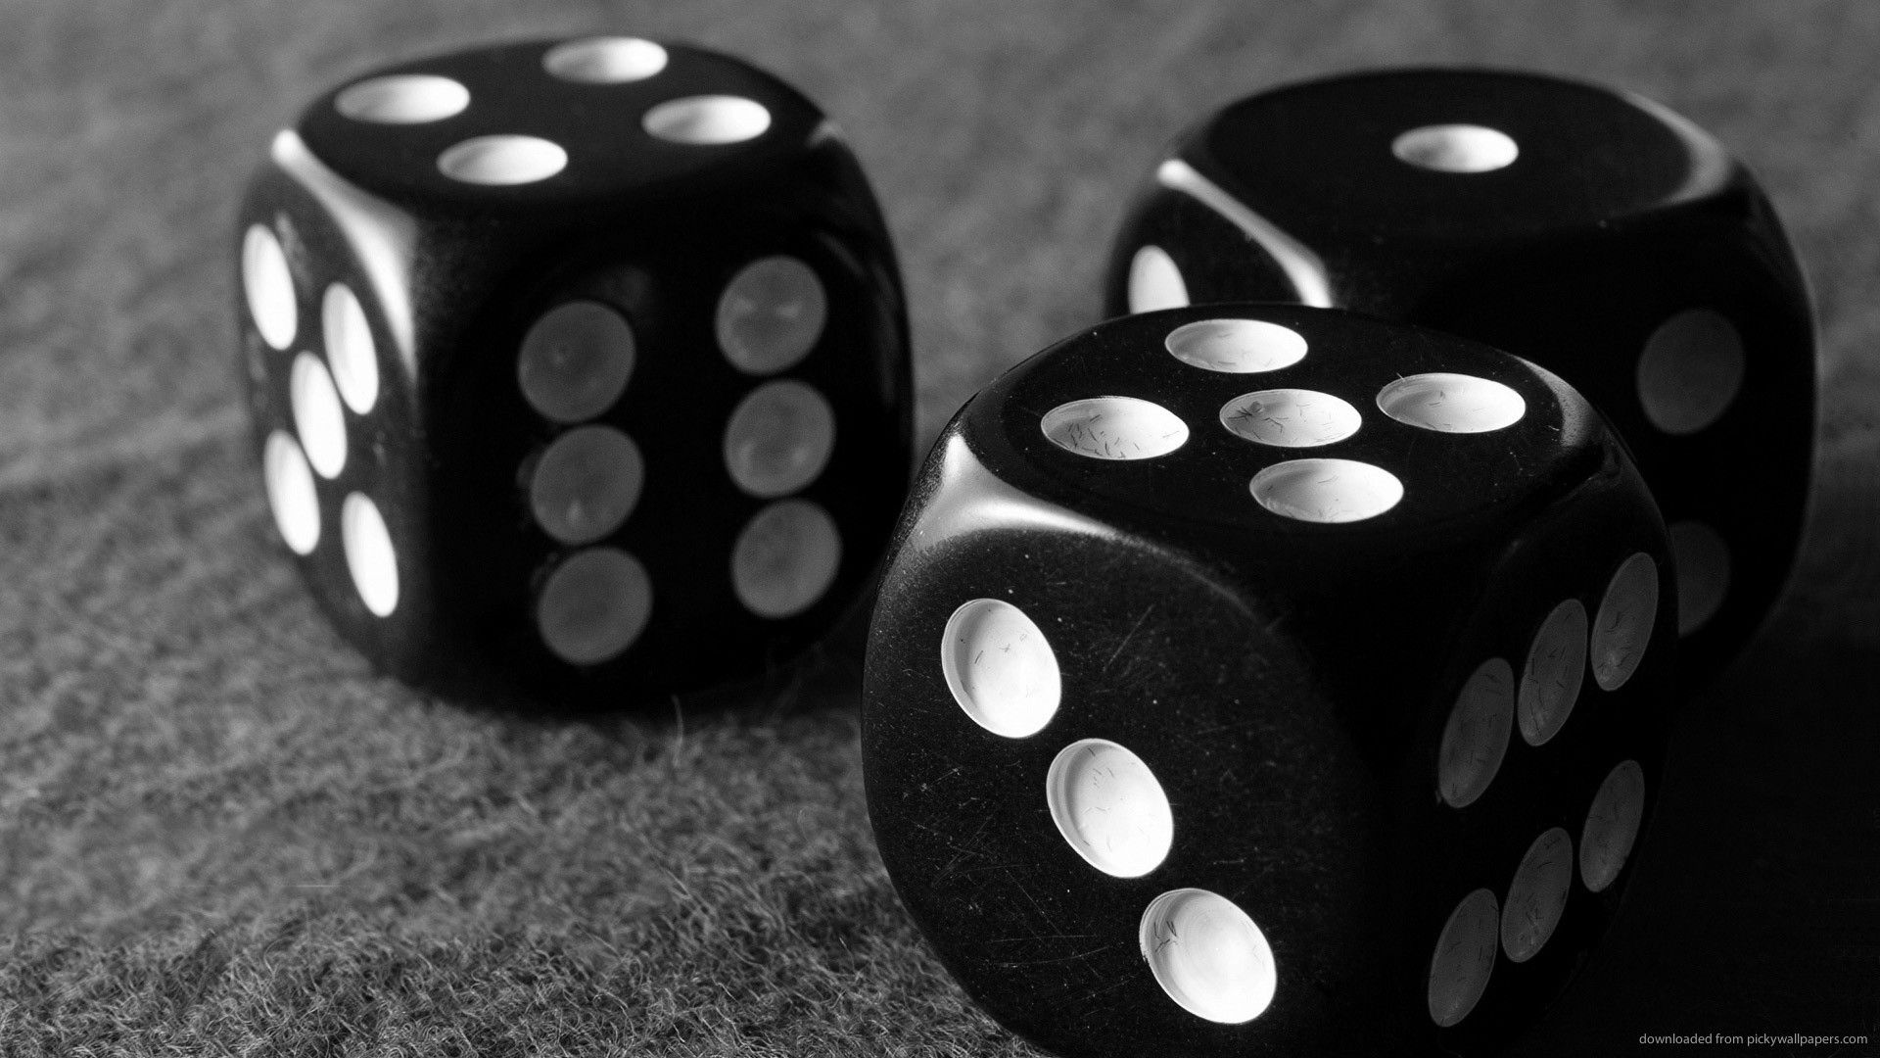
Requirements
The software should be intuitive and easy to use, allowing users to interact with the program by using basic menu functions to start the game and exit, as well as the ability to roll a dice by pressing a button and seeing the progress of the game. The software should have sound effects that add to the fun and excitement of playing Bunco.

Slide 10
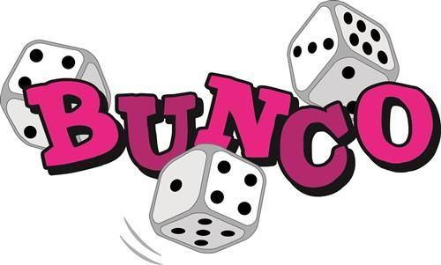
Functional requirements
The software shall allow multiple players to participate in a game of Bunco.
The software shall allow each player to roll three dice.
The software shall keep track of scores for each round.
The software shall indicate the current player's turn.
The software shall have a feature that allows players to roll the dice virtually.
The software shall have a feature that plays different sound effects when certain events occur during the game.
The software shall have basic menu functions, including the ability to start the game and exit.

Slide 11

Non-functional requirements
Scalability: the software should be able to accommodate a varying number of players without performance issues
Reliability: the software should be stable and not crash or produce errors during use
Performance: the software should not be laggy . It should work properly
User-friendly : It should be clean and neat so users can use easly .
Constraints:
Graphics : It may be limited on terms of graphics compare to other bunco games on market .
Time: Limited amount of time is given to finish
Experience: Lack of experience on game development
Resources: Not the best resources may team have.

Slide 12

Functionalities
Starting a new game: Specify the number of players participating.
Rolling the dice: Virtually roll the dice and generate random values.
Score tracking: Display and update scores after each round.
Current player indication: Highlight or indicate the current player's turn.
User interactions: Showcase menu functions and buttons for navigation.
Sound effects: Play relevant sound effects during the game.

Slide 13
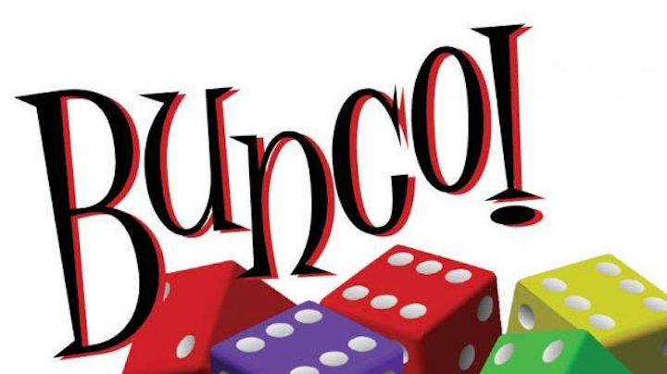
Software development
During the process of programming the project there were different stages of the development: importing modules, concepts of object-oriented programming, image processing, GUI development, randim number generation, error handling, looping and iteration, user input interaction, etc.

Slide 14
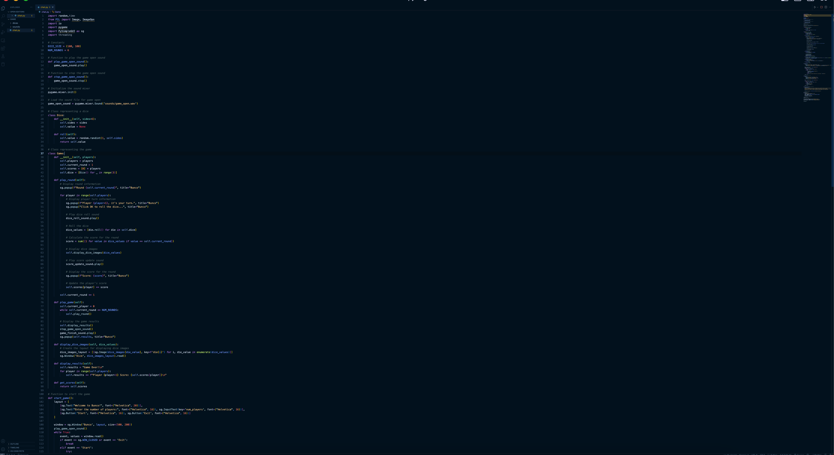
Code

Slide 15
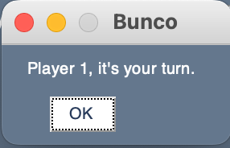
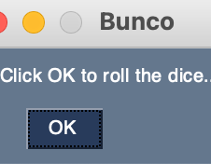
Demonstration

Slide 16
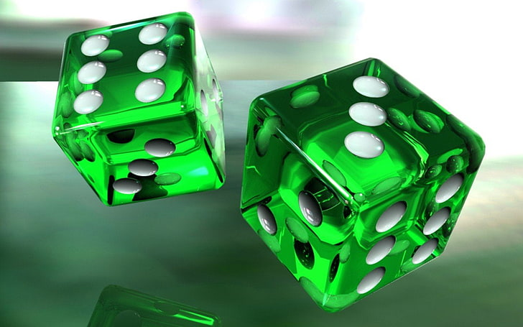
Q&A and Testing – Black-Box list
What does input for the software look like (e.g., what type of data, how many pieces of data)?
○ The input for the software includes various types of data, including player names, dice rolls, and game settings. The number of pieces of data will depend on the number of players, number of rounds, and other settings selected.
What does output for the software look like (e.g., what type of data, how many pieces of data)?
○ The output for the software includes game scores, current player turn, and other game-related information. The number of pieces of data will depend on the number of players, number of rounds, and other settings selected.
What equivalence classes can the input be broken into?
○ The input can be broken into equivalence classes based on the number of players, number of rounds, type of dice rolls, and other game settings selected.

Slide 17
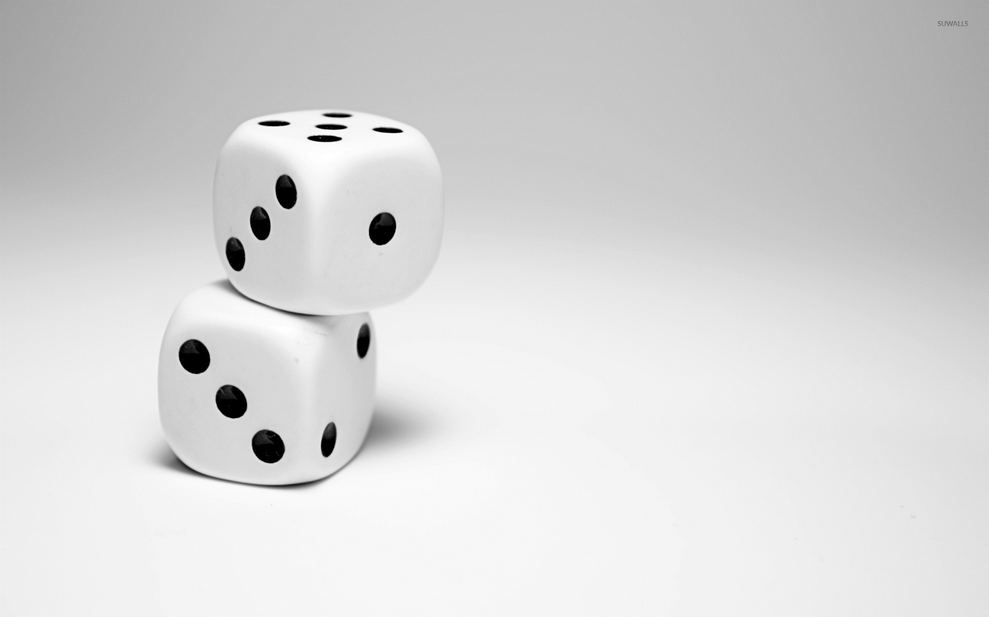
Q&A and Testing – Black-Box list
What boundary values exist for the input?
○ Boundary values for the input include minimum and maximum number of players, minimum and maximum number of rounds, minimum and maximum number of dice rolls, and other game settings
Are there other cases that must be tested to test all requirements?
○ Other cases that must be tested include error-handling cases such as incorrect input values, invalid user actions, and unexpected software behavior.
Other notes:
○ The testing should also include testing for sound effects, GUI design, and user experience. Additionally, the software should be tested for reliability and performance, ensuring that it can handle multiple players and maintain stability without crashing or producing errors during use.

Slide 18
Black-box Test Cases
Test ID | Description | Expected Results | Actual Results
T1 | Input: Number of players = 0 | Display an error message: "Invalid input! Please enter a valid integer." | As expected
T2 | Input: Number of players = 1 | Start the game with 1 player | As expected
T3 | Input: Number of players = 4 | Start the game with 4 players | As expected
T4 | Input: Number of rounds = 0 | Display an error message: "Invalid input! Please enter a valid integer." | As expected
T5 | Input: Number of rounds = 6 | Start the game with 6 rounds | As expected
T6 | Input: Number of rounds = 10 | Start the game with 10 rounds | As expected
T7 | Input: Roll dice and match current round number | Increase player score by 1 | As expected
T8 | Input: Roll dice and get a Bunco (all three dice match current round number) | Increase player score by 21 | As expected
T9 | Input: Click "Instructions" button | Display the game instructions in a popup window | As expected
T10 | Input: Click "Exit" button | Terminate the program and close the window | Game starts from the beginning

Slide 19
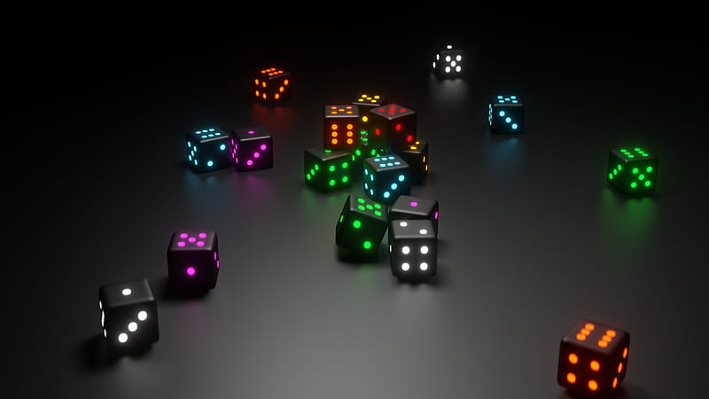
Functionality Testing
The game starts with a main menu where the user can choose to start the game, view instructions, or exit.
Clicking the "Instructions" button displays the game instructions in a popup window.
Clicking the "Exit" button closes the main menu window and terminates the program.
Clicking the "Start Game" button opens a new window to enter the number of players.
Entering an invalid input (non-integer) and clicking "Start" displays an error message.
Entering a valid number of players and clicking "Start" starts the game.
The game consists of multiple rounds, and each player takes turns rolling the dice.
A popup window displays the current round information and the player's turn.
Clicking "OK" rolls the dice for the player and displays the score for that turn.
The dice images corresponding to the rolled values are displayed in a separate window.
The game progresses through the rounds until the specified number of rounds is reached.
After all rounds are played, a popup window displays the final scores of each player.
The "Game Over" sound is played, followed by the "Game Finish" sound.

Slide 20
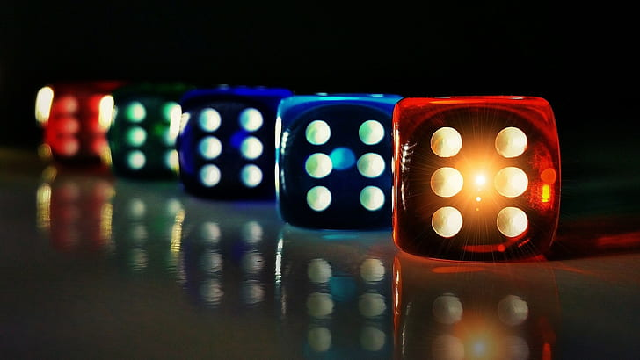
User Interface Testing
The user interface is simple and easy to understand.
The main menu and game windows are appropriately sized and visually appealing.
The game displays relevant information through popup windows, such as round number, player turn, dice images, and scores.

Slide 21

Sound Testing
The game includes various sound effects to enhance the user experience.
The "Game Open" sound is played when the game starts.
The "Dice Roll" sound is played when the dice are rolled.
The "Score Update" sound is played when the score for a turn is updated.
The "Game Finish" sound is played when the game ends.
All sound effects played as expected and added to the game experience.

Slide 22

Dice and Score Calculation Testing
The game uses three dice objects to simulate rolling three dice.
The dice values are generated randomly within the range of 1 to 6.
The score for each player's turn is calculated correctly based on the rolled dice values.
If a dice value matches the current round number, the player earns 1 point.
If all three dice values match the current round number (Bunco), the player earns 21 points.
The scores are accumulated correctly for each player throughout the game.

Slide 23

Error Handling Testing
The game handles invalid input for the number of players and displays an error message.
The program gracefully terminates when the user clicks the "Exit" button or closes the window.

Slide 24
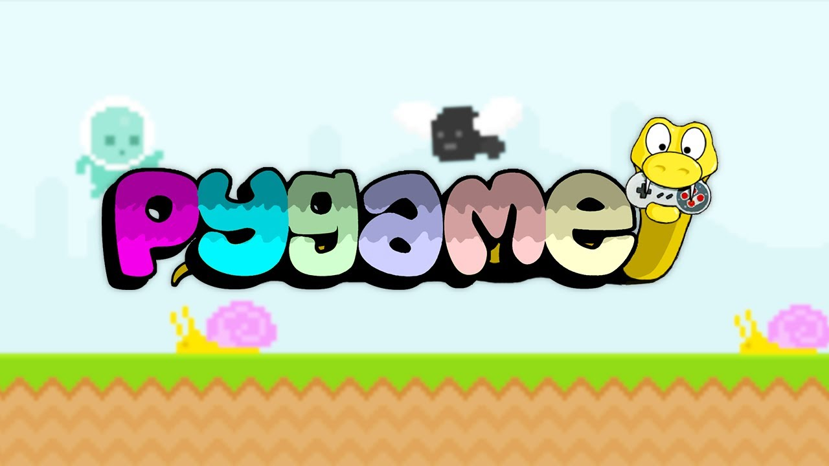
Lessons Learned
Team-work, communication and division of tasks
Organising, maintaining and updating the GIT repository of the project
Using Python and pygame library alongside with OOP principles
Testing Routine
Writing and updating documantations and user manuals

Slide 25
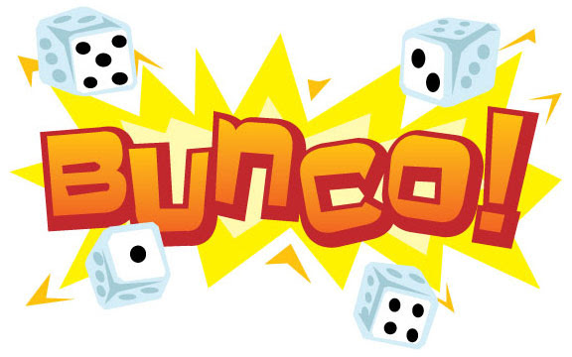
Possible improvements
In future, these features could be added:
Animation of the dice rolling;
Advanced menu of the game and rounds;
Upgrade the design, making it in retro-pixel art style

Slide 26
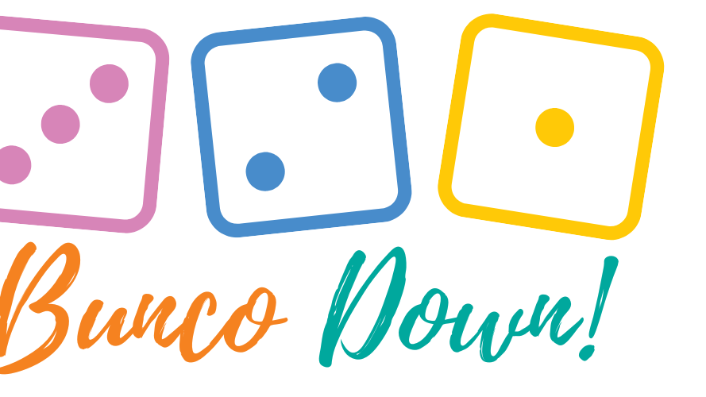
Summarizing
So, after completing the analysis of tasks and requirments, evaluating the time and technologies, needed to be used, coming up with the design, writing the code and pushing the GIT server and performing the QA Testing, we can say that upgraded our knowledge and skills and finished the course project to a working prototype.

Slide 27

Thank you for attention!
Prepared by Oleksii Lychov, Murad Rajabov, Firad Aslanov, Shamil Mammadrzayev

