Slide 1
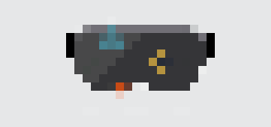

Crafted By:
Yuke Liang, Travis Shu, Qihan Wang, Zhaoning Wang

Slide 2
Overview
Objective:
3D modeling with one-click UX
Customer:
Designers,
3D Scene Engineers,
Minecraft Developers!
Technology Stack:
HoloLens,
UWP, Unity3D,
Azure Data Factory
Key Component:
Convolutional LSTM,
MRTK
Notes:
Allow the user to create a 3D pixelized Minecraft-style object from real life object using hololens

Slide 3
Image Input
Model Rendering
Object Display
Input the image to be rendered as 3D object
Can either be photos taken in HoloLens or images uploaded to the cloud
Generate the 3D model as a .obj file
Accomplished by our pre-trained reconstruction model in Azure
Project the rendered model in HoloLens
Render the model as an interactable 3D prefab in our Unity scene
At least one photo required
Multiple views increase the performance of the rendering
The image will be stored in a blob storage on Azure
The input of the image will trigger the workflow of model rendering in next step
Started with taking in the images from previous step
Feed the image into our reconstruction model using a 3D-R2N2 implementation in a Linux VM on Azure
Store the output .obj file in another blob storage on Azure
Retrieve the .obj file from Azure once user triggers the object display in HoloLens
Construct an interactable 3D prefab in Unity scene
The user can drag and drop, or duplicate the 3D model if necessary

Slide 4
After the Hackathon…
Incorporate the features in Layout
Allow the users to export their layout
Improve the overall accuracy of the reconstructed model with more dataset coverage

Slide 5


Slide 6


