Slide 1
[Placeholder: Traps Pics]

Slide 2
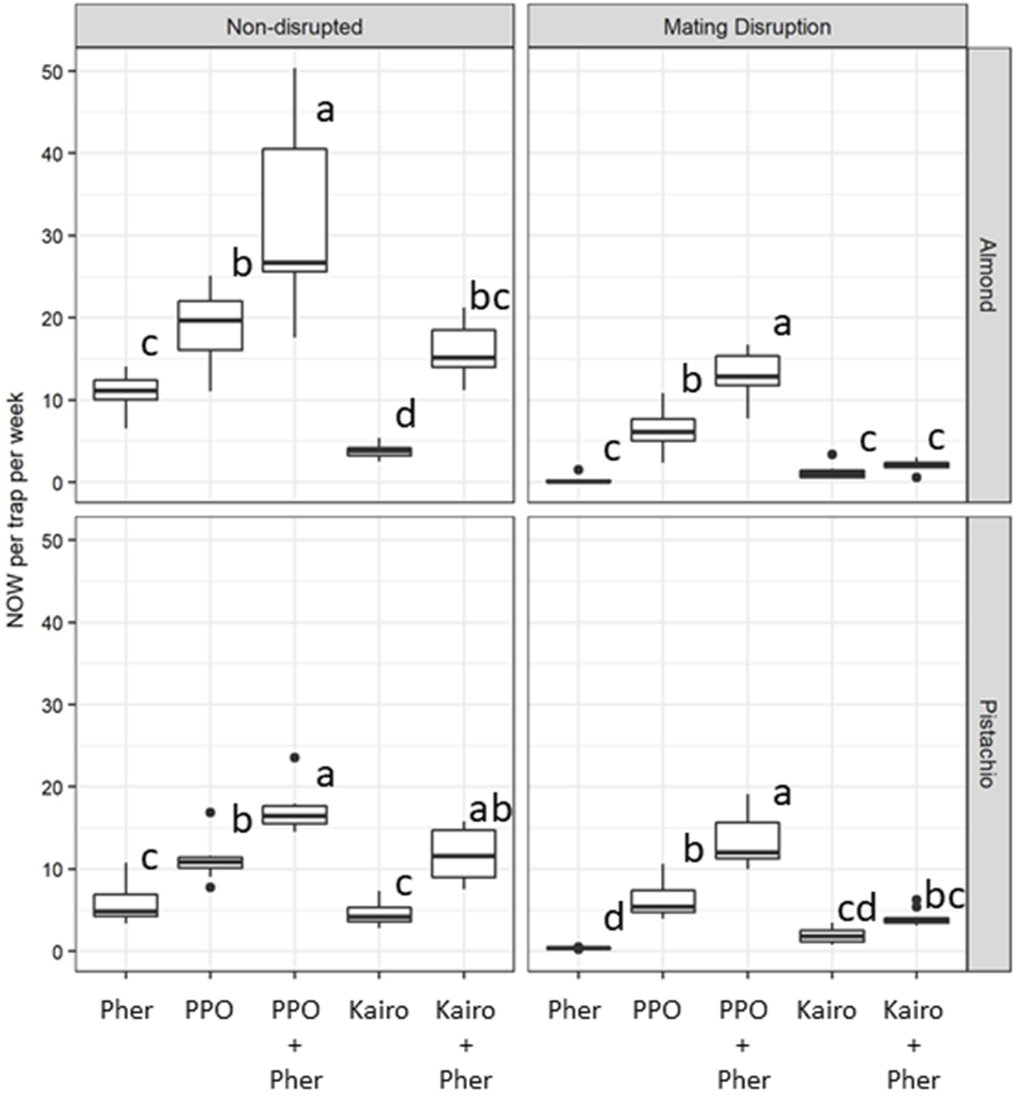

Slide 3
