Slide 1
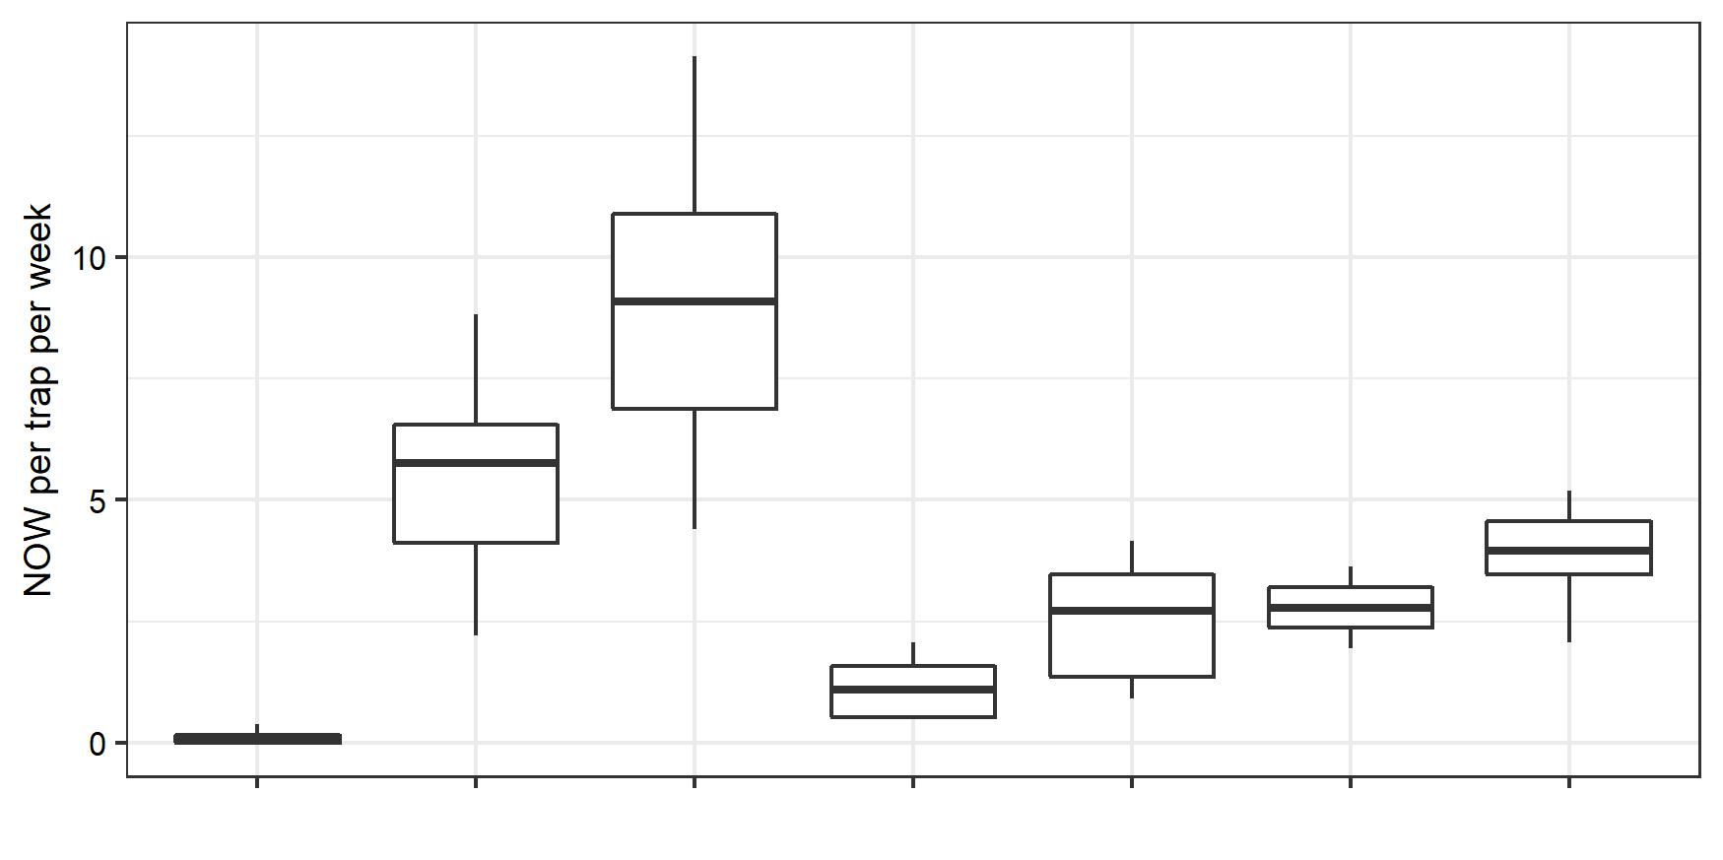
a
ab
bc
c
c
d
e
Trap Type:
Wing
Wing
Wing
Delta
Delta
Modified
Modified
Lure:
Phero
PPO
PPO-Phero
PPO
PPO-Phero
PPO
PPO-Phero

