Slide 1
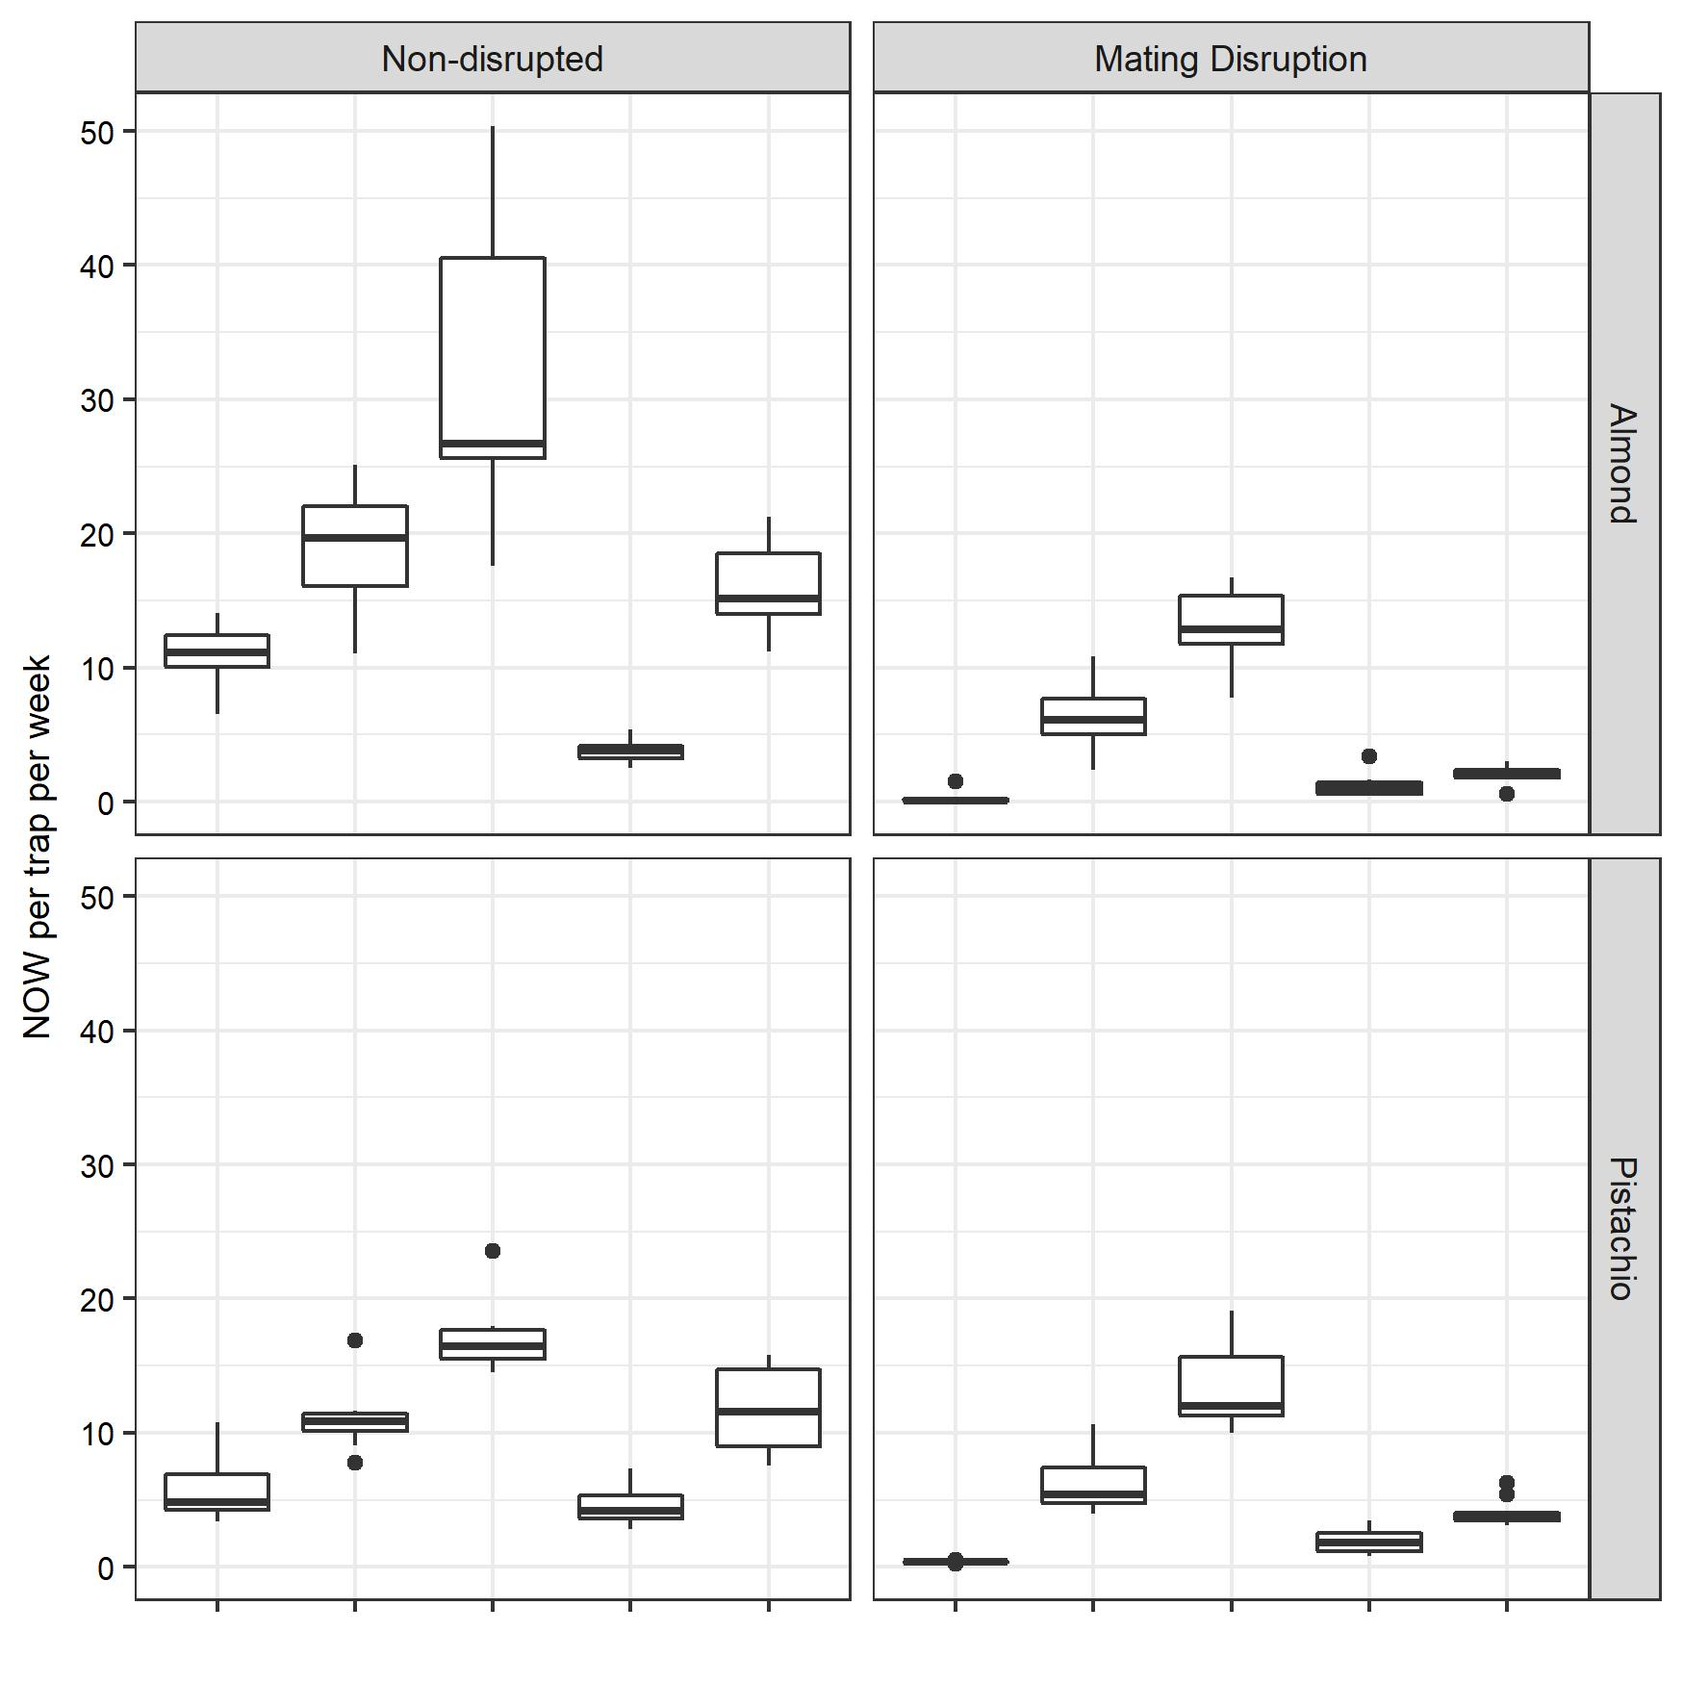
a
b
bc
a
c
b
d
cd
c
d
a
a
b
ab
c
b
c
d
c
e
Pher
PPO
PPO
+
Pher
Kairo
Kairo
+
Pher
Pher
PPO
PPO
+
Pher
Kairo
Kairo
+
Pher

