Slide 1
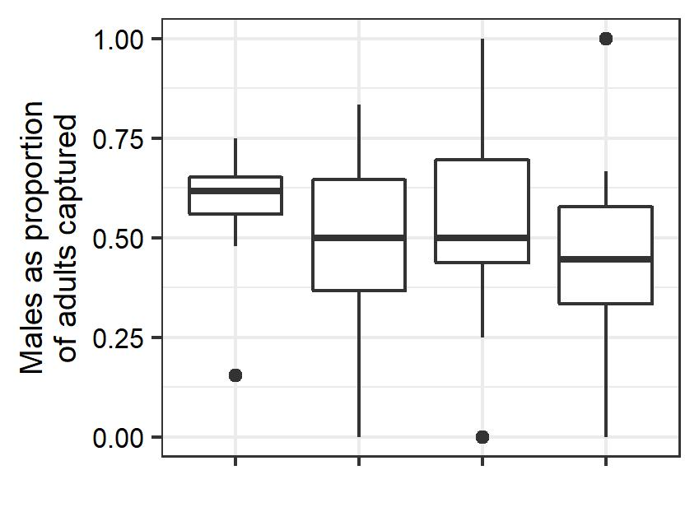
a
ab
ab
b
Delta
PPO+Phero
Bucket
PPO+Phero
Wing
PPO+Phero
Bucket
PPO

