Slide 1

LINQ: Getting things you didn’t know you wanted, in ways that you don’t understand!
See Also: WIZARDRY, MAGIC, SORCERY
Chuck Bates
SOFTWARE ENGINEER
Security/mitigations

Slide 2
History/Purpose of LINQ
Syntax
Common LINQ Operators
Filtering: Where(), First(), FirstOrDefault(), etc.
Ordering: OrderBy(), OrderByDescending()
Quantifications: Any(), All(), Contains(), etc.
Grouping: GroupBy()
Projecting: Select()
Flatten: SelectMany()
Deferred Execution (Lazy vs. Eager)
Performance Comparisons (if time)
Overview

Slide 3
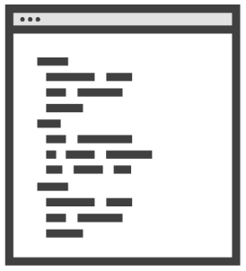
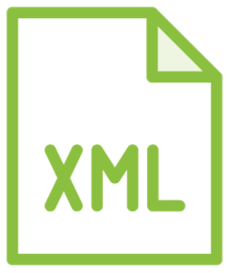


History of LINQ
(Language Integrated Query)
Notes:
In the olden days…
If you wanted to interact with data, how you did varied widely by the type of data
Microsoft wanted a unified syntax and feature set

Slide 4
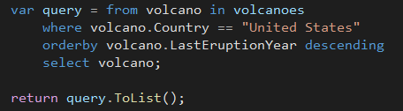

Syntax
Query
Method
Semantically Identical
but…
Some queries must be expressed as method calls!
and method syntax is faster…
and simpler to write…
and just better…

Slide 5
LOTS OF CODE

