Slide 1

LINQ: Getting things you didn’t know you wanted, in ways that you don’t understand!
See Also: WIZARDRY, MAGIC, SORCERY
Chuck Bates
SOFTWARE ENGINEER
Security/mitigations
Notes:
Welcome to LINQ: Getting things you didn’t know you wanted, in ways that you don’t understand!
If you don’t know me, I’m Chuck and I work in the Security BU.
Today we are going to dive into LINQ, but fair warning, this is not a deep dive into the obscure parts, this is meant as an introductory presentation for those new to .Net.

Slide 2
History/Purpose of LINQ
Syntax
Common LINQ Operators
Filtering: Where(), First(), FirstOrDefault(), etc.
Ordering: OrderBy(), OrderByDescending()
Quantifications: Any(), All(), Contains(), etc.
Grouping: GroupBy()
Projecting: Select()
Flatten: SelectMany()
Deferred Execution (Lazy vs. Eager)
Performance Comparisons (if time)
Overview
Notes:
Here’s an overview of what we are going to cover.
First we will briefly discuss the history and purpose of LINQ.
Second we will look at the different syntaxes that LINQ could be written in, with briefly touching on some of the tradeoffs.
Third, and the majority of our time, we will be looking at and running examples of the most common LINQ operators that we all should be familiar with. This includes operators that:
- filter
- order
- quantify
- group
- project
- flatten
I’ll explain more on what these mean when we go through them.
Fourth we will look at what’s called Deferred Execution and how it can affect your LINQ code.
Finally, if we have time, I have a simple performance comparison of using LINQ versus not.
Any questions before we go? Let’s go!

Slide 3

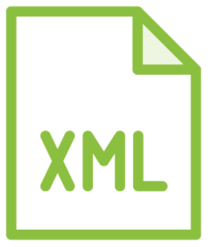


History of LINQ
(Language Integrated Query)
Notes:
So LINQ. LINQ stand for Language Integrated Query, and how it came about is a simple story really.
Back in the early days of .Net, if you wanted to interact with data, how you did so varied widely by the type of data.
If you wanted to query data in a relational database, there were established .Net libraries to do that.
If you wanted to work with in memory data, that was done in a different way.
Or if you wanted to query another data source like an XML file (XML was BIG back then…) there was yet another set of APIs to do so.
Microsoft wanted a unified syntax and feature set, as features varied some and syntax varied a lot.
And so, LINQ was born!

Slide 4
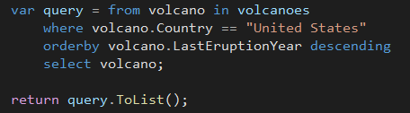

Syntax
Query
Method
Semantically Identical
but…
Some queries must be expressed as method calls!
and method syntax is faster…
and simpler to write…
and just better…
Notes:
Let’s take a look at the two syntaxes that you can compose LINQ in.
You can compose LINQ in one syntax referred to as Query Syntax.
This looks and reads much like SQL or other relational database querying languages, but with a few differences.
(For example the Select always comes last)
The second syntax is known as Method Syntax. This takes the form of chained method calls.
Generally speaking, these to syntaxes are SEMANTICALLY IDENTICAL. But…
Query Syntax can’t quite do ALL the operators Method Syntax can,
And Method Syntax is faster,
And simpler to write,
And just better,
But we digress, both syntaxes are “ valid “. For this presentation though, I will be showing code almost exclusively in Method Syntax.

Slide 5

The Data We Will Work With
Notes:
Before we jump into code, let’s take a quick look at the data we will be using.
VOLCANOES!!!
(yes that’s a real eruption of a volcano in Chile)
We’ll be using a data set I retrieved from the Smithsonian. The data is a csv of ~1,400 rows containing fields like type, country, last eruption year, rocks, etc.
Let’s go code!

Slide 6
LOTS OF CODE

