Slide 1
Mines, Minerals, and Minecraft
Dr. Charles “Chuck” Bell
Lesson 2: 23 January 2019

Slide 2
Agenda
Bible Study: 10-15 minutes
The Raspberry Pi: 5-10 minutes
Hacking Minecraft with Python: 30-45 minutes
Introduction to Python Programming
Example Project: Teleporting Steve

Slide 3
Bible Study
Metals in the Bible

Slide 4
Metals in the Bible
Six metals are mentioned in the Bible and in many passages they are listed in the same order: gold, silver, copper, iron, tin, and lead.
God gave man the specialized skills for the Tabernacle: "I have endowed him with a divine spirit of skill, ability, and knowledge … to make designs for work, in gold, silver, and copper" (Ex. 31:3–5), but not to the general layman (no professionals).
The Bible describes the Philistine monopoly of metalsmiths and their strategic importance: "Now there was no smith to be found throughout all the land of Israel; for the Philistines said, 'Lest the Hebrews make themselves swords or spears'" (I Sam. 13:19).
The methods of working metal after its extraction varied according to the type of metal and the use to which it was put: casting, hammering, gilding, preparing metal, wires, etc.

Slide 5
Mines and Minerals
Silver or Gold
Which is more valuable today? Why?
Which was more valuable in Bible times?
Which is easier to mine?
Which is easier to refine?

Slide 6
Gold
Gold is one of the rare metals found as an element in nature.
It is extracted from the earth by a process of collecting and washing.
Specialized goldsmiths employed two methods in working gold.
Beating it with a hammer into very thin sheets which was possible because of the gold's softness. The sheets were used for, among other things, gilding, and also for making gold wire: "They hammered out sheets of gold and cut threads…" (Ex. 39:3).
Melting the gold and then casting it (Ex. 25:12). In the process of melting, the gold was also refined; refined gold, which was necessary for certain purposes (I Chron. 28:18), is apparently identical with "pure gold" (Ex. 25:17).

Slide 7
Silver
The main minerals in which silver appears are natural silver and silver sulfides.
Silver is commonly found in association with gold and copper, and sometimes lead.
Silver was known to man in earliest antiquity; articles of silver have been found in Ereẓ Israel from as early as the Middle Bronze Age.
Silver mines in ancient times were located in Spain, Egypt, and Anatolia.
Silver was extracted from its ore by smelting, with the use of bellows, and the slag containing lead was separated from the silver (Jer. 6:29–30).

Slide 8
Silver
Job was acquainted with the technical process of extracting silver: "Surely there is a mine for silver, and a place for gold which they refine" (Job 28:1).
Ezekiel also describes the method of extracting silver and mentions slag containing bronze, iron, lead, and tin (Ezek. 22:20–22).
Because of the high value of silver, it was used as a means of payment from earliest times, in preference to gold which was extremely soft.
Silver was also used for making vessels for the Tabernacle and the Temple. It was a symbol of wealth and position.

Slide 9
Copper
The copper referred to in the Bible is not pure copper but an alloy of copper and tin. This alloy – bronze – was the most useful and important metal from the beginning of the third millennium B.C.E. to the 13th century B.C.E. when it began to be replaced by iron.
Copper mines in the ancient Near East were located in Cyprus (from which the name copper is apparently derived), Sinai, and Egypt.
It was the main metal extracted in Ereẓ Israel in antiquity and is the only one mined there today.
Copper is usually extracted from sulfide minerals, and partly from silicates, and carbonates; very small amounts of native copper are also found.
However, today copper is becoming more valuable due to low yield.

Slide 10
Iron
Job was acquainted with the technical process of extracting iron from iron ore: "iron is taken out of the earth" (Job. 28:2).
Isaiah described the smith's technique of working iron with the help of charcoal to produce steel suitable for making vessels (Isa. 54:16).
The Bible mentions Tubal-Cain as the first metalsmith (Gen. 4:22).
Some scholars identify the family of Japheth, to whom Tubal-Cain was related, with peoples who inhabited the coast of the Black Sea.
Iron was first exploited by the Hittites in Asia Minor and it was brought to Syria and Ereẓ Israel by Phoenician merchants.
Iron often appears in figures of speech in the Bible, but it mainly symbolizes the material from which instruments of war were made.

Slide 11
Tin
Tin was known to, and utilized by, the ancient Egyptians.
There was an extensive international trade in tin that was alloyed with copper to make bronze – the copper of the Bible.
Tin was mentioned by Ezekiel as one of the products imported by the Phoenicians from Tarshish (27:12).
It appears in the Bible together with the other metals, gold, silver, copper, iron, and lead, for example, in connection with the laws of their purification after being captured as loot (Num. 31:22).
Tin is mentioned by Ezekiel as one of the components of the slag obtained by reducing silver from its ore (22:18–22) and by Isaiah: "smelt away your dross as with lye, and remove all your tin" (1:25).
No specific tin vessels are mentioned in the Bible.

Slide 12
Lead
The ancient sources of lead were Asia Minor and Syria, and it was included among the metals brought by the Phoenicians from Tarshish (Ezek. 27:12).
Lead galena is found today at the foot of Mount Hermon; however, nothing is known of its extraction in antiquity.
Because of its high specific gravity, it served as weights for fishermen's nets – "they sank like lead in the majestic waters" (Ex. 15:10).
The plumb line may also have been made of lead (Amos 7:7).
Lead served also as a cover of utensils because of its high specific gravity (Zech. 5:7–8).
The verse, "… that with an iron pen and lead they were graven in the rock for ever!" (Job. 19:24), seems to indicate that as early as biblical times, lead was used for writing; because of the softness of lead, writing implements were made of stone filled lead.
Lead, or lead minerals, may have been used for cosmetics and dyes.

Slide 13
Value of Metals
Value attached to metals can be seen from the pages concerning the Temple menorah (Men. 28b), where they are listed either in descending order – gold, silver, tin, lead – or ascending order – iron, tin, silver, gold.
Coins made of less valuable metal being considered currency in relation to those of the more valuable one, which is then considered commodity but not currency (see BM 4:1; Mishnah lists gold, silver, and copper in descending order, whereas the same Mishnah in the Jerusalem Talmud (BM 4:1, 9c) puts silver before gold).
Thus, in some cases silver was considered more valuable (think usable) than gold!

Slide 14
The Raspberry Pi

Slide 15

History of the Raspberry Pi
Early concepts started in 2006.
Based on Atmel ATmega644.
Officially launched in 2012.
Inspired by Acorn’s BBC Micro from 1981.
Original concept was to inspire and educate children in computers.

Slide 16
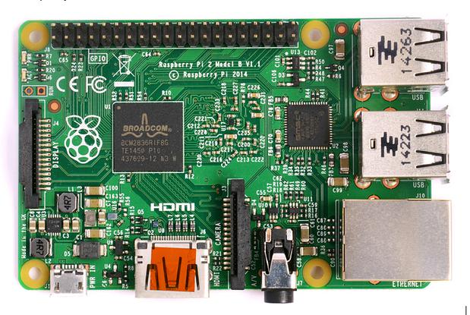
Review
GPIO
MicroSD-slot
(underneath)
4x USB 2.0
Micro USB for power (min. 5V/1A)
Ethernet
3.5mm Audio/Video Jack
HDMI
Camera connector

Slide 17
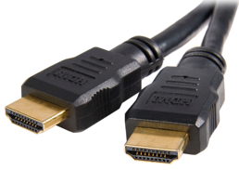
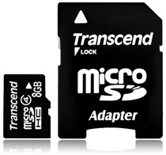
Required Accessories
Power Supply : 5V
Video Out: HDMI cable and monitor
MicroSD recommend 8GB or greater.
Keyboard make sure to (US settings)

Slide 18
Programming the Raspberry Pi 3
You can use a host of different languages including C++, Java, and Python
The “Pi” in the name refers to Python, which is the preferred programming language.
Python is a scripting language that is easy to learn.
Use Python to program Minecraft!

Slide 19
HARDWARE DEMONSTRATON

Slide 20
Using a Raspberry Pi
Powering on the Raspberry Pi is easy!
Connect the peripherals (monitor, keyboard, mouse)
Power on the board
You MUST shutdown the Raspberry Pi.
VERY IMPORTANT!!!
Click on the menu and choose shutdown.
Failure to do so may corrupt the SD card (hard drive)

Slide 21
Hacking Minecraft with Python

Slide 22
Get Set…
You will need to arrange 2 program windows on your desktop
Minecraft Pi
Python 2
Python is a programming language you will use to interact with Minecraft (make buildings, show messages, etc.)
Load BOTH programs and arrange your screen like this…

Slide 23
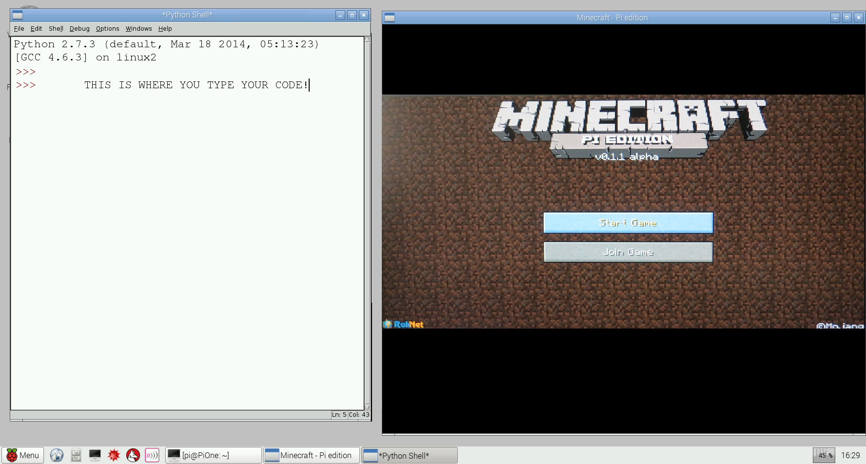
Minecraft & Python Screens
To enter your code, you click FILE and NEW…
To move the mouse out of Minecraft, press the TAB key first

Slide 24
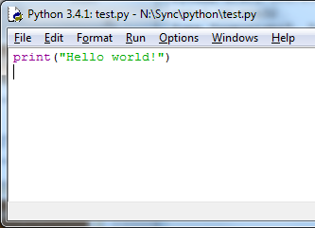
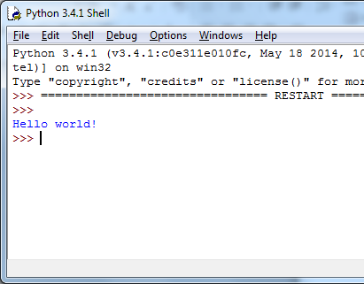
Get the right Python
In Python, you have the window to store the program code AND a window where it runs. You need to type your code into this window

Slide 25
Interacting with Minecraft
We can connect to Minecraft by using Python run externally.
Uses the Python Minecraft application programming interface (API)
We then write scripts (programs) that interact with the Minecraft environment.
We can save them and replay them anytime.

Slide 26
Text Messages
Start a new Python window, by clicking ‘File’ and ‘New.’
Click in your new empty Python window and type this code.
import mcpi.minecraft as minecraft
mc = minecraft.Minecraft.create()
msg = “Hello world”
mc.postToChat(msg)
Click on File and save your code in your Pi ‘Documents’ folder as text.py
Click Run -> Run Module
Try another few. What happens with long sentences?
Capital letters and spaces MUST be correct, or your code won’t work

Slide 27
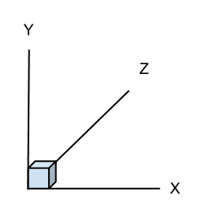
Where am I?
Graphs use X co-ordinates for left-right and Y co-ordinates for up-down.
Minecraft is a 3D game, so also has forwards-backwards movement.
X = Left-Right Y = Up-Down Z = Forward-Backward

Slide 28
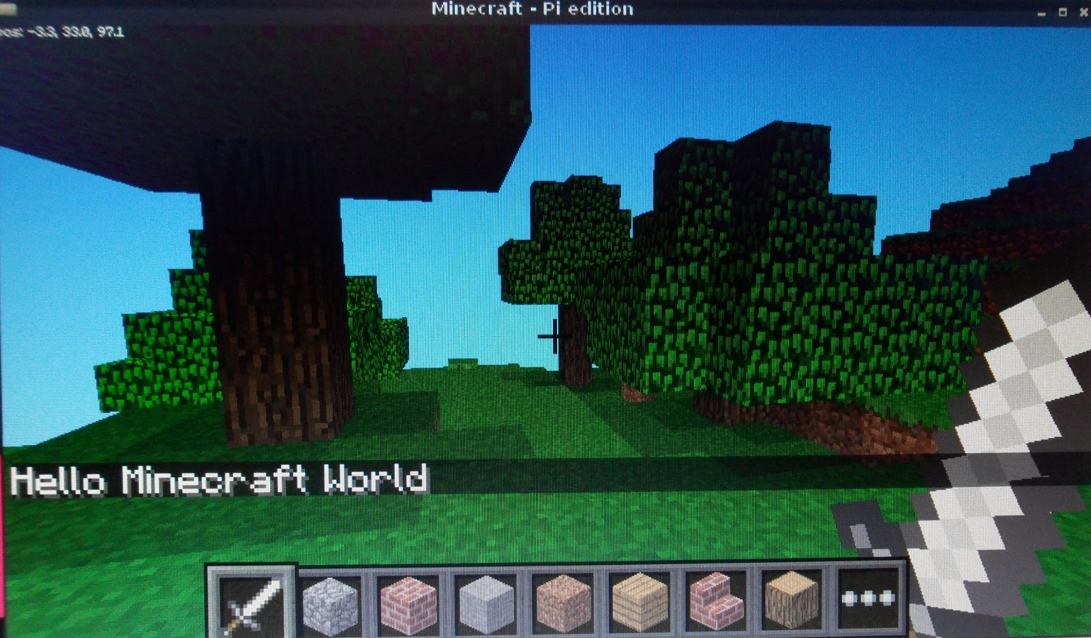
There I am!
( -3, 33, 97 )
Coordinates are shown in upper-left corner on screen.

Slide 29
Get Position
You can get Steve’s position and display it in Python.
Let’s try it now. Open a new file and enter this:
# Connect to Minecraft
from mcpi.minecraft import Minecraft
mc = Minecraft.create()
# Get the player's position and display it
pos = mc.player.getPos()
print pos.x, pos.y, pos.z
Move Steve around and re-run the code.

Slide 30
Teleporting
Start a new Python window by clicking ‘File’ and ‘New’. Click in this new window and type this code.
import mcpi.minecraft as minecraft
import time
mc = minecraft.Minecraft.create()
time.sleep(1)
pos = mc.player.getPos()
mc.postToChat(“You are located x=“ +str(pos.x) + “,
y=“ +str(pos.y) +”, z=“ +str(pos.z))
time.sleep(2)
mc.postToChat(“Get ready to fall from the sky!”)
time.sleep(5)
mc.player.setPos(pos.x, pos.y + 60, pos.z)
Click on File and save your code in your Pi ‘Documents’ folder as teleport.py

Slide 31
What we learned in Python
Connecting to the Minecraft API
Using API functions
Using variables
Printing messages

Slide 32
Keywords
Keywords are reserved words that have special meaning in the Python language. Because they are reserved, they can not be used as identifiers. Examples of keywords are if, while, class, import.

Slide 33
Variables in Python
A variable has
A name – identifier
A data type - int, float, strings, etc. (determined by context implicitly or converted explicitly)
num = 1 + 2
num = float(25) / 2.5

Slide 34
Integer operators
The operations for integers are:
+ for addition
- for subtraction
* for multiplication
/ for integer division: 14/5 = 2
/ for floating point division: 14.0/5.0 = 2.8
% for remainder: 14 % 5 = 4
*, /, % take precedence over +, -
x + y * z will do y*z first
Use parentheses to dictate order you want.
(x+y) * z will do x+y first.

Slide 35
Python Assignment Statements
In Python, = is called the assignment operator and an assignment statement has the form <variable> = <expression>
Here, <variable> would be replaced by an actual variable and <expression> would be replaced by an expression

Slide 36
Comments
Often we want to put some documentation in our program. These are comments for explanation, but not executed by the computer.
If we have # anywhere on a line, everything following this on the line is a comment – ignored
It is always a good practice to document your code!
Not only to let others know what it does, but to remind yourself as well!
#
# This is a comment!
#

Slide 37
LAB TIME
Use the remainder of class to explore the teleport code. Try different values and see where Steve goes!
You can leave when you’re finished.
DO NOT DISTURB the other classes!
REMEMBER TO SHUTDOWN YOUR RASPBERRY PI
DO NOT POWER IT OFF UNTIL YOU SHUTDOWN

Slide 38
Questions or comments?

