Slide 1
Mines, Minerals, and Minecraft
Dr. Charles “Chuck” Bell
Lesson 5: 27 February 2019

Slide 2
Agenda
Bible Study: 10-15 minutes
The Raspberry Pi: 5-10 minutes
Hacking Minecraft with Python: 30-45 minutes
Introduction to Python Programming
Example Project: Building Ice Houses

Slide 3
Bible Study
Gems in the Bible

Slide 4
Gems in the Bible
Gemstones (precious stones) have, and will, play a vital and fascinating role in the Bible.
God, long before man, used stones such as diamonds, rubies and emeralds to adorn one of the greatest beings he could create by fiat - Lucifer (Ezekiel 28:13).
Much later, he commanded Moses to create a special breastplate for the nation's High Priest that contained twelve large gems that each represented one of the tribes of Israel (Exodus 28:17 - 20).

Slide 5
Gems in the Bible
The Hebrews obtained gemstones from the Middle East, India, and Egypt.
At the time of the Exodus, the Bible states that the Israelites took gemstones with them.
When they were settled in the Land of Israel they obtained gemstones from the merchant caravans travelling from Babylonia or Persia to Egypt and those from Saba and Raamah to Tyre (Ezekiel).
King Solomon even equipped a fleet which returned from Ophir laden with gems (Kings).
Gemstones are mentioned in connection with the breastplate of the High Priest of Israel (Exodus), the treasure of the King of Tyre (Ezekiel), and the foundations of the New Jerusalem (Revelation).

Slide 6
Gems in the Bible
The twelve stones of the breastplate and the two stones of the shoulder-ornaments were considered by the Jews to be the most precious.
Both Ezekiel and Revelation have gems as a major point and allude to the Twelve Tribes of Israel.
At the time of the Septuagint translation, the stones to which the Hebrew names apply could no longer be identified, and translators used various Greek words.
Josephus (first Jewish scholar) claimed he had seen the actual stones.

Slide 7
Gems in the Bible
The ancients did not classify their gemstones by analyzing their composition and crystalline forms: names were given in accordance with their color, use, or their country of origin.
Therefore, stones of the same or nearly the same color, but of different composition or crystalline form, bear identical names.
Another problem is nomenclature; names having changed in the course of time: thus the ancient chrysolite is topaz, sapphire is lazuli, etc.
We’ve already learned there were 12 stones on the priest’s breastplate representing the 12 tribes, but in Revelation, there are also 12 stones we should consider.

Slide 8
Gems in the Bible
In Revelation (21:19-21), we read a description of the foundations of New Jerusalem:
The foundations of the city walls were decorated with every kind of precious stone. The first foundation was jasper, the second sapphire, the third agate, the fourth emerald, the fifth onyx, the sixth ruby, the seventh chrysolite, the eighth beryl, the ninth topaz, the tenth turquoise, the eleventh jacinth, and the twelfth amethyst. The twelve gates were twelve pearls, each gate made of a single pearl. The great street of the city was of gold, as pure as transparent glass.

Slide 9
Gems in the Bible
Clearly, gems are very important to God!
Other gemstones mentioned in the Bible include diamond, pearl, alabaster, flint, carbuncle and even malachite.

Slide 10
The Raspberry Pi – Python Programming

Slide 11
What we have learned in Python
We learned a lot about Python without realizing it!
Printing messages, connecting to the API, and running our programs!
Let’s now look at some of the concepts in-depth
Identifiers and Keywords
Variables
Assignment statement
Comments
Conditionals
Using loops

Slide 12
Identifiers
Identifiers are names of various program elements in the code that uniquely identify the elements. They are the names of things like variables or functions to be performed. They're specified by the programmer and should have names that indicate their purpose.
In Python, identifiers
Are made of letters, digits and underscores
Must begin with a letter or an underscore
Examples: temperature, myPayrate, _score2

Slide 13
Keywords
Keywords are reserved words that have special meaning in the Python language. Because they are reserved, they can not be used as identifiers. Examples of keywords are if, while, class, import.

Slide 14
Variables in Python
A variable has
A name – identifier
A data type - int, float, strings, etc. (determined by context implicitly or converted explicitly)
num = 1 + 2
num = float(25) / 2.5

Slide 15
Integer operators
The operations for integers are:
+ for addition
- for subtraction
* for multiplication
/ for integer division: 14/5 = 2
/ for floating point division: 14.0/5.0 = 2.8
% for remainder: 14 % 5 = 4
*, /, % take precedence over +, -
x + y * z will do y*z first
Use parentheses to dictate order you want.
(x+y) * z will do x+y first.

Slide 16
Python Assignment Statements
In Python, = is called the assignment operator and an assignment statement has the form <variable> = <expression>
Here, <variable> would be replaced by an actual variable and <expression> would be replaced by an expression

Slide 17
Comments
Often we want to put some documentation in our program. These are comments for explanation, but not executed by the computer.
If we have # anywhere on a line, everything following this on the line is a comment – ignored
It is always a good practice to document your code!
Not only to let others know what it does, but to remind yourself as well!
#
# This is a comment!
#

Slide 18
Conditional statements
Sometimes in a program, we may need to make decisions that change how the program reacts, produces output, identifies errors, warnings, etc.
Recall from our last experiment we asked the user to enter a value between 1 and 6. How do we know whether the user did what was asked?
We can use a conditional like this:
if <something is true> then
<do operation A>
else
<do operation B>
Notice we do “A” when the condition (an expression is evaluated) is true.
Otherwise, we do “B”.
This is how programmers ’control’ the program flow (execution).
Let’s try this in a more advanced example using the IDLE editor.

Slide 19
Loops: the WHILE loop
Another type of loop is the while loop.
The loop uses a condition such that as long as the expression evaluates to True, it will execute the body (code block) of the loop.
The while loop goes like this:
while <expression>:
<code to execute>
The expression can be any combination of inequalities and conditionals.

Slide 20
Loops: the for loop
Sometimes we need to do something in a program more than once.
We may need to execute a set of statements several times.
A common example is executing a code block a specific number of times.
We have the “for” loop for executing a “for each value in” statement.
Example: suppose we want to execute a code block 10 times.
The for loop goes like this:
for <variable> in range(<start>, <end>):
<code to execute>
Note: the range() function end is exclusive. So, if we want to do something 10 times, using (1, 10) won’t work. Why?

Slide 21
Hacking Minecraft with Python

Slide 22
But first, let’s review…
File: iceman2.py
# iceman2.py – Set every tile Steve hits to ice.
from mcpi.minecraft import Minecraft
from mcpi import block
mc = Minecraft.create()
while True:
pos = mc.player.getTilePos()
mc.setBlock(pos.x, pos.y, pos.z, block.SNOW)
for hit in mc.events.pollBlockHits():
mc.setBlock(hit.pos.x, hit.pos.y,
hit.pos.z, block.ICE)

Slide 23
Making an Ice House
Now that we know we can set any block to ice, wouldn’t it be nice to be able to build things by programming them into existence?
When you want to create lots of blocks you can use the function setBlocks() which, when passed two positions, will fill the gap in between with any block you want. The quickest and easiest way to create buildings in Minecraft is by creating a cube and then hollowing it out by creating a cube of air in the middle.

Slide 24
Building an Ice House
Open IDLE by clicking Menu > Programming > Python 3.
Use File > New Window to create a new program and save it as icehouse1.py.
Import the minecraft and block modules.
import mcpi.minecraft as minecraft
import mcpi.block as block
Create a connection from your program to Minecraft and call it mc.
mc = minecraft.Minecraft.create()
Get the player’s position.
p = mc.player.getTilePos()
Use the setBlocks() function to create a cube of ice next to Steve of size 11 x 5 x 11.
mc.setBlocks(p.x + 1, p.y, p.z + 1,
p.x + 10, p.y + 5, p.z + 10,block.ICE)
Create a cube of air inside the ice, making it hollow:
mc.setBlocks(p.x + 2, p.y + 1, p.z + 2,
p.x + 9, p.y + 4, p.z + 9,block.AIR)
Run your program by clicking Run > Run Module.

Slide 25
Building an Ice House
A large cube of ice will appear next to Steve; if you break some of the ice blocks, you’ll see that it’s hollow and you can walk inside.
The ice house is still pretty basic and at the moment there’s no way to get in, so modify your program to create a door and put some carpet on the floor.

Slide 26
Building an Ice House
Save your icehouse1.py file as icehouse2.py.
Add the code to your program to make a gap in the front of the ice cube for a door.
mc.setBlocks(p.x + 5, p.y + 1, p.z + 1,
p.x + 6, p.y + 3, p.z + 1,
block.AIR)
Use setBlocks again to change the blocks on the floor to be made of red wool.
mc.setBlocks(p.x + 2, p.y, p.z + 2,
p.x + 9, p.y, p.z + 9,
block.WOOL.id, 14)
Run your program by clicking Run > Run Module.

Slide 27
Building an Ice House
A door will now appear in the ice house and a red wool carpet will be on the floor.
The number 14 on the line block.WOOL.id, 14 makes the wool red.
Try changing it to a different number between 0 – 15 and running the program again, until you find a color you like.

Slide 28
Code: icehouse2.py
from mcpi.minecraft import Minecraft
from mcpi import block
mc = Minecraft.create()
p = mc.player.getTilePos()
mc.setBlocks(p.x + 1, p.y, p.z + 1,
p.x + 10, p.y + 5, p.z + 10,block.ICE)
mc.setBlocks(p.x + 2, p.y + 1, p.z + 2,
p.x + 9, p.y + 4, p.z + 9,block.AIR)
mc.setBlocks(p.x + 5, p.y + 1, p.z + 1,
p.x + 6, p.y + 3, p.z + 1,block.AIR)
mc.setBlocks(p.x + 2, p.y, p.z + 2,
p.x + 9, p.y, p.z + 9,
block.WOOL.id, 14)

Slide 29
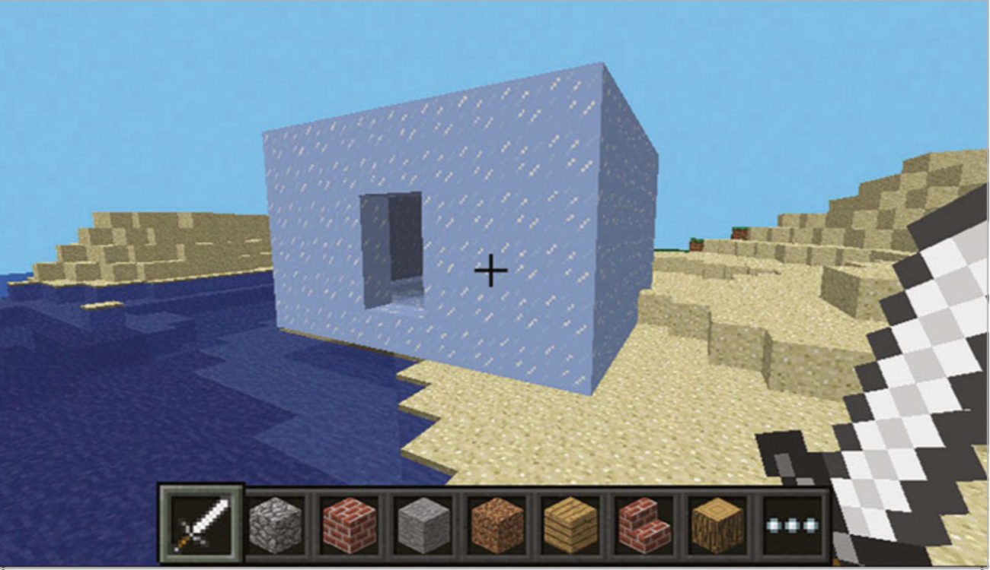
Building an Ice House

Slide 30
LAB TIME
Use the remainder of class to explore the ice house code. Try different values for the blocks and size of the house. Make as many houses as you want!
You can leave when you’re finished.
DO NOT DISTURB the other classes!
REMEMBER TO SHUTDOWN YOUR RASPBERRY PI
DO NOT POWER IT OFF UNTIL YOU SHUTDOWN

Slide 31
Questions or comments?

