Slide 1
Mines, Minerals, and Minecraft
Dr. Charles “Chuck” Bell
Lesson 1: 16 January 2019

Slide 2

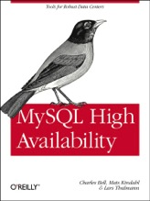
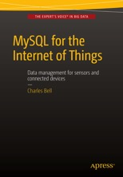
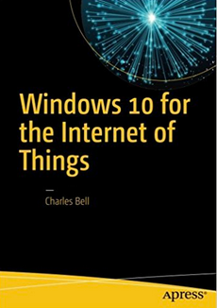
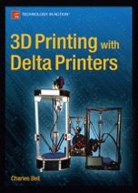

About the speaker
Charles “Chuck” Bell, PhD Engineering
Senior Developer, Oracle Corporation
Author
3D Printing
Internet of Things
MySQL
Sensor Networks
High Availability Database Systems
MySQL Document Store
Beginning InnoDB Cluster

Slide 3
About the Class
Each Wednesday at 7:00 PM we will meet in the dock in the game room (this room).
Class Agenda
Bible Study: 10-15 minutes
The Raspberry Pi: 5-10 minutes
Hacking Minecraft with Python: 30-45 minutes

Slide 4
Bible Study
Mines and Minerals in the Bible

Slide 5
Mines and Minerals
Mining Definition (Webster's Dictionary)
(p. pr. & vb. n.) of Mine.
(n.) The act or business of making mines or of working them.
(a.) of or pertaining to mines; as, mining engineer; mining machinery; a mining region.

Slide 6
Mines in the Bible
There are very few references to mines in the Bible.
Most of what we know about mining in the Bible comes from Job 28:1-11.
A highly-poetical description given by the author of the book of Job of the operations of mining as known in his day is the only record of the kind which we inherit from the ancient Hebrews.
No traces of ancient mines have yet been found in Palestine and Syria.
What metals were taken out came from the superficial strata.
Travelers in Northern Arabia and the Red Sea country have found there evidences of ancient mining operations.

Slide 7
Mines in the Bible
The Wady Magharah "the valley of the cave”
There are still traces of the Egyptian colony of miners who settled there for the purpose of extracting copper from the freestone rocks, and left their hieroglyphic inscriptions upon the face of the cliff.
The ancient furnaces are still to be seen, and on the coast of the Red Sea are found the piers and wharves whence the miners shipped their metal in the harbor of Abu Zelimeh.
Three methods were employed for refining gold and silver:
by exposing the fused metal to a current of air
by keeping the alloy in a state of fusion and throwing nitre upon it
by mixing the alloy with lead, exposing the whole to fusion upon a vessel of bone-ashes or earth, and blowing upon it with bellows or other blast.

Slide 8
Mines in the Bible
The chief supply of silver in the ancient world appears to have been brought from Spain.
The Egyptians evidently possessed the art of working bronze in great perfection at a very early time, and much of the knowledge of metals which the Israelites had must have been acquired during their residence among them.
Of tin there appears to have been no trace in Palestine.
The hills of Palestine are rich in iron, and the mines are still worked there, though in a very simple, rude manner.

Slide 9
Mines Egypt
The usual Egyptian method of mining was to follow the vein from the surface as far as it was practicable with tools corresponding to our pick and hoe, hammer and chisel.
The shafts frequently extended into the ground a distance of 180 to 200 ft.
The rock when too hard to be dug out was first cracked by having fires built on it.
The metal-bearing stone was carried in baskets to the surface, where the crushing and separating took place.
The mining operations were performed by an army of slaves who were kept at their work day and night, driven with the lash until they died, when their places were taken by others.

Slide 10
Next week…
Next week, we will learn about the importance of the metals mentioned in the Bible.
Does anyone know why God said the streets of Heaven will be paved with gold?

Slide 11
The Raspberry Pi

Slide 12
Hacking Minecraft with Python

Slide 13
Class Repository
All of the class files will be saved online in a special repository that you can access from home.
It uses a service called Github
URL: https://github.com/ChuckBell/Mines-Minerals-and-Minecraft

Slide 14
Using the Class Repository (Github)
What is Github?
Github is a code hosting and sharing website
Github, like many code hosting websites, allows for public access to code but private access to updates (can only update by invitation)
This allows for interested programmers to take part in furthering development
Why use code sharing services?
Easy to distribute work
Easy to improve on the work of others
Easy to take help from others
There are three ways to use Github.
Browse to the files and download them individually and/or view the files.
Download the files in a .zip file and extract it on your PC.
Clone the repository (advanced)

Slide 15
Using github: download

Slide 16
Cloning the Repository
The best way to use a Github repository is to “clone” it.
This keeps an active, read-only copy of the repository on your computer.
Requires you to install “Git”, which can be downloaded from https://git-scm.com/downloads
Concepts
Clone/cloning: make a read-only copy
Pull: retrieve the latest changes
Push: send changes to the repository (restricted)

Slide 17
Cloning the Repository
MacBook-Pro:~ cbell$ cd Documents/
MacBook-Pro:Documents cbell$ mkdir class
MacBook-Pro:Documents cbell$ cd class
MacBook-Pro:class cbell$ git clone https://github.com/ChuckBell/Mines-Minerals-and-Minecraft.git
Cloning into 'Mines-Minerals-and-Minecraft'...
remote: Counting objects: 17, done.
remote: Compressing objects: 100% (14/14), done.
remote: Total 17 (delta 3), reused 7 (delta 1), pack-reused 0
Unpacking objects: 100% (17/17), done.
MacBook-Pro:class cbell$ cd Mines-Minerals-and-Minecraft/
MacBook-Pro:Mines-Minerals-and-Minecraft cbell$

Slide 18
Questions or comments?

