Slide 1
Parables and Pythons
Dr. Charles “Chuck” Bell
Lesson 1: 12 September 2018

Slide 2
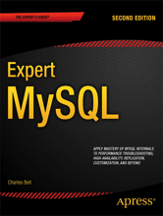
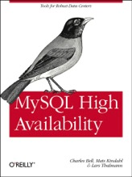
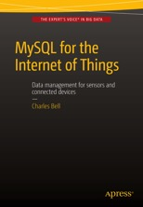
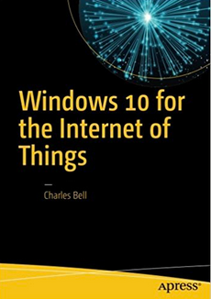
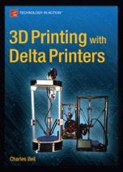
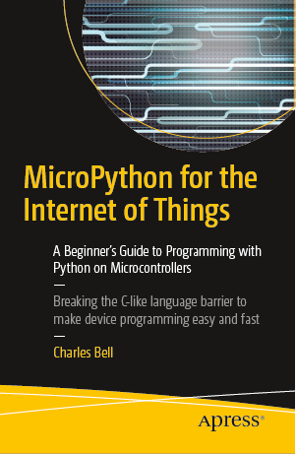
About the speaker
Charles “Chuck” Bell, PhD Engineering
Senior Developer, Oracle Corporation
Author
3D Printing
Internet of Things
MySQL
Sensor Networks
High Availability Database Systems
MySQL Document Store
Beginning InnoDB Cluster

Slide 3
About the class
Each Wednesday we will meet in the dock for a short group session.
When we break out, we will be in this portion of the dock.
Please bring your laptops every night.
On the last day of class, we will have a programming contest to showcase your new talent.
There will be two or more categories with each challenge graded and points awarded for completeness and accuracy
You will have chances to earn bonus points to be applied to your score
For example, doing the homework and turning it in the following week (ON TIME) will result in 1 or more bonus points.
The winner of the contest will be the student with the most points earned (with bonus points applied)

Slide 4
Class agenda
Bible Study: 10-15 minutes
The Golden Age of British Comedy: 2-3 minutes
Computer Programming with Python: 30-45 minutes
You will be assigned homework each class, but participation is voluntary
What follows is a brief example of the class agenda

Slide 5
Bible study: the parables of Jesus

Slide 6
Introduction to parables
Everyone who has attended church for any length of time has heard many of the parables in the Bible.
Parables have contributed to our vocabulary and have made certain words and phrases common-place.
Good Samaritan
Talent
Prodigal Son
Parables are often the source of sermons and Bible lessons year-round.
Parables have been allegorized, psychologized, and reduced to bullet points for moral behavior.
But they are far more than that!
There are moral, political, social issues addressed by the parables.
We’ll learn much more about parables starting next week.

Slide 7
The golden age of British comedy

Slide 8
And now for something completely different…
https://www.youtube.com/watch?v=122jTAEsEOk

Slide 9
who (what) is Monty python?
Monty Python were a British surreal comedy group who created Monty Python's Flying Circus, which first aired on the BBC in 1969 featuring a series of short skits (sketches). Does that sound familiar?
Members include Graham Chapman, John Cleese, Terry Gilliam, Eric Idle, Terry Jones, and Michael Palin
The show ran from 1969 to 1974
The troupe also made several movies including And Now for Something Completely Different, Holy Grail, Life of Brian, Live at the Hollywood Bowl, and Meaning of Life
Also performed on Broadway (and film) called Spamalot (named after one of their skits)
Considered by many to be “intellectual” humor
Note Some content may be inappropriate for young adults (and younger). Seek your parents’ permission before viewing Monty Python material.

Slide 10
Computer Programming

Slide 11
python? Isn’t that a snake?
Python was developed by Guido van Rossum from the late 1980's to early 1990's in the Netherlands.
It was derived from and influenced by many programming languages including Modula-3, C, C++, and even Unix shell scripting languages.
Fourth generation scripting language.
Used by many developers for systems operations and application (devops), scripting, and more.
Is one of the “P”s in LAMP stack (Linux, Apache, MySQL, Python/Perl/PHP)
A fascinating fact about Python is it was named after the BBC show, “Monty Python's Flying Circus” and has nothing to do with the reptile by the same name.
In fact, quoting Monty Python in source code documentation (and even a humorous diversion for error messages) is very common and while some professional developers may cringe at the insinuation, it's considered by Pythonistas as showing your Python street cred.

Slide 12
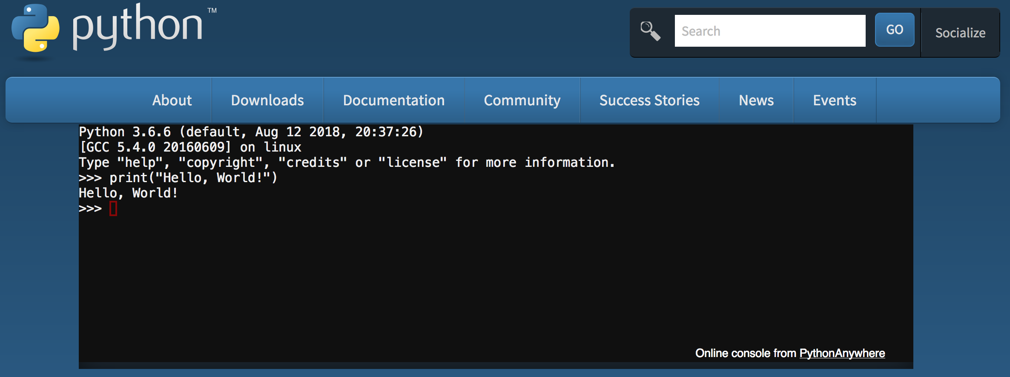
Getting started
Python comes pre-installed with Mac OS X and Linux
For Windows, you can download Python from http://python.org/
You can also use an online Python from https://www.python.org/shell/
You can use either Python 2.7+ or 3.4+.

Slide 13
Python interpreter
Interactive interface to Python
Just open a terminal and type ”python” or “python3”
Python interpreter evaluates inputs interactively
To exit the interpreter, press CTRL-D or enter quit()
$ python3
Python 3.6.0 (v3.6.0:41df79263a11, Dec 22 2016, 17:23:13)
[GCC 4.2.1 (Apple Inc. build 5666) (dot 3)] on darwin
Type "help", "copyright", "credits" or "license" for more information.
>>> print("Hello, World! My name is Chuck.")
Hello, World! My name is Chuck.
>>> quit()

Slide 14
Python scripts
The Python interpreter can also process files (called scripts) and execute them.
File are named with a .py extension.
Script files are not interactive.
Example:
$ python3 ./sqrt.py
Please enter a number: 25
The square root of 25 is 5.0.

Slide 15
Homework assignment
Install Python on your laptop.
Start the Python interpreter and enter the following lines of code.
num = input("Please enter a number: ")
num_sqrt = float(num) ** 0.5
print("The square root of {0} is {1}.".format(num, num_sqrt))
Print out your screen and turn it in for (1) bonus point for the programming tournament.
Use these values: [-1, 13, 25, and 12312313]
For an extra point, save the code to a file and run it as a script and printout a transcript.

Slide 16
Questions or comments?

