Slide 1
Parables and Pythons
Dr. Charles “Chuck” Bell
Lesson 9: 14 November 2018

Slide 2
Class agenda
Bible Study
The shortest parables
The Golden Age of British Comedy
Stoning
Computer Programming with Python
Review of Concepts
Hands-On Practice
Sample challenges
Homework

Slide 3
Bible study: the parables of Jesus

Slide 4
The Shortest Parables
There are two parables that are very short, but go together - the mustard seed and the yeast (leaven).
They are in response to Jesus being asked, “What is the Kingdom of Heaven like?”
They are found in several books in the Gospel with nearly identical wording with very little variation. So, they must be important.
Mathew 13:31-33 (both)
Mark 4:30-32 (mustard seed)
Luke 13:18-21 (both)
Thomas 20 (non-canonical writings - mustard seed)
Theses parables are often considered controversial because, while they appear together and seem related, some believe they have different meanings.

Slide 5
The Shortest Parables – Mathew 13:31-33
(Matt 13:31): He told them another parable: “The kingdom of heaven is like a mustard seed, which a man took and planted in his field.
(Matt 13:32): Though it is the smallest of all seeds, yet when it grows, it is the largest of garden plants and becomes a tree, so that the birds come and perch in its branches.”
(Matt 13:33): He told them still another parable: “The kingdom of heaven is like yeast that a woman took and mixed into about sixty pounds of flour until it worked all through the dough.”
These parables belong together. Each should help us to understand the other, but of all the parables Christ told, none has produced such diametrically opposed interpretations as these two.

Slide 6
The Mustard Seed - Controversy
This parable has come under a lot of scrutiny and some conclude it is a parody or myth.
The mustard plant was not something a gardener or farmer would plant (cultivate).
It grows wild in most places
Often used as a ’cover’ crop for fields
In Palestine, mustard plants mostly grew in the desert areas
The mustard plant could never grow large enough to support many birds and no bird nests.
There is one variant of the black mustard plant that can grow up to 10 feet tall, but it is mostly found near the Jordan. Keep in mind, trees in the region rarely grew larger
The black mustard plant, while it has stems that resembles tree trunks, it not strong enough to support bird nests, but could support a few birds perching or resting on the limbs if the wind were not blowing
Mustard plants, in general, grow into shrub-like plants and not trees
Given these, some argue the illustration is flawed and thus is a ‘negative’ message

Slide 7
The Mustard Seed - Interpretations
On the one hand, some teachers see these as parables of the kingdom’s expansion and growth, so that in time it actually comes to fill the whole world.
Thus it is a positive message predicting the grow of the Church and therefore the Kingdom of God – starting from a small number of followers to a world-wide gathering of the faithful for which God has prepared Heaven.
This interpretation is supported by interpreting the following parable about yeast.

Slide 8
The Mustard Seed - Interpretations
On the other hand, the mustard seed and the resulting plant is a very poor illustration for several botanical reasons including the size of the plant, its deplorable cultivation, and unlikely metaphor.
Thus, the message conveyed is negative in that it doesn’t make sense to compare Heaven to the mustard plant.
This interpretation is also supported by interpreting the following parable about yeast in a positive manner.

Slide 9
The Yeast - Interpretations
We see similar dichotomy of interpretations in this parable - even though it is only one sentence long.
The positive position likens the growth of the church with bread that has been leavened (yeast added) so that it expands. Thus, the Kingdom of Heaven will grow larger with the addition of the redeemed who grow in Christ.
However, the negative position has a lot of merit.

Slide 10
The Yeast - Interpretations
The negative position suggests that the yeast or “leaven” in that age was a small portion of spoiled bread dough, which is added to good dough to make it rise.
In nearly all cases in the Old Testament (and in Jewish life today) yeast is a symbol of evil. In the sacrificial laws of Israel it was/is excluded from every offering to the Lord made by fire.
At the time of the feast of unleavened bread, every faithful Jew was to search his home for any trace of yeast and then get rid of it. That is done today by orthodox Jews and symbolizes for them, as it did earlier, the putting away of sin.
Jesus spoke of the leaven (or yeast) of the Pharisees and Sadducees, and Herod, in each case meaning their evil influence (Matt. 16:12; Mark 8:15).
Thus, the Kingdom of Heaven will contain “bad” people - people who are spoiled or not holy.

Slide 11
Conclusions
The mustard seed very likely was well known in Jesus’ time and his audience would have picked up the abnormal growth of a shrub into a tree. Thus, a negative view of this parable can be argued.
However, Jesus’ story telling was often meant to evoke thought and, at times, even controversy. If we focus too much on the subjects out of context (words like mustard seed), we will miss the point altogether. In fact, we will allow our own thinking to take our eyes off of the Kingdom of Heaven.
Likewise, yeast has been used in the Old Testament as a symbol of evil, but it is also a very useful ingredient for baking bread - sometimes it is simply yeast.
It is difficult to see how an important and thoroughly understood symbol of evil could be used by Jesus to represent the exact opposite, namely, the blessed impact of His gospel on the world.

Slide 12
Conclusions
Also, it is significant that these two parables are bracketed by that of the devil’s work in sowing tares among the wheat (vv. 24-30), and Christ’s explanation of that parable (vv. 36-43). This suggests they should be taken not as teaching something entirely different from the parable of the tares, but as expanding it.
Read the other parables!
Therefore, we should look at these parables as positive messages that predict not only the triumph of God’s Kingdom, but more importantly we should take comfort that Jesus has promised that Heaven will be “leavened” by turning the sinner into a positive impact for Christ. That, I believe, is what Jesus was trying to say in these parables.

Slide 13
The golden age of British comedy
Subtle nuance: women were not allowed to participate.

Slide 14
https://www.youtube.com/watch?v=FQ5YU_spBw0

Slide 15
Computer Programming
Hands On Learning

Slide 16
Expressions
expression: A data value or set of operations to compute a value.
Examples: 1 + 4 * 3
42
Arithmetic operators we will use:
+ - * / addition, subtraction/negation, multiplication, division
% modulus, a.k.a. remainder
** exponentiation
precedence: Order in which operations are computed.
* / % ** have a higher precedence than + - 1 + 3 * 4 is 13
Parentheses can be used to force a certain order of evaluation. (1 + 3) * 4 is 16

Slide 17
Math functions
Python has useful commands for performing calculations.
To use many of these commands, you must write the following at the top of your Python program:
from math import *
Command name | Description
abs(value) | absolute value
ceil(value) | rounds up
cos(value) | cosine, in radians
floor(value) | rounds down
log(value) | logarithm, base e
log10(value) | logarithm, base 10
max(value1, value2) | larger of two values
min(value1, value2) | smaller of two values
round(value) | nearest whole number
sin(value) | sine, in radians
sqrt(value) | square root
Constant | Description
e | 2.7182818...
pi | 3.1415926...

Slide 18
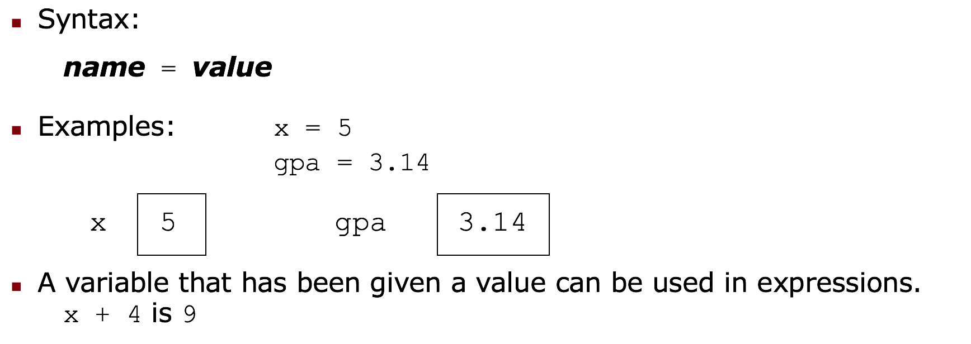
Variables
variable: A named piece of memory that can store a value.
Usage: Compute an expression's result, store that result into a variable, and use that variable later in the program.
assignment statement: Stores a value into a variable.

Slide 19
input
input : Reads a number from user input.
You can assign (store) the result of input into a variable.
Example:
age = input("How old are you? ")
print "Your age is", age
print "You have", 65 - age, "years until retirement"
Output:
How old are you? 53
Your age is 53
You have 12 years until retirement

Slide 20
The for loop
for loop: Repeats a set of statements over a group of values.
Syntax:
for variableName in groupOfValues:
statements
We indent the statements to be repeated with tabs or spaces.
variableName gives a name to each value, so you can refer to it in the statements.
groupOfValues can be a range of integers, specified with the range function.
Example:
for x in range(1, 6):
print x, "squared is", x * x
Output:
1 squared is 1
2 squared is 4
3 squared is 9
4 squared is 16
5 squared is 25

Slide 21
Range Function
The range function specifies a range of integers:
range(start, stop) - the integers between start (inclusive) and stop (exclusive)
It can also accept a third value specifying the change between values.
range(start, stop, step) - the integers between start (inclusive) and stop (exclusive) by step
Example:
for x in range(5, 0, -1):
print x
print "Blastoff!"
Output:
5
4
3
2
1
Blastoff!

Slide 22
if
if statement: Executes a group of statements only if a certain condition is true. Otherwise, the statements are skipped.
Syntax:
if condition:
statements
Example:
gpa = 3.4
if gpa > 2.0:
print "Your application is accepted."

Slide 23
if/else
if/else statement: Executes one block of statements if a certain condition is True, and a second block of statements if it is False.
Syntax:
if condition:
statements
else:
statements
Example:
gpa = 1.4
if gpa > 2.0:
print "Welcome to Mars University!"
else:
print "Your application is denied."
Multiple conditions can be chained with elif ("else if"):
if condition:
statements
elif condition:
statements
else:
statements

Slide 24
while
while loop: Executes a group of statements as long as a condition is True.
good for indefinite loops (repeat an unknown number of times)
Syntax:
while condition:
statements
Example:
number = 1
while number < 200:
print number,
number = number * 2
Output:
1 2 4 8 16 32 64 128

Slide 25
Logic
Many logical expressions use relational operators:
Logical expressions can be combined with logical operators:
Operator | Meaning | Example | Result
== | equals | 1 + 1 == 2 | True
!= | does not equal | 3.2 != 2.5 | True
< | less than | 10 < 5 | False
> | greater than | 10 > 5 | True
<= | less than or equal to | 126 <= 100 | False
>= | greater than or equal to | 5.0 >= 5.0 | True
Operator | Example | Result
and | 9 != 6 and 2 < 3 | True
or | 2 == 3 or -1 < 5 | True
not | not 7 > 0 | False

Slide 26
Strings
string: A sequence of text characters in a program.
Strings start and end with quotation mark " or apostrophe ' characters.
Examples: "hello" "This is a string" "This, too, is a string. It can be very long!"
A string may not span across multiple lines or contain a " character. "This is not a legal String."
"This is not a "legal" String either."
A string can represent characters by preceding them with a backslash.
\t tab character
\n new line character
\" quotation mark character
\\ backslash character
Example: "Hello\tthere\nHow are you?"

Slide 27
Indexes
Characters in a string are numbered with indexes starting at 0:
Example:
name = "P. Diddy"
Accessing an individual character of a string:
variableName [ index ]
Example:
print name, "starts with", name[0]
Output:
P. Diddy starts with P
index | 0 | 1 | 2 | 3 | 4 | 5 | 6 | 7
character | P | . |  | D | i | d | d | y

Slide 28
String properties
len(string) - number of characters in a string
(including spaces)
str.lower(string) - lowercase version of a string
str.upper(string) - uppercase version of a string
Example:
name = "Martin Douglas Stepp"
length = len(name)
big_name = str.upper(name)
print big_name, "has", length, "characters"
Output:
MARTIN DOUGLAS STEPP has 20 characters

Slide 29
Lists - REview
The simplest list is one we’ve already used: a character string!
A list is a contiguous segment of memory that stores a set of values.
Lists are “counted” or “indexed” starting at 0.
List indexes use the [n] syntax where n is the index (number).
A list can hold any number of values.
Lists have additional methods that we can use to manipulate the data.
0 1 2 3 4 5
0 1 2 3 4 5
H
e
l
l
o
!
H
e
l
l
o
!

Slide 30
Review: Dictionaries
Store pairs of entries called items { 'CS' : '743-713-3350', 'UHPD' : '713-743-3333'}
Each pair of entries contains
A key
A value
Key and values are separated by a colon
Paris of entries are separated by commas
Dictionary is enclosed within curly braces

Slide 31
Review: dictionaries
Strings, lists, tuples, sets and dictionaries all deal with aggregates
Two big differences
Lists and dictionaries are mutable
Unlike strings, tuples and sets
Strings, lists and tuples are ordered
Unlike sets and dictionaries

Slide 32
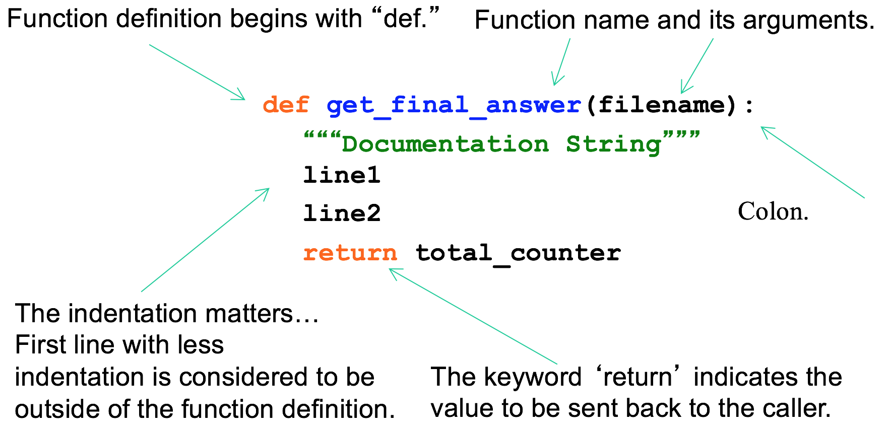
Defining a function

Slide 33
Sample Challenges
The following are three sample challenges like the ones we will have during our programming contest, which is NEXT WEEK!
Rules for the programming contest:
You can attempt as many challenges as you like.
Each challenge has a maximum point total – those with higher values are more complicated.
You can earn partial credit for each challenge if it is partially correct, but there must be no syntax errors.
You may not use the Internet to search for solutions.
You may ask for explanation of technical details, but you may not ask any Python questions.
The student with the highest point total wins.
Winner will be notified by email.

Slide 34
Challenge #1 – 1 point
We have a function that controls two monkeys, a and b, and the parameters a_smile and b_smile indicate if each is smiling. We are in trouble if they are both smiling or if neither of them is smiling. Return True if we are in trouble.
Solve the challenge by completing this code:
def monkey_trouble(a_smile, b_smile):
# Complete this code
print("Are we in trouble if:")
print("Both A and B are smiling?", monkey_trouble(True, True))
print("Neither A nor B are smiling?", monkey_trouble(False, False))
print("Only A is smiling?", monkey_trouble(True, False))
print("Only B is smiling?", monkey_trouble(False, True))

Slide 35
Challenge #2 – 10 points
Make a two-player Rock-Paper-Scissors game. (Hint: Ask for player plays (using input), compare them, print out a message of congratulations to the winner, and ask if the players want to start a new game)
Remember the rules:
Rock beats scissors
Scissors beats paper
Paper beats rock
Use a function named find_winner() that accepts two parameters; the answer from player 1 and the answer from player 2.

Slide 36
Challenge #3 – 20 points
Write a program that asks the user how many Fibonacci numbers to generate and then generates them. Take this opportunity to think about how you can use functions. Make sure to ask the user to enter the number of numbers in the sequence to generate.(Hint: The Fibonacci sequence is a sequence of numbers where the next number in the sequence is the sum of the previous two numbers in the sequence. The sequence looks like this: 1, 1, 2, 3, 5, 8, 13, …)

Slide 37
Challenge #4 – 50 points
Hashmat is a brave warrior who with his group of young soldiers moves from one place to another to fight against his opponents. Before Fighting he must calculate one thing: the difference between his and the opponent's soldiers (in number). From this difference he decides whether to fight or not. Hashmat's will not fight if his enemy forces exceed 120% of his own force.
The input contains two numbers in every line separated by a comma. These two numbers in each line denote the number soldiers in Hashmat's army and his opponent's. The input numbers are not greater than 2^32. Input is terminated by 0, 0.
For each line of input, if Hashmat withdraws, randomly determine the number of soldiers lost during the withdraw limited to no more than 10%. If there is a battle, use a random number of casualties for each side and determine a winner based on superior number of survivors.
Sample Input/output
10, 12
> Hashmat attacks! Friendly losses: 3, enemy losses: 6. Hashmat wins!

Slide 38
Homework
All homework assignments can be handed in on hardcopy (with your name at the top) or emailed to me at drcharlesbell@gmail.com.

Slide 39
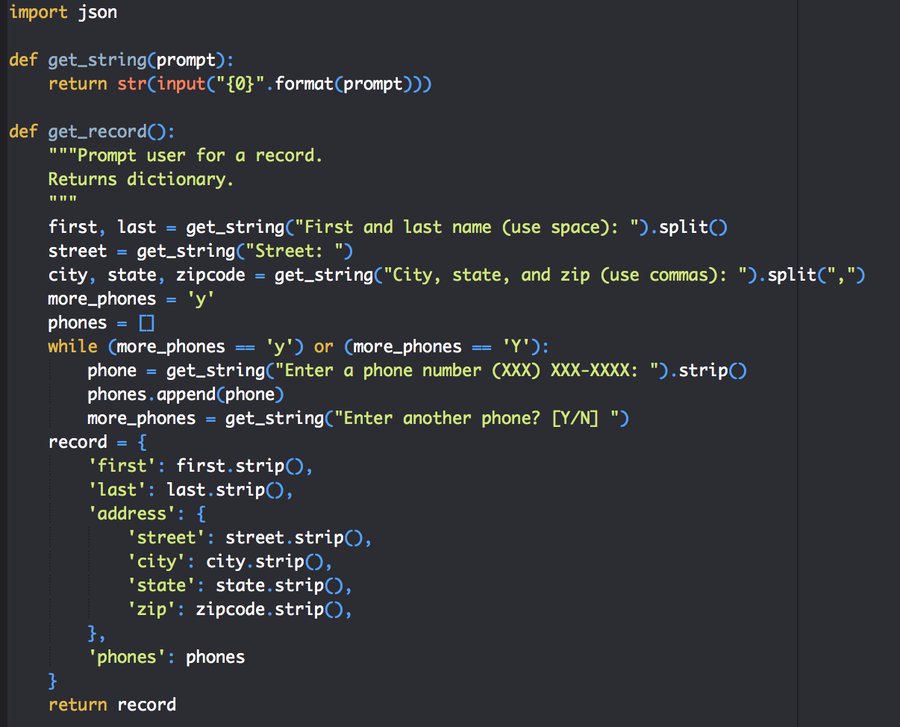
Homework #7 Review

Slide 40
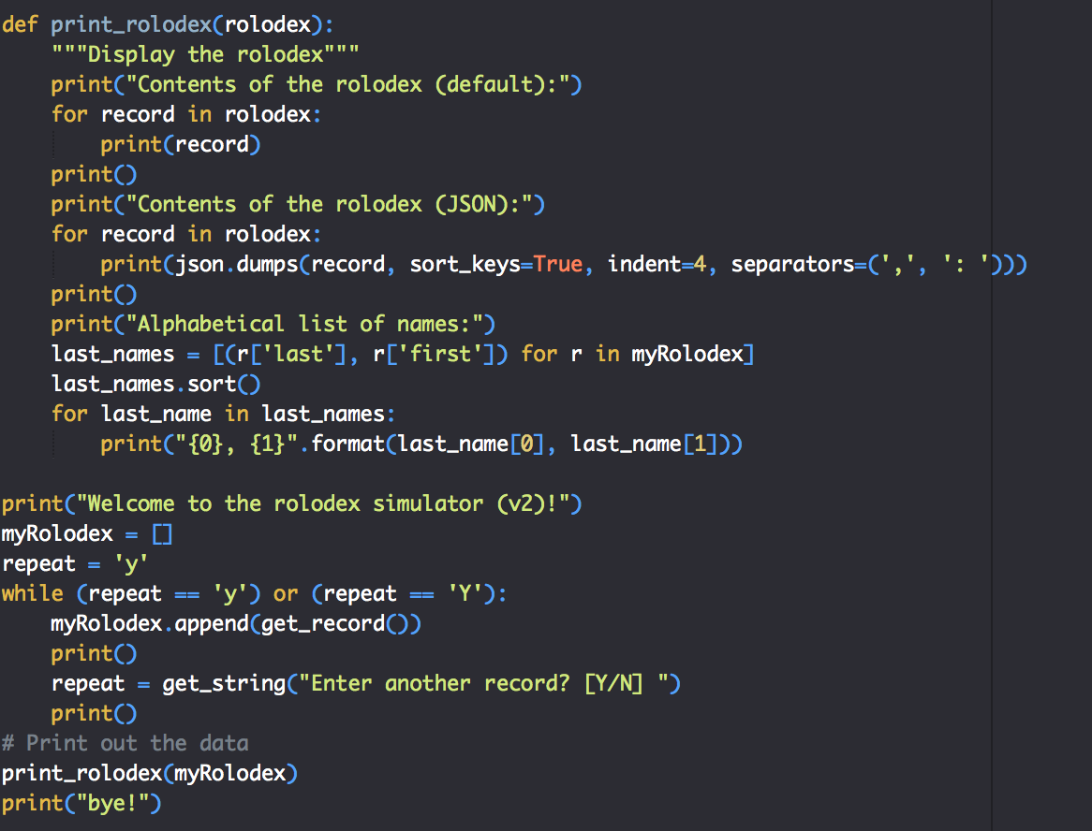
Homework #7 Review

Slide 41
Homework #7 - Review
...
Contents of the rolodex (default):
{'first': 'Joe', 'last': 'Smith', 'address': {'street': '123 East Main', 'city': 'Tappahannock', 'state': 'VA', 'zip': '22521'}, 'phones': ['804 555-1212']}
{'first': 'Amos', 'last': 'Anthony', 'address': {'street': '500 Oracle Pkwy', 'city': 'Glen Forest', 'state': 'CA', 'zip': '90125'}, 'phones': ['560 344-1212']}
Contents of the rolodex (JSON):
{
"address": {
"city": "Tappahannock",
"state": "VA",
"street": "123 East Main",
"zip": "22521"
},
"first": "Joe",
"last": "Smith",
"phones": [
"804 555-1212"
]
}
...

Slide 42
Homework #7 - Review
...
{
"address": {
"city": "Glen Forest",
"state": "CA",
"street": "500 Oracle Pkwy",
"zip": "90125"
},
"first": "Amos",
"last": "Anthony",
"phones": [
"560 344-1212"
]
}
Alphabetical list of names:
Anthony, Amos
Smith, Joe
bye!

Slide 43
Homework assignment #8
(2 points) Make a tic-tac-toe game that takes input in the form of row, col for each player. Use a list of lists to store the board and contents. Prompt until a winner is determined.
ttt_board = [[-1,-1,-1],[-1,-1,-1],[-1,-1,-1]] -1 = not chosen, X or 0
(2 bonus points) Use a function to print the “board”.
print_board(board, row, col) – takes a list of
(1 bonus point) Use a function to determine if there is a winner:
check_for_winner(board) – print the contents of the rolodex.

Slide 44
Homework assignment #8
WAIT! How do you print a tic-tac-toe board on the screen?
Notice on your keyboard there is a | and – as well as +.
Consider what this does:
board = [[-1,-1,-1],[-1,-1,-1],[-1,-1,-1]]
print("+-+-+-+")
for row in board:
for col in range(0,3):
if row[col] in ('X','O'):
print("|{0}".format(row[col]), end='')
else:
print("| ", end='')
print("|")
print("+-+-+-+")

Slide 45
Homework assignment #8
Example Output:
$ python3 ./ttt1.py
+-+-+-+
| | | |
+-+-+-+
| | | |
+-+-+-+
| | | |
+-+-+-+

Slide 46
Questions or comments?

