Slide 1

APP DESIGN AND Development WITH THE IONIC FRAMEWORK
http://ionicframework.com/
Chuck Leone
https://github.com/ChuckLeone/

Slide 2
Part 1: introduction

Slide 3
Overview
About:
The Ionic framework is a free, open source platform consisting of mobile-optimized HTML, CSS and JavaScript. Built using AngularJS and SASS, the Ionic Framework uses Apache Cordova for device APIs such as camera, location services, accelerometer and more. This framework allows developers to build cross-platform applications in HTML, CSS and JS using a single codebase. Native apps for Android and iOS can be designed, built and deployed without the need for native platform coding.
Prerequisites:
Ionic uses HTML, CSS and JavaScript as its main development platform. Knowledge of these technologies are a minimum requirement with additional knowledge of SASS and AngularJS. Additionally it is strongly recommended that you have a basic understanding of AngularJS and SASS in order to better understand the Ionic framework.

Slide 4
Benefits
Robust, matured framework
Easy to use, fast for prototyping and development
Hardware accelerated transitions
Zero jQuery
Built in icon set, similar to fontawesome
Web server/preview allows easy/fast development
Over 60 ngCordova plugins available via ngcordova.com
Extensive documentation
Ionic.io backend service for push notifications, analytics, more – currently FREE(alpha)

Slide 5
Dev Environment Requirements
1) Android Development Kit: http://developer.android.com/sdk/installing/index.html
2) Java Development Kit: http://www.oracle.com/technetwork/java/javase/downloads/index.html
3) Node.js - https://nodejs.org/ (install via download link)
4) Ionic framework - http://ionicframework.com/ (install via command line)
5) Cordova - http://cordova.apache.org/ - (install via command line)1)
6) Mac –iOS SDK, Xcode, Apple Developer account (installing ondevices and publishing) http://cordova.apache.org/docs/en/3.3.0/guide_platforms_ios_index.md.html#iOS%20Platform%20Guide

Slide 6
Recommended Reading
Official Documentation:
http://ionicframework.com/docs/
Learning sites:
http://campus.codeschool.com/courses/shaping-up-with-angular-js
http://www.pluralsight.com/courses/building-mobile-apps-ionic-framework-angularjs (3hrs)

Slide 7
Part 2: Starting a project

Slide 8
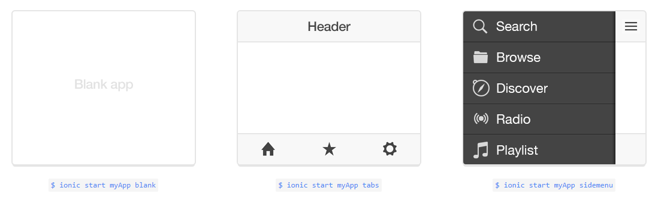
1. Start a new project Launch a Command prompt and change to the directory you want to create the app inside of. Use the start command to create a new Ionic app, enter a name for the app(in this case “myApp”), then choose a template (in this case tabs for a tabbed app). $ ionic start myApp tabs This command will create a new project folder named “myApp” using the Ionic template for a tabbed application. Other templates to choose from include blank and sidemenu:

Slide 9
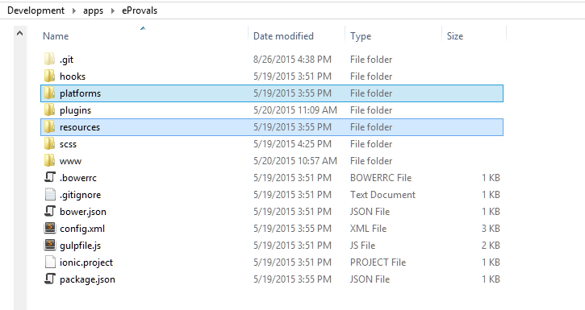
2. Add mobile platforms To add native mobile platform supports to your app, use the platform command from a command line prompt inside of the root folder for the app you are developing:
$ Ionic platform add ios
$ Ionic platform add android
The add command creates platform specific files and folder structures for each of the platforms you add.

Slide 10
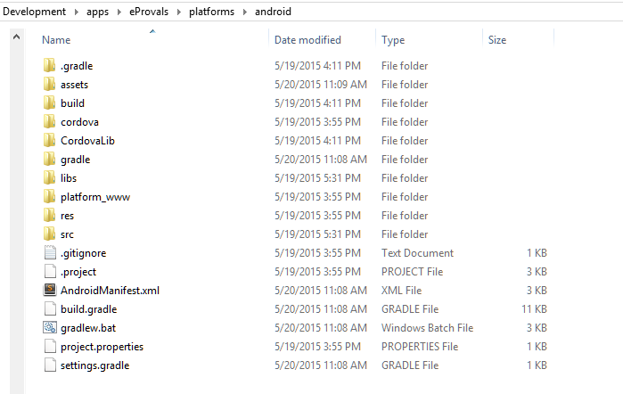
Platform folder

Slide 11
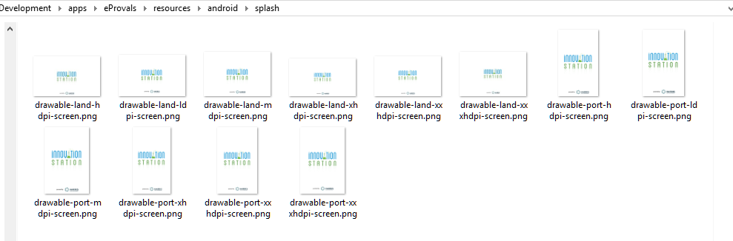
Resources folder

Slide 12
3. Live Preview Ionic Framework features a preview server with live reload. Running the server loads the index file into the development workstation’s default browser then sets a script to listen for changes made to files in the project. To run the server from a command line use the serve command: $ ionic serve Open the project folder with your favorite IDE or editor and build your app just as you would any website or Angular JS application.

Slide 13
4. Building and Running the Native App
At this point you can build the app and push it to an emulator or a mobile device. The commands to run and build are:
$ Ionic build ios ← builds all the native code necessary for iOS
$ Ionic build android ← builds all the native code necessary for Android OS
$ Ionic emulate ios ← runs the app on an iOS emulator
$ Ionic emulate android ← runs the app on an Android emulator
$ Ionic run ios ← builds and installs the app to iOS devices
$ Ionic run android ← builds and installs the app ot Android devices
Mobile devices will need to be connected via USB.
Android developer options need to be enabled via the system settings on the device and have USB connection enabled.

Slide 14
Expanding Your App with ngCordova Plugins
http://ngcordova.com/ is a expansive library of over 70 plugins that can help add features and enhancements your app including
Local Storage
Device Camera
Touch ID
HealthKit
SQLite
Local Notifications
Social Sharing
Device Motion/Orientation
Geolocation
Google Analytics
Battery Status
Push Notifications
1. Installation
Download from http://ngcordova.com/
or
$ bower install ngCordova

Slide 15
2. Include the JS file in your project
Include ng-cordova.js or ng-cordova-min.js in your index.html file before cordova.js and after angular js files.
3. Add ngCordova Plugins
add ngCordova plugins to your app with the plugin command on a command line:
$ cordova plugin add cordova-plugin-camera
4. Implementation
Inject as an Angular dependency:
angular.module('myApp', ['ngCordova'])

Slide 16
Implementation (continued)
Wrap each plugin call with the deviceready event
.addEventListener("deviceready", function () {
$cordovaPlugin.someFunction().then(success, error);
}, false);
// OR with IONIC
$ionicPlatform.ready(function() {
$cordovaPlugin.someFunction().then(success, error);
});

Slide 17
Downloads
https://github.com/ChuckLeone/ionic-presentation

